Slide 1
Submitted by the experts of OICA and CLEPA
Informal Document: ACSF-14-06
Presentation of ACSF C tests
Industry input to ACSF IG
14th meeting
August 2017, Köln
v2

Slide 2
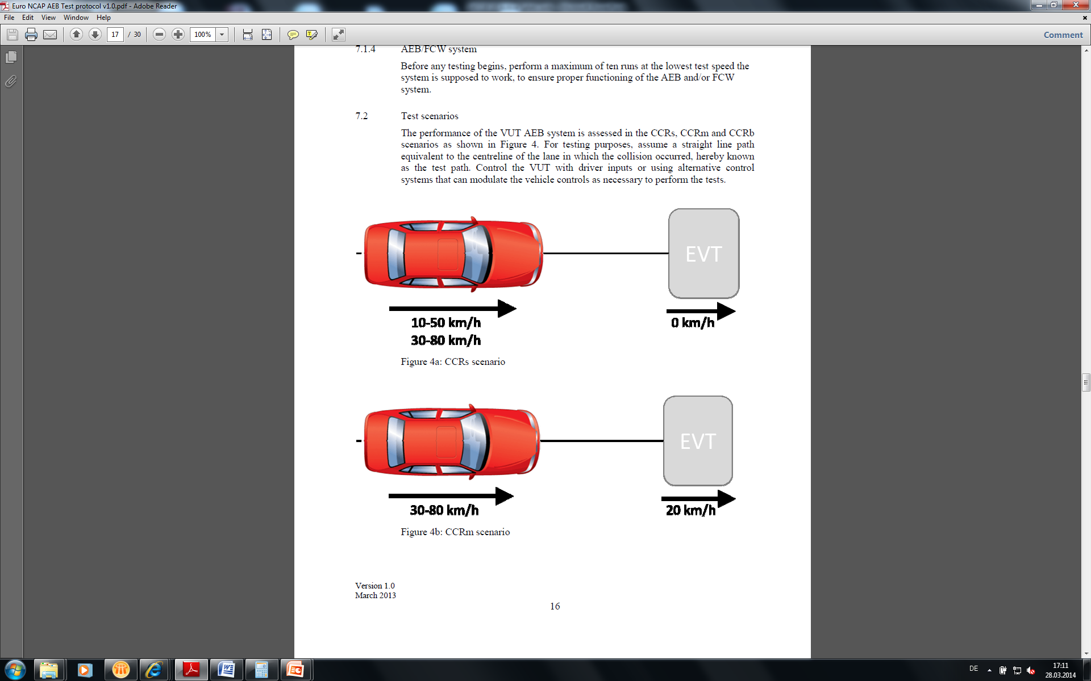
3.5.1. Lane change functional test
Conditions are not met
Lateral jerk and below max values
B1 resumes
All conditions are met
V_{smax≧}V_{test ≧} V_{smin}
Direction Indicator lamp
flashing time≧ 3sec.
Lane change manoeuvre ≦ 5sec.
DI lamp off ≦ 5sec.
Lane change procedure

Slide 3
3.5.2. Abort of lane change test
Minimum value of Sd_{rear}
≦[15m]
A high volume series production passenger car of category M1 AA saloon
v_{test}
Center of the lane ±20cm
v_{test}
Center of the lane ±20cm
V_{smax≧}V_{test ≧} V_{smin}
The driver shall initiate the lane change by the deliberate action.
The lane change procedure does not start.
or
The lane change procedure is canceled no later than 10 seconds after the deliberate action of the driver, if the lane change procedure has started and the manoeuver is delayed. The driver is informed that the manoeuver is delayed.
Is it needed?

Slide 4
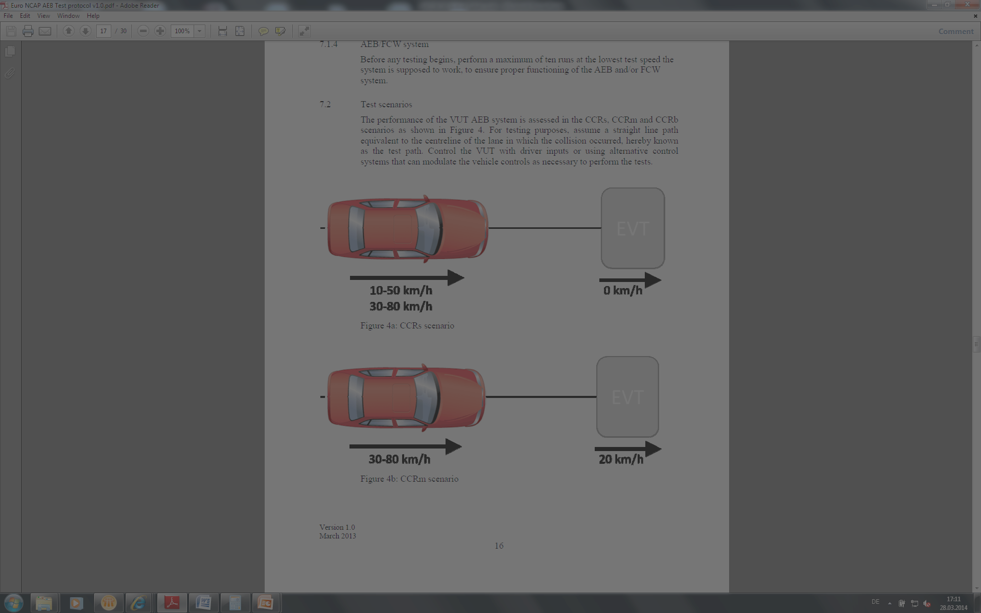

3.5.3. Overriding force test
Applicable Paragraph
5.6.5.3
V_{smax≧}V_{test ≧} V_{smin}
firmly maintain the steering in the straight direction
Procedure
Initiate lane change
Before the start of the lane change manoeuvre, the driver shall firmly maintain the steering in the straight direction.
Measure the steering effort

Slide 5
3.5.4. Deactivation test
V_{smax≧}V_{test ≧} V_{smin}
Deactivation by the driver (5.6.5.6.8.)
Deactivate the direction indicator
flashing time < 3sec.
Procedure
Initiate lane change
Before the start of the lane change manoeuvre, the driver shall deactivate the direction indicator.

Slide 6
3.5.5. Sensor performance test
Rear sensor
CAN
CAN monitor
ECUs
A high volume series production passenger car of category M1 AA saloon
Capture Trigger
Vehicle system under test
v_{test} + 10 to 50 km/h
≦6m
V_{smax≧}V_{test ≧} V_{smin}
≦63m
Measurement
Capture the sensor data at the timing the rear vehicle is detected
Confirm the actual distance to the rear by using GPS data of both vehicles
Connection of CAN monitor system should be allowed.
The test shall be repeated with a motorbike (L3), and the distance shall be set at 55m.

Slide 7
3.5.6. Sensor blindness test
Extra-test proposed by industry
V_{smax≧}V_{test ≧} V_{smin}
The rear sensor(s) is made blind.
A lane change is commanded
The lane change does not start

Slide 8
3.5.7.3. Engine start/run cycle test (Phase 1)
V_{smax≧}V_{test ≧} V_{smin}
Procedure
A new engine start/run cycle
Check ACSF C is default off.

Slide 9
3.5.7.3. Engine start/run cycle test (Phase 2)
V_{smax≧}V_{test ≧} V_{smin}
Procedure
Perform phase 1
The driver switches on ACSF C
The driver commands a lane change right after ACSF C switched on → No lane change

Slide 10
3.5.7.3. Engine start/run cycle test (Phase 3)
Rear sensor
CAN
CAN monitor
A high volume series production passenger car of category M1 AA saloon
ECUs
Capture Trigger
Vehicle system under test
v_{test} + 10 to 50 km/h
≦6m
V_{smax≧}V_{test ≧} V_{smin}
Procedure
Following the completion of the test phase 2
A vehicle approaches from the rear on the adjacent lane
After the rear coming vehicle entirely passed the test vehicle, the driver commands a lane change.
≦48m
Test is passed if:
The lane change is performed
and
The distance between both vehicles at the time ACSF detects the rear coming vehicle is ≧ 48m
Measurement
Capture the sensor data at the timing the rear vehicle is detected
Confirm the actual distance to the rear by using GPS data of both vehicles
Connection of CAN monitor system should be allowed.

