Slide 1
Submitted by the experts of OICA and CLEPA
Informal Document: ACSF-14-08
50N Overriding Force
Bench Study
Industry input to ACSF IG
14th meeting
August 2017, Köln
v2

Slide 2
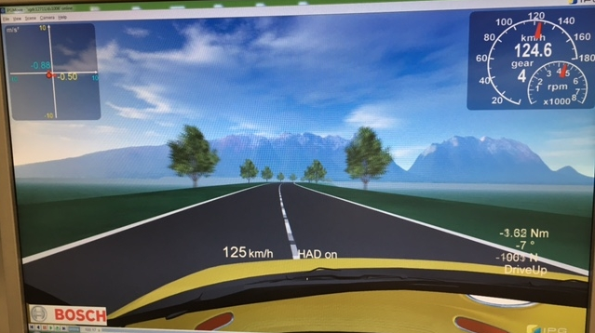
50N Overriding Force – Bench Study
Date: 7. August 2017
Location: Bosch Schwäbisch Gmünd
Test bench: Steering simulator
Participants: 5 members of the IWG-ACSF
Basis: Vehicle drives with CAT B1
Speed can be adjusted by pedal
Overriding Force: 50N
Results:
All participants propose to stick to the 50N as maximum value for the oversteering force for all CSF, ACSF and ESF systems and for all vehicle categories. They experienced 50N to be easily controllable for everybody.
The members of the ACSF Informal Group are invited to participate in this study at Bosch in Schwäbisch Gmünd.
10. August 2017

