Slide 1
Informal Document - ACSF-15-03
Verification of detection range
(55 m for L3)
Korea Automobile Testing & Research Institute
Automated Driving Research Office

Slide 2
Verification of detection range(55m)
■ Before making a decision about sensor requirement which covers minimum distance
and minimum operation speed, we need to make sure that min. detection range(55m
for L3) is a logically calculated value.
- As we know, we have been discussing ‘sensor detection range’ for 3 times of ACSF
meetings.
- Despite the number of meetings with much discussion and elapsed time, the conclusion
(55m for L3) is little confusing.
- Therefore, ROK would like to provide this document for summarization of flow of
ACSF meeting proceedings so far.
- Let’s review it now.

Slide 3
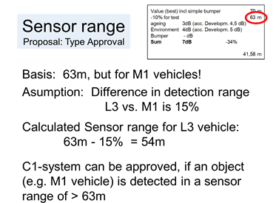
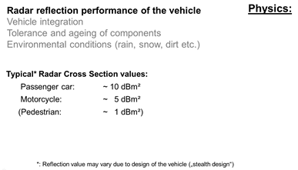
The previous history
ACSF-12-09 by UK and Secretary (page 5) | ACSF-13-15 by OICA&CLEPA (page 6)
?
ACSF-14-04 paragraph 5.6.5.8.1
The ACSF Category [C1] shall be able to detect vehicles approaching from the rear in an adjacent lane up to a distance as specified below: • 63m for a regular high volume series production passenger car of category M1 AA saloon, • 55m for a regular high volume series production vehicle of category L3, other than sub-category L3-A1. JUSTIFICATION: See ACSF-13-15

Slide 4
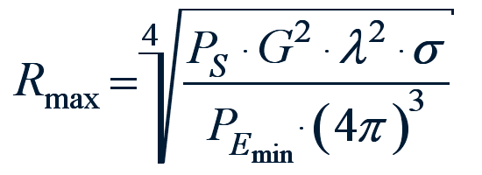
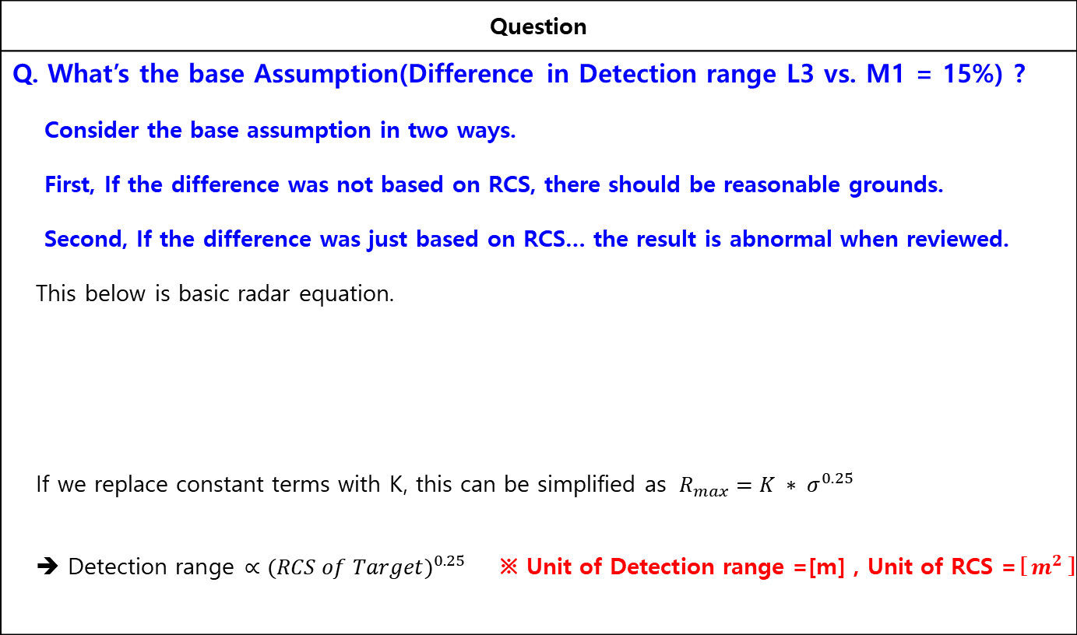
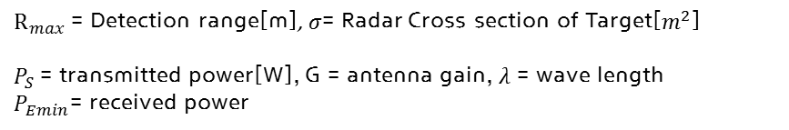
Logical Verification
Question
Q. What’s the base Assumption(Difference in Detection range L3 vs. M1 = 15%) ? Consider the base assumption in two ways. First, If the difference was not based on RCS, there should be reasonable grounds. Second, If the difference was just based on RCS… the result is abnormal when reviewed. This below is basic radar equation. If we replace constant terms with K, this can be simplified as $R_{max}=K ∗ σ^{0.25}$ ➔ Detection range $∝{(RCS of Target)}^{0.25}$ ※ Unit of Detection range =[m] , Unit of RCS =[$m^{2}$]
variable
1
$R_{max}$= Detection range[m], $σ$= Radar Cross section of Target[$m^{2}$]
$P_{S}$= transmitted power[W], G = antenna gain, $λ$ = wave length
$P_{Emin}$= received power
constant
2

Slide 5
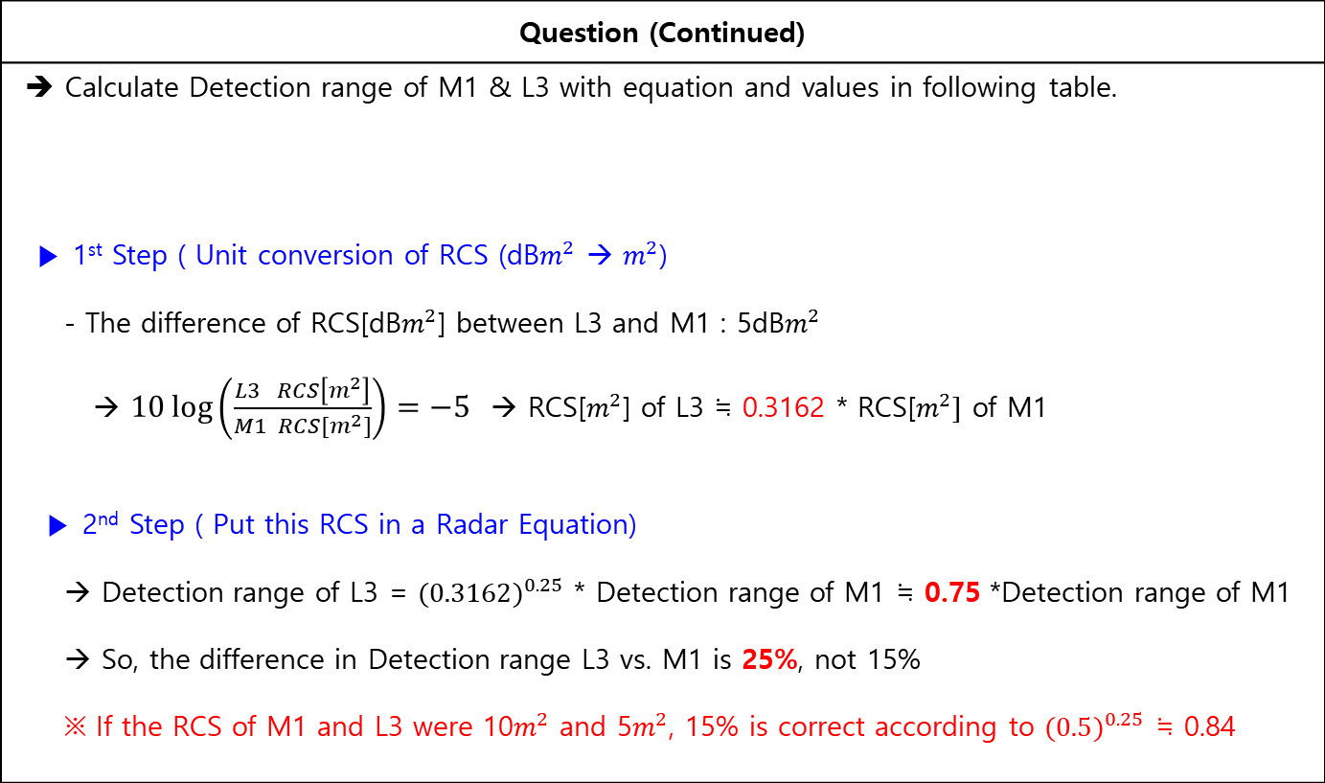
Logical Verification
Question (Continued)
➔ Calculate Detection range of M1 & L3 with equation and values in following table. ▶ 1st Step ( Unit conversion of RCS (dB$m^{2}$ → $m^{2}$) - The difference of RCS[dB$m^{2}$] between L3 and M1 : 5dB$m^{2}$ → $10\log\left(\frac{L3 RCS\left[m^{2}\right]}{M1 RCS[m^{2}]}\right)=−5$ → RCS[$m^{2}$] of L3 ≒ 0.3162 * RCS[$m^{2}]$ of M1 ▶ 2nd Step ( Put this RCS in a Radar Equation) → Detection range of L3 = ${(0.3162)}^{0.25}$ * Detection range of M1 ≒ 0.75 *Detection range of M1 → So, the difference in Detection range L3 vs. M1 is 25%, not 15% ※ If the RCS of M1 and L3 were 10$m^{2}$ and 5$m^{2}$, 15% is correct according to ${(0.5)}^{0.25}$ ≒ 0.84
Radar Equation | RCS value of L3, M1
Detection range[m] $∝{(RCS [m^{2}])}^{0.25}$ | L3 : 5dB$m^{2}$, M1: 10dB$m^{2}$
1
2
3
4

Slide 6

Suggestion
The illogical sentence should not be accepted in this Regulation.
Even if lots of discussions have been made, especially the wrong calculation results, we have to reconsider by giving the following options
< Solution A>
Srear : 55m → 48m(25% ↓ against 63m for M1)
< Solution B>
Remain Srear as 55m but, agree with 7dB$m^{2}$ of L3 RCS
Solution A ? Solution B ?
Else(i.e. No the further discussion) ?

