Slide 1
Informal Document - ACSF-15-04
Reaction time & Safety time gap
On the public road
Korea Automobile Testing & Research Institute
Automated Driving Research Office

Slide 2
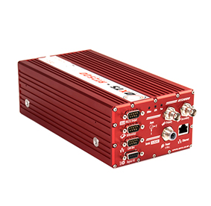
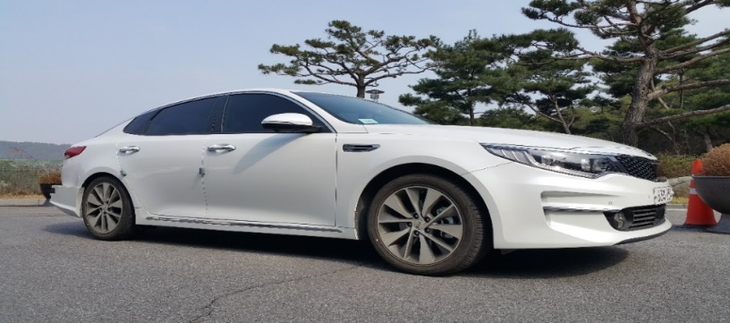
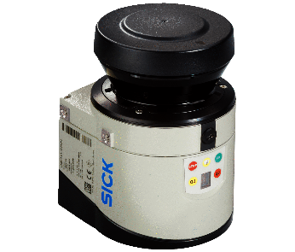
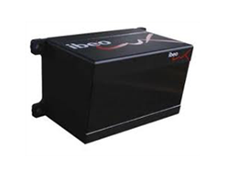
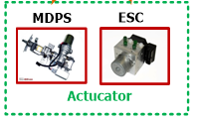
Configuration of Experimental Vehicle
    Experimental Vehicle Configure
Micro Autobox
Computer
RT GPS
Rear-side Radar
(Delphi)
Front Radar
(Delphi)
Rear-side LiDAR
(SICK LMS151)
Front LiDAR
(IBEO LUX)

Slide 3
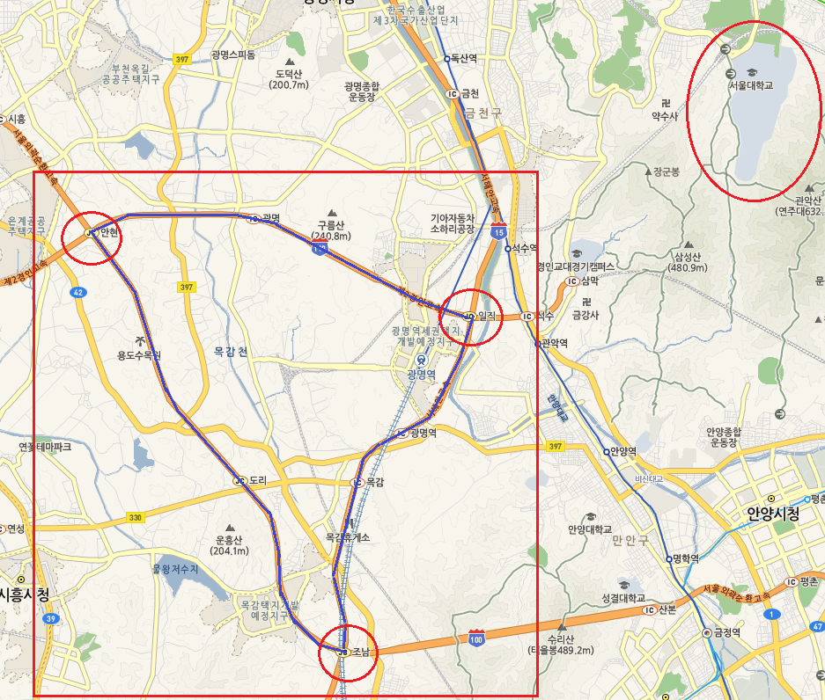
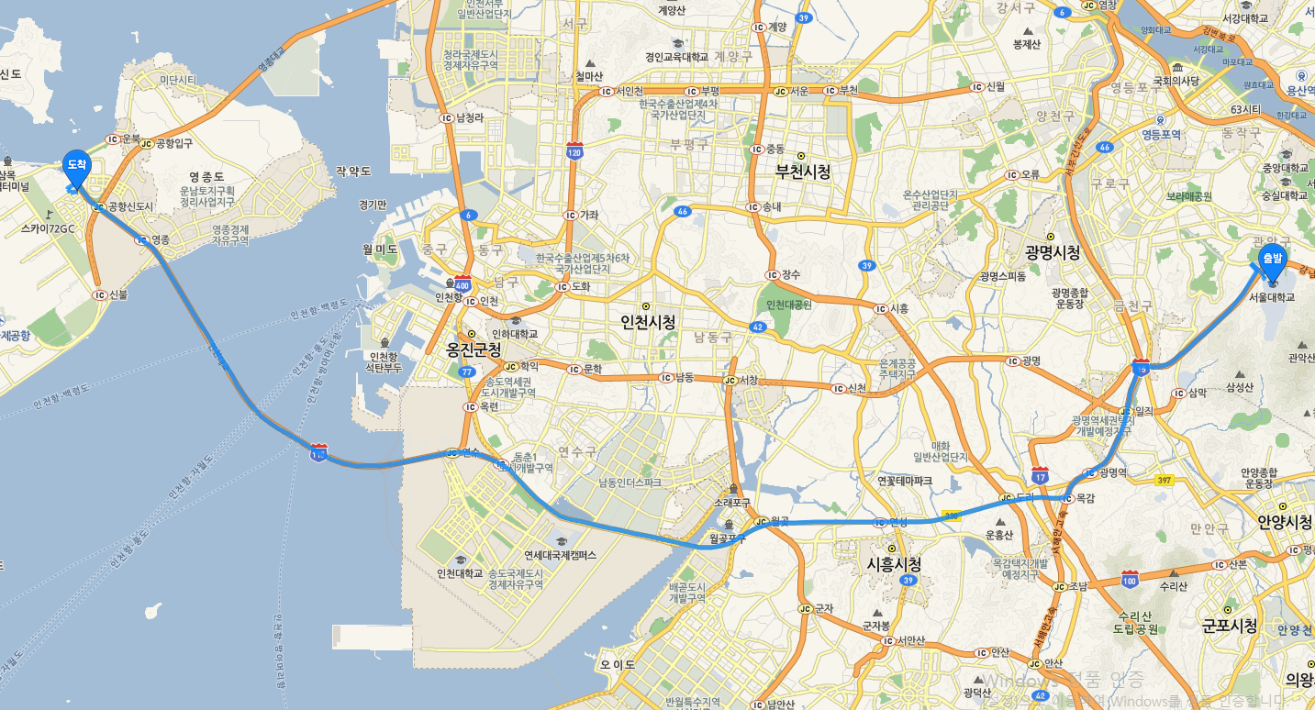
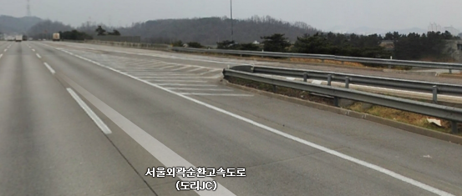
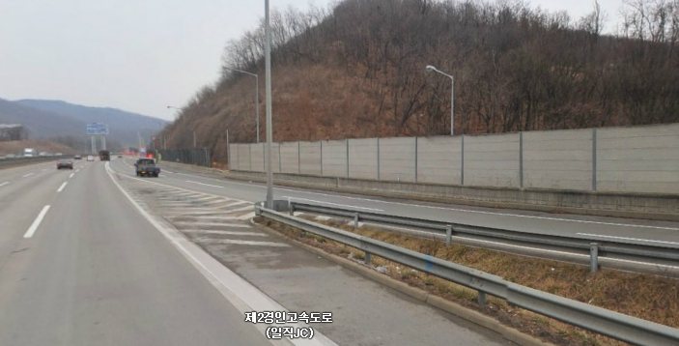
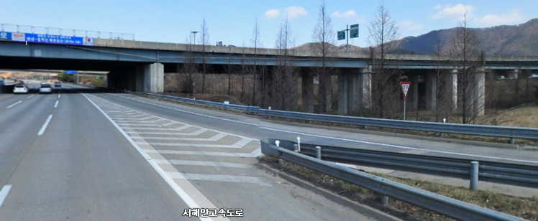
Lane Change Data Acquisition
    Experiment Location(highway)
50~100kph
50~100kph
50~110kph
Highway from Seoul to Incheon airport - Total 50km
50~100kph
Highway near Seoul - Total 250km
Triangular merge section

Slide 4
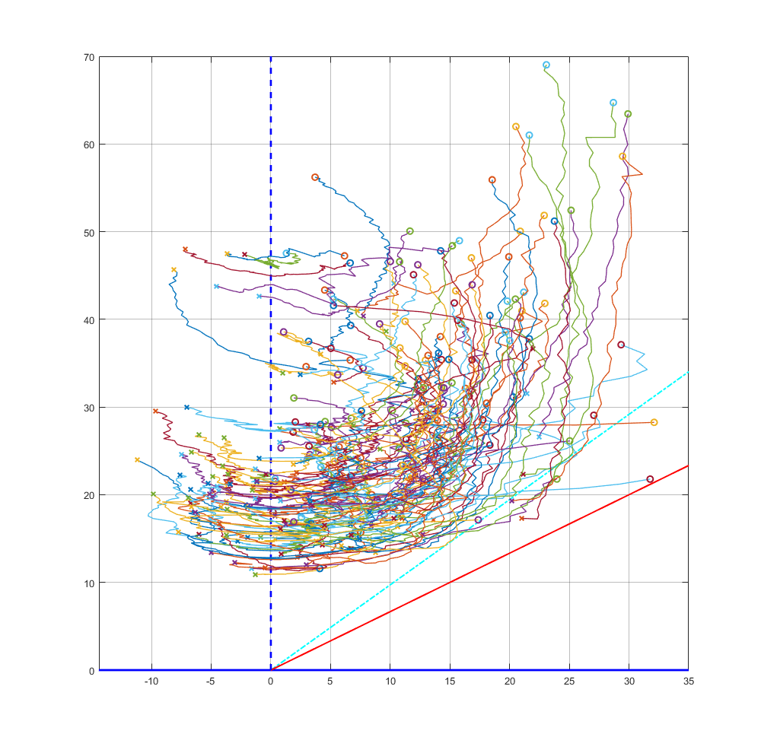
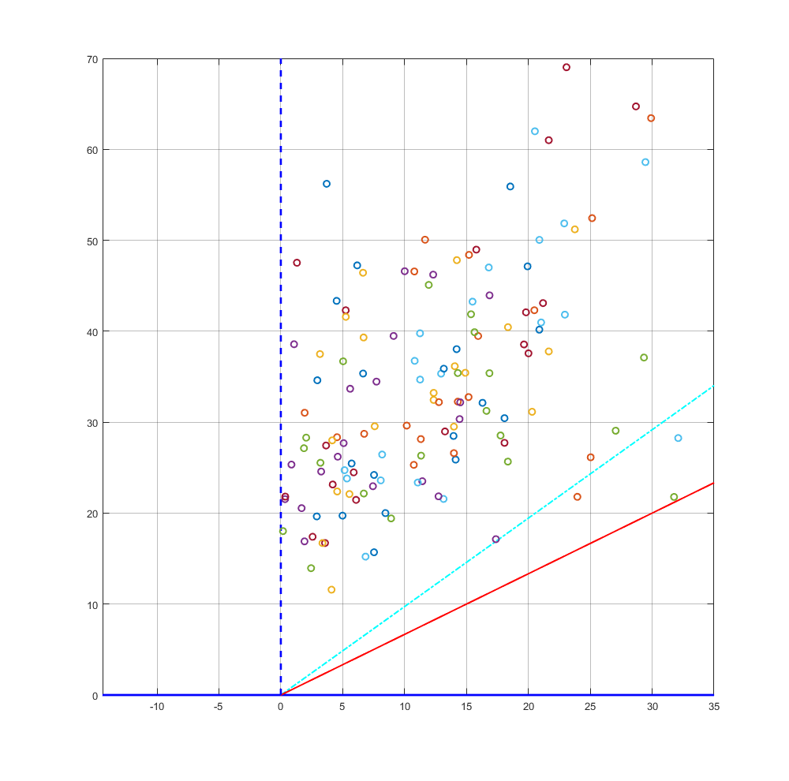
Safety Region Plot based on driving data
O : LC Start X : LC End
Clearance[m]
Clearance[m]
Relative Velocity[km/h]
Relative Velocity[km/h]

Slide 5
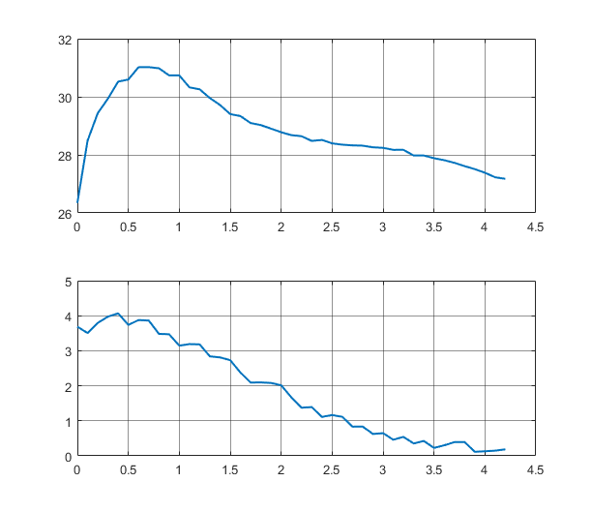
Reaction time for Lane Change Procedure
    Example of Reaction Time decision
S_{rear} = dv*t_{B}+ dv²/2a_{brake} + v_{ego}*t_{G}
Target velocity[m/s]
Reaction
Time
Target Vehicle deceleration
Lateral Distance[m]
time [sec]
Vehicle moving Start(=LC start)

Slide 6
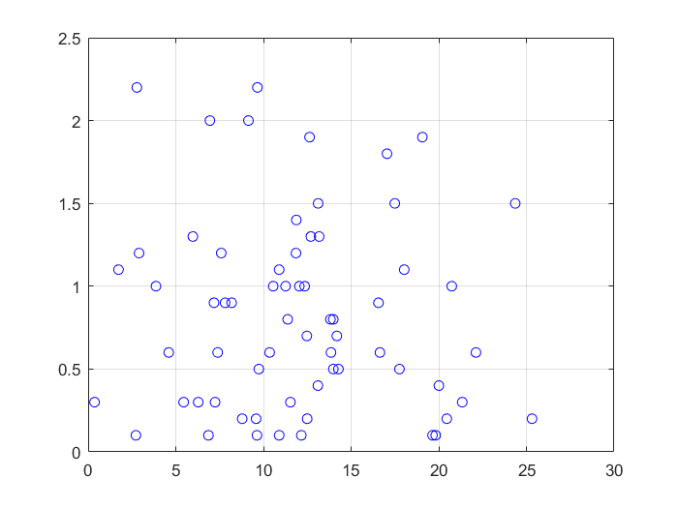
Reaction time for Lane Change Procedure
    Reaction Time distribution
S_{rear} = dv*t_{B}+ dv²/2a_{brake} + v_{ego}*t_{G}
From 0~10km/h
Min = 0.1sec, Max = 2.2sec
Average = 0.85sec
From 10~20km/h
Min = 0.1sec, Max = 1.9sec
Average = 0.86sec
From 20~30km/h
Min = 0.2sec, Max = 1.5sec
Average = 0.60sec
Reaction Time[sec]
→ Average 0.83sec
Relative Velocity[km/h]

Slide 7
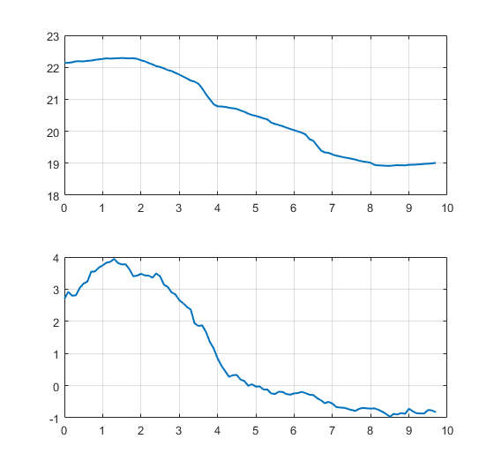
Safety time gap for Lane Change
    Example of Safety time gap
S_{rear} = dv*t_{B}+ dv²/2a_{brake} + v_{ego}*t_{G}
Target velocity[m/s]
Deceleration of braking
ends
Lateral Distance[m]
time [sec]

Slide 8
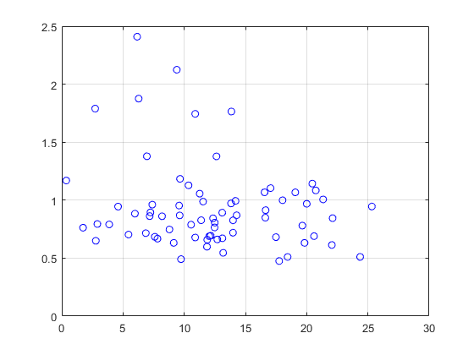
Safety time gap for Lane Change
    Safety time gap at the end of deceleration
S_{rear} = dv*t_{B}+ dv²/2a_{brake} + v_{ego}*t_{G}
From 0~10km/h
Min = 0.49sec, Max = 2.41sec
Average = 1.03sec
From 10~20km/h
Min = 0.48sec, Max = 1.86sec
Average = 0.88sec
From 20~30km/h
Min = 0.51sec, Max = 1.14sec
Average = 0.87sec
Safety time gap[sec]
→ Average 0.95sec
Relative Velocity[km/h]

