Slide 1
Lane change driver reaction times
Informal Document: ACSF-15-17
Industry input to ACSF IG
15th meeting
November 2017, Bonn

Slide 2
Intention of the Investigation
During lane change there are two important facts to consider in terms of timing.
  Reaction time (duration)
    Literature is available
  Start point of the reaction time
    Investigation to find out when this reaction time starts

Slide 3
Cover story for the test -
Active Steering assistant
The investigation consists of three phases (for the test person*)
  Set-up phase : become familiar with the operation of the system/ car / environment and, in particular, to get used to drive on the target speed of 130 km / h.
  natural driving behavior, is to be recorded as a reference
  different variants of a system for guidance will be tested.
  Boundary conditions:
    If the rest of traffic permits, drive on the straight sections on the left lane.
    If permissible, accelerate speedily to 130 km / h on the straight sections and keep this speed as good as possible.
    Please drive as you usually do in traffic.
  *The test persons were selected through our driving simulator test management

Slide 4
Test procedure
The investigation consists of two phases
  Set-up phase : become familiar with the operation of the system/ car / environment and, in particular, to get used to drive on the target speed of 130 km / h.
  Test of (reaction time) the start point of reaction
After the test the test persons were asked if the cover story was plausible.
  All test persons stated that they believed in the cover story.

Slide 5
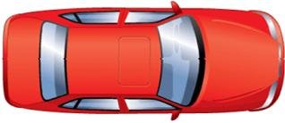
Setup
Test car at 130 kph, rabbit at 80 kph - dv=50 kph (13,8 m/s)
Test manager triggers the rabbit at approximately 96m (hidden trigger)
Rabbit activate the direction indicator
Rabbit drifts to the lane
After 3 seconds rabbit crosses the line (distance TC and rabbit → 55m)
Test car
Test person
Test manager
Rabbit

Slide 6
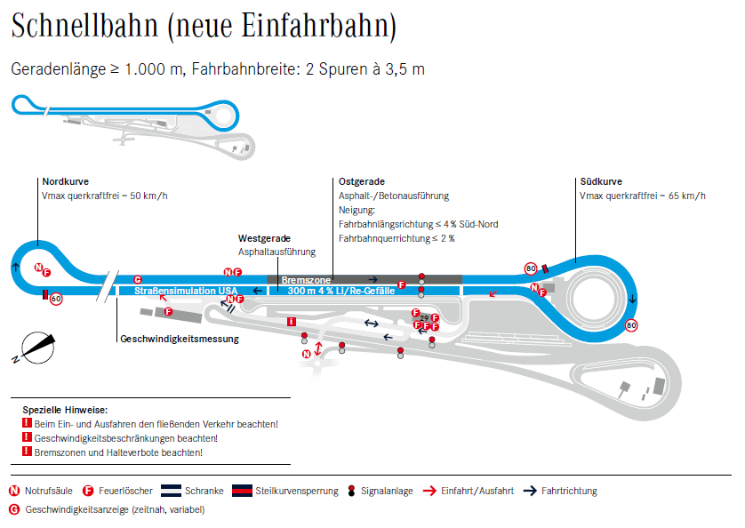
Proving Ground in Sindelfingen

Slide 7
Instruction for the test manager
  Drive 5 to 6 laps to get used to
  After the acclimatization phase
    “ Now we start with the second part, we want to record the natural driving behavior as a reference. Please drive as you usally do on the road.”
  The rabbit must be overtaken twice by the test car.
  In a suitable situation, set the lane change trigger by radio (walkie talkie).
  After lane change
    Trigger the measurement equipment
    Test person ask to remember the behavior in this lane change situation
    Fill test protocol
  Move back to the parking position on the proving ground
  Interview
  Questions
  Good bye

Slide 8
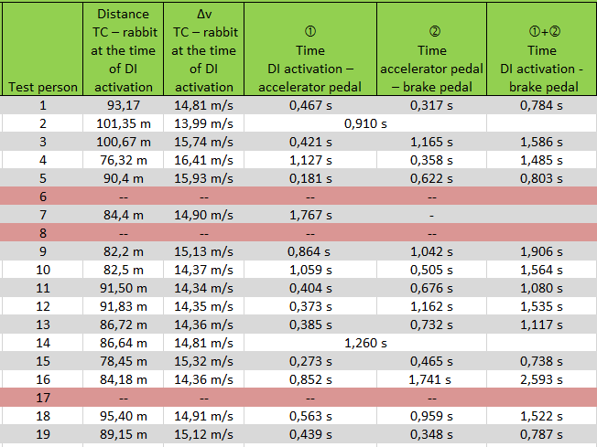
Test results
TC - Test car
DI - Direction indicator

Slide 9
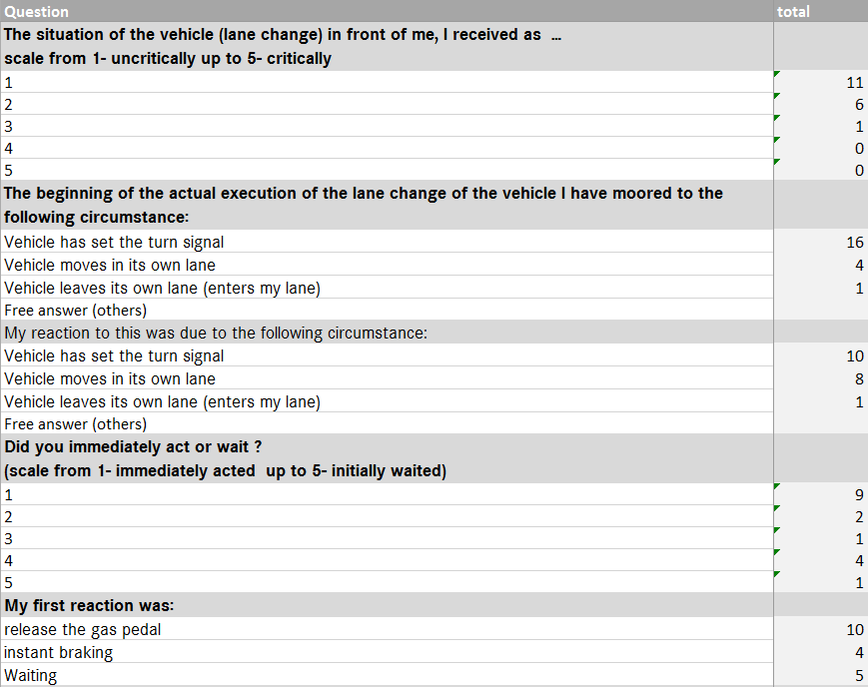
Interview after the test

Slide 10
BACKUP

Slide 11
Cover story for the test -
Active Steering assistant
The test consists of three phases
We start with a set-up phase over a few laps, during which you first become familiar with the operation of the system and, in particular, get used to drive on the target speed of 130 km / h. During this phase you drive without the assistance of driver assistance systems.
In the second part, the natural driving behavior with regard to the lane keeping is to be recorded as a reference. In addition, following the acclimatization phase, you will again drive a few laps without the assistance of driver assistance systems.
Finally, in the third part you will experience different variants of a system for guidance. This is especially to assess the stability of the line keeping. Please rate in this part naturalness and comfort of the system. Please say immediately if you notice any commuting, leaving the center of the lane, or other effects, and how they affect you, how strongly you perceive them and whether you feel impaired by them.
  While driving, please consider the following rules:
    The rules and maximum speeds of the proving ground always apply.
    If the rest of traffic permits, drive on the straight sections on the left lane.
    If permissible, accelerate speedily to 130 km / h on the straight sections and keep this speed as good as possible.
    Please drive as you usually do in traffic.
    Note in particular that other vehicles may be traveling at the same time on the proving ground.
    Safety comes first: As soon as you feel unwell, please inform your test administration immediately.
    Please DO NOT use the DISTRONIC until explicitly requested to do so.

Slide 12
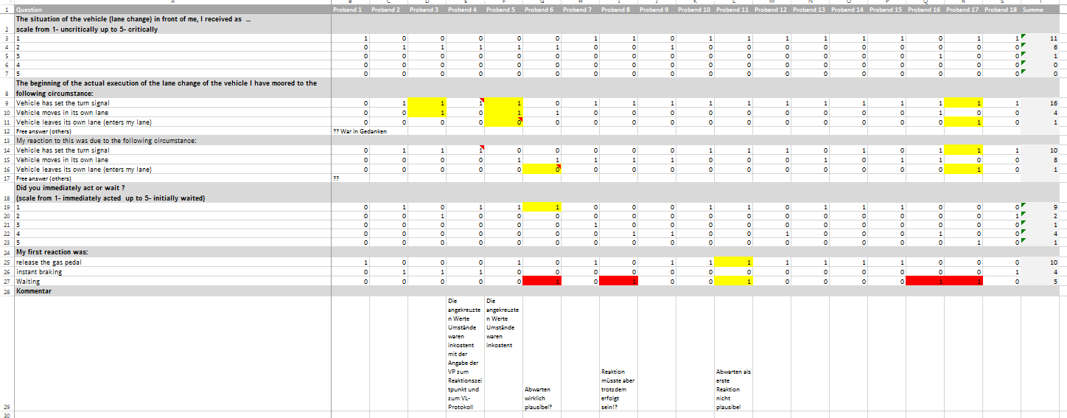
Interview after the test

Slide 13
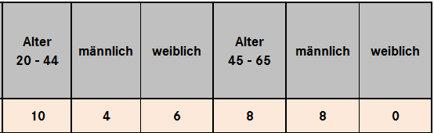
Test persons
The test persons were selected by the driving simulator test management.
The test persons are all Daimler employees, because they need acces to the proving ground.
None of them is working in driver assistance systems.

