Slide 1
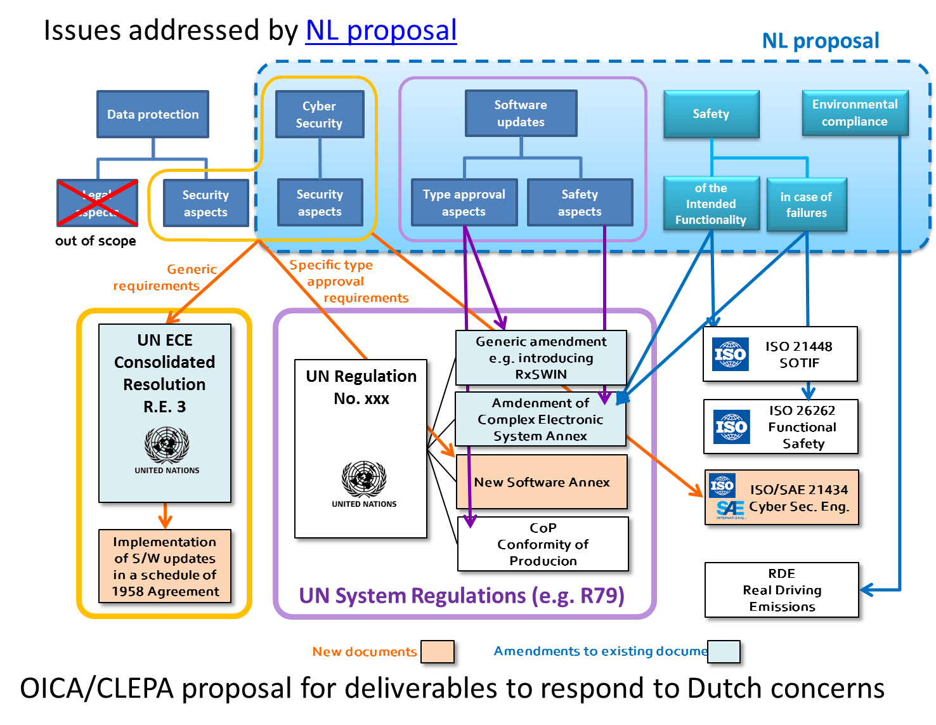
Submitted by the Secretary
TFCS-09-03
Original slide of
TFCS-ahSU2-02-Rev1

Slide 2





Submitted by the Secretary
TFCS-09-03
Data protection
Cyber Security
Software updates
Safety
Environment
Legal
aspects
Security
aspects
Security
aspects
Security
aspects
Type approval aspects
Safety
aspects
of the intended functionality
in case of failure
out of scope
Engineering Process
Specific type
approval
requirements
Generic amendment
introducing RxSWIN
CoP
Conformity of Producion
ISO 21448
SOTIF
ISO 26262
Funct. Safety
ISO/SAE 21434
Cyber Sec. Eng.
New Software Annex
Amdenment of
CEL Annex
Generic requirements
UN Regulation
No. xxx
RDE
Real Driving Emissions
UN ECE
xxx
Resolution
Revised overview
(draft)
Implementation of S/W updates in a schedule of 1958 Agreement
e.g. Consolidated Resolution R.E.3 or Stand-alone Software Resolution
e.g. UN Regulation 79
New documents
Amendments to existing documents
Topics out of scope of UN TF-CS/OTA

