Slide 1

GRSG IWG VRU-Proxi
3c Direct vision - D standard on direct vision
2nd meeting, 04th/05th of July 2017, London

Slide 2

Content
German Regulation on the Approval of Road Vehicles (StVZO)
Directives for the Field of Vision of Road Vehicles (§35b StVZO)
Requirements for School Buses (§34a StVZO)

Slide 3
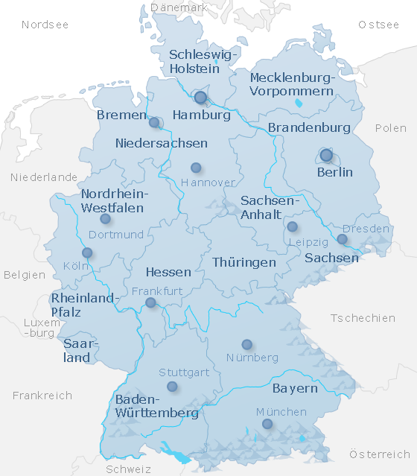

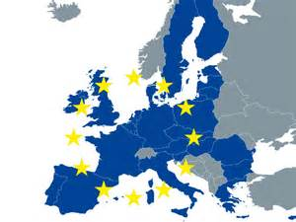
German Regulation on the Approval of Road Vehicles (StVZO)
§19 Granting and validity of the type-approval:
  …The type-approval shall also be granted if the vehicle complies with the directives, as amended, instead of the provisions of this Regulation,
  Amendement: Annex IV of 2007/46/EC of 5 September 2007 establishing a framework for the approval of motor vehicles and their trailers, and of systems, components and separate technical units intended for such vehicles …
Implementation
StVZO
2007/46/EC
2002/24/EC
2003/37/EC

Slide 4
German Regulation on the Approval of Road Vehicles (StVZO)
Use of StVZO today
Majority of vehicles in Germany is certified based on European regulations
  but
National approval based on StVZO is still possible for all vehicles that are not affected by European regulations (e.g. individual designed vehicles – road sweeper or cranes, bicycles, special components …)
  → In this case additional requirements for the field of vision have to be considered.

Slide 5
Content
German Regulation on the Approval of Road Vehicles (StVZO)
Directives for the Field of Vision of Road Vehicles (§35b StVZO)
Requirements for School Buses (§34a StVZO)

Slide 6
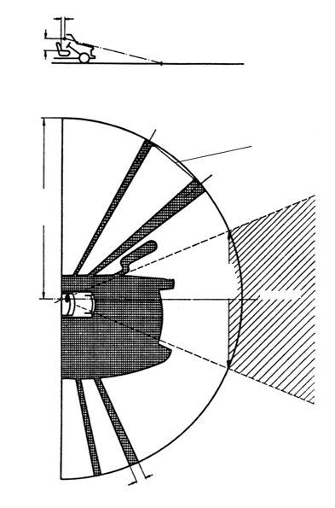
Directives for the Field of Vision of Road Vehicles (§35b StVZO)
1. Definition of Eye-Point
300 mm
700 mm
Eye-point

Slide 7
Directives for the Field of Vision of Road Vehicles (§35b StVZO)
2. Definition of Semi-circle of Vision
300 mm
700 mm
Eye-point
Measurement-point
12 m
Eye-point
12 m

Slide 8
Directives for the Field of Vision of Road Vehicles (§35b StVZO)
3. Definition of Sector of Vision
Sector of Vision
≥ 7.5 m
Eye-point
12 m

Slide 9
Directives for the Field of Vision of Road Vehicles (§35b StVZO)
4. Assessment of obstructions (details see document)
Minimum distance between the centres of two obstructions
Sector of Vision
≥ 7.5 m
2.5 m
Permitted obstruction on the semi-circle of vision (see diagram next slide)
Eye-point
12 m

Slide 10
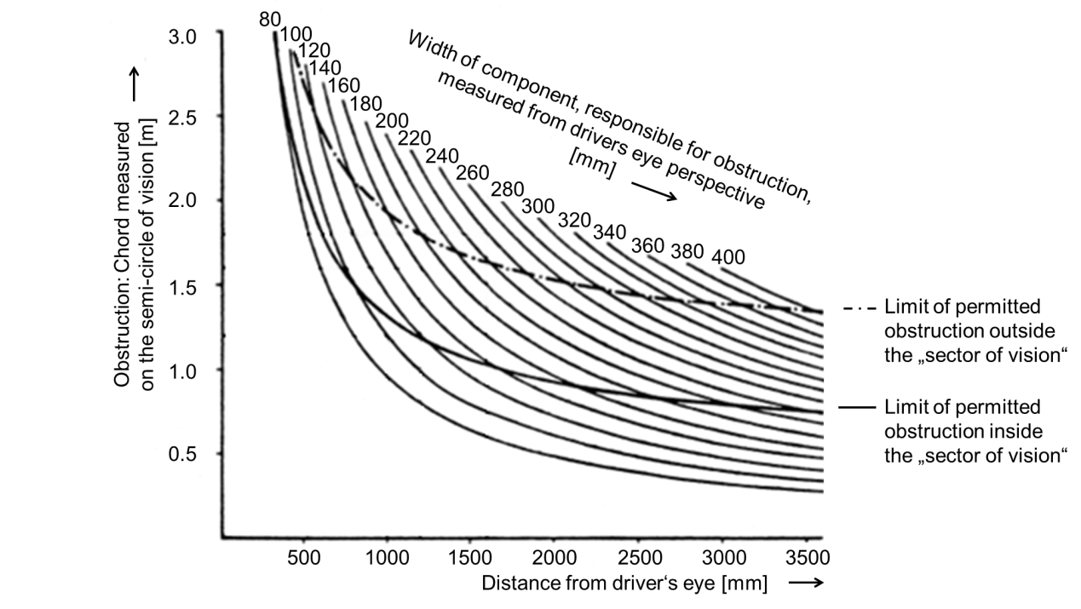
Directives for the Field of Vision of Road Vehicles (§35b StVZO)
4. Assessment of obstructions (details see document)

Slide 11
Directives for the Field of Vision of Road Vehicles (§35b StVZO)
4. Assessment of obstructions (Examples)
Width of component [mm] | Distance between eye-point and component [mm] | Obstruction [m] | Note
100 | 1000 | 1.2 | permitted
160 | 1200 | 1.6 | not permitted within the “sector of vision“ but partially permitted outside the “sector of vision“
240 | 1600 | 1.8 | not permitted
ok
(ok)
Not ok

Slide 12
Content
German Regulation on the Approval of Road Vehicles (StVZO)
Directives for the Field of Vision of Road Vehicles (§35b StVZO)
Requirements for School Buses (§34a StVZO)

Slide 13
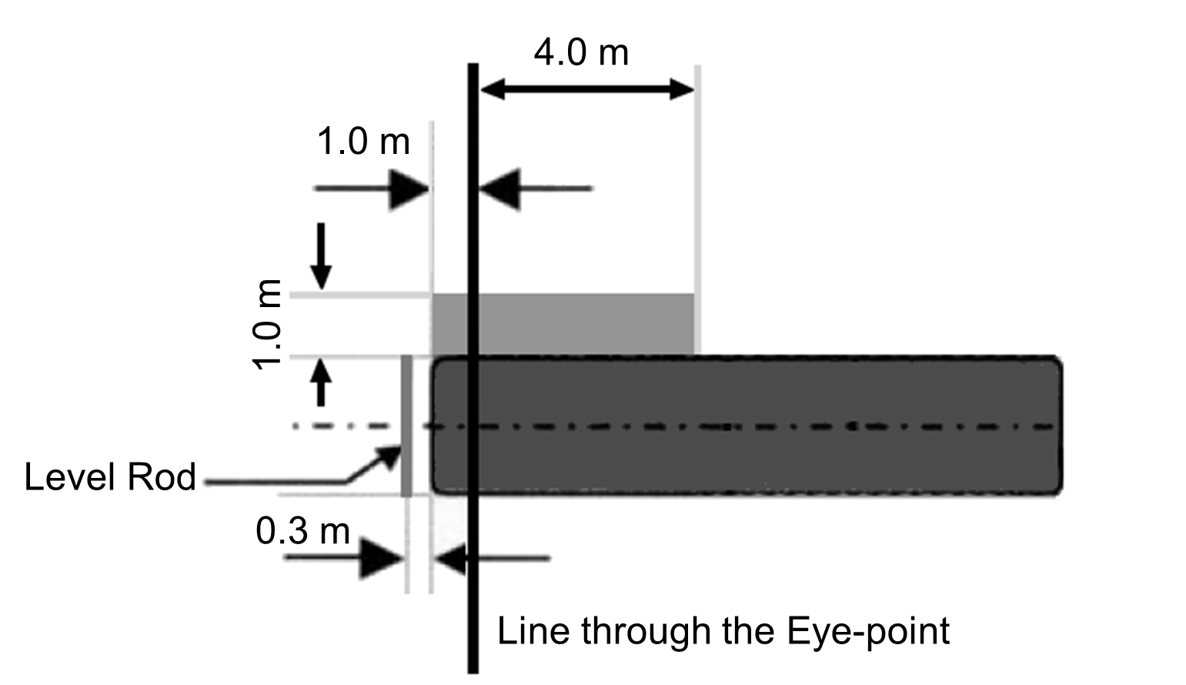
Requirements for School Buses (§34a StVZO)
1. Additional fields of vision (details see document)
Eye-point
1200 mm
0.3 m

