Slide 1
TYREGTR-17-09
Agenda item 4.1
Informal Working Group Tyre GTR
Session 17, Brussels Nov 2nd-3th
Action item 6 : ETRTO will provide the justification to change in R54 (and in GTR) the definition of the measuring rim, considering the prerogatives of the IWG to change or not existing text from R54.

Slide 2
Global technical regulation No. 16, Amendment 1, ECE/TRANS/180/Add.16/Amend.1
2.41. "Measuring rim" means an actual rim of specified width as defined by one of the
standards organizations as specified in Annex 7, on which the tyre is fitted for measuring the physical dimensions;
A unique Rim width

Slide 3
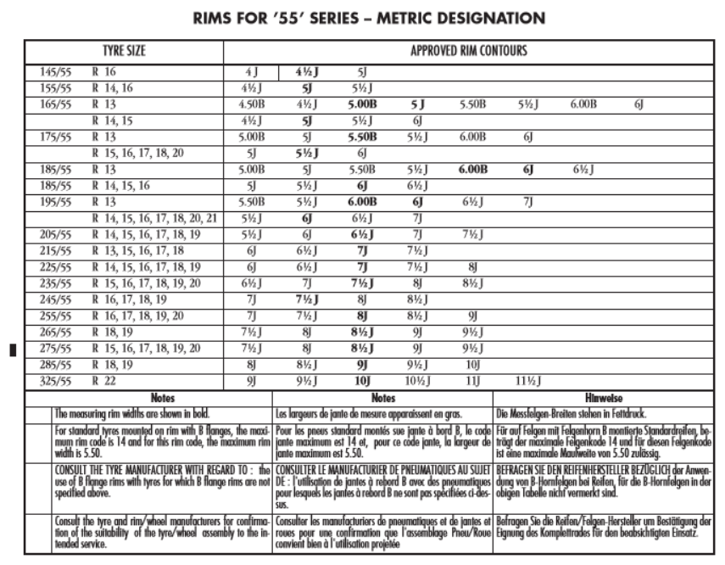
In Most Standards Organizations, the Measuring rim is a unique rime for a given dimension

Slide 4
Global technical regulation No. 16, Amendment 1, ECE/TRANS/180/Add.16/Amend.1
2.41. "Measuring rim" means an actual rim of specified width as defined by one of the
standards organizations as specified in Annex 7, on which the tyre is fitted for measuring the physical dimensions;
  3.5.3. The theoretical section width shall be calculated by the following formula:
S = S1 + K(A-A1), …
A is the width (expressed in mm) of the measuring rim, as declared by the manufacturer;
  3.11. High speed performance test for passenger car tyres
  3.11.4.1. Mount a new tyre on the test rim specified by the manufacturer as the "measuring rim and test rim".
  3.22. Tyre rolling resistance test
  3.22.3.2. Measuring rim (see Annex 9)
The tyre shall be mounted on a steel or light alloy measuring rim, as follows:
(a) For Class C1 tyres, the width of the rim shall be as defined in ISO 4000-1:2010;
(b) For Class C2 and C3 tyres, the width of the rim shall be as defined in ISO 4209 1:2001.
In cases where the width is not defined in the above mentioned ISO Standards, the rim width as defined by one of the standards organizations as specified in Annex 7 may be used."
A unique Rim width
Any Rim width
Any Rim Width
A unique Rim width

Slide 5
Other Inconsistency
Rim widths reference to:
  Standards organization
  eg 2.41. "Measuring rim" means an actual rim of specified width as defined by one of the standards organizations as specified in Annex 7, on which the tyre is fitted for measuring the physical dimensions;
  ISO
  eg 3.22.3.2. The tyre shall be mounted on a steel or light alloy measuring rim, as follows:
  (a) For Class C1 tyres, the width of the rim shall be as defined in ISO 4000-1:2010;
  (b) For Class C2 and C3 tyres, the width of the rim shall be as defined in ISO 4209 1:2001.
  Annex 9 of Tyre GTR “Measuring rim width”

Slide 6
Industry recommends the IWG Tyre GTR to consider the following Proposal:
  Remove the concept of 'measuring rim' in the sense of rims on which a test is to be performed from GTR and replace it by 'test rim' in line with the ISO definition.
  New definition of test rim: "test rim: rim on which a tyre is fitted for testing“
  in line with ISO: 4223-1 2002 para 8.8
  New definition of “measuring rim width: specified rim width as defined in Annex 9 on which the tyre is fitted for measuring the physical dimensions”
  Introduce for each test of the GTR a paragraph defining the test rim to be used.
  Remove the references to ISO 4000-1and 4209-1 from the main text of R117 annex 6, 2.2 and GTR 3.21.3.2, since the measuring rim width is given in an annex in the annex (9).
  Update the Annex 9 of the Tyre GTR with the relevant content of ISO 4000-1 and 4209-1 defining the approved rims and the measuring rim widths.
Proposal brings clarity and coherence to the Tyre GTR text without changing the technical provisions intent

