Slide 1
TYREGTR-17-11
Agenda item 4.4
Informal Working Group Tyre GTR
Session 17, Brussels Nov 2nd-3th
Agenda item 4.4 : (Sections 3.19) and UN Regulation No. 54 (Section 3.16) and addition of new harmonized provisions for high speed test for LT/C tyres (new Section 3.16);

Slide 2

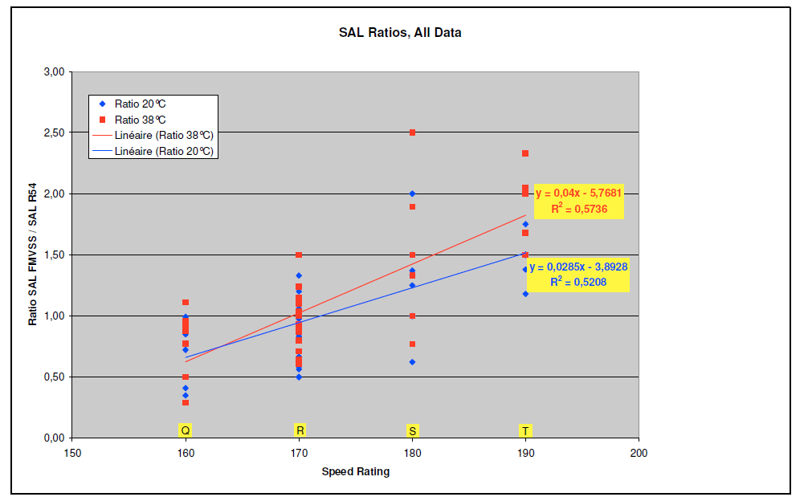
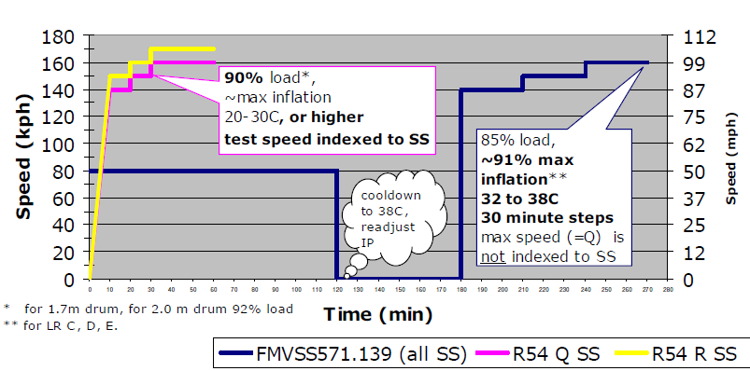
Work done by the Tyre Industry (2010-2013) has shown that the R54 Load Speed test is more severe than the FMVSS one based on the notion of SAL for Speed Symbols “S” and above, while the FMVSS test is more severe for Speed Symbol “Q” and presumably below.
“R” speed symbol relative severity is unclear.
Background
Comparison: R54 vs FMVSS139 High Speed Tests
    Assessment of FMVSS139 High Speed vs R54 Load/Speed
FMVSS 139 more severe
R54more severe
?
Which Test is the most severe?
Available Results do not allow to decide between R54 and FMVSS139 HS tests for ‘R’ Speed Symbols
Can we make the R54 test more severe for ‘R’ and ‘Q’ speed symbols at equal failure mode?

Slide 3
Industry Analysis: R54 test “severisation” approach
Test Parameters | FMVSS139 | R54
Test Temperature | 32-38C | 20-30C
Load vs Load Carrying Capacity (LCC) | 85% | 90%
Inflation pressure | 91% of maximum | 100% of IP for LCC
Speed | Not indexed | Indexed to SS
Duration | 270’ | 60’
Which Load/Inflation combination is more severe?
More Severe
Equally Severe
Less severe
Case dependent
UN-ECE R54/FMVSS 139 tests very different: temperature, load, Inflation pressure, speed, duration

Slide 4
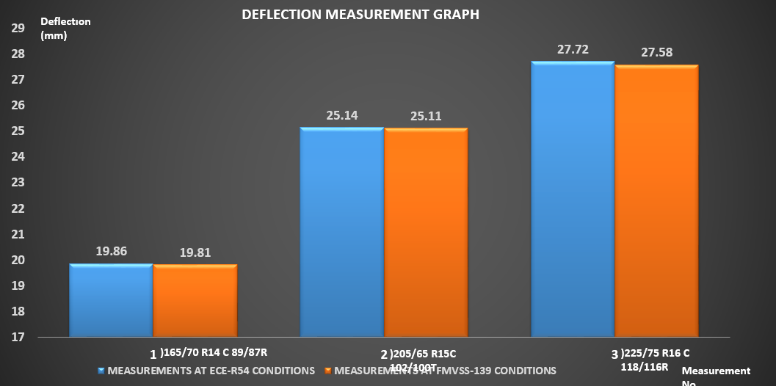
Industry Analysis: R54 test “severisation” approach
Observation: Maximum Difference in Deflection 0.5% between FMVSS139 vs R54 Load/Inflation
Working Hypothesis: Power dissipated in tyre structure function of deflection, for given temperature, test steps speeds and durations
Test Parameters | FMVSS139 | R54
Test Temperature | 32-38C | 20-30C
Deflection | Equal | Equal
Speed | Not indexed | Indexed to SS
Duration | 270’ | 60’
More Severe
Equally Severe
Less severe
Case dependent
Which Test Program?
Relative Severity reduced to test temperature, Speed/Durations of Test Steps

Slide 5
Industry Proposed Program:
Define a potentially modified UN-ECR R54 Load/speed test minimum requirement
in order to be equally/more sever than the current FMVSS 139 test for ‘Q’, ‘R; speed symbols.
Program 1: Assess current R54 test at 25C vs FMVSS 139 test at 38C with SAL (+5kmph/10’) applying from current limit:
      30’ at Speed corresponding to speed category symbol for R54 Load/Speed test
      30’ at 160 kmph for FMVSS 139 High Speed test
Program 2: Same as Program 1, but R54 made more severe by increasing test temperature to 38C
Program 3: R54 test made more severe by increasing test temperature to 38C, and SAL applying from:
      60’ at Speed corresponding to speed category symbol for R54 Load/Speed test
      30’ at 160 kmph for FMVSS 139 High Speed test
Ref WGLTC-10-006

Slide 6
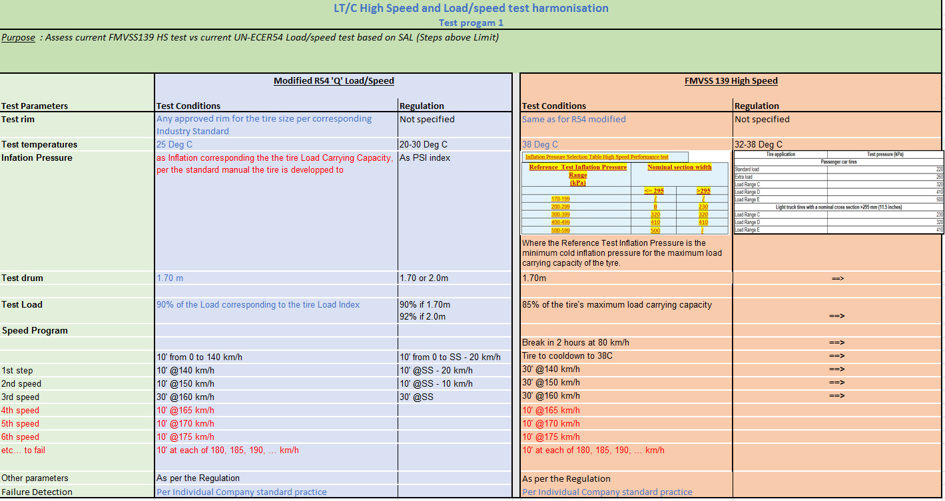
Legend
 | Change vs the regulation
 | Option from the regulation
 | As per regulation
 | Change vs Program 1

Slide 7
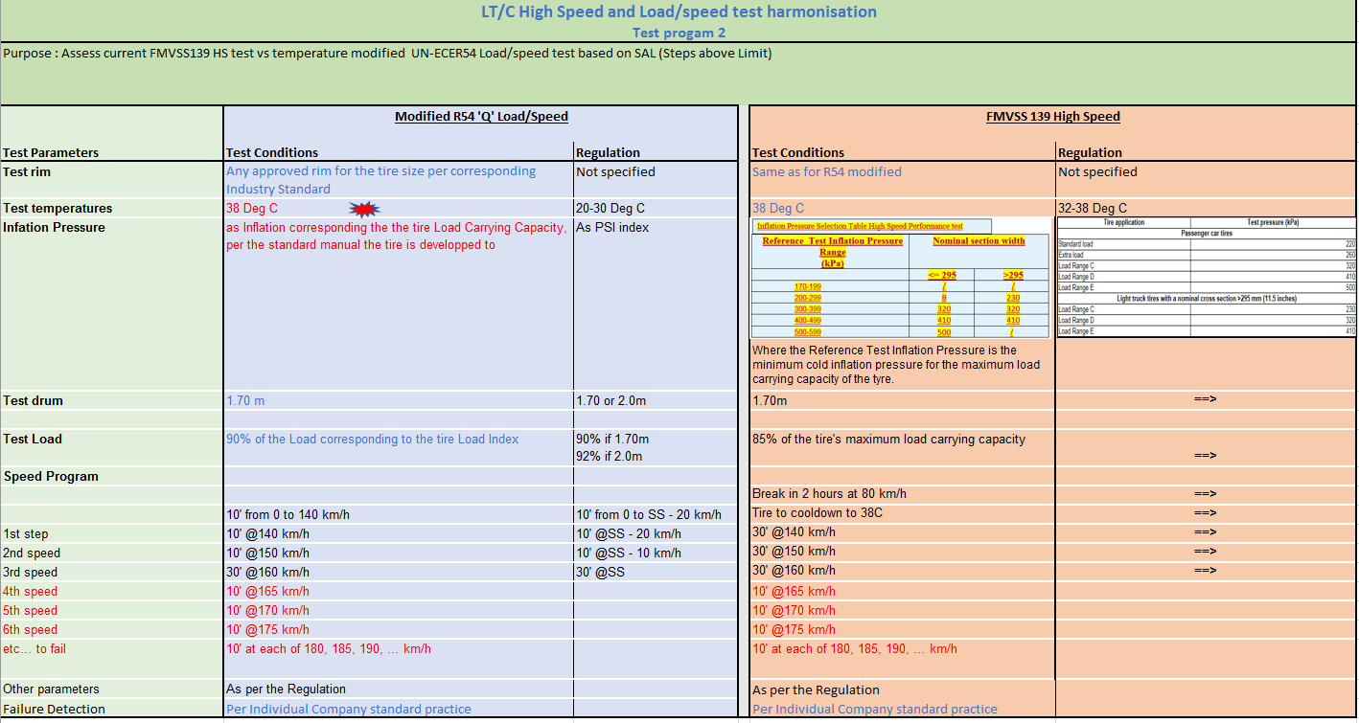

Slide 8
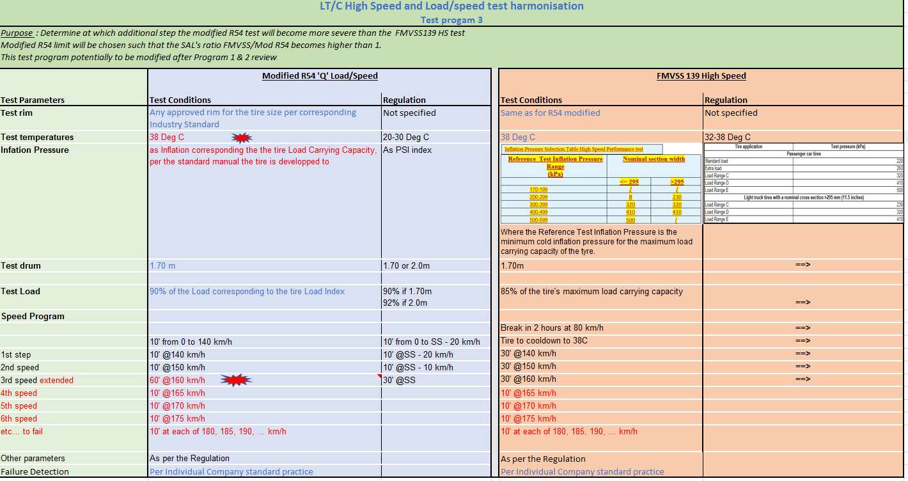

Slide 9
Proposed assesment method
Use the Step above limits (SAL) concept
    Representative of failure mode
    Statistical and complementary to the phenomenological experiments
    Accepted for the passenger case
    Subjective
Rather than the temperature approach
    Objective
    Limited number of experiments possible because of instrumentation/processing
    Not representative of the failure mode
    Available and complementary to the Statistical approach
In order to minimize the differences in severity increase between the FMVSS and the (modified) R54 test, the additional steps will be the same for both tests: +10’/+5 kmph

Slide 10
Timeline/test requirements
Preparation | Sept-2017 | Each company to propose 2-3 candidate sizes, to be reviewed with Industry in September (20th)
Program 1 + Program 2 | End of Nov 2017 | 2 sizes per company: - a common reference size for all companies (see p 10) - one free size
Reconvene | Mid december 2017 | Review Results and Decide next steps
Program 2 3 | May-2018
Reconvene |  | Review Results and Decide next steps
Program 3 | July-2018
Reconvene |  | Review Results and conclude
Contingency
GRRF | Sept 2018 | Informal document presented and reviewed
GRRF | Nov 2018 | Working document to be presented to GRRF for approval Jan 2019

Slide 11
Thanks You

Slide 12


Steps above Limits (SAL) concept
Fail
Passes
Passes
Fail
Min
Passes
Min
Two steps Above limit
One Step Above limit

Slide 13
II. Problem Statement
Market Share LT/C per Speed Symbol and Region
Significant share of LT/C with SS <‘Q’ in Japan, India, and with SS > ‘Q’ in Europe, US, India

Slide 14
II. Problem Statement: Test Type Differences
High Speed/Endurance Regulatory Requirements – Regulations in Compendium
Speed Symbol/Tread Depth | FMVSS | UN-ECE R54
<‘Q’ / <18/32” | Endurance | Endurance
 | Low Pressure
 | High Speed | None
<‘Q’ / >= 18/32” | FMVSS 119 Endurance | Endurance
>= ‘Q’ / <18/32” | Endurance | None
 | Low Pressure
 | High Speed | High Speed
>=‘Q’ / >=18/32 | FMVSS 119 Endurance | None
 | None | High Speed
Japan
India
Europe
US
India
Partial matching of test type requirements between US and UN-ECE
Unlikely Acceptance by CP’s to remove actual requirements because of different services in different countries
Addition of tests types to encompass current local requirements will result in non value added burden and product reengineering
Challenge:
Consolidation of different test types while keeping regional proven safety without adding significant unnecessary burden

