Slide 1
JRC comments and questions in advance
EVS1421-604 Canada
EVS GTR IWG Session #14
Ottawa, September 2017

Slide 2
Relevant to Thermal propagation
Document | Title | Author
EVS1421-604 | Thermal runaway initiation and propagation – xEV cell, module and pack testing | Steven Recoskie Canada
Is the patent of the heating device available? If not can you please provide more details?
Could you comment if the heater is dimensioned according to the size of the unit to be tested?

Slide 3
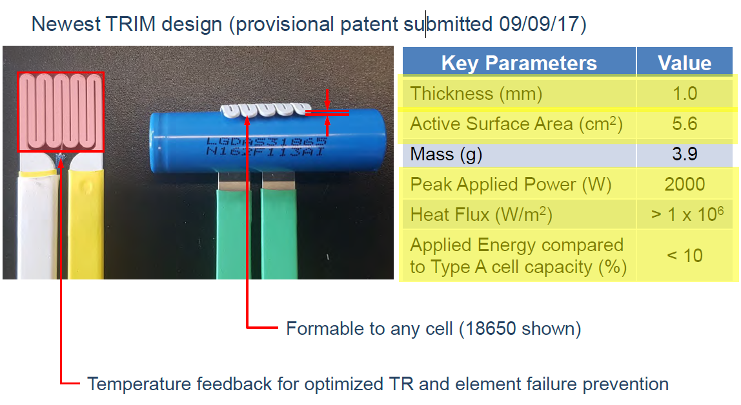
Relevant to Thermal propagation
Document | Title | Author
EVS1421-604 | Thermal runaway initiation and propagation – xEV cell, module and pack testing | Steven Recoskie Canada
Slide No 11
Is the 10% added energy valid for any battery size? Is there any effect of the fraction of the battery surface covered by the heater on the applied energy and the TR?

Slide 4
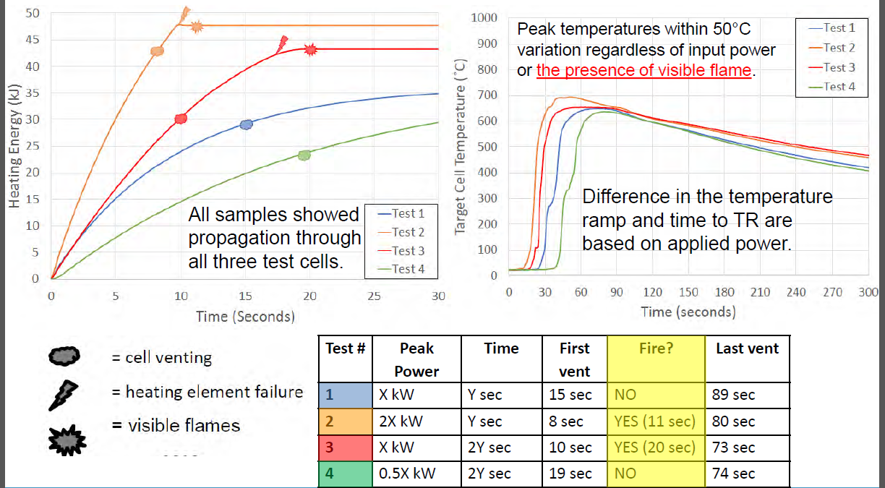
Relevant to Thermal propagation
Document | Title | Author
EVS1421-604 | Thermal runaway initiation and propagation – xEV cell, module and pack testing | Steven Recoskie Canada
We note that when there is a failure of the heating element there are flames visible. Do you consider that the failure of the heater may have an impact on the test outcome?
Slide No 14

Slide 5
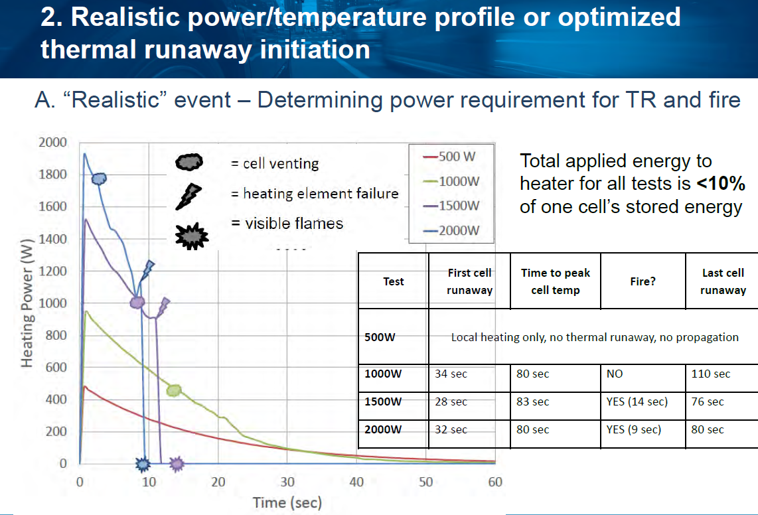
Relevant to Thermal propagation
Document | Title | Author
EVS1421-604 | Thermal runaway initiation and propagation – xEV cell, module and pack testing | Steven Recoskie Canada
Slide No 18
Was the temperature of the heater measured?
What was the maximum temperature of the heater for the different power levels applied?

