Slide 1

Japan’s proposal for
GTR2 B1
17-18 Oct.2017
JAPAN AUTOMOBILE STANDARDS INTERNATIONALIZATION CENTER
http://www.jasic.org

Slide 2
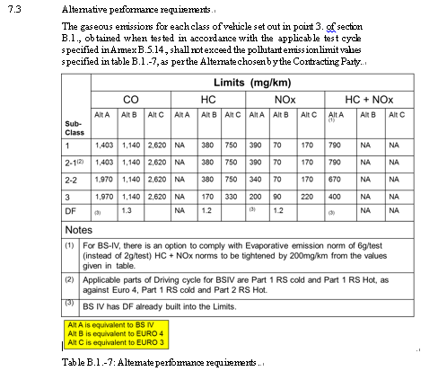
Proposal for performance requirements
Proposal
EPPR-21-03 GTR 2 revision - Table B.1 - 7 of Part B 1: Alternate performance requirements are revised as follows.
・Delete fixed deterioration factor.
Table B.1.-7: Alternate performance
Justification
The fixed deterioration factor is equivalent to deterioration durability and should not be included in the performance requirements.
It should be described in another GTR of durability (to be developed in the future).

