Slide 1
Informal Document - ACSF-16-01
16th ACSF Informal meeting
Informal meeting Date: January 23rd – 25th, 2018
Tuesday 23 January, 2018 starting at 14:00 until
Thursday 25 January, 2018 ending at 15:00
Welcome Reception Date: January 23rd, 2018
Venue: AP Ichigaya
Address: 1-10 Goban-cho Chiyoda-ku, Tokyo Japan
Caution!! This meeting room is different from JASIC office!

Slide 2
Registration
Please send the following information to;
Mr. Jochen Schaefer (Jochen.Schaefer@de.bosch.com) and Mr. Yoshihisa Tsuburai (tsuburai@jasic.org)
no later than 10th January, 2018.
※In the case, we have more than 50 registrations, we have to limit the participation to delegates, which have participated in the previous sessions on a regular basis.
1) your name
2) your title and name of your business
3) your e-mail address
4) your arrival and departure date if you don’t participate in a full schedule.
5) your participation for the Welcome Reception on January 23rd.

Slide 3
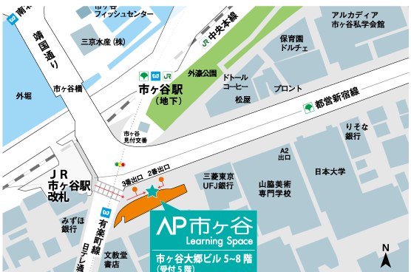
MAP
AP Ichigaya
Address: 1-10 Goban-cho Chiyoda-ku, Tokyo Japan
Tel：+81-(0)3-3511-3109
Fax：+81-(0)3-3511-7109
Google map;
https://www.google.com/maps/d/viewer?mid=13lqQh_nJ5AhEGCLwA6BQGvllnOE&hl=en_US&ll=35.69069912272502%2C139.73579670300637&z=18
Arcadia Ichigaya
JR Chuo Line
Yasukuni Street
Toei Shinjuku Line
Ichigaya station (Underground)
JR Ichigaya station
Ichigaya Mitsuke Police station
Nihon University
Exit 3
Exit 2
Mizuo bank
AP Ichigaya

Slide 4
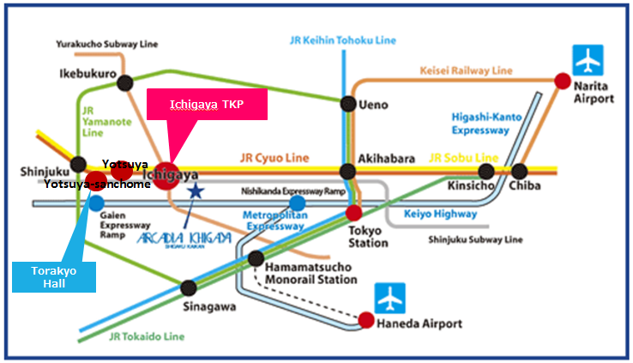
Access from the airports
AP Ichigaya
From Narita Airport to AP Ichigaya
80-120 mins by Airport Limousine Bus to Shinjuku.
Limousine Bus service to Shinjuku is available every hour.
https://www.limousinebus.co.jp/en/bus_services/narita/shinjuku.html
From Shinjuku, take JR Sobu Line(yellow above) for Ichigaya.
Narita Express Train is also available every hour and takes an hour to Shinjuku.
http://www.jreast.co.jp/e/nex/
From Haneda Airport to AP Ichigaya
60 mins by Airport Limousine Bus to Shinjuku.
Limousine Bus service to Shinjuku is available every hour.
https://www.limousinebus.co.jp/en/bus_services/haneda/shinjuku.html
From Shinjuku, take JR Sobu Line(yellow above) for Ichigaya.
By Train
The easiest and quickest way to Ichigaya is:
►Take the Tokyo Monorail from each of the airport terminals and get off at Hamamatsucho.
http://www.tokyo-monorail.co.jp/english/index.html
►Transfer to the JR Yamanote Line at Hamamatsucho and get off at Akihabara.
https://www.jreast.co.jp/e/destinations/tokyo/
►Change to the JR Sobu Line at Akihabara and get off at Ichigaya.
By Taxi
The fare varies depending on traffic conditions for the route from each of the airport terminals to
Ichigaya (5,000 yen ~ 10,000 yen).

Slide 5
Accommodations
Hotel Name (En) | Hotel name (Jpn) | URL | Access to the nearest station
TOKYO DOME Hotel | 東京ドームホテル | http://www.tokyodome-hotels.co.jp/e/ | 5 minute walk to Suido-bashi Sta.
Hotel Agnes | アグネスホテル | http://www.agneshotel.com | 5 minute walk to Iidabashi Sta.
Arcadia Ichigaya | アルカディア市ヶ谷 | http://www.arcadia-jp.org/access_english.htm | 1 minute walk to Ichigaya Sta.
Tokyo Green Palace | 東京グリーンパレス | http://www.tokyogp.com/english/index.html | 1 minutes walk from Kojimachi Station ( Yurakucho Subway Line ) 7 minutes walk from Ichigaya Station ( JR Sobu Line or Yurakucho / Namboku Subway Line )
APA Hotel (Shinjuku Gyoemmae) | APAホテル＜新宿御苑前＞ | http://www.apahotel.com.e.ju.hp.transer.com/language/shutoken/33_shinjukugyoenmae.html | 1 minute walk to Sinjukugyoen Sta.
Shinjuku CITY Hotel N.U.T.S Tokyo | 新宿 CITY HOTEL N. U. T. S 東京 | http://hotel-nuts.com/eng/index.php | 5 minute walk to Shinjyuku-Gyoen Sta.
Hotel New Otani | ホテルニューオータニ | http://www.newotani.co.jp/tokyo/ | 5 minute walk to Akasaka Mitsuke Sta.
ANA Intercontinental Tokyo | ANAインターコンチネンタルホテル東京 | http://www.anaintercontinental-tokyo.jp/e/access/ | 5 minute walk to Tameike-Sanno Sat.
KEIO Plaza Hotel | 京王プラザホテル | http://www.keioplaza.com/ | 10 minute walk to Shinjuku Sta.
Hyatt Regency Tokyo | ハイアットリージェンシー東京 | http://tokyo.regency.hyatt.com/en/hotel/home.html | 10 minute walk to Shinjuku Sta.
The Capital Hotel Tokyu | キャピトルホテル東急 | http://www.capitolhoteltokyu.com/en/index.html | Direct access to Tameike-sanno Sta./Kokkai-Gijidomae Sta.
Akasaka Excel Hotel | 赤坂 エクセルホテル東急 | http://www.tokyuhotelsjapan.com/en/hotel/TE/TE_AKASA/index.html | 1 minute walk to Akasaka-Mitsuke Sta.
Hotel WING International | Hotel WING International | http://www.hotelwingjapan.com/ | 5 minute walk to Yotsuya-Sanchome Sta.
MITSUI GARDEN Hotel | 三井ガーデンホテル四谷 | https://secure.reservation.jp/gardenhotels/stay_pc/rsv/index.aspx?hi_id=3&lang=en-US | 5 minute walk to Yotsuya Sta.
TOKYU STAY YOTSUYA | 東急ステイ四谷 | http://www.tokyustay.co.jp/e/hotel/YOT/ | 3 minute walk to Yotsuya Sta.

Slide 6
Other Information
JASIC Website http://www.jasic.org/e/03_location/location_jasic.htm
Narita Airport Website
http://www.narita-airport.jp/en/index.html
Haneda Airport Website
http://www.haneda-airport.jp/inter/en/
JR lines in the Tokyo area
https://www.jreast.co.jp/e/downloads/
Tokyo Metro Guide
http://www.tokyometro.jp/en/index.html
General information on Japan
http://www.jnto.go.jp/eng/
General information on Tokyo
http://www.gotokyo.org/en/index.html

Slide 7
If you have any question, please contact with
Mr. Tsuburai
tsuburai@jasic.org
How to access AP Ichigaya
How to access Hotel

