Slide 1
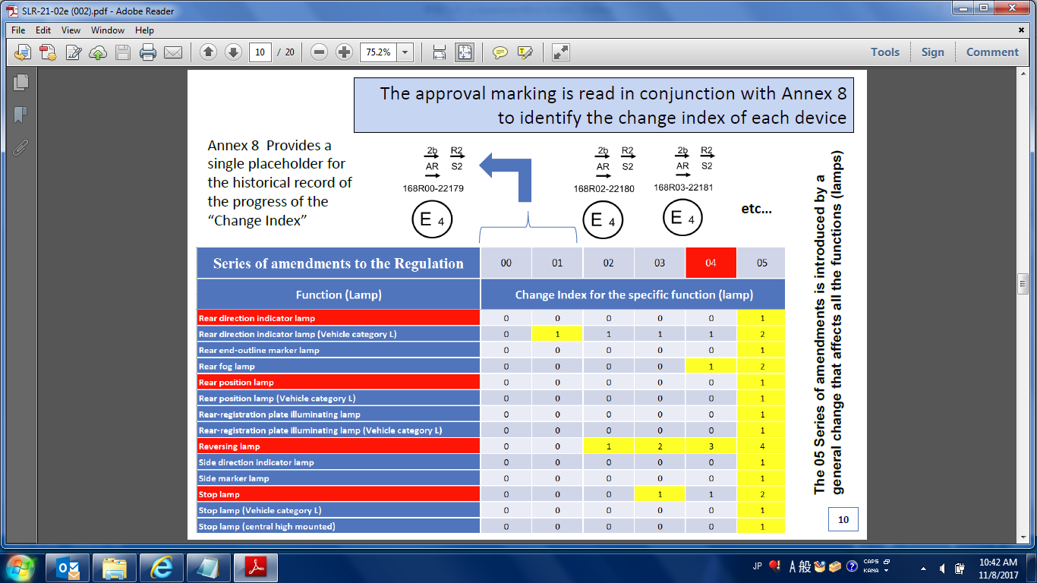
This figure shows only the case of extension approval.(Extension approval isn’t required in 01 Series)
Need to clarify also the cases of new approval as next page.

Slide 2
Series of amendments to the Regulation | 00 | 01 | 02 | 03 | 04 | 05
Case-1 : New Approval
Case-2 : Extension Approval provided that all lamp functions can fulfill the requirements of the latest series of amendment with no modification or small modification(s) under same device |  | Extension approval isn’t required.
2b R2
AR S2
2b R2
AR S2
2b R2
AR S2
2b R2
AR S2
2b R2
AR S2
2b R2
AR S2
Device doesn’t include function which requirement is changed stringently, but new series number has to be applied.
168R00-1111
168R01-2222
168R02-3333
168R03-4444
168R04-5555
168R05-6666
E4
E4
E4
E4
E4
E4
2b R2
AR S2
2b R2
AR S2
2b R2
AR S2
2b R2
AR S2
2b R2
AR S2
168R00-22179
168R02-22179
168R03-22179
168R04-22179
168R05-22179
E4
E4
E4
E4
E4

Slide 3
Approval Marking Example of a Combination of
Road illumination Devices and Light Signaling Devices
Low/High beam
headlamp
HCR RL
A 1b
DRL
Front direction
Indicator lamp
HCR RL
A 1b
Front position
lamp
169R03-22179
168R04-22179
168R04
169R03
E4
E4
R-169 series 03.
Approval number
22179
22179
It isn’t obligated to locate markings correlatively
between Reg. No/Series No and Function code.

