Slide 1
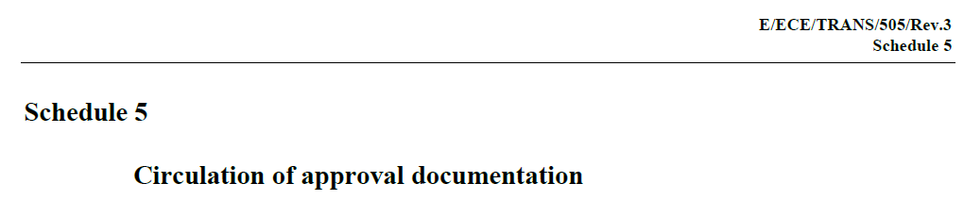
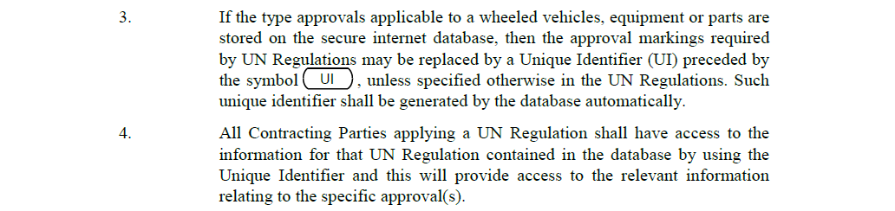
Transmitted by the GRE Chairman
Informal document WP.29-173-XX
173rd WP.29, 14-17 November 2017
Agenda item x.y.
SLR-21-07
Mandatory Application of the Unique Identifier (UI)
in the Simplified Lighting and Light –Signalling Regulations
E-ECE-TRANS-505-Rev.3e -Revision 3 of the 1958 Agreement - Schedule 5

Slide 2
Mandatory Application of the Unique Identifier (UI)
in the Simplified Lighting and Light –Signalling Regulations
GRE has concluded that it is necessary to implement the Unique Identifier (UI) as a mandatory requirement to replace the conventional type approval markings
If the type approvals applicable to a wheeled vehicles, equipment or parts are stored on the secure internet database,
then the approval markings required by UN Regulations may be replaced by a Unique Identifier (UI) preceded by the symbol , unless specified otherwise in the UN Regulations. Such unique identifier shall be generated by the database automatically.

Slide 3
Why do we need the Unique Identifier marking solution?
The use of the "Unique Identifier“ has been foreseen since June 2012 when WP29 launched the simplification activity. (ECE-TRANS-WP29-2012-119).
Mandatory use of Unique Identifier is a prerequisite for an effective transition towards the simplified lighting and light-signalling regulations.
The principle of grouping a number of devices into a single regulation is not compatible with the use of detailed approval markings on devices
With different markings for each device within one regulation the traditional marking becomes extremely complicated. This will be even more critical in the case of minimum performance based requirements (Phase 2 SLR).
Use of an electronic system of UI is a clear benefit compared to E-marking paper version processing. TAAs will be in position to identify the level of product compliance and performance more easily and will be able to relate it to products certified in different certification environments.

Slide 4
Why do we need the Unique Identifier marking solution?
Example of a CONVENTIONAL grouped approval marking for a device combining functions type approved to the new LSD and RID and RRD Regulations.
Indication of driving beam performance
Daytime Running Lamp
Low/High beam
headlamp
HCR -20 RL F3
A 1b IA
Front Fog lamp
Front position
lamp
Side retro-reflector
XXX R03 -22179
YYY R04 -22179
ZZZ R00 -22179
Front direction
Indicator lamp
E4
LSD Regulation series 03
RID Regulation series 04
RRD Regulation series 00
Approval number 22179
Note:
A type approval marking involving an AFS system would be far more complicated

Slide 5

Why do we need the Unique Identifier marking solution?
Example of a CONVENTIONAL grouped approval marking for a device combining functions type approved to the new LSD and RID and RRD Regulations.
Indication of driving beam performance
Daytime Running Lamp
Low/High beam
headlamp
HCR -20 RL F3
A 1b IA
Front Fog lamp
Front position
lamp
Side retro-reflector
XXX R03 -22179
YYY R04 -22179
ZZZ R00 -22179
Front direction
Indicator lamp
Note:
This grouped marking would be replaced by
E4
LSD Regulation series 03
RID Regulation series 04
RRD Regulation series 00
Approval number 22179
Note:
A type approval marking involving an AFS system would be far more complicated

Slide 6
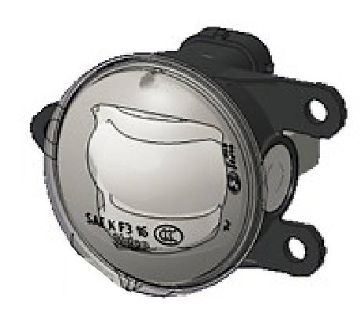
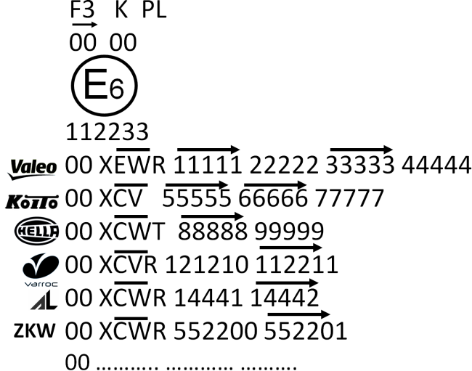
Why do we need the Unique Identifier marking solution?
EXAMPLE OF A CONVENTIONAL APPROVAL MARK OF A SINGLE ROAD ILLUMINATION DEVICE
Due to the size of this marking the optical working surface would be distorted, with the result of non-compliance of the photometric performance. Consequently the commercial exploitation of this device as a contributor to AFS systems is not possible.
The only visible part of the device when the lamp is fitted on the vehicle is the lens (80% optical area) Ø60mm
ALL this CONVENTIONAL marking shall be visible when the lamp is fitted on the vehicle

Slide 7
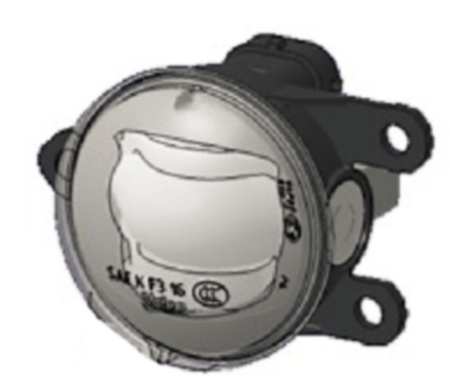
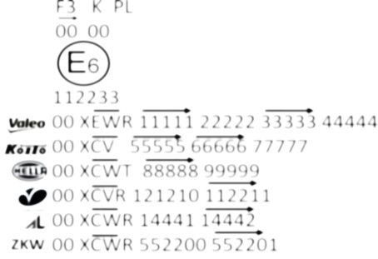
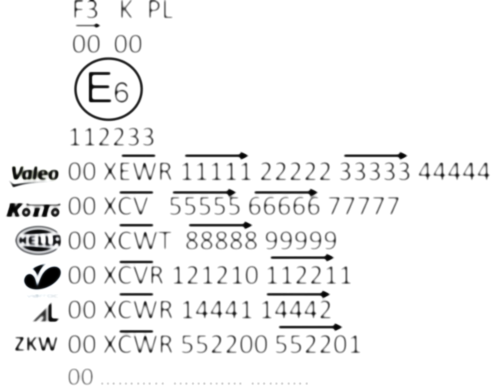

Why do we need the Unique Identifier marking solution?
EXAMPLE OF A CONVENTIONAL APPROVAL MARK OF A SINGLE ROAD ILLUMINATION DEVICE
Due to the size of this marking the optical working surface would be distorted, with the result of non-compliance of the photometric performance. Consequently the commercial exploitation of this device as a contributor to AFS systems is not possible.
45 mm
35 mm (or more)
The only visible part of the device when the lamp is fitted on the vehicle is the lens (80% optical area) Ø60mm
These markings would be replaced by the UI
ALL this CONVENTIONAL marking shall be visible when the lamp is fitted on the vehicle

