Slide 1
Transmitted by The International Automotive Lighting and Light-signalling Expert Group
SLR-21-08/Rev.1
2017-12-21
Preparation of a detailed proposal concerning Conventional Type Approval Markings
and the Application of the Unique Identifier (UI) for decision at the SLR 21st Session
Dear “Simplificators” ,
I have prepared this document with the intention of explaining my latest understanding of how the approach developed at GRE-78 can be implemented into the new Simplified Regulations.
Now I kindly invite you to study this document and send me your comments, objections and suggestions. Time is very short because the next SLR meeting on 18-21 December is the deadline to agree upon a solution as finalised, formal drafts of the LSD, RID and RRD Regulations shall be prepared for submission to GRE for its 79th session.
If you are able to propose corrections and improvements to my proposal please send these to me by email as soon as possible and certainly before 15 December 2017.
Thanking you for your support,
Geoff Draper
1

Slide 2
Transmitted by The International Automotive Lighting and Light-signalling Expert Group
SLR-21-08/Rev.1
2017-12-21
Conventional Type Approval Markings
and the Application of the Unique Identifier (UI)
This document is the result of discussions and agreements at GRE-78, the IWG-DETA-30 and IWG-IWVTA-25 sessions and WP29-173.
The GRE case for mandating the UI for Lighting and Light-Signalling Regulations is outlined in
SLR-21-07 (UI Presentation for 173rd WP29 session). The GRE Chairman clearly stated this during his GRE Report at the 173rd WP.29 session.
Revision 3 of the 1958 Agreement (E-ECE-TRANS-505-Rev.3e) – Schedule 5 requires
“……. the secure internet database established by the United Nations Economic Commission for Europe” and also states
“If the type approvals ….. are stored on the secure internet database, then the approval markings required by UN Regulations may be replaced by a Unique Identifier (UI) preceded by the symbol , unless specified otherwise in the UN Regulations. Such unique identifier shall be generated by the database automatically.”
The following pages explain the use of the “Change Index” and how it is applied to conventional type approval markings and to the application of the UI.
2

Slide 3
DRAFT Definition of “Change Index” in the Simplified Regulations
(LSD, RID, RRD)
This Regulation incorporates all [Light Signalling Devices / Road Illuminating Devices / Retro-reflective Devices] but follows the General Guidelines for UNECE Regulatory Procedures and Transitional Provisions in UNECE Regulations contained in [TRANS/WP.29/1044 Rev.1). – under amendment by WP.29 - ECE/TRANS/WP.29/2017/107] Consequently, any change to the provisions of this UN Regulation, that is subject to a new series of amendments, applies to the entire Regulation, even if the change is only affecting one, or more devices.
Although this whole UN Regulation becomes subject to the new series of amendments the actual progress of amendments related to each device may not correspond to the overall status of this Regulation. To correctly manage the applicable series of amendments for each device, this Regulation includes transitional provisions that clearly indicate which devices are subject to the amendments introduced into the latest series, along with their introduction dates.
A summary of the actual regulatory status applicable to each device is included in a table as part of the main text of this UN Regulation. This table includes a “change index” that indicates the progress of amendments of the particular device in relation to the changes in the series of amendment of this complete Regulation. Reference to the “change index” is included in the communication form of Annex 1 of this UN Regulation.
3

Slide 4
The Application of the “Change Index” to the Simplified Regulations
(LSD, RID, RRD)
Text agreed by GRE at its 78th session
A device type approved according to a lower level of series of amendments to this regulation may be installed on a new type of vehicle, provided that the change index related to each individual lamp, being part of this device, does not differ from that indicated in Table [2].
A new series of amendments shall have no impact on existing devices, type approved according to previous series of amendments to this regulation, provided that the change index related to each individual lamp, being part of this device, does not differ from that indicated in Table [2]. In this case no impact means no modification or update of the type approval documents and markings on the device is required.
4

Slide 5
Current Approach to the Application of Type Approval Markings in case of modifications of approved products or of UN Regulations (Based on WP29 IWG IWVTA SG58-23-04 (Latest draft 10 November 2017)
 | Product status | Regulation update | Impact on approval | Impact on the Communication Document | Impact on UN type approval marking
1 | New product | - | New approval | Approval no (’s) issued; New communication document | Approval no(’s) issued; UN type approval marking(s) on the new product
2 | Modification of the product, no impact on approval | - | No impact | No impact | No impact
3 | Modification of the product with impact on approval | - | Extension required | Communication document updated with details of the extension | No impact
4 | Modification of the product which exceeds its type definition | - | New approval | New approval no (’s) issued; New communication document | New approval no(’s) issued; new UN type approval marking(s) on the new product
5 | No product modification, product already complies with the new series of amendments to UN Regulation | Update of UN Regulation, new series of amendments | Extension of approval with indication of the new series of amendments | Communication document updated with details of the extension | New UN type approval marking(s) on the UN-MODIFIED product (because of the change of series of amendments )
6 | Modification of the product to provide for compliance with the new series of amendments to UN Regulation, not exceeding type definition
 |  |  |  |  | New UN type approval marking(s) on the MODIFIED product because of the change of series of amendments )
5

Slide 6
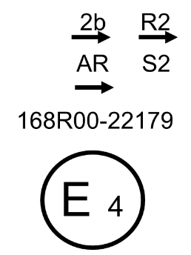
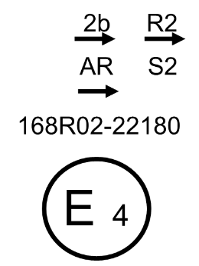
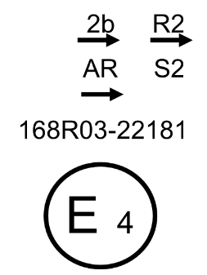
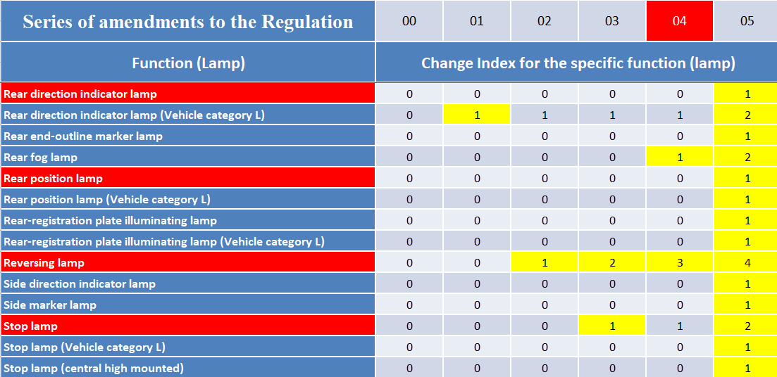
Underlying Principles of Approval Marking for the LSD Regulation
- Example extracted from Table [2] of the Regulation
(Series of amendments and the Change Index for the specific function (lamp) )
The 05 Series of amendments is introduced by a general change that affects all the functions (lamps)
etc…
6

Slide 7
Example of a Single LSD Approval Marking
2b
168R04-22179
E 4
R-168 series 04.
Approval number 22179
7

Slide 8
Example of a Combined LSD Approval Marking
2b
R2
AR
S2
168R04-22179
E 4
R-168 series 04.
Approval number 22179
8

Slide 9
Example of a Combined LSD-RID Approval Marking
A
HCR PL 30
F3
1a
169R02
168R04
E 4
R-169 series 02.
R-168 series 04.
73571
Approval number 73571
9

Slide 10
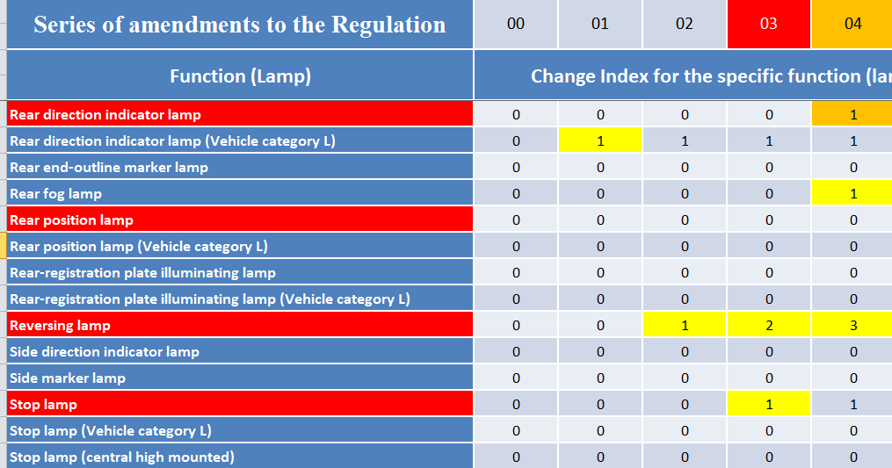
Underlying Principles of Approval Marking for the LSD Regulation
- Example extracted from Table [2] of the Regulation
(Series of amendments and the Change Index for the specific function (lamp) )
Extension of Approval
04
Change Index for the specific function (lamp)
Rear direction indicator lamp
1
2
10

Slide 11
LSD Marking examples – Extension of Approval
● Basic type approval,
03 series of amendment
● Extension of the direction indicator lamp approval according to 04 series of amendment
2b
R2
2b
R2
AR
S2
AR
S2
168R03
168R04
E 4
E 4
● No extension required for the other 3 functions (lamps)
22179
22179
11

Slide 12
Underlying Principles of the Application of the UI to Replace Approval Markings
for the Simplified Regulations (LSD, RID, RRD)
(Note: Is a definition of “Unique Identifier” required in R48)
“Unique Identifier ” means the mark on the device that includes a unique sequential number issued by the type approval authority. This number is the key to entry into the UN secure internet database, as described in Schedule 5 of the 1958 Agreement where all type approval documentation is held.
The format of the “Unique Identifier (UI) ” marking is:
The “Unique Identifier ” replaces all the Type Approval Markings on the device. It is THE “Unique” identifier for the device and therefore shall conform to the format shown above and shall not have other markings associated with it. Note: other markings will be present on the device, as required by the Regulation but these should be clearly separated from the UI.
The “Unique Identifier ” is automatically generated by the database when the type approval authority uploads the communication form following the granting of a type approval for a new device, or the extension of an existing approval. The table on page 14 provides a detailed explanation. Therefore, in the case of an extension to an existing approval, a new “Unique Identifier ” will be generated and the marking on the device shall be updated.
The over-riding principle is that there is NO direct relationship between the Type Approval Number and the “Unique Identifier ”, i.e. In the case of an extension to an existing approval the Type Approval Number will not change but the “Unique Identifier ” will change. (Note: In the case of conventional markings an extension to an existing type approval also involves a change to the marking, to relate to the corresponding series of amendments)
12

Slide 13
FOR REFERENCE - ECE/TRANS/WP.29/2017/107 – Paragraph VIII.
Circulation of type-approval documentation, use of the secure internet database and use of a Unique Identifier
When drafting a new UN Regulation or an amendment of a UN Regulation, the subsidiary bodies of WP.29 shall bear in mind the general principle that the distribution of type-approval documentation can be performed by using the secure internet database established by UNECE and that, in principle, the approval marking may be replaced by a Unique Identifier, generated by that database application. The subsidiary bodies shall make a reference to Schedule 5 of Revision 3 of the 1958 Agreement and may specify:
(a) that the circulation of type-approval documentation has to be performed by using the secure internet database; and / or
(b) that the approval marking may not be replaced by a Unique Identifier.
(Draper comment – The sentence above makes no sense and should read as follows: “(a) that the circulation of type-approval documentation has to be performed by using the secure internet database; and (b) that the approval marking may / may not be replaced by a Unique Identifier.
51. In the absence of such specification, and where the approval documentation is stored on the secure internet database, the approval markings required by UN Regulations may be replaced by the Unique Identifier.
52. For consistency throughout the UN Regulations, the following text is suggested to be included in the chapter "Approval" of the UN Regulation;
For case (a) of paragraph 50 above: "Notice of approval or of extension, refusal or withdrawal of approval of a vehicle type pursuant to this UN Regulation shall be communicated by means of a secure internet database in accordance with Schedule 5 of the 1958 Agreement to the Contracting Parties applying this UN Regulation, using the communication form conforming to the model in Annex ...";
For case (b) of paragraph 50 above: "The approval mark prescribed in paragraph …. above may not be replaced by a Unique Identifier (UI) as referred to in Schedule 5 of the 1958 Agreement.". (Draper: See my comment highlighted above)
Where the Unique Identifier replaces the approval marking, a template shall be added to the chapter "Arrangement of the type-approval marking", following:
"type-approval marking using the Unique Identifier referred to in paragraph … of this UN Regulation.“.
54. The above Unique Identifier shows that the type concerned has been approved and that the relevant information on that type-approval can be accessed on the UN secure internet database by using 270650 as Unique Identifier. Any leading zeros in the Unique Identifier may be omitted in the approval marking.
55. Finally, the subsidiary bodies of WP.29 may consider clarifying that, in the case the Unique Identifier replaces the approval mark, all provisions with regard to the legibility, location of the marking on the product, etc., also apply to the Unique Identifier.
13

Slide 14
General guidelines on the use of the UI in case of modifications of approved products or of UN Regulations.
Based on WP29 IWG IWVTA SG58-23-04 (Latest draft 10 November 2017)
 | Product status | Regulation update | Impact on approval | Impact on the Communication Document | Impact on UN type approval marking (current) | Impact on UI marking (with database)
1 | New product | - | New approval | Approval no (’s) issued; New communication document | Approval no(’s) issued; UN type approval marking(s) on the new product | Approval no (‘s) linked to a UI UI marking on the product
2 | Modification of the product, no impact on approval | - | No impact | No impact | No impact | No impact
3 | Modification of the product with impact on approval | - | Extension required | Communication document updated with details of the extension | No impact | No impact
4 | Modification of the product which exceeds its type definition | - | New approval | New approval no (’s) issued; New communication document | New approval no(’s) issued; new UN type approval marking(s) on the new product | New approval no (‘s) linked to a new UI New UI marking on the product
5 | No product modification, product already complies with the new series of amendments to UN Regulation | Update of UN Regulation, new series of amendments | Extension of approval with indication of the new series of amendments | Communication document updated with details of the extension | New UN type approval marking(s) on the UN-MODIFIED product (because of the change of series of amendments ) | No Impact (*) because the product is un-modified
6 | Modification of the product to provide for compliance with the new series of amendments to UN Regulation, not exceeding type definition
 |  |  |  |  | New UN type approval marking(s) on the MODIFIED product because of the change of series of amendments ) | New UI marking on the modified product
14
(*) Note: Please refer to the next page because of comments submitted by the expert of Japan in SG-58-23-04

Slide 15
5 | No product modification, product already complies with the new series of amendments to UN Regulation | Update of UN Regulation, new series of amendments | Extension of approval with indication of the new series of amendments | Communication document updated with details of the extension | New UN type approval marking(s) on the UN-MODIFIED product (because of the change of series ) | No Impact (*) because the product is un-modified
6 | Modification of the product to provide for compliance with the new series of amendments to UN Regulation, not exceeding type definition
 |  |  |  |  | New UN type approval marking(s) on the MODIFIED product because of the change of series | New UI marking on the modified product
(*) Comment submitted by the expert of Japan in SG-58-23-04
There might be some cases where distinction by UI would be necessary between the products complying with the new series of amendments and that complying with the former series of amendments.
Distinction by UI between product A and product A’ might be necessary in the following case.
Reason: The performance of product A and that of product A’ is different. Accordingly product A complies with only the original UN Regulation xx whereas product A’ complies with 01 series of UN Regulation xx.
Product status | UN Regulation Update | Impact on approval | Impact on UI
new product = product A | original UN Rxx | new approval | new UI marking
modified product = product A’ | original UN Rxx | extention of approval | no impact on UI
----------------01 series of amendments to UN Rxx was adopted and entered into force.-------------
no modification of product A’ | 01 series of UN Rxx | extention of approval | no impact on UI
15

Slide 16
5 | No product modification, product already complies with the new series of amendments to UN Regulation | Update of UN Regulation, new series of amendments | Extension of approval with indication of the new series of amendments | Communication document updated with details of the extension | New UN type approval marking(s) on the UN-MODIFIED product (because of the change of series ) | No Impact (*) because the product is un-modified
6 | Modification of the product to provide for compliance with the new series of amendments to UN Regulation, not exceeding type definition
 |  |  |  |  | New UN type approval marking(s) on the MODIFIED product because of the change of series | New UI marking on the modified product
CONCLUSION:
Taking account of the comment from the expert of Japan it is necessary to adopt the same rule for the UI as for that applying today to markings in the case of an approval or an extension to a new series of amendments:
i.e. A new UI number shall be issued to correspond to a change in the status of the approval that will be indicated in the communication document
(*) Comment submitted by the expert of Japan in SG-58-23-04
There might be some cases where distinction by UI would be necessary between the products complying with the new series of amendments and that complying with the former series of amendments.
Distinction by UI between product A and product A’ might be necessary in the following case.
Reason: The performance of product A and that of product A’ is different. Accordingly product A complies with only the original UN Regulation xx whereas product A’ complies with 01 series of UN Regulation xx.
Product status | UN Regulation Update | Impact on approval | Impact on UI
new product = product A | original UN Rxx | new approval | new UI marking
modified product = product A’ | original UN Rxx | extention of approval | no impact on UI
----------------01 series of amendments to UN Rxx was adopted and entered into force.-------------
no modification of product A’ | 01 series of UN Rxx | extention of approval | no impact on UI
16

Slide 17
PROPOSED APPROACH to the use of the UI in case of modifications of approved products or of UN Regulations.
Based on WP29 IWG IWVTA SG58-23-04 (Latest draft 10 November 2017)
 | Product status | Regulation update | Impact on approval | Impact on the Communication Document | Impact on UN type approval marking (current) | Impact on UI marking (with database)
1 | New product | - | New approval | Approval no (’s) issued; New communication document | Approval no(’s) issued; UN type approval marking(s) on the new product | Approval no (‘s) linked to a UI UI marking on the product
2 | Modification of the product, no impact on approval | - | No impact | No impact | No impact | No impact
3 | Modification of the product with impact on approval | - | Extension required | Communication document updated with details of the extension | No impact | No impact
4 | Modification of the product which exceeds its type definition | - | New approval | New approval no (’s) issued; New communication document | New approval no(’s) issued; new UN type approval marking(s) on the new product | New approval no (‘s) linked to a new UI New UI marking on the product
5 | No product modification, product already complies with the new series of amendments to UN Regulation | Update of UN Regulation, new series of amendments | Extension of approval with indication of the new series of amendments | Communication document updated with details of the extension | New UN type approval marking(s) on the UN-MODIFIED product (because of the change of series ) | New UI marking on the un-modified product
6 | Modification of the product to provide for compliance with the new series of amendments to UN Regulation, not exceeding type definition
 |  |  |  |  | New UN type approval marking(s) on the MODIFIED product because of the change of series | New UI marking on the modified product
17

Slide 18
Use of the “Unique Identifier” with other markings on the Device
The UI only acts as a substitute for the Type Approval Markings
Additional markings are required on the device(s) as defined in the text of the Regulation but shall be located away from the UI to avoid confusion.
Additional markings associated with specific functions (lamps) shall be shown with the corresponding symbol for that function.
Only the symbols that relate to functions having specific marking requirements will be shown.
example:
Combined LSD Approval Marking
3918341
2b
R2
A
(Note:
The RID Regulation contains more cases where functions have particular marking requirements – particularly for AFS)
Question: As the UI uniquely represents a specific type approval and its communication form is it necessary to include all these function specific additional markings on the device?
18

Slide 19
Examples of current Type Approval Markings and the Equivalent UI Marking
Only the symbols that relate to functions having specific marking requirements will be included.
Question: As the UI uniquely represents a specific type approval and its communication form is it necessary to include all these additional function specific markings on the device ?
19

Slide 20
Further work to be completed before SLR-21
Draft a definition of “change index”
Amend the draft LSD, RID and RRD Regulations to incorporate this approach in the main body and annexes
Add a clear guidance in Annex 7 on how to apply the markings
Amend the table 2 to include the change index and its progression as the series of amendments is updated.
Produce a draft proposal for the text of the Regulation that would apply to:
  conventional markings
  and
  b) the use of the UI
Question: Is it necessary to produce a text that includes both conventional markings and the UI as alternatives, or should we only draft a version mandating the use of the UI?
20

