Slide 1
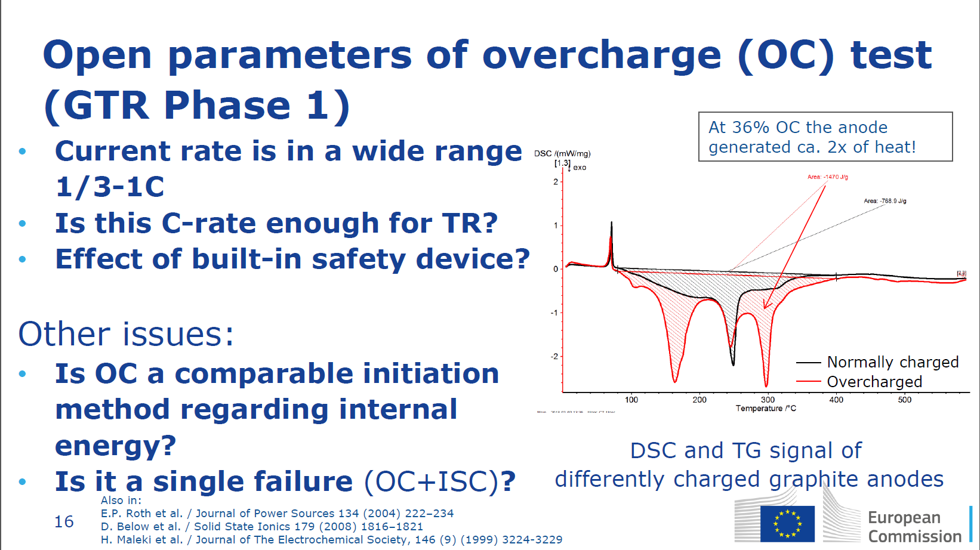
EVS-1534-612 Comments
An internal short circuit would not be protected by a PTC, CID, or similar cell safety device
In order to more accurately replicate a internal short circuit using the overcharge test method these devices could be disabled.

