Slide 1
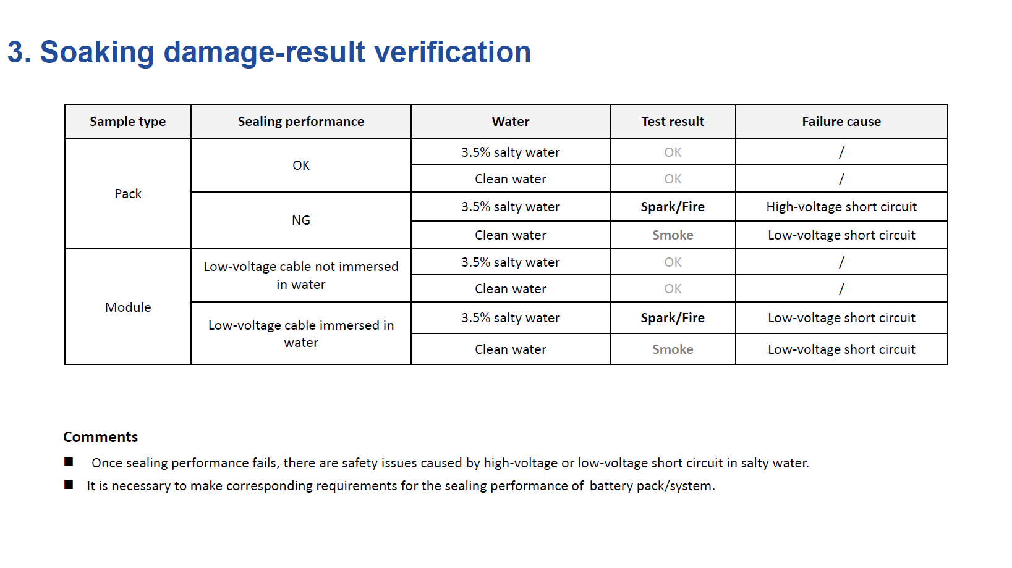
EVS-1543-102 Comments
Agree that the goal should not be to prove tolerance to saltwater ingress, but rather prove proper sealing performance

Slide 2
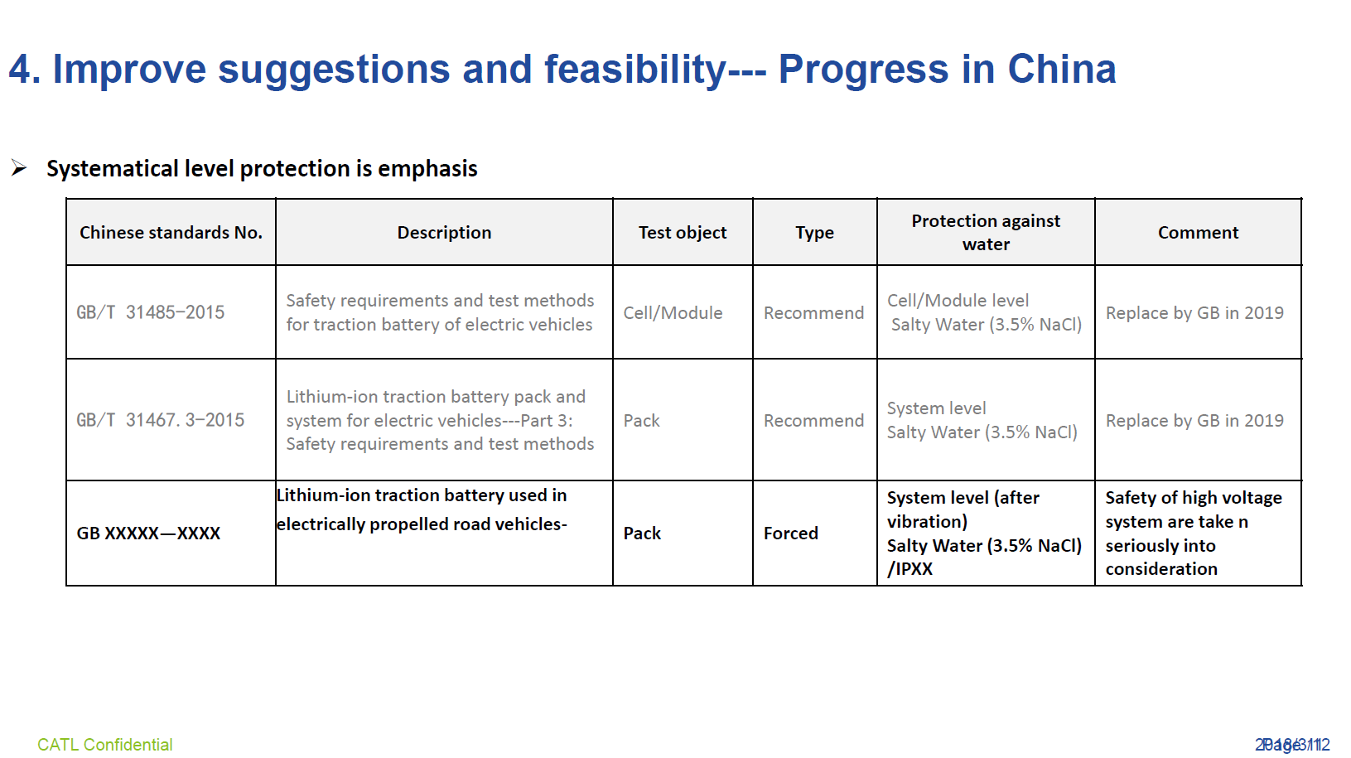
EVS-1543-102 Comments
Post-vibe immersion testing does not seem unreasonable however it is not clear that vibe will properly accelerate sealing performance and may cause an unrepresentative leak

