Slide 1
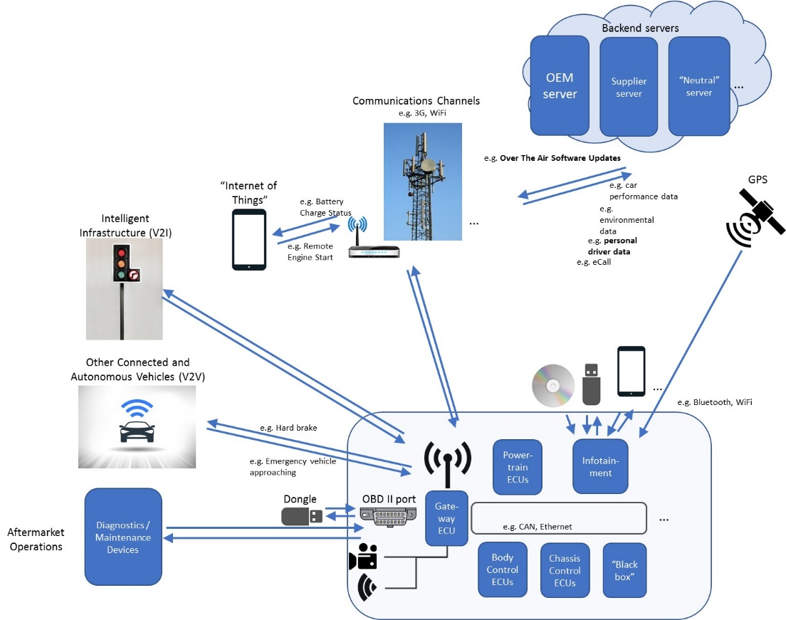
Submitted by the Secretary
TFCS-09-12
Original image
provided by OICA/CLEPA

Slide 2
Submitted by the Secretary
TFCS-09-12
Communication
channels
Revised overview
(OICA draft)
WWW
e.g. 3G, WiFi, ...
„Internet of
Things“
e.g. Battery status,
Vehicle functionalities, ...
OEM
Server
Supplier
Server
„Neutral“
Server
SD
e.g. Over the air
Updates, performance
data, eCall...
Backend Servers
GNSS
V2V
@
P/T
ECUs
Chassis
ECUs
Body
ECUs
Infotainment
V2I
Camera
Gateway
ECUs
Black
Box
External storage devices /
Nomadic devices
Radar, ...
e.g. CAN, Ethernet, ...
Design & Development
Production & Distribution
Use
End of
Life
Grid connection,
incl. smart charging
Diagnostic/
Maintenance Tools
OBD II
GNSS – Global Navigation Satelite System , V2V – Vehice-to-Vehicle , V2I – Vehicle-to-Infrastructure , P/T – Powertrain , ECU – Electronic Control Unit , OBD – On Board Diagnostic

Slide 3
Revised overview
FIA (draft)
Communication
channels
Automotive Gateway
ADMIN
Service Providers
e.g. 3G, WiFi, ...
OEM
SD
e.g. Services like e.g. Over the Sir Updates, Performance Data,
eCall, Battery Status, Vehicle Functionalities
GNSS
TCU
In-Vehicle-Network
V2V
@
P/T
ECUs
Chassis
ECUs
Body
ECUs
Infotainment
Camera
Automotive
Gateway
V2I
Black
Box
External storage devices /
Nomadic devices
Radar, ...
e.g. CAN, Ethernet, ...
Design & Development
Production & Distribution
Use
End of
Life
EV: Grid connection,
incl. smart charging
Diagnostic/
Maintenance Tools
OBD II
GNSS – Global Navigation Satelite System , V2V – Vehice-to-Vehicle , V2I – Vehicle-to-Infrastructure , P/T – Powertrain , ECU – Electronic Control Unit , OBD – On Board Diagnostic

