Slide 1
Quick investigation of selected cap-holder systems
IEC

Slide 2
SV8.5

Slide 3
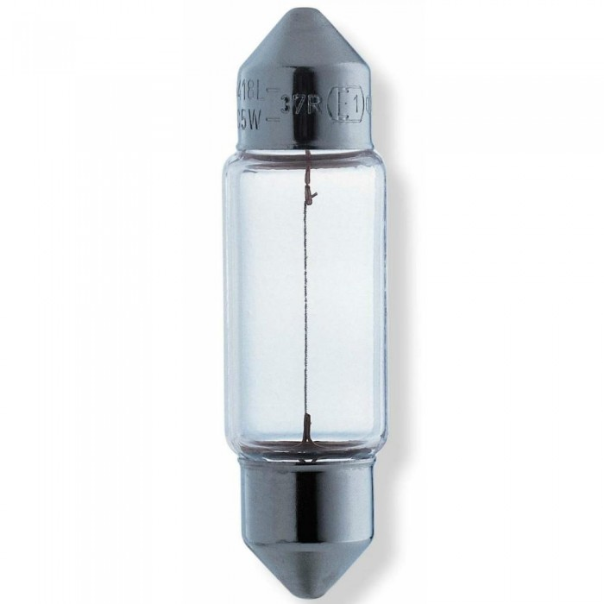
Analysis of Mechanical Keying (Cap/holder)
C5W / C21W family
The same cap/holder system SV8.5 (without additional keying) is used by the following categories:
C5W – 6V (35mm)
C5W – 12V (35mm)
C5W – 24V (35mm)
C21W – 12V (41mm)
Mis-insertion (mis-use) is prevented by:
2 different lengths (5W and 21W)
Information on the package (category and voltage)
Information on the light source (category and voltage)
Information on the luminaire (category and voltage)
Example: C5W

Slide 4
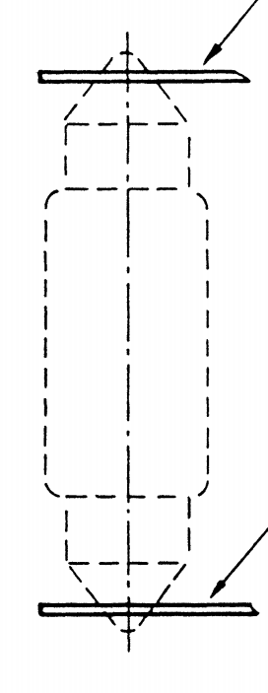
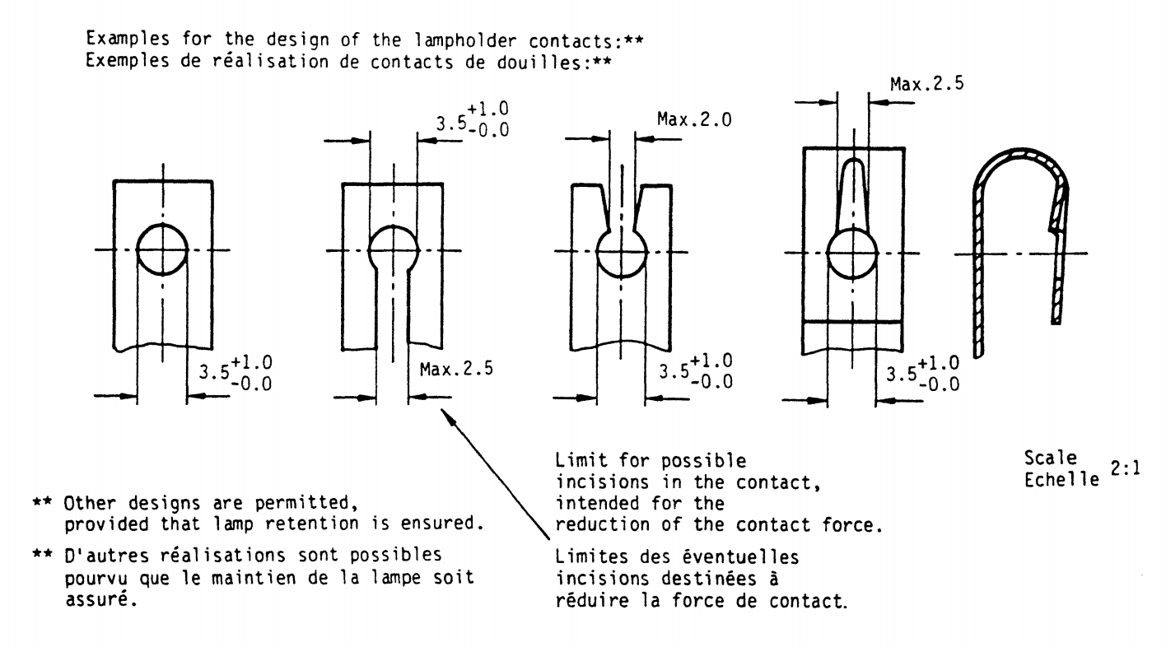
The holder system “SV8.5” (IEC 60061-2 7005-81)
"quick investigation, IEC"
Only the “circular whole of 3,5mm diameter” is defined. No dimensions defined that would allow keying features

Slide 5
W2.1x9.5d

Slide 6
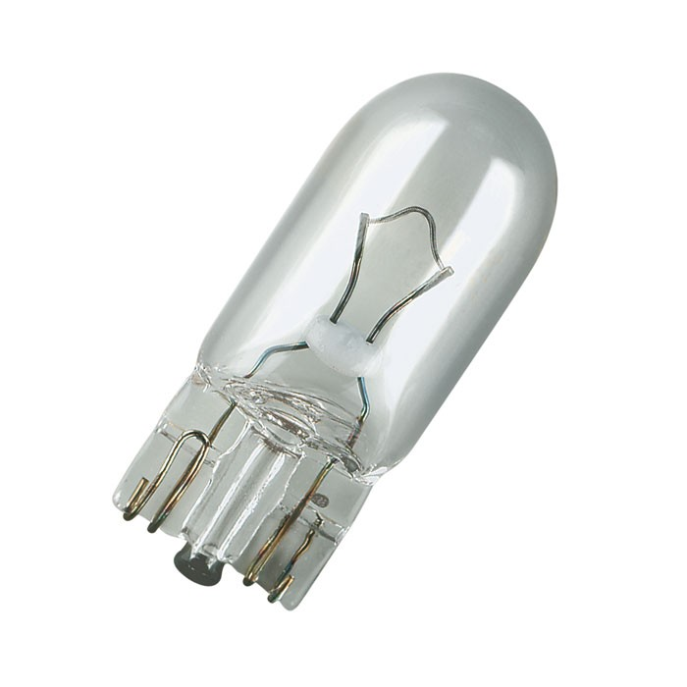
Analysis of Mechanical Keying (Cap/holder)
W3W / W5W / W10W / W16W-family
The same cap/holder system W2.1x9.5d (without additional keying) is used by the following categories:
W3W – 6V
W3W – 12V
W3W – 24V
W5W – 6V
W5W – 12V
W5W – 24V
WY5W – 6V
WY5W – 12V
WY5W – 24V
WR5W – 12V
WR5W – 24V
W10W – 6V
W10W – 12V
WY10W – 6V
WY10W – 12V
W16W – 12V
WY16W – 12V
Mis-insertion (mis-use) is prevented by:
Information on the package (category and voltage)
Information on the light source (category and voltage)
Information on the luminaire (category and voltage)
Example: W5W

Slide 7
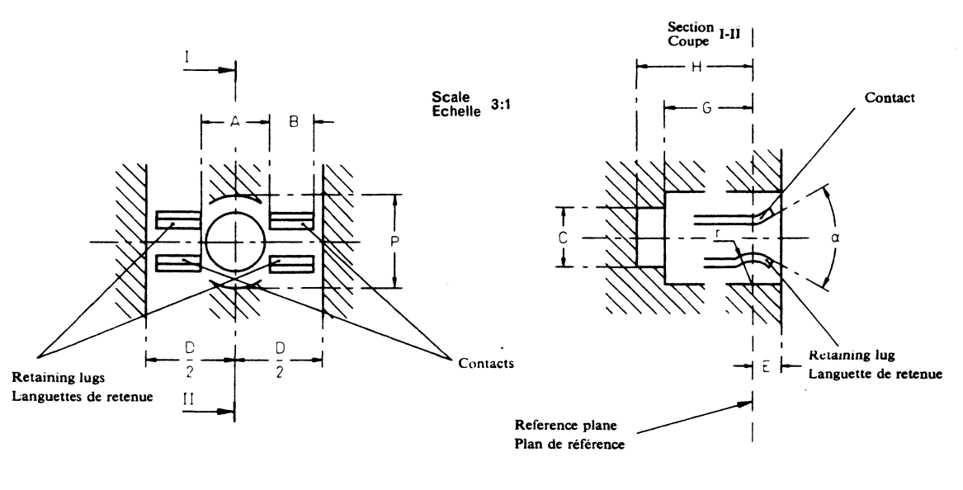
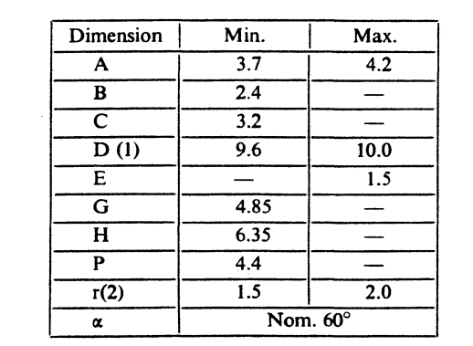
The holder system “W2.1x9.5d” (IEC 60061-2 7005-91)
G, H and C have no maximum-> no keying-feature possible in this direction
P has no maximum
-> no keying-feature possible in this direction
D has a maximum, but this surface is needed to fix the light source in the correct position -> no keying-feature possible in this direction
(See also note 1)

Slide 8
BA(...)15

Slide 9
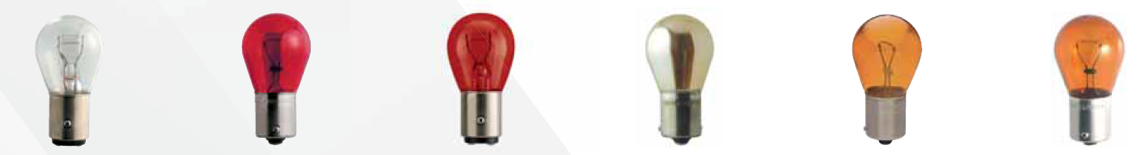
Analysis of Mechanical Keying (Cap/holder) Bayonet 15 mm family
B15d/s, BA15d/s, BA15d/s-3(100°/130°) BAU 15d/s, BAWd/s, BAX15d/s, BAY15d/s, BAZ15d/s
The cap/holder family B(A)(AU)(AW)(AX)(AY)(AZ)15d/s , exists in the following combinations:
(categories for automotive and lamps for general lighting):
B15d General lighting services
BA15d General lighting services
BA15s P21W (6V, 12V & 24V)
R5W (6V, 12V & 24V)
R10W (6V, 12V & 24V)
BAX15d S4 (6V & 12V)
BAX15s (reserved)
BAY15d P21/5W (6V, 12V & 24V)
BAY15s (reserved)
BAZ15d P21/4W (6V, 12V & 24V)
BAZ15s
BAU15d PR21/4W (12V & 24V)
BAU15s PY21W (12V & 24V)
RY10W (6V, 12V & 24V)
BA15d/s-3(100°/130°) PY21/5W (12V)
BAW15d - PR21/5 (12V & 24V)
BAW15s PR21W (12V & 24V)
RR10W (6V, 12V & 24V)
RR5W (6V, 12V & 24V)
Mis-insertion (mis-use) is prevented by:
Information on the package (category and voltage)
Information on the light source (category and voltage)
Information on the luminaire (category and voltage)

Slide 10
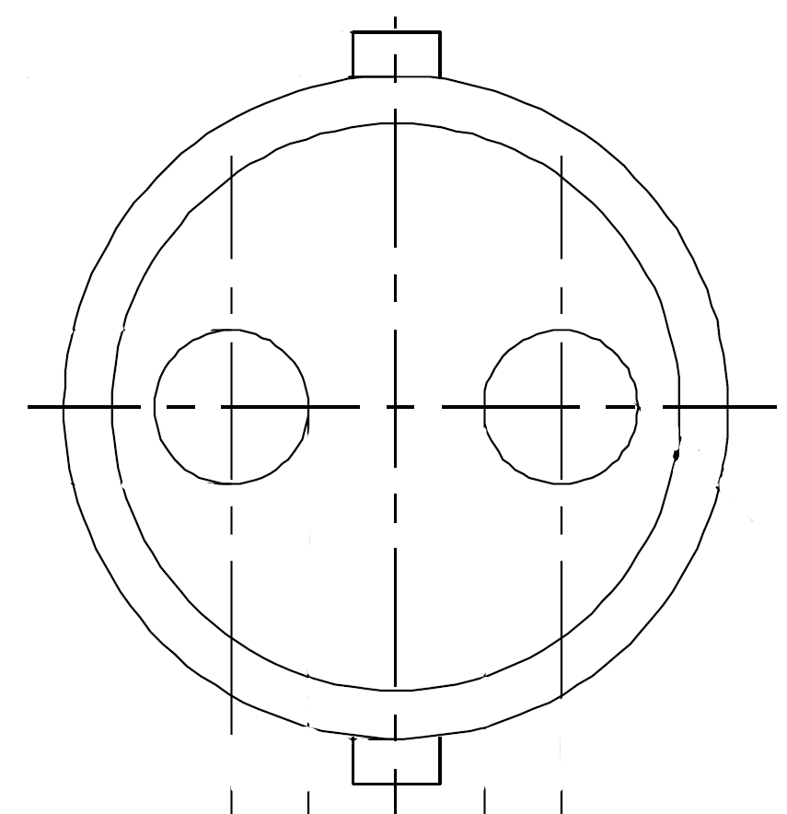
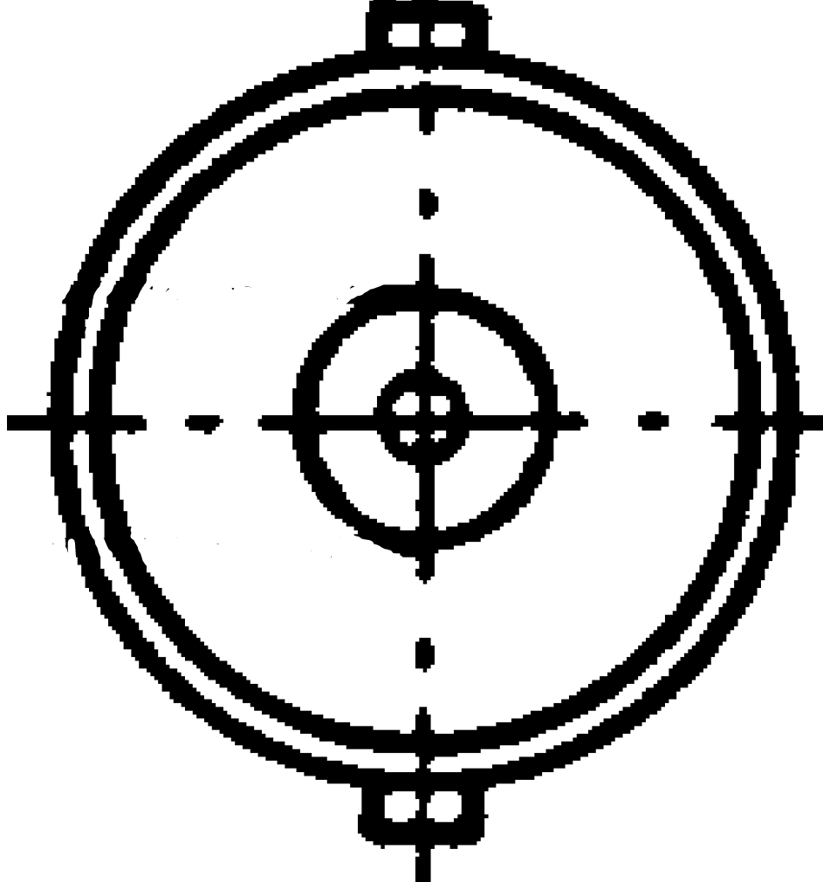
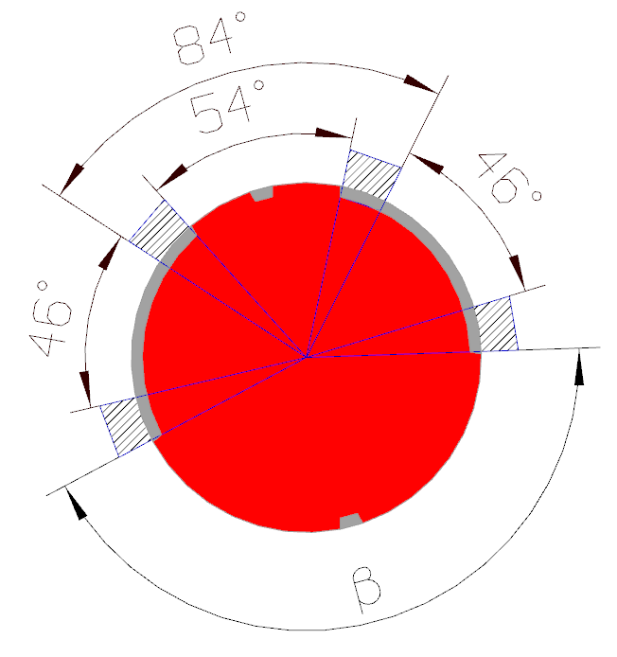
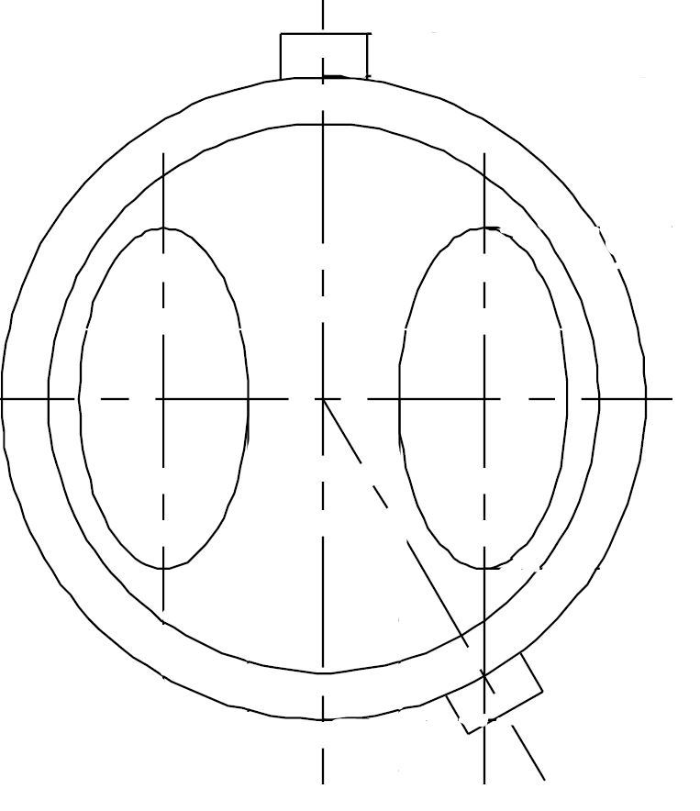
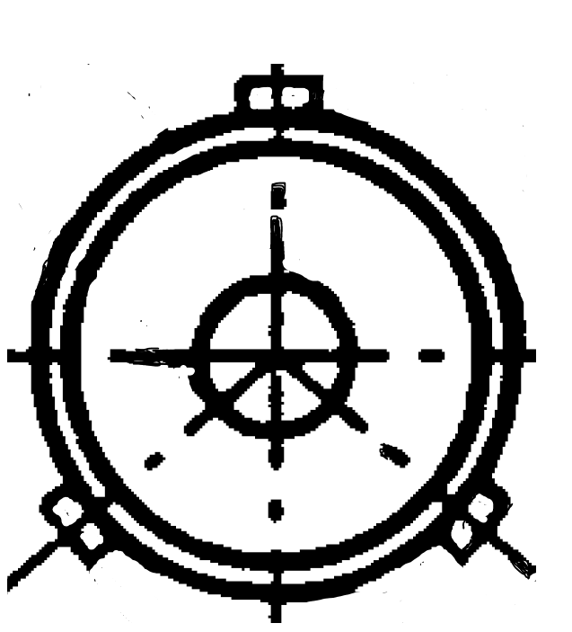
The BA(…)15 holder system (IEC 60061-2 7005-11”X”)
54° is used by a single pin including the movement in the holder design
Remaining area 2 x 46° for an “extra pin” is to small:
Minimum 54° is required for a single pin, including it’s movement.
Hatched area’s represent the holder material required for the holder construction (enabling movement stop position for the cap)
Family of key functions:
Single contact / double contact
2nd pin on 180°
2nd pin on +150°
2nd pin on -150°
2nd pin on +130° & 3rd pin on -130°
Resulting occupied space in angular positions
β is occupied by bayonet15 mm family by:
- 2nd and 3rd pin
- movement of the pin in the holder design

