Slide 1
ASEP
IMMA inputs to R51 ASEP IWG
12 Sept 2018

Slide 2
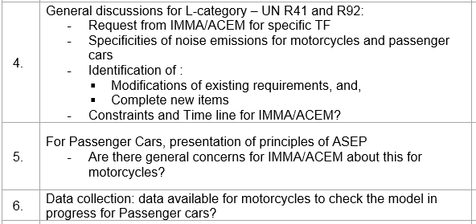
R51 ASEP IWG Motorcycle related agenda items:

Slide 3
IMMA committed to improve ‘real world’ motorcycle noise:
IMMA is aligned with the position of Germany, as in GRB-66-12:
  ‘Reduce sound level limits in a moderate way and take a bigger focus on Manipulation, Loop-holes, Grey-Areas and enforcement in near future!’
IMMA Approach:
  Short term : R41 Mandatory ASEP → GRB/2018/11
  Medium term: Expand the ASEP provisions to reflect better real world noise:
    Test in any throttle position allowed
    Widen the vehicle speed boundaries to 20 – 100 km/h
    Test in all gears
    Keep current mistery points concept (=additional operating conditions) to keep testing burden realistic
    Technical details are being evaluated and worked out
IMMA requests a dedicated R41 Task Force to take into account Motorcycle particularities

Slide 4
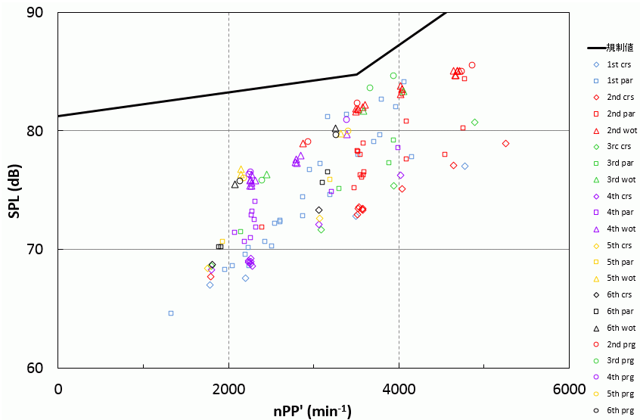
Current R41.04 ASEP test method can reflect better real world driving circumstances by expanding the test conditions
Sample of ASEP test results with a motorcycle with exhaust flaps:
limit
- Any throttle:
  -WOT
  -Cruising
  -Partial
  -Progressive
Any gear
Expanded speed range (incl. 20-100kmh)

Slide 5
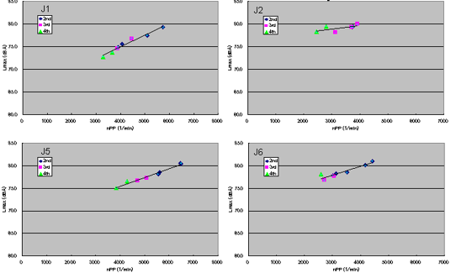
Motorcycle noise has good correlation with engine speed due to low influence of tyre noise and open architecture of the motorcycle’s engine (no covering).
Reference from document “IMMA/JAMA proposal for ASEP 2006/11/22”

Slide 6
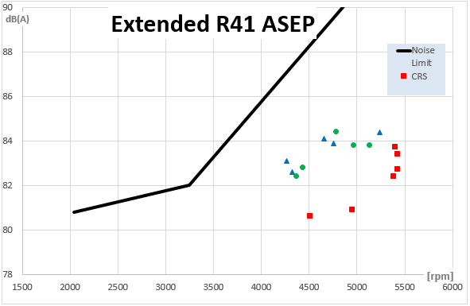
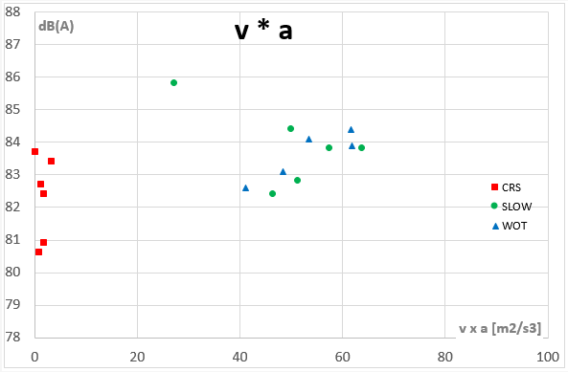
Extended R41 ASEP and v*a concept
Motorcycle with PMR 200W/kg
Good correlation between rpm and sound level
Lack of correlation between v*a and sound level
‘CRS’ = Cruise = constant speed
‘Slow’ = Throttle smoothly and fully opened
‘WOT’ = (instant) Wide Open Throttle (as currently in Annex 7 of R41-04)

Slide 7
Timeline: Revised R41 ASEP proposal ready by end 2019.
Motorcycle ASEP discussions should be finished on time before the initiatives on lower Type Approval limit values* start, because IMMA believes only lowering Type Approval limits will not solve the real world sound emission issue.
*EC proposal on lower Type Approval limit values expected end 2019.
Starting a completely new ASEP approach (currently not engineered for motorcycles) will need new limits as well and is not expected to meet the above timeline.

Slide 8
Conclusion:
A dedicated Motorcycle sub-group can take into account Motorcycle needs in terms of technical differences and timeline.
Thank you for your attention

