Slide 1
Informal Document - ACSF-17-01
17th ACSF Informal meeting
Informal meeting Date: April 11th – 13th, 2018
Wednesday 11th April, 2018 starting at 10:00 until
Friday 13th April, 2018 ending at 12:00
Venue: Direction générale des entreprises (DGE)
67 Rue Barbès
94200 Ivry sur Seine (south of Paris)
Caution!! This meeting room is in a complete different area as the previous meetings in Paris

Slide 2
Registration
Please send the following information to;
Mr. Rudolf Gerlach (gerlach@de.tuv.com)
no later than 23rd March, 2018.
※In the case, we have more than 50 registrations, we have to limit the participation to delegates, which have participated in the previous sessions on a regular basis.
1) your name
2) your title and name of your business
3) your e-mail address
4) your arrival and departure date if you don’t participate in a full schedule.

Slide 3
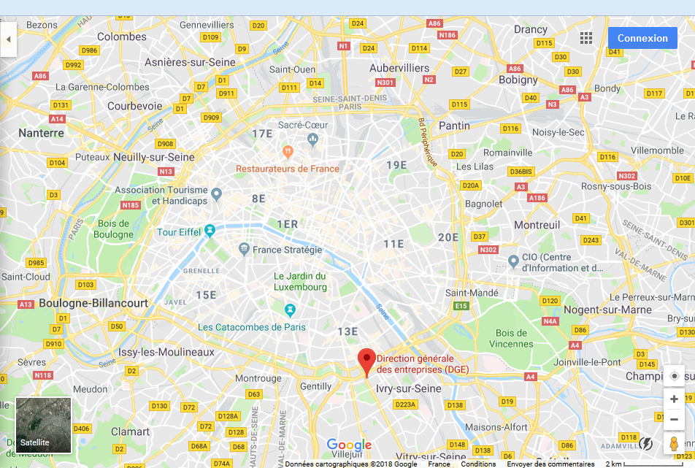

Slide 4
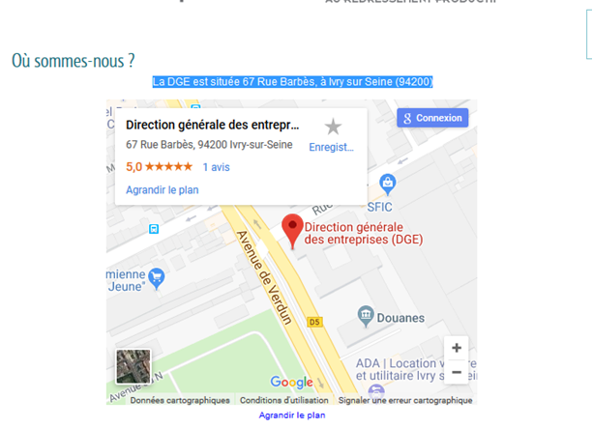

Slide 5
