Slide 1

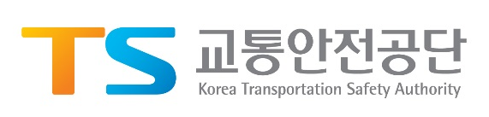

Transmitted by the expert from the Republic of Korea
Opinions on the Reversing Alarm
Park Jinwoo, Chief Researcher
(truehelp@ts2020.kr)
KOTSA (Korea Transportation Safety Authority)
KATRI (Korea Automobile Testing & Research Institute)

Slide 2
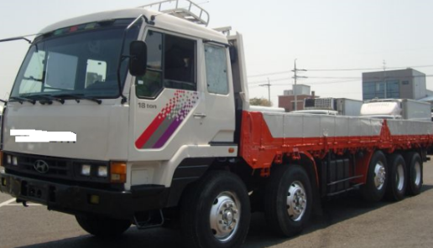
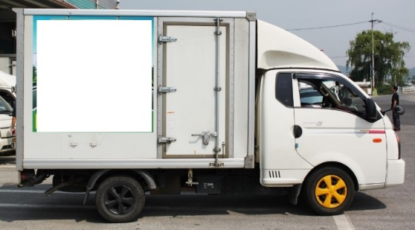
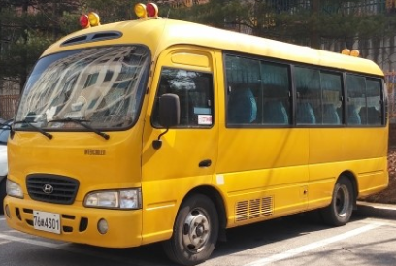


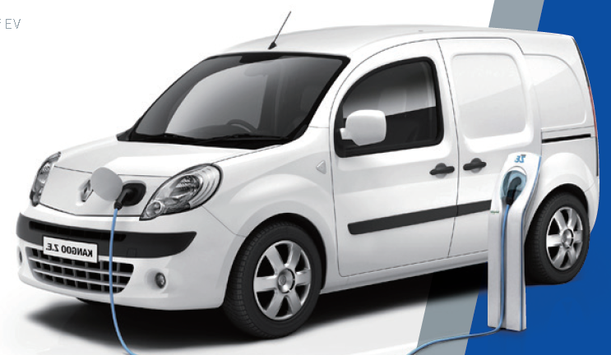
Reversing alarm regulation in Korea
Current Reversing alarm regulation in Korea
The vehicles(N3, Van, Box truck, school bus) shall have rear view camera or rear detecting sensor(parking sensor or back sonar) or reversing alarm device when it move to backward.
N3 & Van
Box type
School bus
2

Slide 3
Reversing alarm regulation in Korea
Future Reversing alarm regulation in Korea
All vehicles shall have rear view camera or rear detecting sensor(parking sensor or back sonar) or reversing alarm device when it move to backward.
Current situation on the reversing alarm regulation
Korea is in the process of making a legislative notice about the Reversing alarm.
Pre-Announcement of Legislation period : 20/10/2017~19/12/2017
It is expected to be implemented from 2019 or 2020.
3

Slide 4
Conclusions
Opinions on the reversing alarm regulation
Measurement point : One point (no scanning)
Distance from vehicle : 2m or 4m
  7m is too far from vehicle, because it is for pedestrians not vehicles and background noise needs to be considered
Height : 1.2m (or 1m, Flexible but just one point)
Frequency Band : 500Hz ~ 4000Hz (Flexible, To be discussed)
SPL : 65 ~ 90 dB(A) at 2m (Flexible, To be discussed)
Sound type : Beep sound. Sound should be emitted repeatedly in the same tone.
In case of other categories vehicles fit the reversing alarm, the scope of regulation should be expanded (not mandatory but just in case of installed)
4

Slide 5
Conclusions
Opinions on the reversing alarm regulation
SPL should be applied differently depending on the categories of vehicles
No pause switch
Button ? : Need to be discussed
New regulation (not be insulted in R28)
5

Slide 6

Thank you
for your attention!

