Slide 1
Submitted by chairs of CS/OTA-TF
Outcome TFCS-11// 20-22 February 2018 @ Washington DC
Update to ITS/AD
Covering:
SOFTWARE UPDATE PAPER
  Outline of process envisaged
  Proposed structure
  Progress made
  Specific questions
  Points of note
CYBER SECURITY PAPER
  Outline of process envisaged
  Proposed structure
  Progress made
  Specific questions
  Points of note

Slide 2
Outcome TFCS-11// 20-22 February 2018 @ Washington DC
SOFTWARE UPDATE PAPER - overview
The recommendation for software updates is that all updates should be treated the same, but with some extra considerations for over-the-air updates
To regulate such updates the following processes would be needed:
  An initial verification that an OEM has suitable procedures for delivering software updates
  Individual software updates are assessed by OEM’s, with type approval authorities being notified if an update may affect any type approved system or change any entry within the information package for the vehicle
  Type approval authorities periodically verify that OEM’s continue to apply the processes and procedures correctly and verify that they are appropriately notifying authorities of software updates as defined within this recommendation

Slide 3
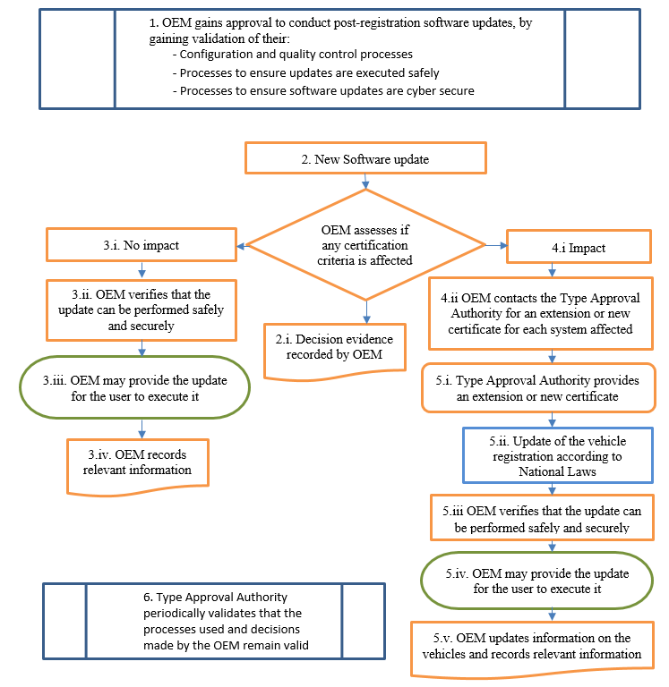
Outcome TFCS-11// 20-22 February 2018 @ Washington DC

Slide 4
Outcome TFCS-11// 20-22 February 2018 @ Washington DC
Overview of software update paper
Recommendations on how to take the paper forward:
  The main text, providing guidance of the process and procedures, to be taken forward as a resolution providing guidance on the regulations
  Annex A to be a horizontal regulation, providing for approval of an OEM’s processes to manage software updates
  Annex B to be a regulation covering software updates that will affect type approval, to be appended to relevant existing regulations where the software has an influence on the vehicle functionality, to introduce the concept of software identification numbers into relevant UN regulations.
Is this acceptable?

Slide 5
Outcome TFCS-11// 20-22 February 2018 @ Washington DC
Progress report
The software update paper was reviewed at the meeting, progress was:
  Chapters complete but open to further comment are:
    Chapter 1 – introduction
    Chapter 3 – document structure
    Chapter 4 - process for software updates
    Chapter 6 – identification of installed software
  Chapters with comments are:
    Chapter 5 – safety and security requirements
    Chapter 7 - recommendations
    Annex B – regulation introducing RxSWIN
  Chapters with major work remaining are:
    Chapter 2 – definitions
    Annex A – horizontal regulation

Slide 6
Outcome TFCS-11// 20-22 February 2018 @ Washington DC
Questions for ITS/AD regarding the software update paper:
    Are you content with the overall structure proposed?
      Are you content with the proposal for a horizontal regulation covering OEM processes as described in Annex A?
      Are you content with the regulations as proposed?
    Production definitely discontinued
    How to should the task force provide extensions of types (via software updates) where the production is definitely discontinued?
    Example: a vehicle type is no longer in production (it is discontinued) but an OEM continues to offer software support. A software update is produced that requires an extension of type approval. An approval authority grants this extension, how should it be communicated?
    Proposal is to add a category to the communication annex fo “APPROVAL EXTENDED AFTER PRODUCTION DEFINITELY DISCONTINUED ”

Slide 7
Outcome TFCS-11// 20-22 February 2018 @ Washington DC
Questions for ITS/AD regarding the software update paper:
    The recommendation envisages continued periodic assessment of the processes, practices and decision making of OEM’s in relation to software updates. This could be considered to be market surveillance. As market surveillance is not within the 1958 agreement the UNECE will need to consider how this could be conducted under its agreements.
    What does ITS/AD recommend?

Slide 8
Outcome TFCS-11// 20-22 February 2018 @ Washington DC
For note:
There are a number of supporting processes that signatory parties and the UNECE will need to address to enable the full implementation of this recommendation, these include:
  It is will be important for UNECE to invest in the development of DETA and DoC
  It should be investigated if PTI should be provided limited access to DETA and DoC in order for the RxSWIN numbers to be verified during PTI
  There should be procedures in place to enable the sharing of information between national bodies to support the administration of these processes.
  Whether a software change requires an extension or renewal of a systems certification depends on the description in the specific regulation (e.g. in the vehicle type definition). Therefore it may be necessary for the specific regulations to be reviewed to incorporate software and if there should be any specific requirements relating to them.

Slide 9
Outcome TFCS-11// 20-22 February 2018 @ Washington DC
CYBER SECURITY PAPER – what it contains:
To regulate cyber security the following processes are recommended:
  An initial verification by a type approval authority of the cyber security management system (processes and procedures) of an OEM. This would provide them a certificate of compliance covering:
    That an OEM is organisationally set up to manage the process
    That an OEM has processes in place to conduct an appropriate risk assessment and processes to manage risks relating to their suppliers
    That the outcome of the risk assessment will influence the vehicle design
    That there is a process to monitor how risks will evolve post production and the OEM has response plans in place should action be needed to respond to a cyber threat
  A vehicle type approval is provided, after an assessment by an authority, of the cyber security mitigations provided within a vehicle type against the cyber risk assessment of that vehicle type.

Slide 10
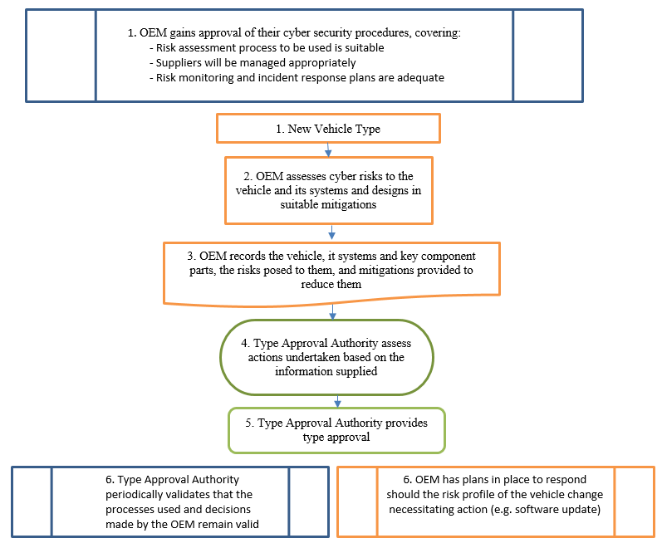

Slide 11
Outcome TFCS-11// 20-22 February 2018 @ Washington DC
What the paper looks like:
It is recommended that the output of the task force be taken forward as two parts:
  The main text, providing guidance of the process and procedures for cyber security, should be taken forward as a resolution
  An annex should be taken forward as a horizontal regulation, providing approval of the processes an OEM has to provide approval of the cyber security of a vehicle type, this will include:
    Approval that the OEM has identified and assessed the cyber risks to a vehicle and applied appropriate mitigations
    Approval that the OEM has suitable processes to support the vehicle post production should the need arise.
Key points:
  The regulation would be based on a subjective assessment
  Parts of the resolution (annexes describing possible threats and mitigation) can provide objective items to aid the assessment but are not currently suitable for the basis of an objective assessment.

Slide 12
Outcome TFCS-11// 20-22 February 2018 @ Washington DC
Progress report
  Chapters complete but open to comment are:
    Chapter 5 – threats to the vehicle
    Annex D – references
  Chapters with comments are:
    Chapter 1 – introduction
    Chapter 2 – definitions
    Chapter 4 – cyber security principles
    Chapter 6 – mitigations
    Chapter 7 – evidencing
    Annex A – threats detailed
    Annex B – mitigations detailed
    Annex E – cyber security regulation
  Chapters with major work remaining are:
    Chapter 8 - recommendations

Slide 13
Outcome TFCS-11// 20-22 February 2018 @ Washington DC
Question on vehicle „lifetime“, continued
Guidance is needed on how to draft requirements for manufacturers to support the cyber security of vehicles post production. Particularly if any text on lifetime, or what a suitable length of time for a vehicle to be support is, should be included.
Current draft text (not finalised):
The OEM shall have a security update policy defining how they will support a vehicle post production.
Possible additional text:
Requirements that shall apply to the security update policy of vehicles include:
  The OEM shall provide updates of the software on a vehicle for critical elements [over a reasonable timespan]*.
  The end-user should be informed if the support for a vehicle or a vehicle component and/or the support for software updates comes to an end.
  The OEM should identify how the end-user would be informed about the termination of support for their vehicle
  The OEM should identify what actions may be taken to protect systems or vehicles in the event that they become unsafe due to cyber threats after the OEM has ceased providing support for those vehicles or systems. For example: Functions that were not required for the vehicle at the time of its homologation may be deactivated.

Slide 14
Outcome TFCS-11// 20-22 February 2018 @ Washington DC
Question on vehicle „lifetime“
How should the task force approach requirements for maintaining the safety and security of vehicles in service, particularly relating to the provision of software updates? Options identified include:
  Do not include any text relating to lifetime.
  The likely outcome is that OEM’s may stop providing active support at some stage but would still be subject to recall legislation and requirements
  Include text defining, in UN regulations, a timespan that vehicles should be supported for by an OEM e.g. 10, 15, 20 or 50 years etc
  This would put a defined period for OEM’s to guarantee support, after which vehicles may still be subject to recall legislation and requirements
  Include text in UN regulations requiring that vehicles should be supported for by an OEM for a reasonable timespan but not define what that should be
  The likely outcome is that OEM’s may stop providing active support at some stage but would still be subject to recall legislation and requirements. Additionally national regulation may define the period
Problems identified:
  This may be a political decision and not appropriate for the task force
  Issues and viability of providing support indefinitely by the OEM and suppliers
  Current practices of recalls and that they may apply to vehicles of any age
  Other legislation may apply in this area, which will vary by signatory state

Slide 15
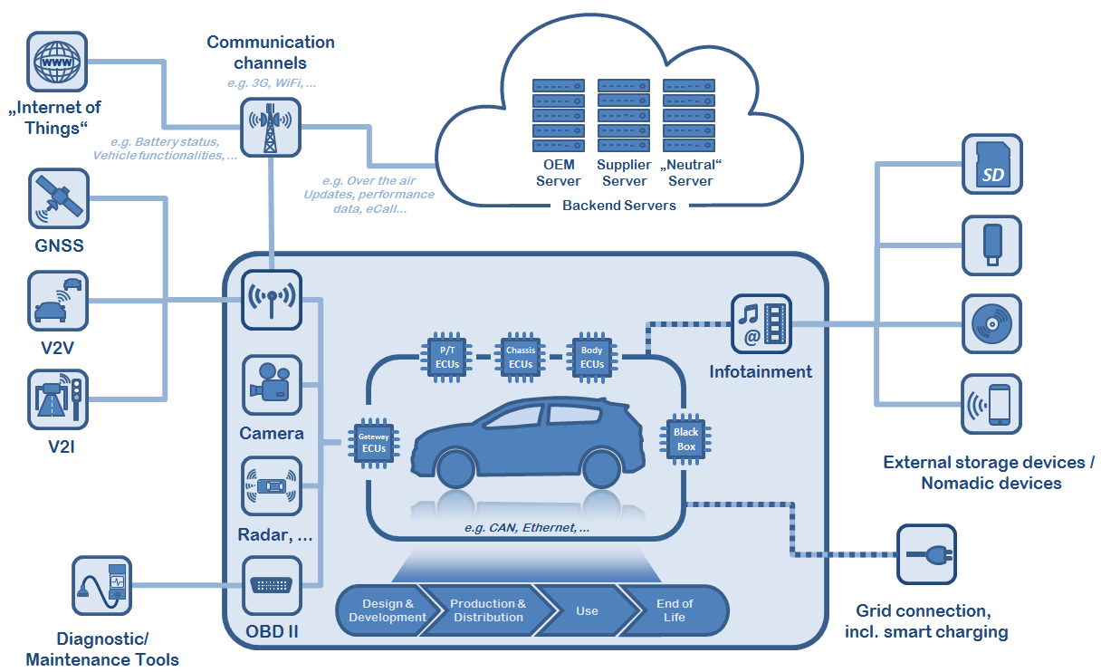
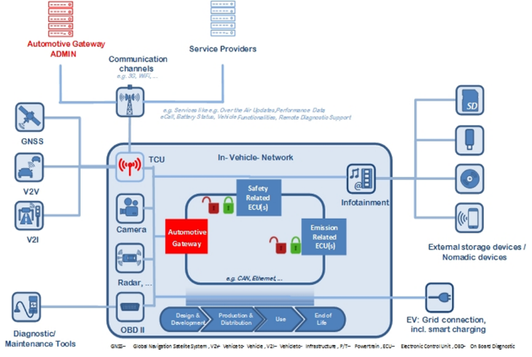
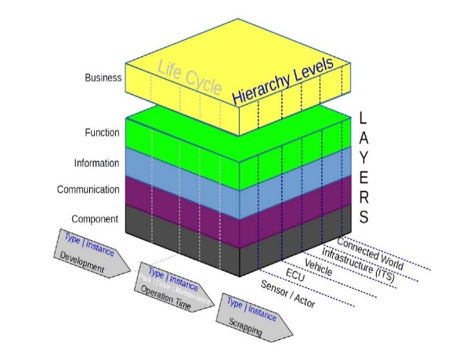
Outcome TFCS-11// 20-22 February 2018 @ Washington DC
Points for ITS/AD regarding cyber security:
The development of the cyber security paper used different „reference models“ to describe what the vehicle ecosystem looks like. Later a further model was proposed describing what a functionally cyber secure might look like (not agreed by the task force).
Current proposal is not to include them in the final document as they may add too much complexity and add little to the requirements. Is this ok?
For the cyber security regulation what is the correct terminology for the use of contracting party, approval authority and competent authority?

Slide 16
Outcome TFCS-11// 20-22 February 2018 @ Washington DC
        Action items for next session (TFCS 12):
        Incorporate feedback from ITS/AD
        Aim is to conclude paper on software updates
        Aim is to conclude paper on cyber security
        Use of ad hoc webex meetings to progress parts of the document needing work or further review beforehand
        Risks identified:
          discussions on lifetime not being concluded satisfactorally
          agreement on text of regulatory annexes not agreed by the end of TFCS 12

Slide 17
Outcome TFCS-11// 20-22 February 2018 @ Washington DC
        Future meetings planned
        Software annex A
          Ad hoc webex meeting to confirm scope and contents (19th March)
          Ad-hoc editting team to refine text ahead of TFCS 12
        Ad hoc webex meeting to define definitions (21st March)
        Ad hoc webex meeting to review cyber security annexes A & B on threats and mitigations (26th March)
        Ad hoc webex to review comments remaining on cyber security paper (4th April)
        Ad-hoc editting team to revise chapter 8 of cyber security paper ahead of TFCS 12
        TFCS 12 to be held 17-19 April 2018 in Seoul, South Korea

