Slide 1
Submitted by OICA Document No. ITS/AD-14-07
(14th ITS/AD, 15 March 2018, agenda item 4-1)
Preliminary Input: Certification of Automated/Autonomous Driving Systems
WP.29 IWG ITS/AD session, Geneva
16 November 2017

Slide 2
Embedded in Whole Vehicle Type Approval
or as a Part of a Self-Certification Regime
The concept and building blocks for certification of automated/autonomous driving systems that are discussed in this presentation could be applied both under a type approval or self-certification regime.
A regulation for certification of automated/autonomous driving systems could also be designed as a Global Technical Regulation (GTR) under the 1998 agreement.
As usual, application of a regulation under a self-certification regime requires precise descriptions of the procedures and tests to be applied by the manufacturer.
In a first step, the intention of this presentation is to start the discussion of suitable building blocks and regulation structure.

Slide 3
Embedded in Whole Vehicle Type Approval or as a Part of a Self-Certification Regime
Example whole vehicle type approval: IWVTA or EC-WVTA
Automated/
Autonomous Driving Systems
UN-Rxxx *
Braking
UN-R13H
Lighting
UN-R48
Steering
UN-R79
Frontal
Impact
UN-R94
Autonomous vehicle systems
UN-Rxxx *
Safety
Autonomous vehicle systems
UN-Rxxx *
etc.
Emissions UN-R83
Noise
UN-R51
Energy consump. UN-R101
Environment
etc.
Anti Theft
UN-R116
Engine power
UN-R85
Other
etc.
* Under discussion if all aspects should be included in a single future Regulation or if –at least for some aspects - a modular split into several Regulations is appropriate

Slide 4
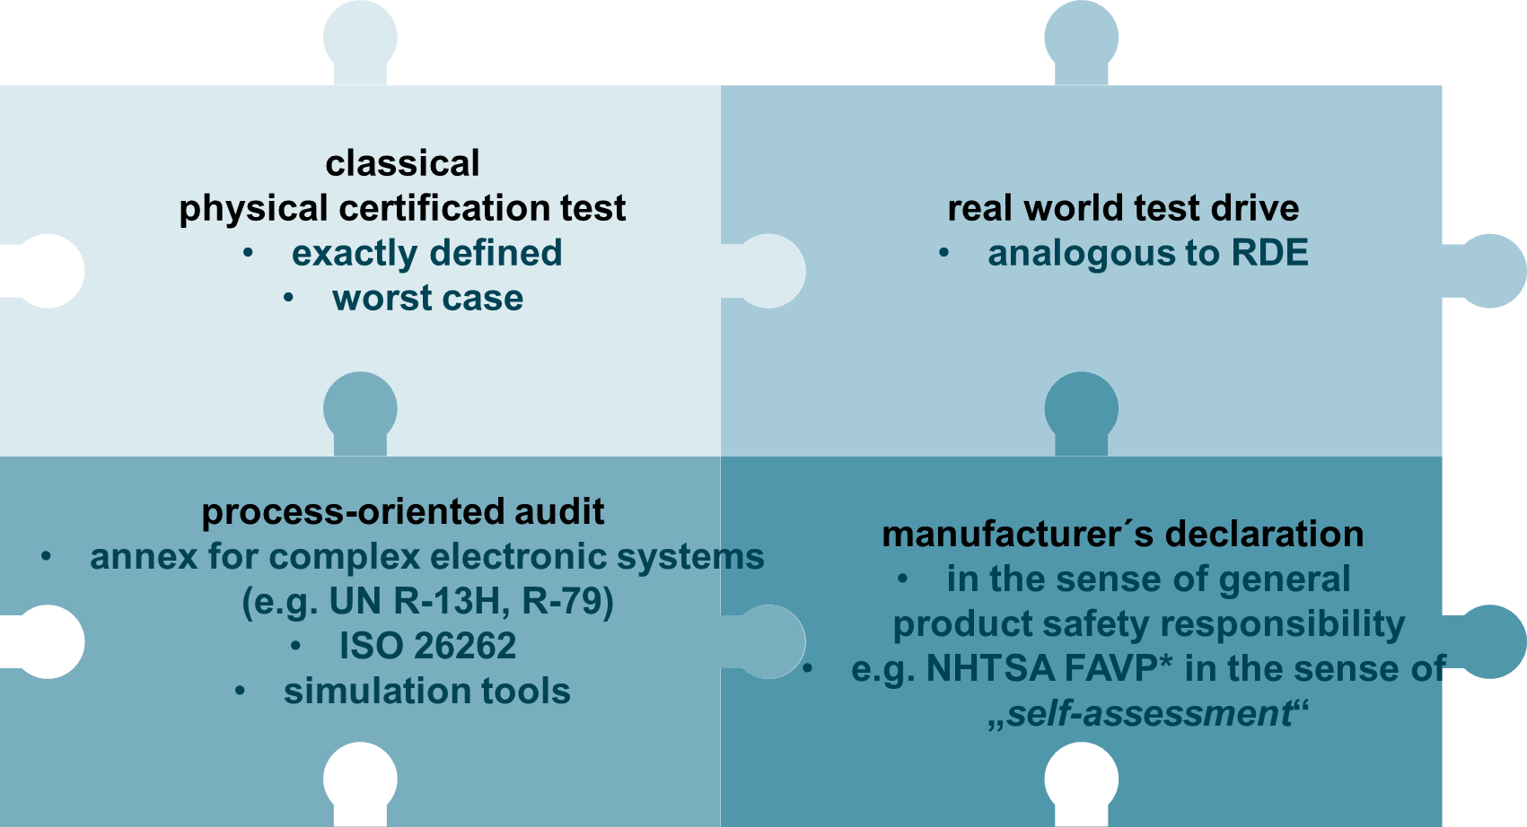
Possible Building Block of a Certification Process
*Federal Automated Vehicles Policy

Slide 5
Challenges/Premises for a Suitable Approach
It is important to consider that WP.29 is aiming at regulating the use of new technologies some of which are not available on the market yet
→ lack of experience should not be neglected and tackled with reasonable strategies
It will be difficult to regulate each and every topic in detail from the early beginning
→ need to prioritize the different topics
→ start with a first set of requirements and develop further as the technology evolves
Technology for Automated/Autonomous Driving Systems will continue to evolve rapidly over the next years
→ need a flexible structures that can be applied to the different kinds of L3-L5 systems
→ “function by function-approach” that would frequently require formal updates/ upgrades of regulations is not practical
Need to find a pragmatic way that on the one hand leaves “controlled” flexibility for industry and authorities and on the other hand defines reasonable requirements/principles to ensure a safe evolution of the new technology over the next years
→ structure should allow to add output of research initiatives and lessons learnt at a later stage

Slide 6
Concept for a Structure of a Regulation
Automation Level 3*-Level 5
Use-Cases: Urban, Highway, Interurban, [Parking] for automation levels 3*, 4 and 5
Requirements address vehicle behavior in road traffic and further general safety requirements
Physical Certification Tests
Dedicated, reproducible worst-case tests for specific scenarios that cannot be guaranteed to occur in real world test drives
Objective performance criteria
Significant testing efforts
Transfer of requirements into reproducible tests technically difficult or likely to result in remarkable functional restrictions
Real World Test Drive
Test drive to assess the vehicle’s standard behavior in public road traffic, compliance with traffic laws and maneuvers according to defined checklist
Limited testing efforts
Subjective influence on judgments
Requires highly skilled and qualified test house/certification agency to appropriately assess systems
Audit
OEM provides e.g.:
- Safety concept / functional safety strategy
- Simulation and development data to verify vehicle behavior in edge cases
- Manufacturer’s self declarations
- etc.
← pros/cons: see RWTD
* If not covered by UN-R 79 ACSF – ACSF results for highway could also be transferred afterwards

Slide 7
Overview: Contents and Methods for Verification
 |  | Physical testing (defined, test track/ lab) | Real world driving test | Audit by test house/certifica-tion agency | Self declaration by manufacturer
General system requirements* | HMI (internal and external) | X | X
 | Driver monitoring |  | X | X
 | Transition scenario |  | X | X
 | Minimum risk maneuver |  |  | X
 | Functional safety |  |  | X | X
 | Data storage | X |  | X
 | Cybersecurity |  |  | X | X
 | OTA-updates |  |  | X | X
Vehicle behavior on the road | (a) Basic capabilities of the vehicle |  |  | X | X
 | (b) Test scenarios for physical testing | X
 | (c) Real world test drive |  | X
 | (d) Repository of test cases |  |  | X | X
* If not covered by a separate UN-Regulation (under discussion, see also footnote slide 2)

Slide 8
Main Concepts (1 of 3)
Physical certification tests
General idea: scenarios for which it can be guaranteed that they can be tested in the real world driving test need not be replicated as physical tests.
Real world driving test
30-60 minutes in realistic traffic environment for use case: highway, urban, inter-urban
Checklist with mandatory plus optional traffic situations to be filled out by Test House/Certification Agency
Audit
General requirements and safety concepts

Slide 9
Main Concepts (2 of 3)
Traffic rules (code of the road)
Verification of compliance during real world driving test for the country in which test is performed
Verification of all implemented traffic rules (other designated countries for application) during audit
Environmental conditions (Weather and Lighting)
Verification during audit: review of manufacturer´s strategies and testing
Extended repository of test cases
For simulation and real test data collected during development phase
Verification during audit

Slide 10
Main Concepts (3 of 3)
Use-case specific flexibility
If the manufacturer can provide evidence that certain requirements are not relevant due to the foreseen use-case, the respective requirements are not applicable
Flexible regulation structure
Allows to foresee placeholders that can be worked out at a later state (e.g. rural roads/interurban)
Allows to add results of other research initiatives (e.g. scenario data base approach)

Slide 11
UN-RXXX or GTR XX
Development of a Regulation structure and some content has been started by OICA
The draft structure consists of 6 annexes with the following initial content:
1. General System Safety Requirements*
HMI (internal and external)
Driver monitoring
Transition scenario
Minimum risk maneuver
Functional safety
Data storage
Cybersecurity
OTA-updates
*If not covered by a separate Regulation (under discussion, see also footnote slide 2 and 6)

Slide 12
UN-RXXX or GTR XX
Vehicle behavior on the road is reflected by the following Annexes:
2. Special requirements in highway traffic
3. Special requirements in urban traffic
4. Special requirements in interurban traffic
[5. Special requirements in parking scenarios]
6. Special requirements to show adherence to national/regional traffic rules
Each of these Annexes contains the following paragraphs:
    Overall capabilities
    Physical Tests
    Checklist for test drive (use-case specific)
    Extended repository of test cases
OICA can offer walkthrough of working document in the near future when more matured and broader consensus has been reached within OICA

Slide 13
How to Structure the Work
As multiple topics are affected by automated/ autonomous driving systems, the work on a certification regulation should in a first step be organized directly under WP.29 (analogue to UN-R 0 IWVTA) → an assignment to different GRs with different reporting lines should be avoided as the context is likely going to be lost
Consider Lessons Learned from the IWG ACSF when organizing the future work → e.g. use the benefit of temporary small experts group/working packages to efficiently prepare proposals on specific items; see also slide 4
In the long run, aspects of connected and automated/autonomous driving may be transferred to a newly established dedicated GR-Group → needs to be staffed with sufficient resources
Collaboration between the WP.1 and WP.29 relevant groups is key in the process of exchanging knowledge and approaches in regulating automated and autonomous driving functions.

