Slide 1
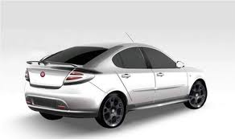

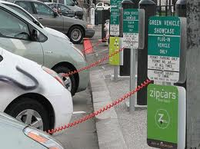

Illustration of Vehicle Attributes for EVE Reference Guide discussion
Vehicle:
Electrified Vehicle range
Energy consumption/efficiency
Vehicle driver-user information
Vehicle recycling and re-use
Vehicle labeling
Infrastructure:
Wireless charging
On-board charging system
Off-board charging standard related to the vehicle
Vehicle as electricity supply
Battery:
Battery performance
Battery durability
Battery recycling
Battery re-use (post-mobility)
Market Deployment Support:
Regulatory incentives
Annex:
Financial incentives
Consumer awareness
Government purchasing
Within WP29 scope
Not sure if within WP29 scope
Likely not within WP29 scope

