Slide 1

Flex-PLI Rebound Issue: Industry Proposal
Industry proposal (update)
to identify the relevant measuring results
in FlexPLI to vehicle tests
to be compared to the Flex-PLI requirements
of the GTR9-PH2
See rebound discussion during the 5. IG-GTR9-PH2 meeting
in Dec. 2012 at the BASt offices
See also documents TEG-128, GTR9-5-08 and GTR9-5-30
6. IG-GTR9-PH2 meeting, NHTSA Washington, 19. & 20.03.2013

Slide 2
Flex-PLI Rebound Issue: Industry Proposal
General:
Updated proposal based on the aforementioned documents GTR9-5-08 and GTR9-5-30
The basic statements to biofidelity & biomechanics of the FlexPLI remain unchanged (see TEG-128)
Relevant results which have to be compared to the requirements are measured during the contact phase of the impactor and the vehicle
6. IG-GTR9-PH2 meeting, NHTSA Washington, 19. & 20.03.2013

Slide 3
Flex-PLI Rebound Issue: Industry Proposal
Updated Proposal:
Distinguish between bending moment results and ligament results since contact phases of tibia and knee are different
Bending moment measurements T1, T2, T3 and T4:
The relevant result is the maximum before 30ms
However, the maximum before 50ms is used when the following conditions are met:
The maximum value up to 30ms is taken at 30ms
The overall maximum is taken after 30ms and the difference relative to the first local minimum prior to the overall maximum is no more than 170 Nm
Whenever deemed necessary
6. IG-GTR9-PH2 meeting, NHTSA Washington, 19. & 20.03.2013

Slide 4
Flex-PLI Rebound Issue: Industry Proposal
Updated Proposal:
Ligament elongation measurements MCL, ACL and PCL:
The relevant result is the maximum of local maximum values before 50ms
6. IG-GTR9-PH2 meeting, NHTSA Washington, 19. & 20.03.2013

Slide 5
Flex-PLI Rebound Issue: Industry Proposal
Justification (1/2):
The proposal is
objective – no individual film assessment
based on measured time history data
easy and robust enough
6. IG-GTR9-PH2 meeting, NHTSA Washington, 19. & 20.03.2013

Slide 6
Flex-PLI Rebound Issue: Industry Proposal
Justification (2/2):
Local peaks for bending moments are clearly before 30ms (see GTR9-5-08: case studies; and GTR9-5-30: page 4)
The 50ms value for ligament measurements are observed by an additional JAMA case study (see next 2 pages)
6. IG-GTR9-PH2 meeting, NHTSA Washington, 19. & 20.03.2013

Slide 7
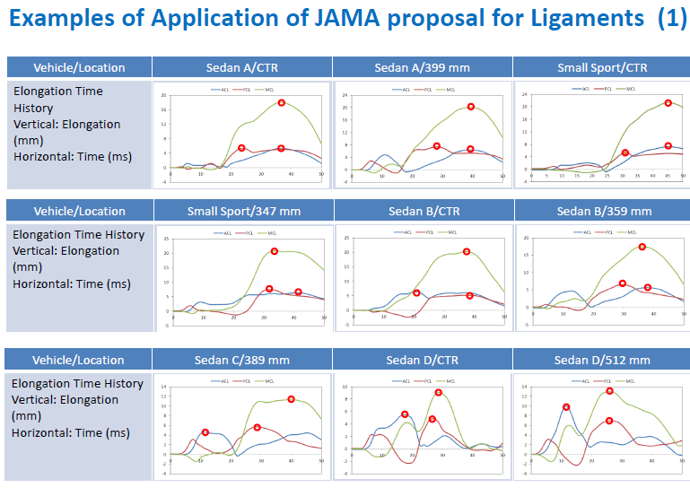
Flex-PLI Rebound Issue: Industry Proposal
6. IG-GTR9-PH2 meeting, NHTSA Washington, 19. & 20.03.2013

Slide 8
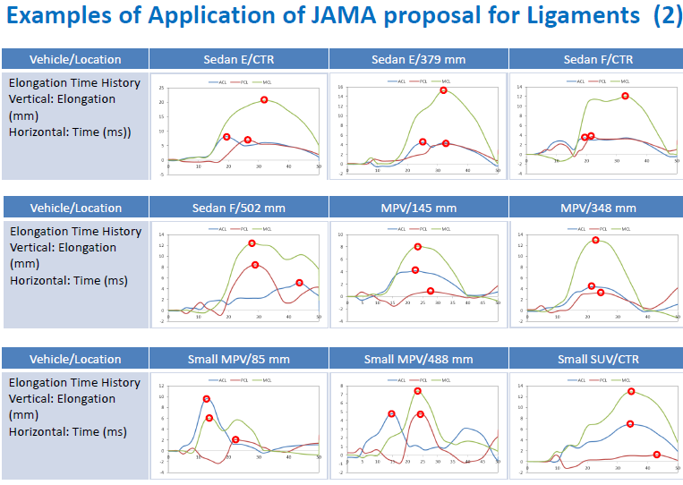
Flex-PLI Rebound Issue: Industry Proposal
6. IG-GTR9-PH2 meeting, NHTSA Washington, 19. & 20.03.2013

Slide 9
Flex-PLI Rebound Issue: Industry Proposal
Next steps:
Use test results of the round robin tests of the master legs to confirm this proposal
Establish a final IG-position latest in Sep 2013 meeting
Develop proposal to implement the rebound issue into the GTR9 and UN-R-127 amendments
6. IG-GTR9-PH2 meeting, NHTSA Washington, 19. & 20.03.2013

Slide 10
Flex-PLI Rebound Issue: Industry Proposal
Thank you
6. IG-GTR9-PH2 meeting, NHTSA Washington, 19. & 20.03.2013

