Slide 1
WLTP-DTP-AP
Status Report and Open issues
TOKYO, 20-21-March-2013
M.C. Astorga

Slide 2
WLTP DTP Additional Pollutants subgroup
Title | AP Subgroup 14th Meeting — Meeting minutes Date: March 07/08 2013 Location: JRC/Ispra
Working Paper Number | WLTP-DTP-AP-21-02

Slide 3
OPEN QUESTIONS
& PREPARATION of a NEW
OI TABLE
FOR DTP
GTR
drafting
2
1
3
4
DEFINITION OF THE VP2 ad hoc CAMPAIGN
-SEPTEMBER 2013 (JRC-Ispra , ITALY)
Next….
Notes:
THE OUTLINE OF MY PRESENTATION:

Slide 4
# | ITEM (AP) | Closed Issue (at working group level) | Open Issue |  | Solution 1 (proposed by the working group) | Solution 2 | Solution 3 | Remarks from AP | Remarks from DTP Webconference 11th March 2013 | Solution in GTR ?
1 | Measurement of NO2 | ø |  |  | bag/modal sampling of NO
2 | NH3-Measurement (scope of measurement, 1) |  |  |  | SCR-vehicles to prevent overdosing of urea |  |  | excempt vehicles with NH3-oxidation catalyst | Confirmation needed from DTP. Solution 1 means, that only SCR-vehicles have to meet the requirements.
3 | NH3-Measurement (scope of measurement, 2) | ø |  |  | concentration at tailpipe |  |  | no solution for mass available! | Point agreed!
4 | NH3-Measurement | Measurement from raw exhaust influences subsequent CVS measurements |  |  | Limit lost sample to 0,5 % of raw exhaust | Additional test for NH3 (→ workload) |  | Measurement from diluted exhaust not possible for NH3 | Further investigations to identify the best solution still necessary. Some data available from VP2.Discussions if further measurements can be performed in September. Solution 1 agreed on Sub-Group AP -Level
5 | NH3-Measurement |  | Measurement from raw exhaust during engine off |  | so far no prefered solution | do not consider data during engine off --> but how to detect engine off? |  | not known if this is a problem for NH3 General issue for EV. Will there be an engine off signal from the EV-group? | Discussion togeheter with EV-group necessary. Oliver Moersch will contact Kobayashi-san and Per Öhlund.
6 | NH3-Measurement (temperature for sampling and analysis) | ø |  |  | 110 to 190 C upon manufacturer's request 110 to 133 C |  |  |  | Solution 1 is generally agreed.
7 | N2O-Measurement (not sufficient results from VP2) | ø |  |  | Use data from industry programs to validate draft GTR |  |  |  | Lot of experience on this; Industry data can be used. The additional industry data is welcomed by the group. Sufficient data now available.
8 | Measurement of EtOH and Aldehydes |  | new methods not confirmed by VP2 |  | Validation will be performed separately in Sept. 2013 |  |  |  | Experts have the opinion, that a low temperature-measurement cannot be performed in a needed accuracy. EtOH and Aldehydes-measurement will be included into the GTR in a later stage (October 2013). The formal document must however be delivered on the 18th August. The AP-measurement has therefore to be introduced into the formal GTR-text by Amendments. The AP group is asked to check, whether a earlier formal version of the GTR text could be available already in August.
9 | Calibration gas forFormaldehyde |  | availability and stability |  |  |  |  | need to contact gas suppliers | Stability at the moment in a range of +-20%
4 green+ 1 yellow+ 4 red

Slide 5
# | 1
ITEM (AP) | Measurement of NO2
Closed Issue (at working group level) | ø
Open Issue
Solution 1 (proposed by the working group) | bag/modal sampling of NO
Remarks from AP
Remarks from DTP Webconference 11th March 2013

Slide 6
# | 7
ITEM (AP) | N2O-Measurement (not sufficient results from VP2)
Closed Issue (at working group level) | ø
Open Issue
Solution 1 (proposed by the working group) | Use data from industry programs to validate draft GTR
Solution 2
Solution 3
Remarks from AP
Remarks from DTP Webconference 11th March 2013 | Lot of experience on this; Industry data can be used. The additional industry data is welcomed by the group. Sufficient data now available.
Solution in GTR ?

Slide 7
# | 2 | 3
ITEM (AP) | NH3-Measurement (scope of measurement, 1) | NH3-Measurement (scope of measurement, 2)
Closed Issue (at working group level) |  | ø
Open Issue
Solution 1 (proposed by the working group) | SCR-vehicles to prevent overdosing of urea | concentration at tailpipe
Remarks from AP | excempt vehicles with NH3-oxidation catalyst | no solution for mass available!
Remarks from DTP Webconference 11th March 2013 | Confirmation needed from DTP. Solution 1 means, that only SCR-vehicles have to meet the requirements. | Point agreed!

Slide 8
# | 4
ITEM (AP) | NH3-Measurement
Closed Issue (at working group level) | Measurement from raw exhaust influences subsequent CVS measurements
Open Issue
Solution 1 (proposed by the working group) | Limit lost sample to 0,5 % of raw exhaust
Solution 2 | Additional test for NH3 (→ workload)
Solution 3
Remarks from AP | Measurement from diluted exhaust not possible for NH3
Remarks from DTP Webconference 11th March 2013 | Further investigations to identify the best solution still necessary. Some data available from VP2.Discussions if further measurements can be performed in September. Solution 1 agreed on Sub-Group AP -Level

Slide 9
Open issues table (OIT)
The OIT was updated and prepared for DTP-Telco on March 11
Solution for lost sample:
Determine max. lost sample to keep influence on subsequent measurements below 0,5 %:
V_lost_max = 0,005 * V_CVS/DF
Max error 0,5 %, approach always overestimates the error, that is real error is smaller!
If the unreturned sample flow exceeds max sample flow, CVS results are void and an additional test without NH3 measurement has to be run.
The approach to go to diluted measurement for NH3 was discussed. The group feels, that a repeatable and reliable diluted measurement is not possible based on the current system description for the CVS. Very stringent restrictions on line lengths, temperatures, materials and system design would be needed.

Slide 10
# | 5 | 6
ITEM (AP) | NH3-Measurement | NH3-Measurement (temperature for sampling and analysis)
Closed Issue (at working group level) |  | ø
Open Issue | Measurement from raw exhaust during engine off
Solution 1 (proposed by the working group) | so far no prefered solution | 110 to 190 C upon manufacturer's request 110 to 133 C
Solution 2 | do not consider data during engine off --> but how to detect engine off?
Solution 3
Remarks from AP | not known if this is a problem for NH3 General issue for EV. Will there be an engine off signal from the EV-group?
Remarks from DTP Webconference 11th March 2013 | Discussion togeheter with EV-group necessary. Oliver Moersch will contact Kobayashi-san and Per Öhlund. | Solution 1 is generally agreed.
Solution in GTR ?

Slide 11
# | 8 | 9
ITEM (AP) | Measurement of EtOH and Aldehydes | Calibration gas forFormaldehyde
Closed Issue (at working group level)
Open Issue | new methods not confirmed by VP2 | availability and stability
Solution 1 (proposed by the working group) | Validation will be performed separately in Sept. 2013
Solution 2
Solution 3
Remarks from AP |  | need to contact gas suppliers
Remarks from DTP Webconference 11th March 2013 | Experts have the opinion, that a low temperature-measurement cannot be performed in a needed accuracy. EtOH and Aldehydes-measurement will be included into the GTR in a later stage (October 2013). The formal document must however be delivered on the 18th August. The AP-measurement has therefore to be introduced into the formal GTR-text by Amendments. The AP group is asked to check, whether a earlier formal version of the GTR text could be available already in August. | Stability at the moment in a range of +-20%
Solution in GTR ?

Slide 12
GTR Open Issues
Apart for NH3, EtOH and aldehydes, all open issues regarding AP have been resolved. For the time being, the text referred to NH3, EtOH and aldehydes will be taken out of the GTR-Draft, allowing for a version without AP open issues.
These parts will be finalized after the validation campaign in Sept 2013.

Slide 13
WLTP-DTP-AP-21-06 08.03.2013 Consolidated Draft AP.docx
uploaded/updated in the interest group
WLTP-DTP (World Light duty Test Procedures development groups)
(Category: Enterprise and Industry).
direct access:
https://circabc.europa.eu/w/browse/75cc4af8-cc22-4665-9156-e674e709452f

Slide 14
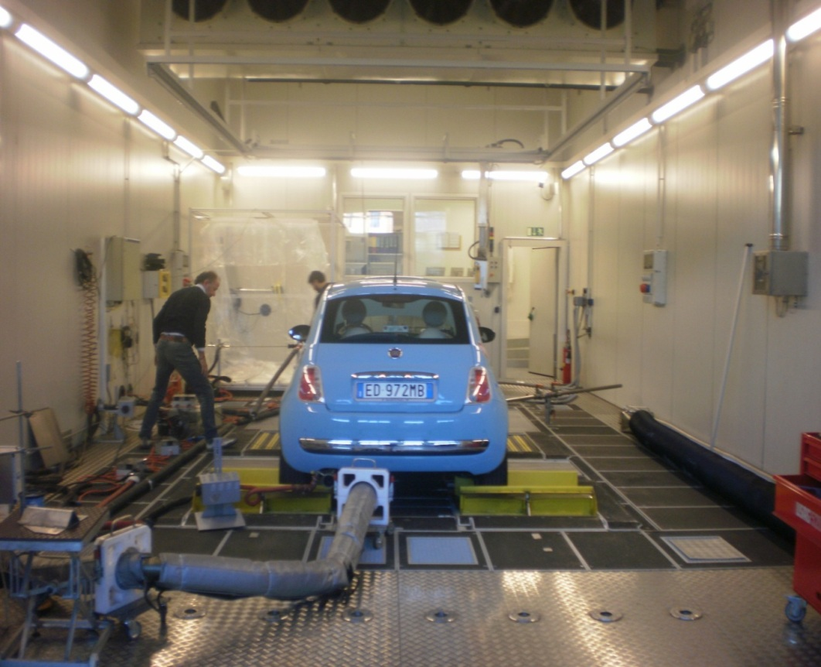
Laboratory VELA 2
Definition and preparation of Test Campaign
Scope:
Validation of EtOH &Aldehydes measurement
(part 1)
Validation of NH3-measurement (part 2)
TIME LINE
2 weeks for measurement of EtOH
and Aldehydes
1 week for measurement of NH3
For both campaigns several instruments
will be available.
Details have been defined
Cars
Vans
Little trucks
Tractors
-10/+30ºC
30-70% RH
Zardini, Astorga, 2012

Slide 15
TRANSPOSITION TO GTR:
DEFINITION OF THE VP2 ad hoc CAMPAIGN -SEPTEMBER 2013 (JRC)
Aldhehydes and Ethanol (2 weeks)
TEST SEQUENCE | VEHICLES | INSTRUMENTS | CALIBRATION GASES | TEST SEQUENCE | DATA RECORDING | EVALUATION
WLTC Version 5.3 L,M,H,XH cold start Sampling for batch methods: 4 phases 22 °C | Flex-Fuel: one FFV is needed (Ford? Volvo?) Fuel: E85 reference fuel Gasoline: EURO5b, JRC (rental car) Fuel: gasoline E5 reference fuel | Ethanol: GC-PID, Laser IR absorption spectrometry Photo Accoustic → no FT-IR Reference method: Impingers Impinger sampler (Horiba?) Handling by JRC, protocol to be established before the campaign Analysis: External lab in Italy, alternative: VW? | EtOH: 10 ppm in N2 100 ppm in N2 Formaldehyde: 10 ppm in N2 (Check by cartridge method) Availability/stability/precision to be checked Acetaldehyde: 25 ppm in N2 (Check by cartridge method) Operating gases: N2 (5.6) carrier gas for GC Liquid N2 for FTIR All gases ordered by JRC | Mo, Fr: Gas Check with cartridges (Aldehydes) Daily: Span gas check (all instruments) Background test WLTC L (no impinger) FFV cold start (order switched daily) Gasoline cold start Fill additional sample bag during L-phase Background test WLTC L (no impinger) Span gas check | Fuel Spec Speed, CVS-Volume DF Regulated pollutants (modal and bag) Impinger sample volume/phase Cartridge sample volume/phase Second by second concentration for modal measurements Background concentration before test for modal measurements | Compare results from different systems Compare modal/bag measurement Repeatability Drift check LOD Time required to get stable reading from bag Interference
 |  | Aldehydes: Laser IR absorption spectrometry | FT-IR GC-PID (Acetaldehyde only) Reference Method: Cartridges + HPLC (JRC)

Slide 16
TRANSPOSITION TO GTR:
DEFINITION OF THE VP2 ad hoc CAMPAIGN -SEPTEMBER 2013 (JRC) : Ammonia
TEST SEQUENCE | VEHICLES | INSTRUMENTS | CALIBRATION GASES | TEST SEQUENCE | DATA RECORDING | EVALUATION
WLTC Version 5.3 L,M,H,XH cold start, & hot start 22 °C | SCR-Diesel 1: VW-Passat, EURO5b, JRC (rental car), VW? SCR-Diesel 2: BMW , EURO5b JRC (rental car) Fuel: Diesel EU5 reference fuel | FT-IR extractive, 190 °C, 5 -10 lpm Photo Acoustic laser spectrometer extractive, sampling line 190 °C, analyser 50 °C w. secondary dilution, 1.2 lpm QL-NX extractive, 113 °C, 8 lpm LDS in situ (Daimler?) LASAR NH3 extractive, 6 lpm, sampling 190 °C analyser 45 °C 75 mbar Diode Laser extractive No return of bypass | NH3: 50 ppm in synthetic air Zero gas: synthetic air Operation gases: Liquid N2 for FTIR All gases ordered by JRC | Mo: precon 30 min @ 120 kph (in case of rental car), 10 min soak, WLTC hot Daily: Span gas check system response time check SCR 1 cold 10 min soak SCR 1 hot (without Start/Stop function) SCR 2 cold 10 min soak SCR 2 hot (without Start/Stop function) Span gas check | Fuel Spec Speed, CVS-Volume DF CO2 from FT-IR Regulated pollutants (modal and bag) Sample volume of each instrument Annotate filter change Second by second concentration for modal measurements Concentration data collected by instrument, use synchronized time stamp, | Compare results from different systems Repeatability Drift check LOD System response time Interference

Slide 17
WLTP DTP Additional Pollutants subgroup
Title | Definition of Test Campaign on EtOH, aldehydes and NH3
Working Paper Number | WLTP-DTP-AP-21-04

Slide 18
EtOH
instrument | Who? | Continuous measurement | EF |  | notes
GC-PID |  | modal dilute |  |  | Gas chromatography-Photoionization detector
Laser IR absorption spectrometry |  | modal dilute | bag
FT-IR |  | modal dilute | bag
Photo AccousticAcoustic |  | no | no
Reference method Impingers | Horiba |  | protocol to be established before the campaign | Handling by JRC | Impinger sampler (?) Analysis: External lab in Italy, alternative: VW?

Slide 19
Aldehydes
instrument | Who? | Continuous measurement | EF | notes
Laser IR absorption spectrometry | MAHA | modal dilute |  | CH3CHO only, HCHO to be confirmed
FT-IR |  | modal dilute
GC-PID |  | modal dilute |  | (Acetaldehyde only)
Reference method Cartridges HPLC | JRC

Slide 20
NH3
instrument | Who? | Continuous measurement | Sampling line T; Sampling flow | notes
FT-IR | JRC |  | 190 °C; 5 -10 l/m | extractive
Photo Acoustic laser spectrometer |  |  | Sampling line 190 °C; Analyser-50°C w.secondary dilution 1.2 l/m | extractive
QL-NX |  |  | 113 °C; 8 l/m | extractive
LDS | (Daimler?) |  | 190 °C; 6l/m Analyser 45°C &75 mbar | in situ
LASAR NH3 |  |  | 190 °C | extractive
Diode Laser | (AVL?;) |  |  | extractive
No return of bypass
[1]diode-laser spectrometer for determination of NH3 in tailpipe exhaust

Slide 21
WLTP-DTP-AP-21-xx
uploaded/updated in the interest group
WLTP-DTP (World Light duty Test Procedures development groups)
(Category: Enterprise and Industry).
direct access:
https://circabc.europa.eu/w/browse/
Thanks for your attention
C.

