Slide 1
Tyre GTR # 16
IWG session 18
Ottawa June 12-14
Proposal for new Editorial Amendments
Document TYREGTR-18-13
Agenda item 4.4

Slide 2
1. Load carrying capacity, load capacity and load rating
ETRTO suggests to replace 2.32 by:
2.32. "Load index" is a numerical code which indicates a reference load used to define
the load carrying capacity of the tyre, which can depend on operating conditions and tyre type
The list of these indices and their corresponding reference loads is given in annex 2.
The service description of a Light Truck (Commercial) tyre may include either one or two load indices.
And to modify 2.38 as follows:
2.38. "Maximum load rating" means the reference load corresponding to the load index;
Accordingly, we suggest to remove all the 6 occurrences of ‘maximum’ in ‘maximum load rating
in the GTR text.
And to replace 2.33 definition by the following:
and the tyre type
ETRTO suggests to replace the occurrences of ‘load capacity’ or ‘load carrying capacity’
by ‘load rating’ where applicable in the text.

Slide 3
2. ETRTO suggests for consistency to replace the occurrences of “LT/C tyres” by “Light Truck (Commercial) tyres” as in 2.31.
Consequently ETRTO suggests to change the definition of the Reference Test Inflation Pressure as follows:
2.56 “Reference Test Inflation Pressure” applicable for Light Truck (Commercial) tyres is the minimum cold inflation pressure associated with the load rating of the tyre corresponding to the load index in single application

Slide 4

3. For consistency, ETRTO suggests to replace the occurrences of ‘passenger tyre(s)’
by ‘passenger car tyre(s)’.
4. Eliminate the expression ‘pneumatic’ that still appears from the core text, in consistency with:
1.1 This global technical regulation covers new radial pneumatic tyres referred to as ‘tyres’
in this document designed primarily for vehicles in Categories 1

Slide 5
5. The single point marking is missing in the current GTR.
Therefore ETRTO proposes the following addition to 3.3.1.2.3.2.:
3.3.1.2.3.2. The service description (load index and speed symbol);
…a Light Truck (Commercial) tyre can have either one or two sets of load capacity indices depending on whether or not the provisions of paragraph 3.16.1.5.are applied;

Slide 6
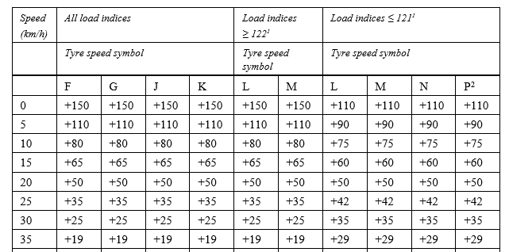


6. Replace header of annex V
From:
Variation of load capacity with speed commercial vehicles tyres
to:
And add:
Of the tyre

Slide 7
Thank you for your attention

