Slide 1


Testing to benchmark the wet traction performance
of tire models for sale in the U.S.
Hisham Mohamed, Mary Versailles, Ken Yates and Brian Seymour
The 18th meeting of the Informal Working Group on Tyre GTR
Ottawa, Ontario, Canada
June 11, 2018

Slide 2

2
1
Background
2
Purpose
AGENDA
3
Tire Selection
4
Test Method
5
Test Results and Analysis

Slide 3
3
Background
GTR No. 16 on Tyres
    The U.S. abstained on initial vote, but voted yes for Amendment 1.
    The U.S. had done some limited testing to show the wet grip trailer method was suitable for self-certification.
    The U.S. indicated some concerns that tires in the North American market would require different treatment based on this limited data.
Fixing America’s Surface Transportation (FAST) Act
    Mandates a study to benchmark the wet traction performance of tires in the U.S.
    Mandates Rulemaking to establish minimum standards for tire fuel efficiency and wet traction.
    In establishing the minimum standard for tire wet traction, NHTSA is required to use the mandated benchmarking study to ensure that passenger tire wet traction performance capability is not reduced to achieve improved tire fuel efficiency.

Slide 4
4
Purpose
To obtain wet traction/grip data:
320 tires of various types tested using the GTR/ECE 117 rev3 standards as guidelines for testing procedures.
Compare 14” to 16” SRTTs.
Data use:
  Set minimum standards for FAST Act mandate.
  Establish consumer ratings.
  Examine GTR and other existing standards when making these decisions.

Slide 5
5
Tire Selection:

Slide 6
6
Tire Selection:

Slide 7
7
Test Method:
GTR/ECE 117 rev3 standards as guidelines for testing procedures.
We used the UTQG surface at SATF.
The test gathered asphalt and concrete peak data.
Equipment requires ten measurements per surface to upload data to database.
We used first six valid measurements to calculate wet grip index.
Reference tires (R):
First set of tests (160 tires/80 sets): Uniroyal Tiger Paw SRTT (ASTM E1136 – P195/75R14).
Second set of tests (160 tires/80 sets): Uniroyal Tiger Paw SRTT (ASTM F2493 – P225/60R16).
Test Sequence: R1, T01a, T01b, R1, T02a, T02b, and ending with R1.
Within the test Sequence each tire was tested alternately on asphalt and concrete until ten measurements were obtained.

Slide 8
8
Test Method:
Test loads:
        For test tires: 75% of their load index (LI).
  For 14” control tires: 50% of the GTR specified range (445 kg to 508 kg or 981 lbs. to 1119.9 lbs.) or 476.3 kg (1050 lbs).
  For 16” control tire: 75% of tire capacity (547.5 kg or 1207 lbs).
Cold inflation pressure:
  For control tires (SRTTs) and for standard load test tires: 179.3 KPa (26 psi).
  For extra load (XL) test tires: 220.6 KPa (32 psi).
Test Speed: 64.4 ± 1.6 km/h (40 ± 1 mph).
Test “surface” temperature limit: 35° C (95 ºF).
  If we exceed the temperature limit we stop at the reference tire.
  We measure ambient temperature but didn’t use it as criteria to limit testing.

Slide 9
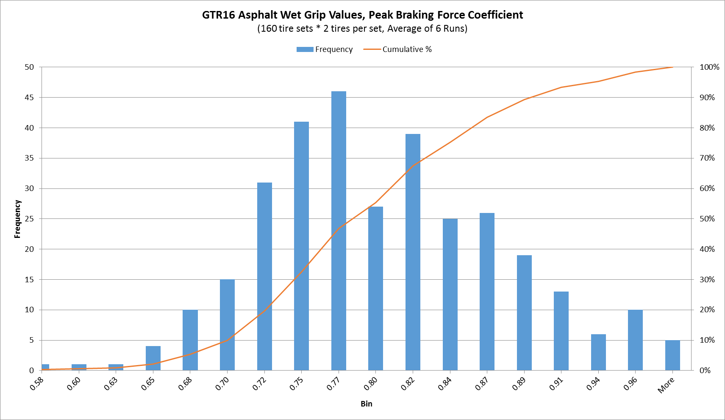
9
Test Results and Data Analysis:

Slide 10
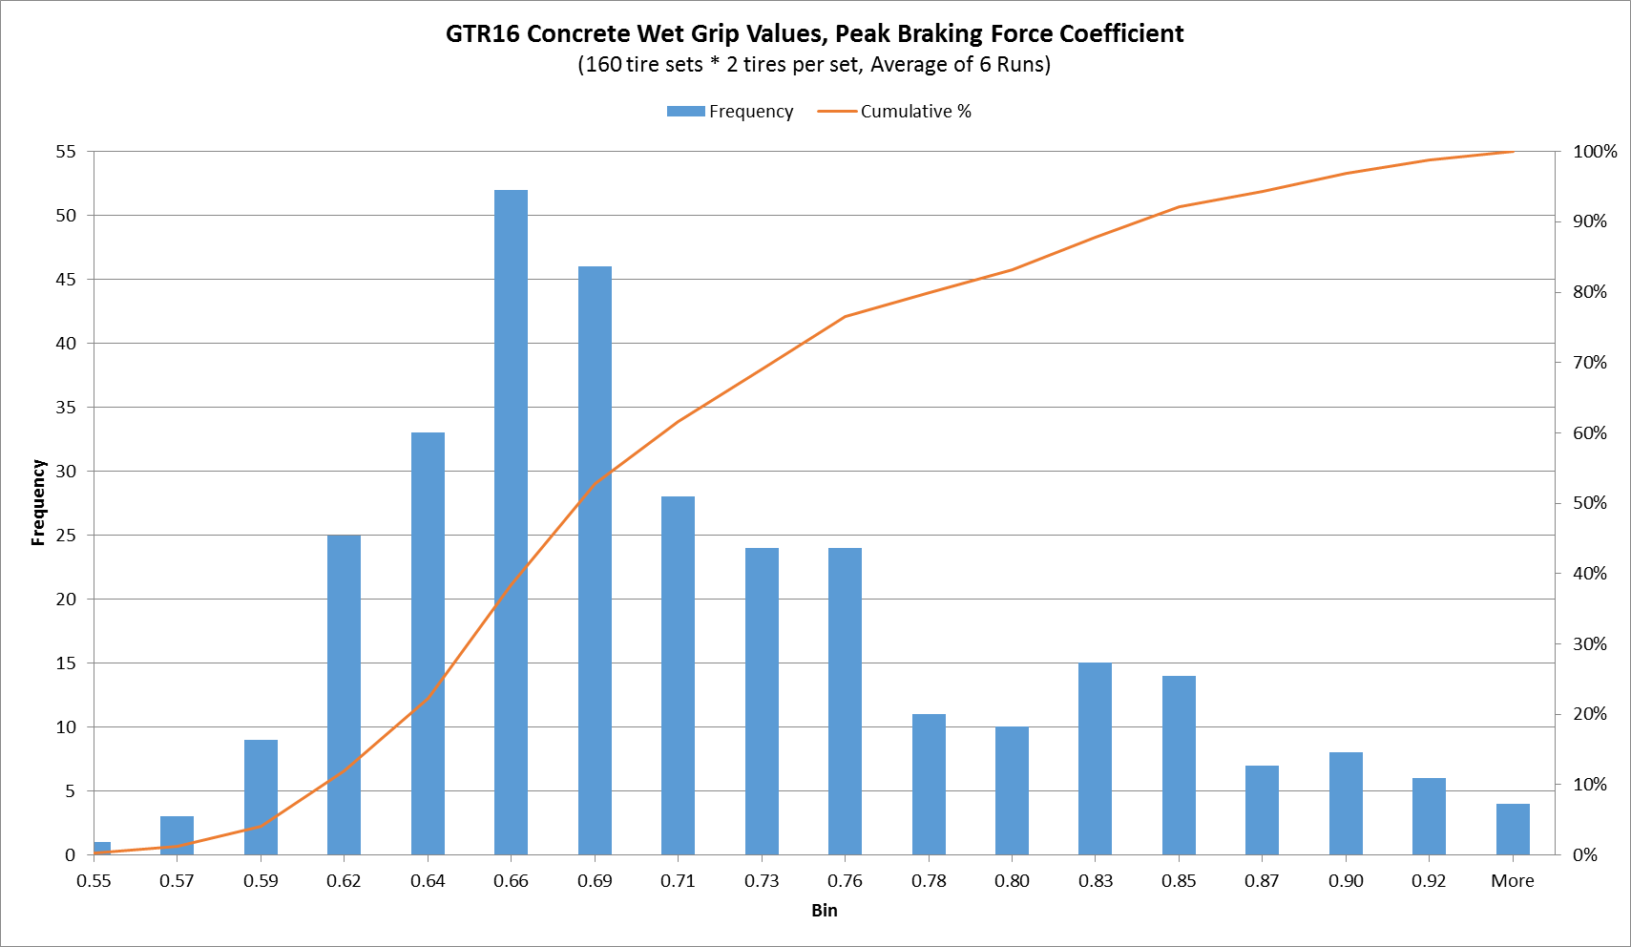
10
Test Results and Data Analysis:

Slide 11
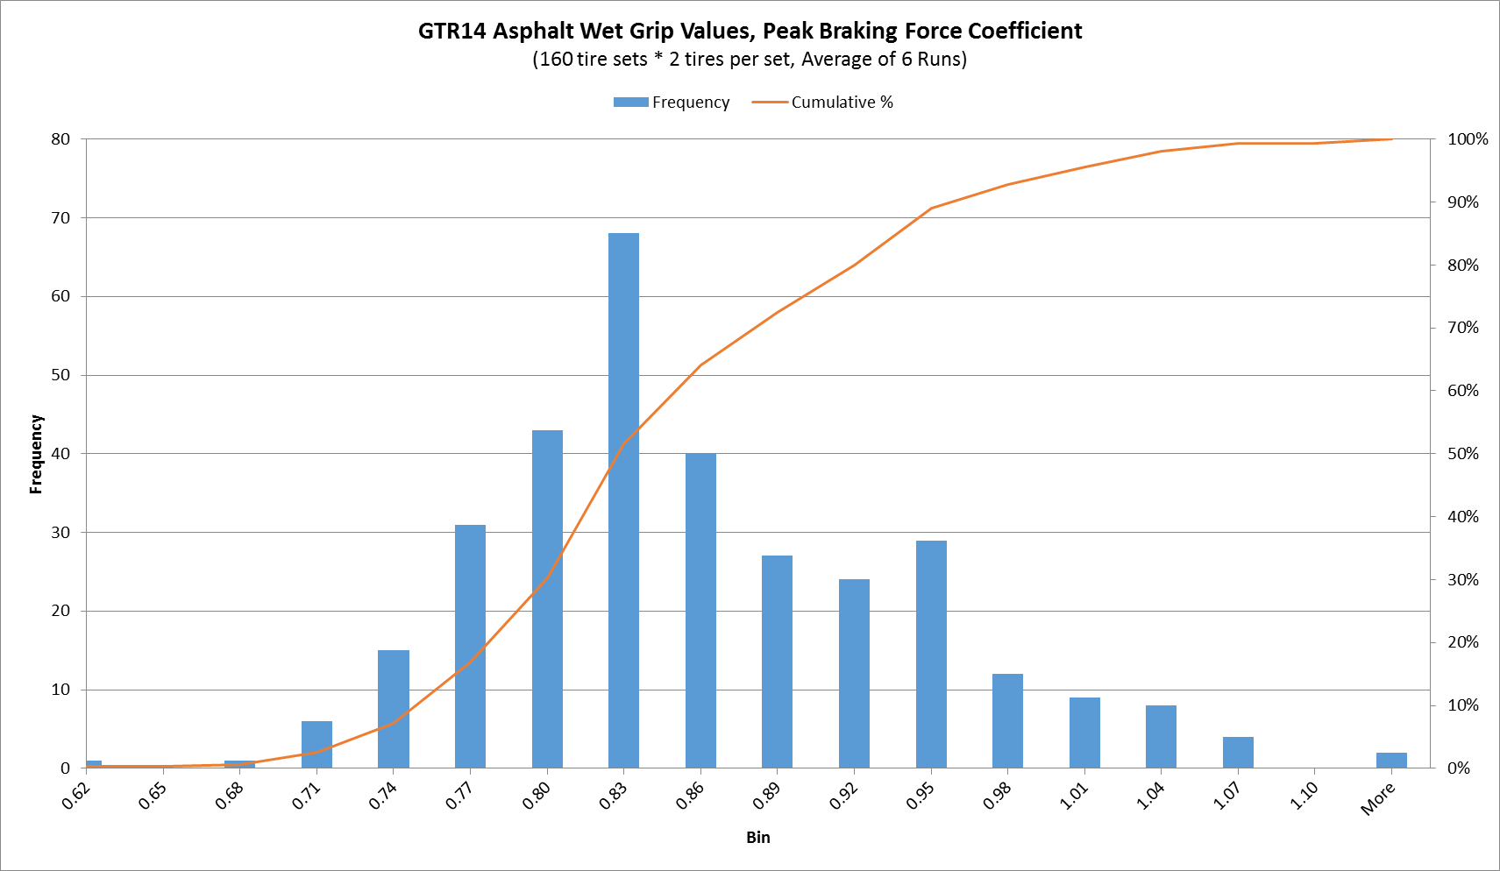
11
Test Results and Data Analysis:

Slide 12
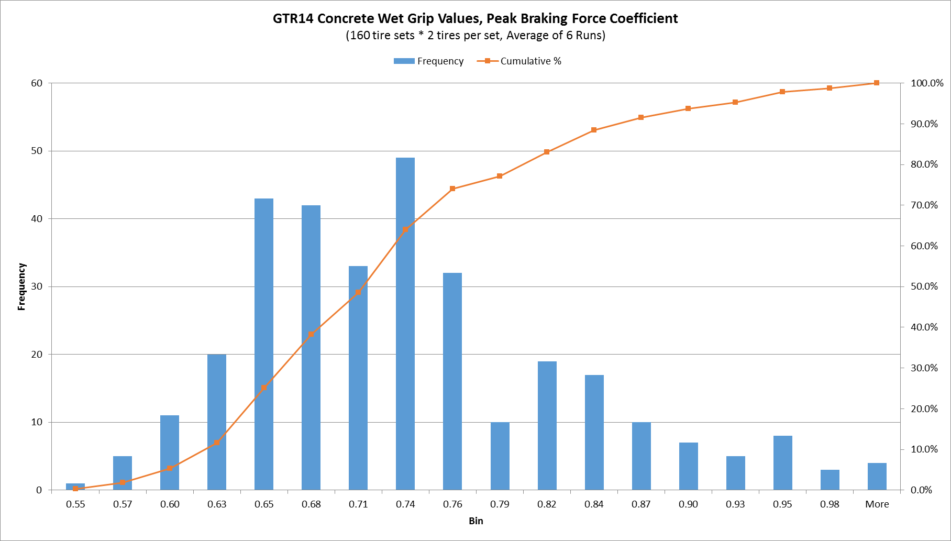
11
Test Results and Data Analysis:

Slide 13

12
Test Results and Data Analysis:
Wet grip index calculations:
Obtain six valid runs with a CV less than 5.
Adjust the SRTTs reference/control tires using table 3 of R117 rev3 to determine the adjusted peak breaking coefficient (Ra).
For pre R117 rev3 and in our case for the tires ran against the 14” SRTTs, the calculation is as follows:
G = Ta / Ra
    where Ta is average of six valid coefficients of test tire.
For tests using R117 rev3 and later versions or 16” SRTTs the wet grip index formula used:

Slide 14
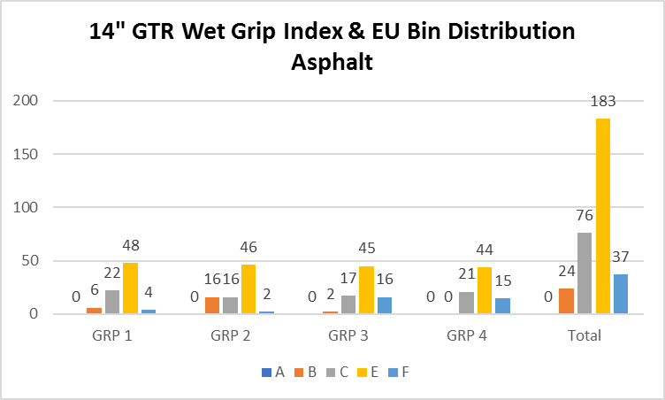
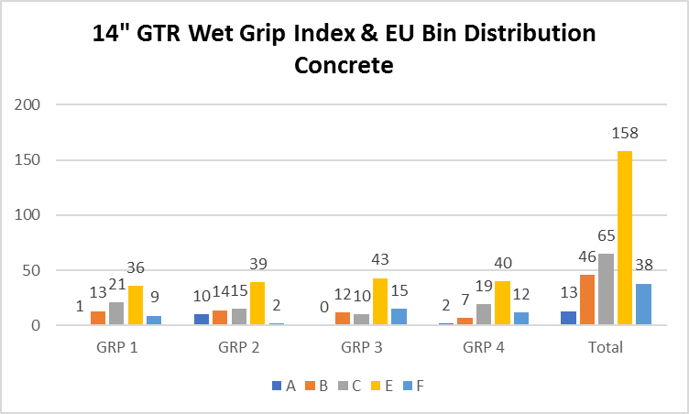
13
Test Results and Data Analysis:

Slide 15
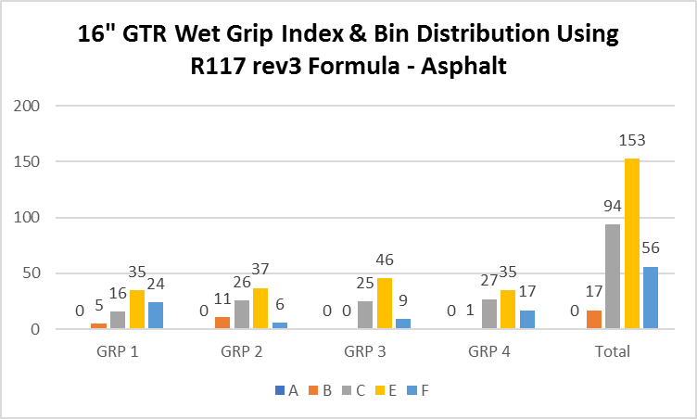
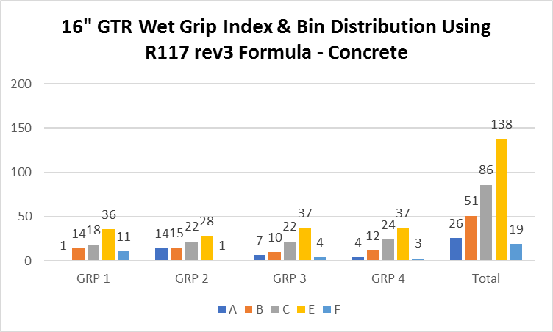
14
Test Results and Data Analysis:

Slide 16
14
Test Results and Data Analysis:

Slide 17

15
Thank you!

