Slide 1
Drive Trace Indices in WLTP
IWG No. 22
Ispra, Italy, April 2018
Bill Coleman

Slide 2
RMSSE vs Delta CO2 (for Lab.) – Petrol vehicle

Slide 3
RMSSE vs Delta CO2 (for Lab.) – Diesel vehicle

Slide 4
Is there a need for further discussion?
RMSSE shows no correlation to CO2 measurements
No one appears to understand why Japan sees lower values than Europe
  Does not appear to be related to the high share of petrol engines in Japan compared to Europe
  Does not appear to be related to the high share of automatic transmissions in Japan compared to Europe
  Does not appear to be related to the different drive cycle in Japan compared to Europe
RMSSE is certainly a measure of the accuracy of following the drive trace, but which limit is correct considering the lack of influence on the measured parameters?
Should we be considering limits for electrified vehicles when we still don’t understand the data on ICE vehicles?
Massive rejection rates could seriously affect the practicability of in-service testing

Slide 5
Back-up
Previous Data from ACEA members

Slide 6
background
Some ACEA members raised several times that an RMSSE limit value of 0.8 km/h would lead to a disproportionate scrap rate and would increase the testing burden, thus requiring more testing capacities.
The industry was asked to provide data to illustrate its statement.
ACEA asked its members to analyse the RMSSE and will present the results received.

Slide 7
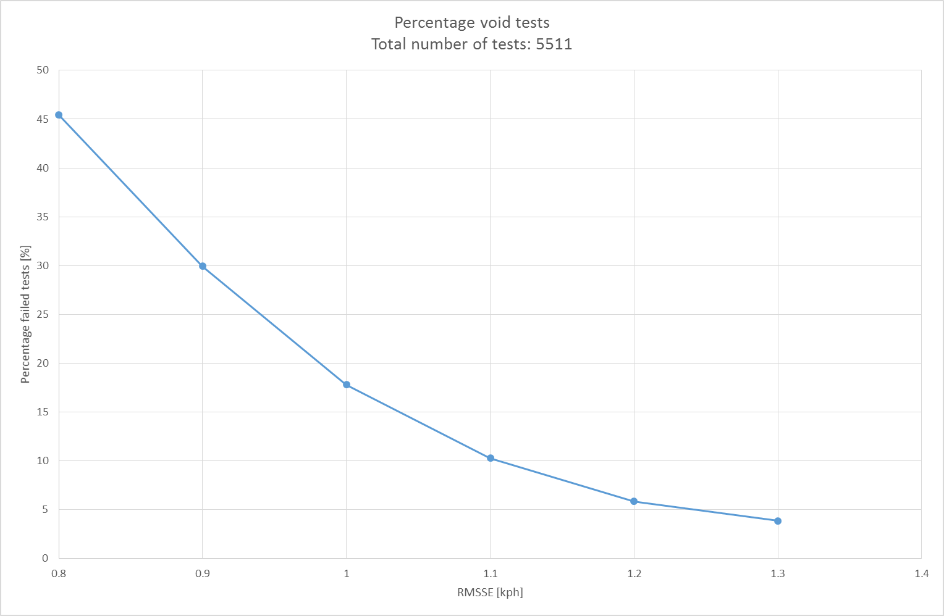
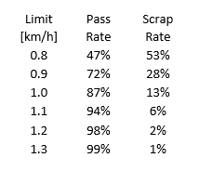
OEM1
0.8
1.3
55%
>95%
45%
<5%

Slide 8
OEM2
0.8
1.3
88%
100%
12%
0%
*Investigation done in one lab with few experienced drivers

Slide 9
OEM3: background
In May 2015 OEM3 analysed a high volume of tests run in house on cycles WLTC (4 phase cycle and individual phases), FTP and US-06 to establish ASCR, RMSSE and IWR metrics.
The WLTC drive has been shown on the drivers aid without tolerance bands, the drivers were instructed to follow the trace. This data was collected since the cycle was finalised (v 5.3) and post processed in May 2015.
2017 WLTP datasets from OEM3 in Europe and OEM3 in North America have been analysed:
    Last 500 WLTPs for OEM3 in Europe.
    WLTPs run since 01 May 2017 for OEM3 in North America.

Slide 10
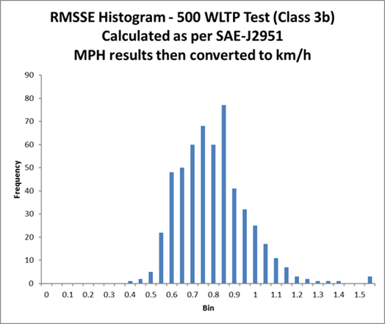
OEM3: Nov 2017 EU WLTP RMSSE
  Proposed limit of 0.8 km/h gives valid test pass rate of 47% and
  scrap rate of 53%, calculated in km/h.

Slide 11
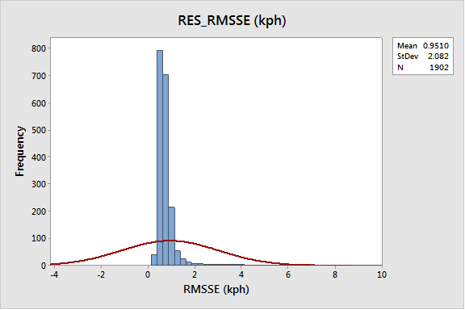
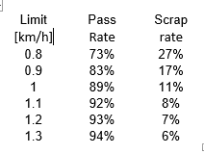
OEM3: Nov 2017 North America WLTP RMSSE
  Proposed limit of 0.8 km/h gives valid test pass rate of 73% and
  scrap rate of 27%, calculated in km/h.

Slide 12
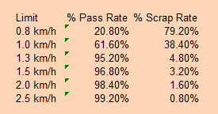
OEM3: May 2015 WLTP RMSSE
Limits need to be converted in to km/h for this RMSSE limit of 0.8 mph = 1.3 km/h would give >95% test validity.
Proposed limit of 0.8 gives valid test pass rate of 21% calculated in km/h. SAE calculation spec refers to mph.

Slide 13
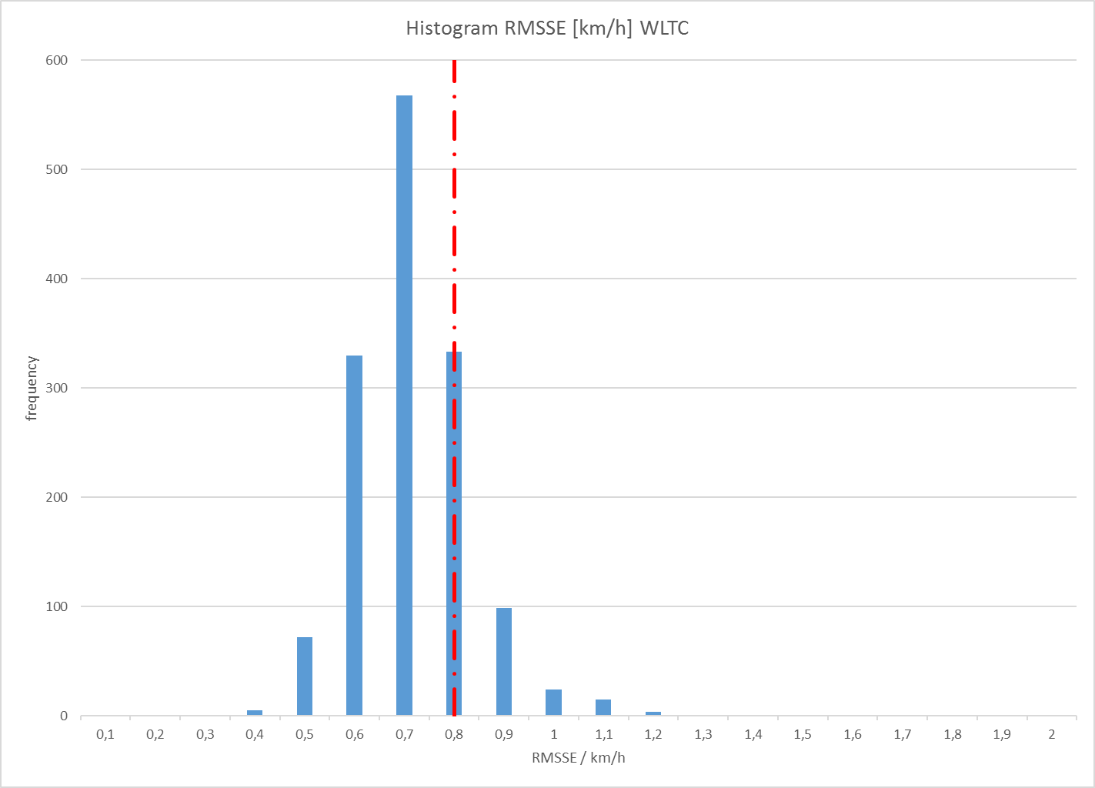
OEM4: Oct./Nov. 2017 WLTP RMSSE
Limit [km/h] | Pass Rate | Scrap Rate
0,8 | 67,24% | 32,76%
0,9 | 90,21% | 9,79%
1 | 97,03% | 2,97%
1,1 | 98,69% | 1,31%
1,2 | 99,72% | 0,28%
1,3 | 100,00% | 0,00%
Limits need to be converted in to km/h for this RMSSE limit of 0.8 mph = 1.3 km/h would give >95% test validity.
Proposed limit of 0.8 gives valid test pass rate of 21% calculated in km/h. SAE calculation spec refers to mph.

Slide 14
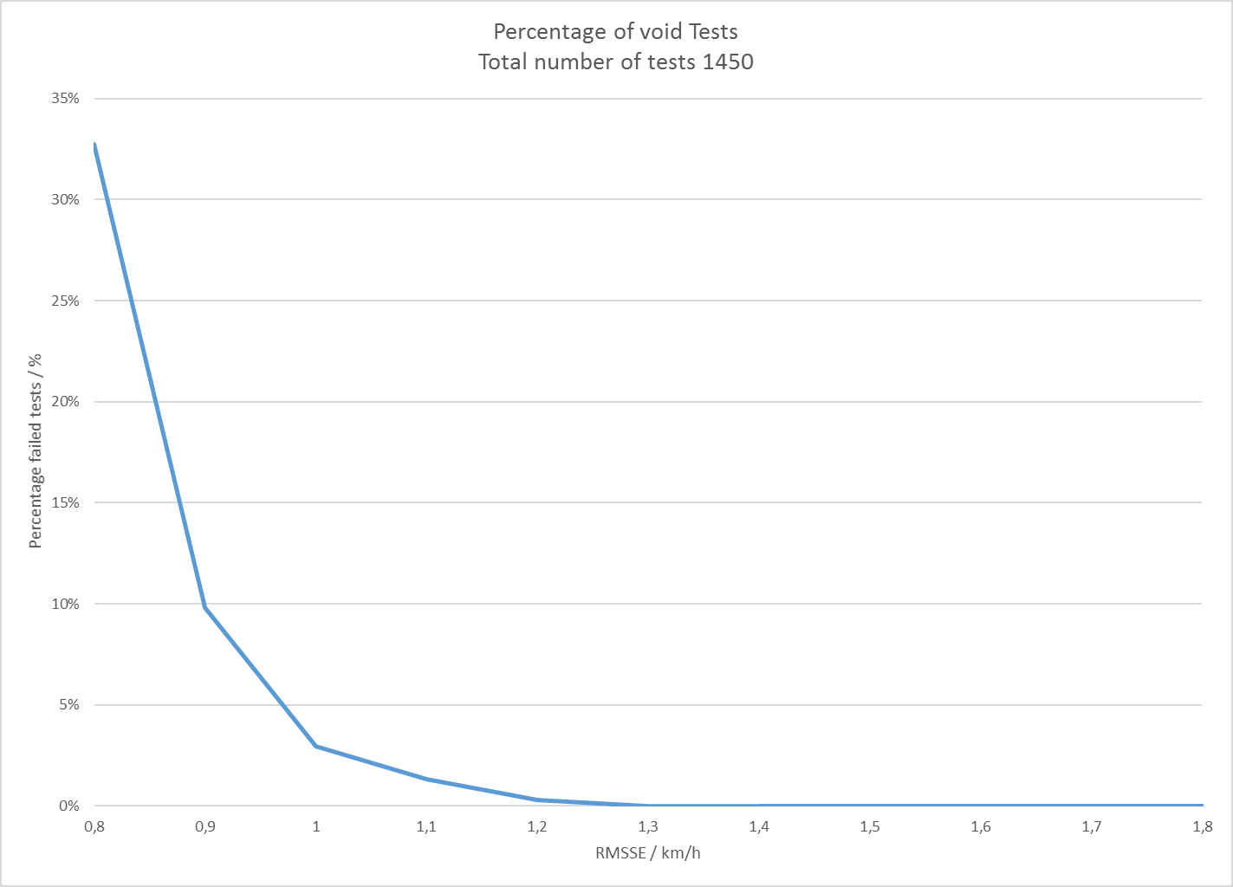
OEM4: Oct./Nov. 2017 WLTP RMSSE
Limit [km/h] | Pass Rate | Scrap Rate
0,8 | 67,24% | 32,76%
0,9 | 90,21% | 9,79%
1 | 97,03% | 2,97%
1,1 | 98,69% | 1,31%
1,2 | 99,72% | 0,28%
1,3 | 100,00% | 0,00%
Limits need to be converted in to km/h for this gtr RMSSE limit of 0.8 mph = 1.3 km/h would give >95% test validity.
Proposed limit of 0.8 gives valid test pass rate of 21% calculated in km/h. SAE calculation spec refers to mph.

Slide 15
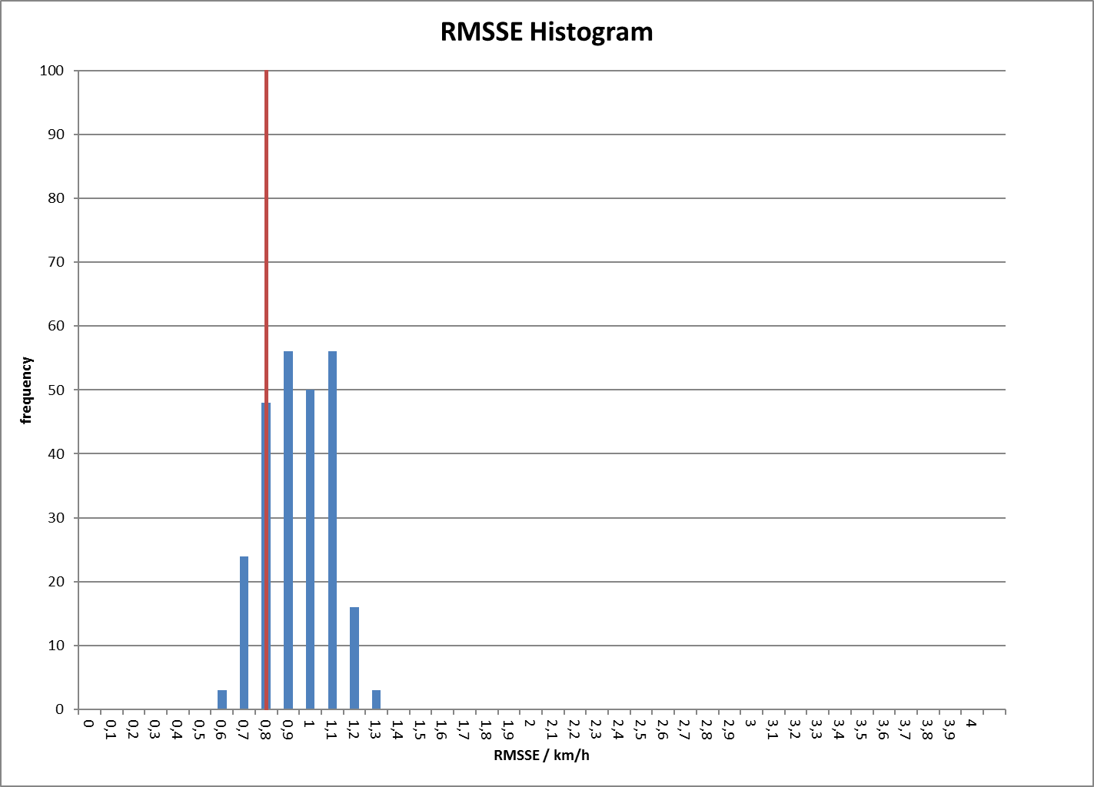
OEM4: July 2015 WLTP RMSSE
Limit | % Pass Rate | % Scrap Rate
0,8 | 29,30% | 70,70%
1 | 70,70% | 29,30%
1,3 | 100,00% | 0,00%
1,5 | 100,00% | 0,00%
2 | 100,00% | 0,00%
2,5 | 100,00% | 0,00%
Limits need to be converted in to km/h for this RMSSE limit of 0.8 mph = 1.3 km/h would give >95% test validity.
Proposed limit of 0.8 gives valid test pass rate of 21% calculated in km/h. SAE calculation spec refers to mph.

Slide 16
conclusion
Adopt driving trace index tolerance criteria for RMSSE as per the following counter proposal:
  RMSSE limit of 1.3 km/h
It is essential to raise the RMSSE limits significantly beyond 0.8 km/h to avoid an unnecessarily stringent test void rate. This is critical for on-time delivery of WLTP certified products that laboratory efficiency is not adversely compromised given the necessary already high number of WLTP tests.

Slide 17
THANK YOU FOR YOUR ATTENTION
@ACEA_eu
www.ACEA.be

