Slide 1
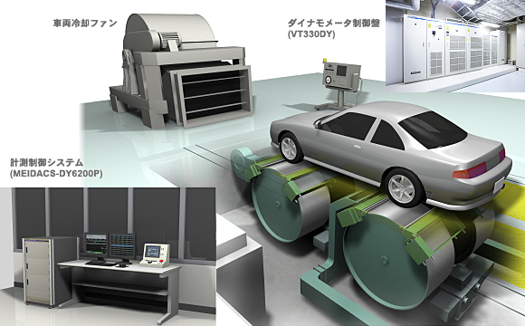
Status report
Dual-Axis dyno taskforce
WLTP-22-10e
by Iddo Riemersma (for EC)
22nd meeting of WLTP IWG
17-20 April 2018, Ispra
cooling fan
dynamometer controller
measurement unit

Slide 2
Current status
The GTR text proposal was discussed and agreed within the taskforce shortly before IWG 21
Discussion on vehicle restraining started in March 2018, upon delivery of a JSAE report (no JASO standard available yet)
A proposal on vehicle restraining by Japan is currently being discussed in the TF

Slide 3
outlook
The taskforce will continue to discuss the issue of 4WD dyno vehicle restraining and prepare a text proposal.
At this moment there is good progress, and there are no obstacles foreseen
After solving the restraining issue, the taskforce will continue to address solutions for other than Type 1 tests
(CoP, Low Temperature, etc.)

Slide 4
additional information

Slide 5
Infographic
4WD dynamometer in 4WD operation
Contracting Party option
4WD dynamometer in 2WD operation
(upon demonstration of equivalency)
2WD dynamometer in 2WD operation
(upon demonstration of equivalency)
4WD vehicle
4WD vehicle
converted to 2WD
4WD vehicle
converted to 2WD
4WD vehicle
converted to 2WD
4WD vehicle
converted to 2WD
4WD vehicle
2 powered axles
mainly powered axle is front
(situation for rear is equivalent)
single roller
dynamometer
twin-roller
dynamometer
2WD vehicle
2WD vehicle
2WD vehicle
2WD vehicle
2WD vehicle
2WD vehicle
1 powered axle
front wheel drive
(situation for rear wheel drive is equivalent)
single roller
dynamometer
twin-roller
dynamometer
4WD dynamometer in 4WD operation
(at the request of the manufacturer)
4WD dynamometer in 2WD operation
2WD dynamometer in 2WD operation
dyno: simulates road load and inertia
dyno: just rotating, not included in energy balance
vehicle: powered axle
vehicle: non-powered axle / in case of 4WD vehicle:
a powered axle, that is converted such, that it
is non-powered for dyno testing

