Slide 1
Input on wind tunnel criteria discussions
For improvement of UNECE WLTP procedure
BMW | 18.04.2018

Slide 2
Input on wind tunnel criteria discussions
Introduction
During the New Issues Task Force meeting in Paris (7.-8.3.2018), most of the improvements for the wind tunnel criteria have been agreed.
BMW took on board two open tasks:
Improving the criteria for the validation process.
Checking the issue of having a cd*A curve (proposal of Japan).
Those are now presented.

Slide 3
Input on wind tunnel criteria discussions
Clarifying validation procedure
6.2.4. Approval criteria
[…]
Each combination of roller chassis dynamometer or moving belt and wind tunnel shall be approved separately.
This includes the application of different wind speeds: Every combination of wind speeds, that is to be used for homologation, is to be validated separately.
Example: Measured wind speeds 80, 100, 120, 140.
Validated combinations: 80&120, 100&140.
Using 80&140 would not be OK, if not validated.
The purpose of the validation is to proof, that a coast down result matches the lab results. This has to be done under the same conditions for validation as for the usage during homologation. Otherwise by using different wind speeds incorrect values could result (in the one or other direction).

Slide 4
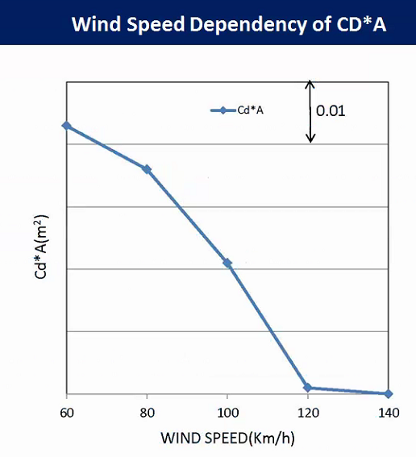
Input on wind tunnel criteria discussions
Requirement of wind speeds – page 1/2
Normally a cd*A value is constant over the velocity. But there are vehicles, where this is not the case (see example from Japan).
From that example, 3 road load curves are determined: a best case, a precise curve, and an approximation with one cd*A value.

Slide 5
Input on wind tunnel criteria discussions
Requirement of wind speeds – page 2/2
Study on extreme case: | cycle energy (4phase) | delta cycle energy | delta CO₂ | conclusion
use cd*A curve (reference) | 11.201 MJ | base | base | significantly more accurate than "best case"
use the best case cd*A value | 11.096 MJ | -0.95 % | -0.65 g/km (4phase) -0.36 g/km (3phase) | could give too low CO₂ values for such vehicles
use one cd*A value (weighted average) | 11.194 MJ | -0.07 % | -0.06 g/km (4phase) 0.07 g/km (3phase) | good approximation, that limits effort and complexity.
Although there are rare case, where the cd*A is increasing at lower speeds, the gtr should deal with that situation.
On the other hand, using a cd*A-curve in the approval process brings a lot of complexity and even the situation, that for one vehicle there could be 2 cd*A values, one for homologation (e.g. vehicle H), one for interpolation (to use for the deltas). This would be very confusing and intransparent.
Scope: Measuring cd*A at two wind speeds is applicable for vehicle H and L, not for options / deltas for interpolation purpose.
Conclusion: Use two wind speeds, to avoid situations like the example above gaining a benefit of ~0.7 g/km; but using a weighted cd*A in the process (one value) instead of a curve, in order to keep approval process and IT tools simple, should be possible at least as an alternative. Having only one cd*A value will provide traceability and transparency towards authorities.
Note: H and L are the basis for interpolation, which is done with a single cd*A value.
Please note also, that for most of the vehicles, this situation does not occur at all, and the error is not even small but zero.

Slide 6
Thank you!

