Slide 1
Drafting Coordinator Report
WLTP-22-13 Drafting Coordinator report version 3
IWG # 22
Ispra, April 2018

Slide 2
WLTP GTR
Amendment 4 of GTR 15 was used as the benchmark GTR since the January 2018 GRPE meeting. That version is:
GRPE-76-26r1e
GTR 15 was amended at a number of places since January. These amendments are shown on the next pages.

Slide 3

WLTP GTR: II. Text of the global technical regulation,
3. Definitions
DC was requested at IWG 21 to come up with a definition of a "coastdown run". As a result, the following three terms have been defined and the input of this group is welcome.
3.2.31. "Coastdown" means a method to determine a vehicle's road load by freewheeling a vehicle, i.e. disconnected of its propulsion systems, from its highest reference speed point to the lowest reference speed point.
3.2.32. "Coastdown run" means a single coastdown in one direction on a test track.
3.2.33. "Split run" means performing more than one overlapping coastdown run using different starting and finishing reference speed points.
Conclusion at IWG #22 (Ispra): Open point. To be discussed at the next New Issues TF meeting or at IWG #23.

Slide 4

WLTP GTR: ANNEX 2 Gear Shifting
Text has been introduced to paragraphs 4.(a) and 4.(b) in Annex 2 (Gear shifting).
Reason (as provided by H. Steven): With these corrections a downshift by more that 1 gear could occur at the transition from a deceleration or constant speed phase to the acceleration phase. In these cases the ACCESS tool replaces the gear for the last sample of the deceleration or constant speed phase by gear 0 and sets the clutch “disengaged”.
Conclusion at IWG #22 (Ispra): This slide is for information only. The latest amendments presented at IWG #22 will be incorporated accordingly into GTR 15.

Slide 5
WLTP GTR: ANNEX 4 Road Load
Paragraphs 4.1.1.1.1. (permissible wind conditions when using stationary anemometry) and 4.1.1.1.2. (permissible wind conditions when using on-board anemometry) where wind speed peaks should be identified over 2 consecutive seconds.
See the next two slides.
This was proposed during the March 2018 New Issues TF meeting in Paris and the use of "continuous" in both cases has yet to be confirmed.
Conclusion at IWG #22 (Ispra): Open point. Still under discussion in Japan.

Slide 6
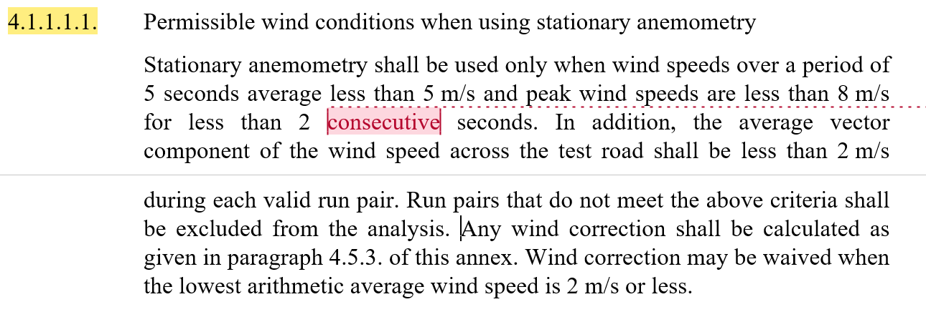
WLTP GTR: ANNEX 4 Road Load
Paragraphs 4.1.1.1.1. (permissible wind conditions when using stationary anemometry):
Conclusion at IWG #22 (Ispra): Open point. Still under discussion in Japan.

Slide 7
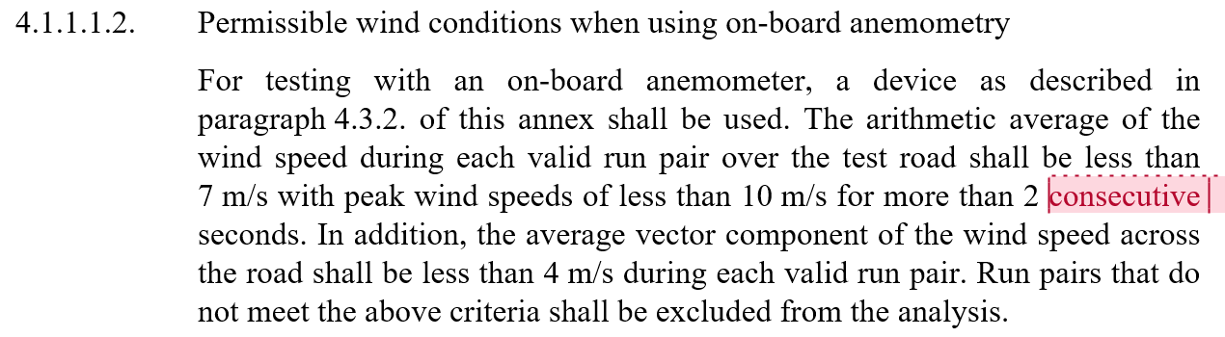
WLTP GTR: ANNEX 4 Road Load
Paragraph 4.1.1.1.2. (permissible wind conditions when using on-board anemometry):
Conclusion at IWG #22 (Ispra): Open point. Still under discussion in Japan.

Slide 8
WLTP GTR: ANNEX 4 Road Load
The equations in paragraph 4.3.1.4.4. of Annex 4 (computing the arithmetic average of the road load where the harmonic average of the alternate coastdown times is to be used), paragraph 8.1.3.2. of Annex 4 (calculating the measured road load) and paragraph 8.2.4.3. of Annex 4 (road load F_{j} at reference speed v_{j}) have been modified to include that Δv is to be defined as 5 km/h.
See the next three slides.
This was agreed during the March 2018 New Issues TF meeting in Paris.
Conclusion at IWG #22 (Ispra): Closed point. Adopted.

Slide 9
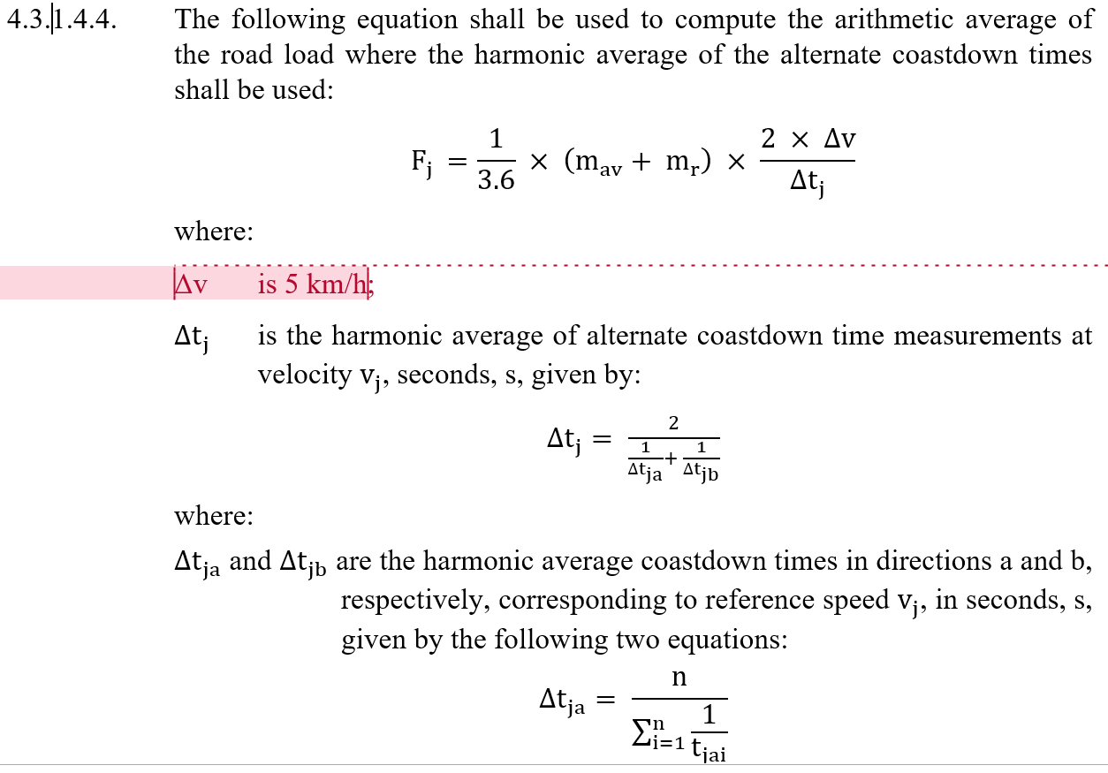
WLTP GTR: ANNEX 4 Road Load
Paragraph 4.3.1.4.4. of Annex 4 (computing the arithmetic average of the road load where the harmonic average of the alternate coastdown times is to be used):
Conclusion at IWG #22 (Ispra): Closed point. Adopted.

Slide 10
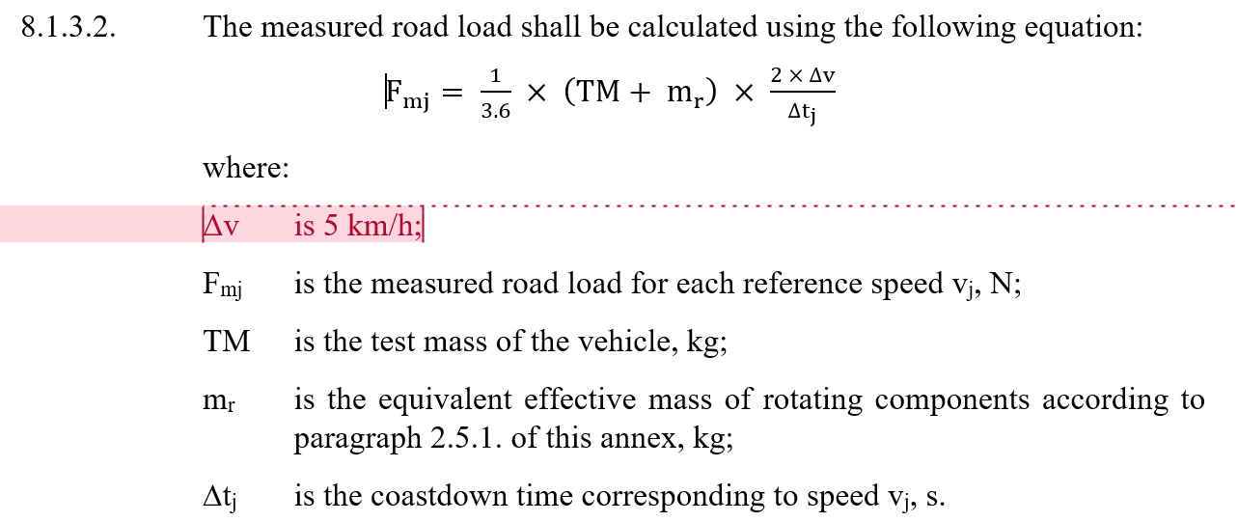
WLTP GTR: ANNEX 4 Road Load
Paragraph 8.1.3.2. of Annex 4 (calculating the measured road load):
Conclusion at IWG #22 (Ispra): Closed point. Adopted.

Slide 11
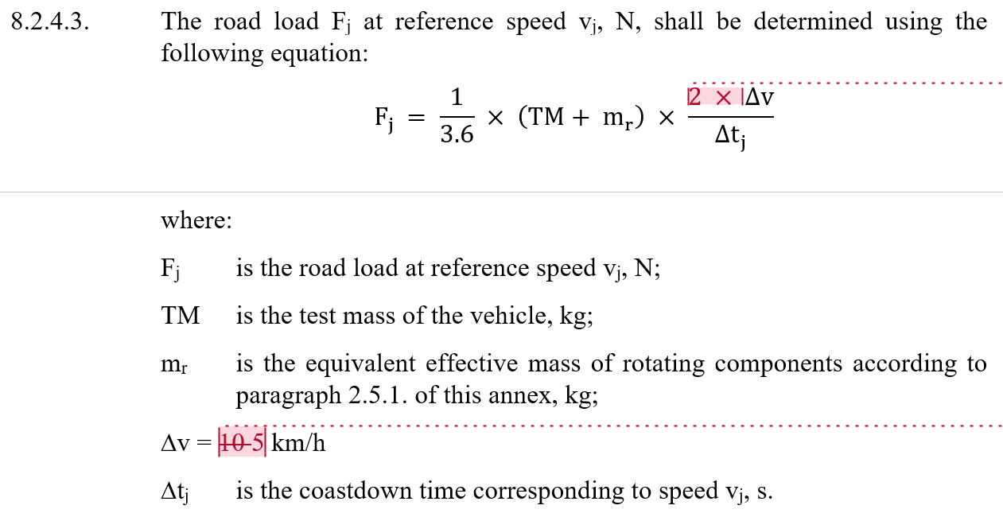
WLTP GTR: ANNEX 4 Road Load
Paragraph 8.2.4.3. of Annex 4 (road load F_{j} at reference speed v_{j}):
Conclusion at IWG #22 (Ispra): Closed point. Adopted.

Slide 12
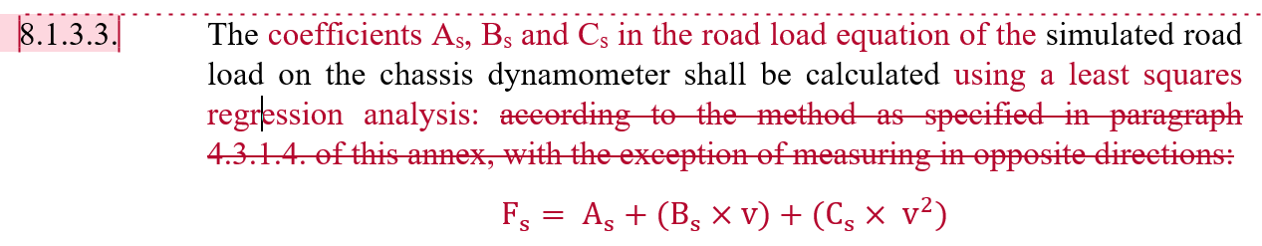
WLTP GTR: ANNEX 4 Road Load
Paragraph 8.1.3.3. of Annex 4 was modified and agreed upon during the March 2018 New Issues TF meeting in Paris to read:
Conclusion at IWG #22 (Ispra): Closed point. Adopted.

Slide 13
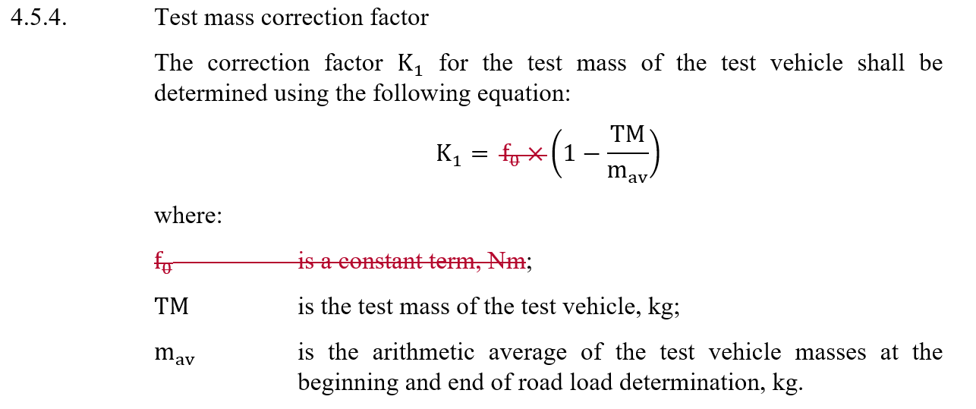
WLTP GTR: Annex 4 Road Load
The equation in paragraph 4.5.4. (Test mass correction factor) has been amended as K₁ should be dimensionless:
Conclusion at IWG #22 (Ispra): Open point. Must be analysed by experts.

Slide 14
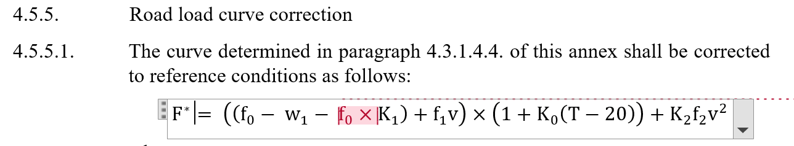
WLTP GTR: Annex 4 Road Load
Multiplying K₁ in paragraph 4.5.5.1. (Road load curve correction for a curve determined using the coastdown method) by the constant term f₀, the units in the equation become consistent:
Conclusion at IWG #22 (Ispra): Open point. Must be analysed by experts.

Slide 15
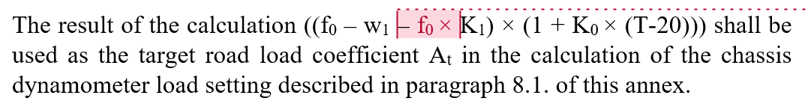
WLTP GTR: Annex 4 Road Load
In this second part of paragraph 4.5.5.1. (Road load curve correction for a curve determined using the coastdown method), K₁ should also be multiplied by f₀:
Conclusion at IWG #22 (Ispra): Open point. Must be analysed by experts.

Slide 16
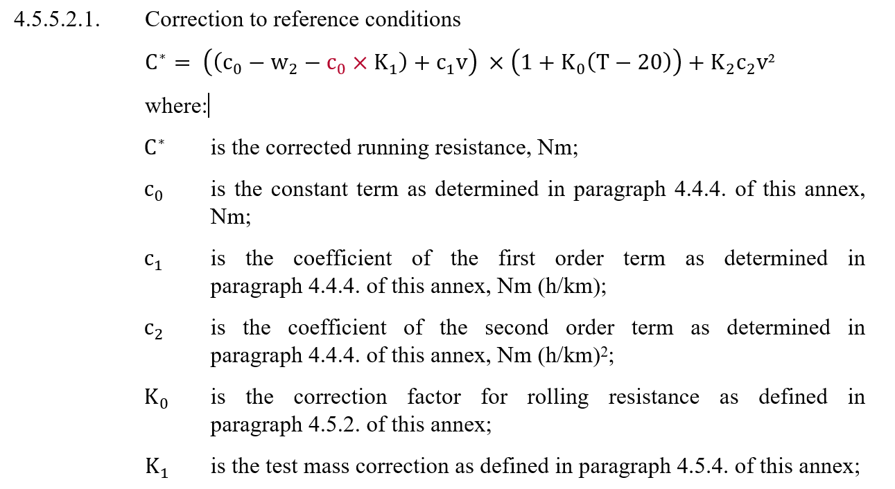
WLTP GTR: Annex 4 Road Load
Multiplying K₁ by c₀ in paragraph 4.5.5.2.1. (Road load curve correction for a curve determined using the torque meter method), the units in the equation become consistent:
Conclusion at IWG #22 (Ispra): Open point. Must be analysed by experts.

Slide 17
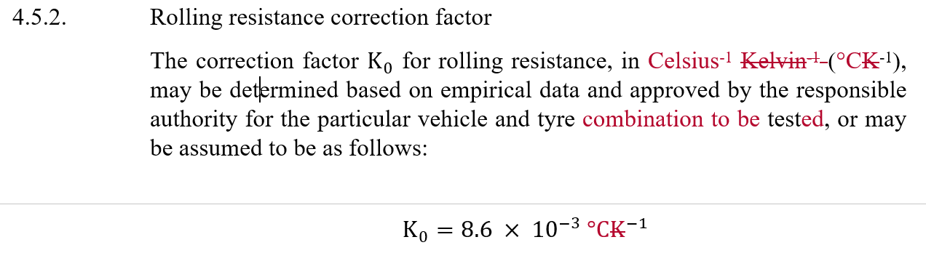

WLTP GTR: Annex 4 Road Load
In both equations, the rolling resistance correction factor, K₀, in the term $\left(1+K_{0}\left(T−20\right)\right)$ has been amended to reflect the use of °C and not Kelvin.
Conclusion at IWG #22 (Ispra): Closed point. Adopted.

Slide 18
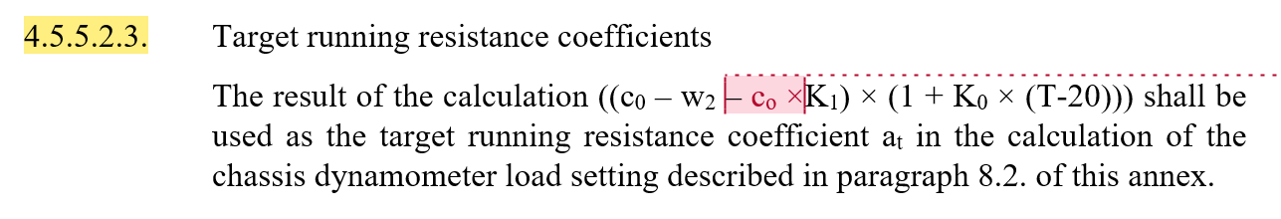
WLTP GTR: Annex 4 Road Load
The equation in paragraph 4.5.5.2.3. has been modified accordingly.
Conclusion at IWG #22 (Ispra): Open point. Must be analysed by experts.

Slide 19
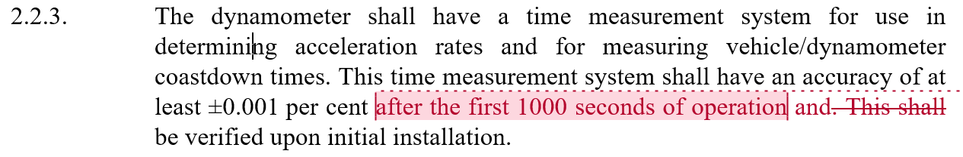
WLTP GTR: Annex 5 Test Equipment
Paragraph 2.2.3. in Annex 5 (accuracy of dynamometer time measurement) was modified and agreed upon during the March 2018 New Issues TF meeting in Paris to read:
Conclusion at IWG #22 (Ispra): Open point. Japan to make a proposal.

Slide 20
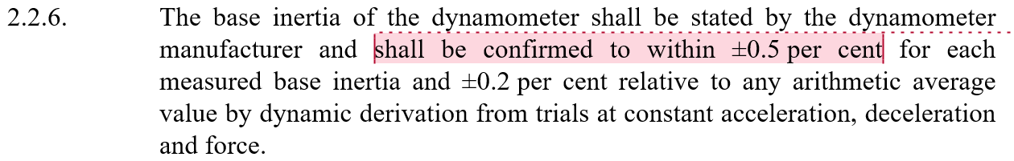
WLTP GTR: Annex 5 Test Equipment
Paragraph 2.2.6. in Annex 5 (accuracy of dynamometer time measurement). Japan is expected to make a proposal based on CFR 1066:
Conclusion at IWG #22 (Ispra): ±0.5 per cent replaced by ±1.0 per cent. Closed point. Adopted.

Slide 21
WLTP GTR: Annex 5 Test Equipment
It was requested during the March 2018 New Issues TF meeting in Paris that paragraph 3.3.5.3. in Annex 5 (CFV-CVS temperature sensor accuracy) be modified to increase the response time from 0.1 seconds to 1.0 seconds. This is to be discussed during this meeting.
Conclusion at IWG #22 (Ispra): Open point. An informal paper is to be prepared for June's GRPE meeting.

Slide 22
WLTP GTR: Annex 5 Test Equipment
The response time a UFM-type CVS (see paragraph 3.3.6.4.3. of Annex 5) may, however, remain at 0.1 seconds.
Reason from L. Hill (Horiba):
"I would not change the specification for the UFM-CVS (leave at 0.1 secs) While the sensitivity to temperature change in a CFV-CVS is inversely proportional to the square root of the absolute temperature, for a UFM-CVS it is inversely proportional to absolute temperature - which means it it more sensitive to temperature changes. We use that 0.1 second transducer in our ultra-sonic exhaust flow meters for this reason."
Conclusion at IWG #22 (Ispra): There was no conclusion but the matter appears not to be controversial.

Slide 23
WLTP GTR: Annex 5 Test Equipment
Paragraphs 3.4.2.4. (calibration of a PDP CVS), 3.4.3.2. (calibration of a CFV CVS) and 3.4.5.6. (calibration of a UFM CVS): The remaining temperatures in K were changed to °C. This was overlooked when all temperatures in the GTR were changed to °C.
Conclusion at IWG #22 (Ispra): Editorial point. Adopted.

Slide 24
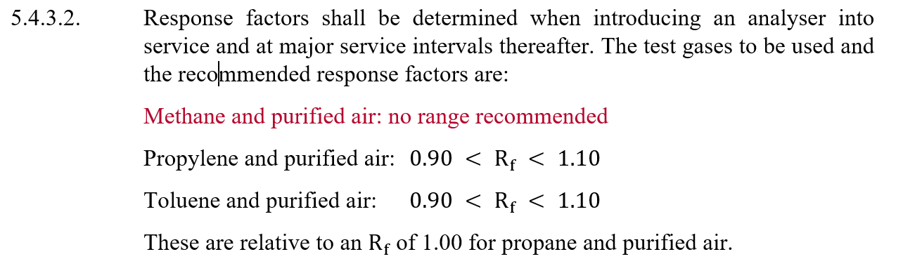
WLTP GTR: Annex 5 Test Equipment
Paragraph 5.4.3.2. (response factors): The sentence "Methane and purified air: no range recommended" was reintroduced after it was deleted a year and a half ago.
Conclusion at IWG #22 (Ispra): The subject of methane response remains an open point.

Slide 25
WLTP GTR: Annex 6 Test Procedure
Paragraph 1.2.3.8. (determination of dCO2₁, dCO2₂ and dCO2₃)
The variables mentioned above appear without any definition/identification for the first time in paragraph 1.2.3.8. of GTR 15.
DC proposes the following:
1.2.3.8. Determination of the acceptance values dCO2₁, dCO2₂ and dCO2₃
Conclusion at IWG #22 (Ispra): Closed point. Adopted.

Slide 26
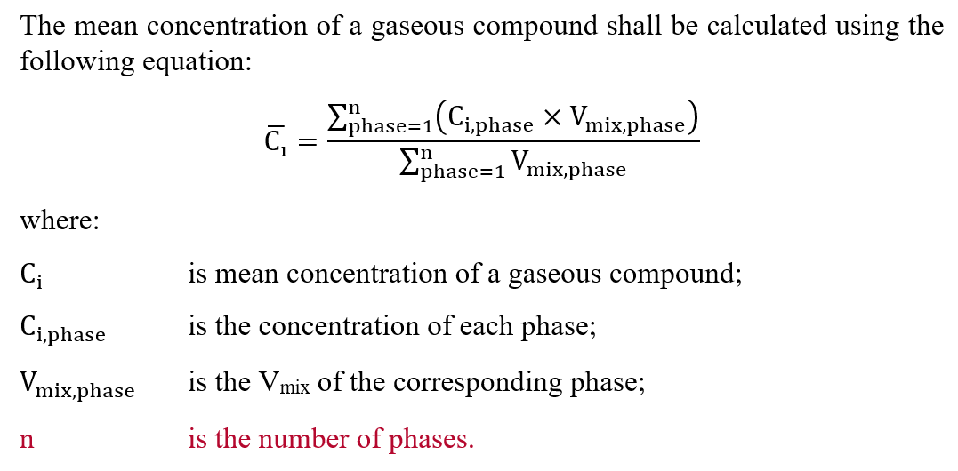
WLTP GTR: Annex 7 Calculations
Paragraphs 3.2.1.1.1. (dilution factor DF): The term "n" was not defined.
It has been defined as:
Conclusion at IWG #22 (Ispra): Closed point. Adopted.

Slide 27
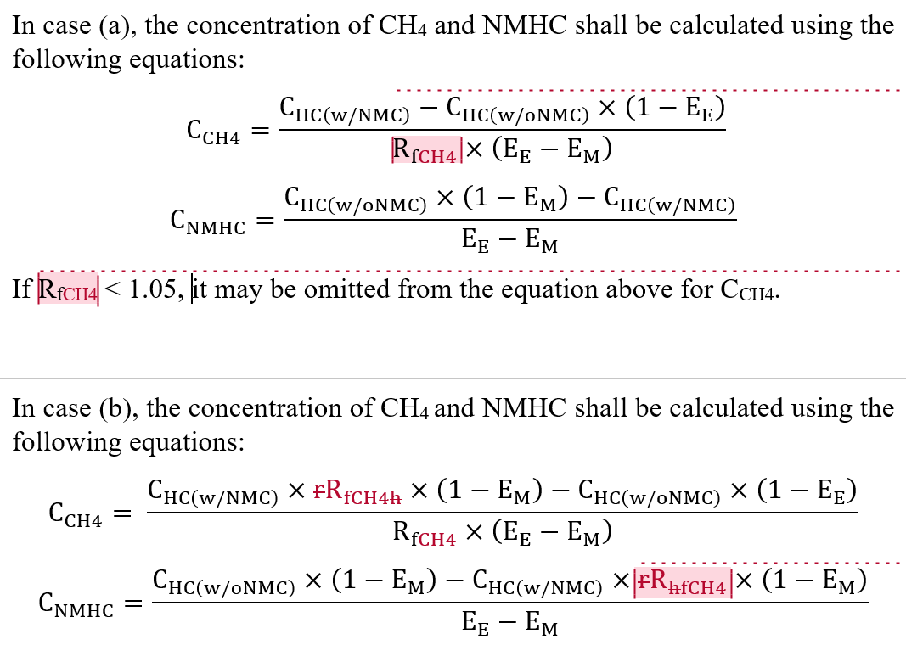
WLTP GTR: Annex 7 Calculations
Paragraph 3.2.1.1.3.2. (methane response): Typos corrected. The entire paragraph is to be reworked in this IWG.
Conclusion at IWG #22 (Ispra): Closed point. Adopted.

Slide 28
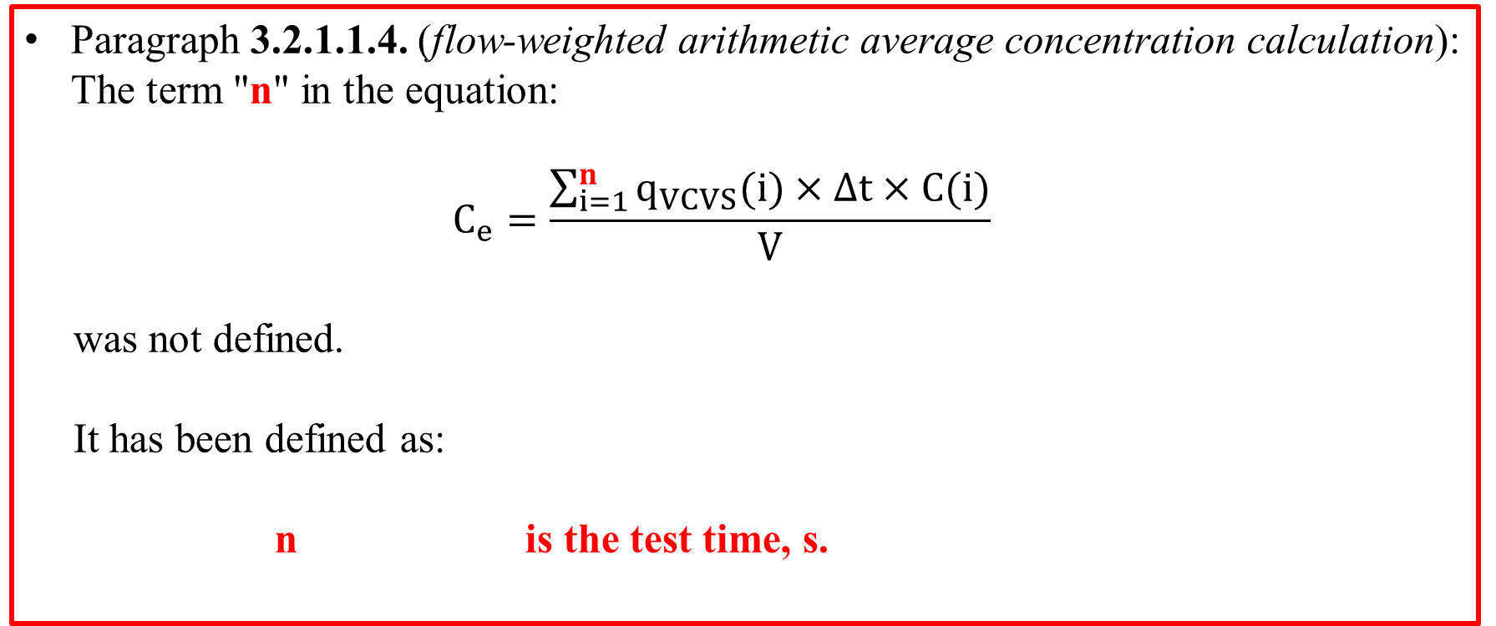
WLTP GTR: Annex 7 Calculations
Paragraph 3.2.1.1.4. (flow-weighted arithmetic average concentration calculation): The term "n" in the equation:
$C_{e}=\frac{\sum_{i=1}^{n}{q_{VCVS}(i)}×∆t×C(i)}{V}$
was not defined.
It has been defined as:
n is the test time, s.
Conclusion at IWG #22 (Ispra): Closed point. Adopted.

Slide 29
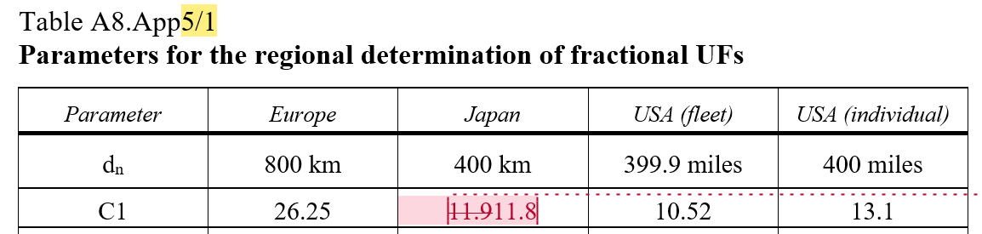
WLTP GTR: Annex 8 Electric vehicles
Table A8.App5/1 (parameters of fractional UFs): C1 for Japan changed from 11.9 to 11.8. Corrected during the March 2018 New Issues TF meeting in Paris.
Conclusion at IWG #22 (Ispra): Closed point. Adopted.

Slide 30
WLTP GTR
The GTR including its track changes is uploaded on a regular basis to the UNECE server under:
https://wiki.unece.org/display/trans/Latest+GTR+15
2018 Calendar
The 2018 calendar is available for your reference under:
https://wiki.unece.org/display/trans/WLTP+2018+calendar
Should you plan any WLTP-related event for 2018, please send me a mail with (a) what the event is (f2f meeting, web), (b) when it is to take place, (c) starting and finishing time. The calendar will be updated and uploaded as soon as possible.

Slide 31
END

