Slide 1


Meeting rules confirmation
2018.09.13
EVS-IWG Secretary
Kenichiroh KOSHIKA

Slide 2
Outline
Improvement reports
Submission condition for 16th IWG
2

Slide 3

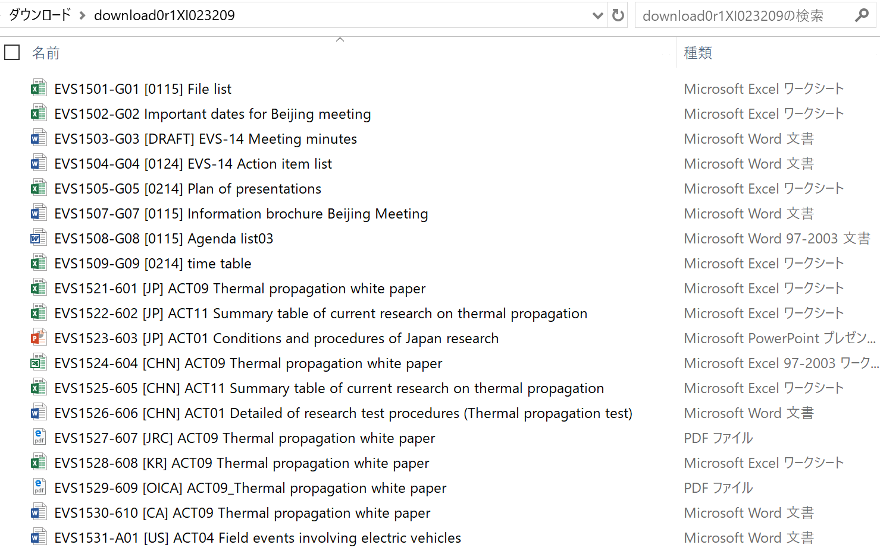
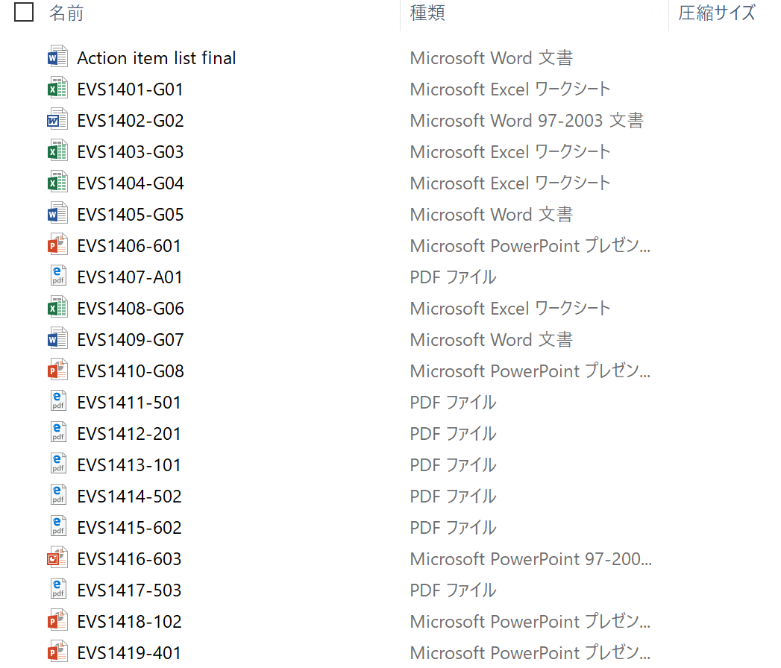
According to your requests: File names
Improvement reports
Before
After
Added more information into the file names
3

Slide 4
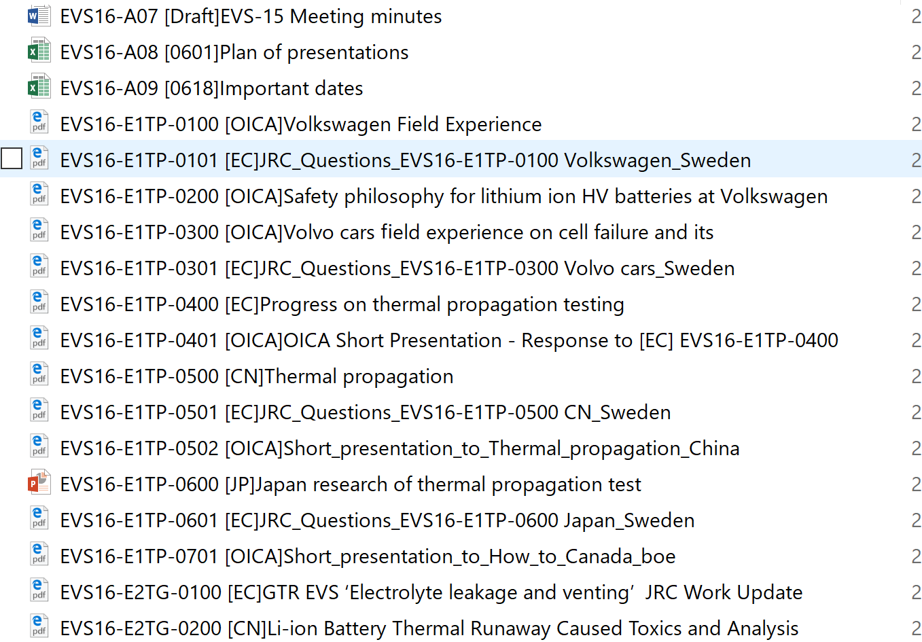
According to your requests: File names
Improvement reports
After
Main
Short presentation
Added more information into the file names
4

Slide 5
Submission condition in EVS 16th meeting
90% of technical presentations were submitted before the deadline
Thank you for your cooperation !
Please keep this high score in the next meeting.
5

Slide 6
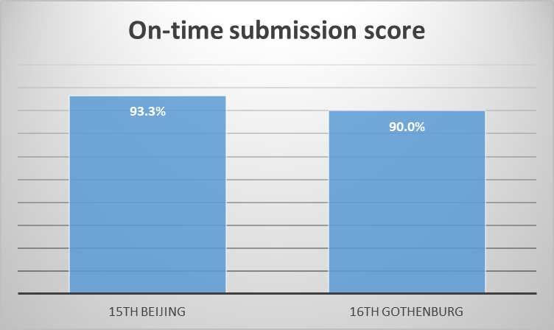
Submission condition in EVS 16th meeting
Score decreased
Please submit before the deadline.
6

Slide 7
Thank you !

