Slide 1

AEB IWG 04
Industry Position Summary
Vehicle detection
Static target
M1
Active between 10-50km/h
Full avoidance up to 35.1km/h
Speed mitigation of at least 20km/h and Collision warning required between 35.1km/h and 50km/h.
Collision Warning no later than 0.8 seconds before emergency braking procedure.
N1
Active between 10-50km/h
Full avoidance up to 24.3km/h for N1
Speed mitigation of at least 10km/h and Collision warning required between 24.3km/h and 50km/h.
Collision Warning no later than 0.8 seconds before emergency braking procedure.
Notes:
Longitudinal and Lateral acceleration in normal day driving
Accident research company in Germany
‘Sharp turns’ range from 1.9 – 5.6m/s/s
The average driver keeps a significant security margin from the physical driving limit, and this margin increases with speed.

Slide 2
AEB IWG 04
Industry Position Summary
Vehicle detection
Moving target
M1
Subject vehicle speed 60km/h
Target vehicle speed 24.9km/h
Full avoidance at test speeds
No Collision Warning requirements
N1
Subject vehicle speed 60km/h
Target vehicle speed 35.7km/h
Full avoidance at test speeds
No Collision Warning requirements
Notes:
Longitudinal and Lateral acceleration in normal day driving
Accident research company in Germany
‘Sharp turns’ range from 1.9 – 5.6m/s/s
The average driver keeps a significant security margin from the physical driving limit, and this margin increases with speed.

Slide 3
AEB IWG 04
Industry Position Summary
Pedestrian detection
M1/N1
Active between 10-50km/h
Subject vehicle speed 50km/h
Required speed mitigation of 20km/h
Crossing scenario and adult dummy only
No collision warning required
Notes:
Longitudinal and Lateral acceleration in normal day driving
Accident research company in Germany
‘Sharp turns’ range from 1.9 – 5.6m/s/s
The average driver keeps a significant security margin from the physical driving limit, and this margin increases with speed.

Slide 4
AEB IWG 04
Ref: http://www.unfallrekonstruktion.de/
Industry Position Summary
AEBS requirements
M1/N1
The regulation should not enforce a time threshold (TTC) in which AEBS should be activated.
AEBS is default ON
Driver has the ability to deactivate AEBS by a minimum of 2 presses of a button whilst the vehicle is stationary.
Pre-conditioning defined by an agreement between the technical service and the manufacturer.
Test targets are not specifically defined but may be a “soft target” and be representative of the attributes applicable to the sensor system of the AEBS under test
Cycling detection requirements to be covered in Phase 2 of the regulatory development.
Notes:
Longitudinal and Lateral acceleration in normal day driving
Accident research company in Germany
‘Sharp turns’ range from 1.9 – 5.6m/s/s
The average driver keeps a significant security margin from the physical driving limit, and this margin increases with speed.

Slide 5
AEB IWG 04
Activation Calculation
Values need to be agreed during AEBS 04
Assumptions M1: Braking Level = 5.76 m/s² Lateral Acceleration = 7.00 m/s² Lateral Offset = 2.5m
Assumptions N1: Braking Level = 4.00 m/s² Lateral Acceleration = 7.00 m/s² Lateral Offset = 2.5m

Slide 6
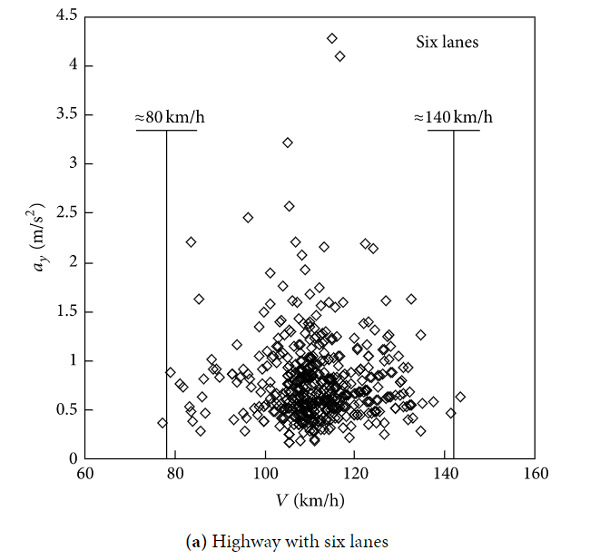
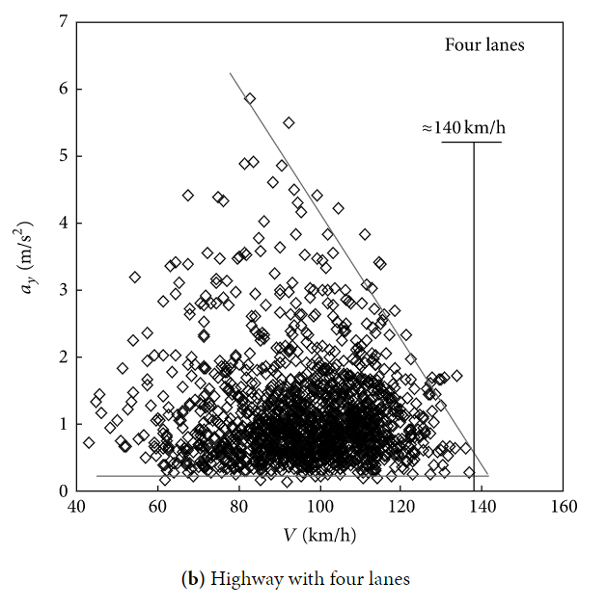
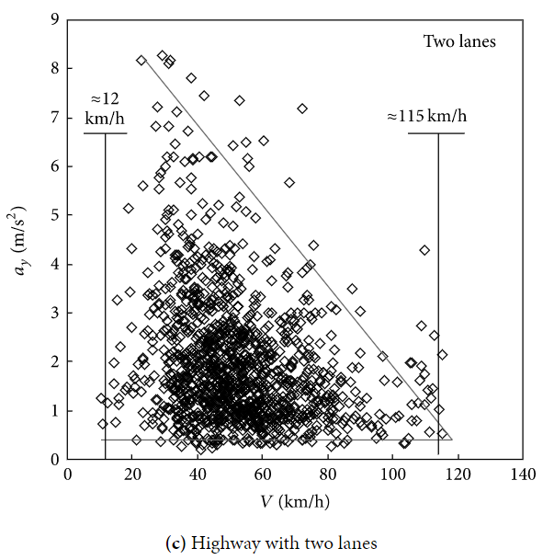
AEB IWG 04
Ref: https://www.hindawi.com/journals/ddns/2015/494130/fig3/
Activation Calculation – Parameter, Lateral Acceleration
An Experimental Study on Lateral Acceleration of Cars in Different Environments in Sichuan, Southwest China – 2014
The lateral accelerations, speeds, and trajectory curvatures of a passenger car on twelve road types with different design speeds.
Notes:
The threshold value of comfort is 1.8 m/s², with medium comfort and discomfort levels of 3.6 m/s² and 5 m/s², respectively.

Slide 7
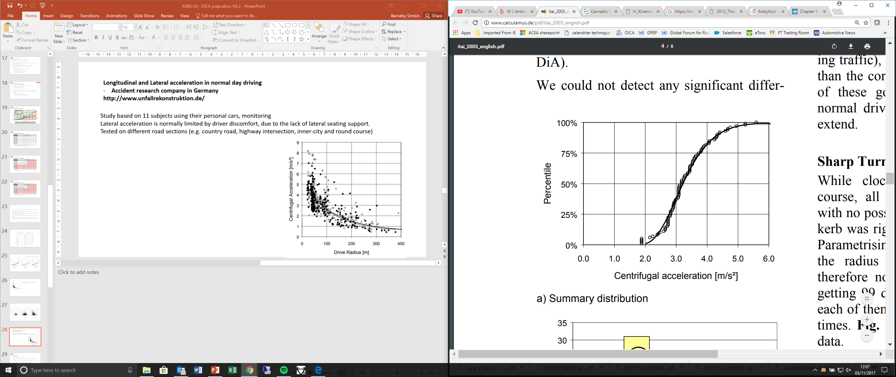
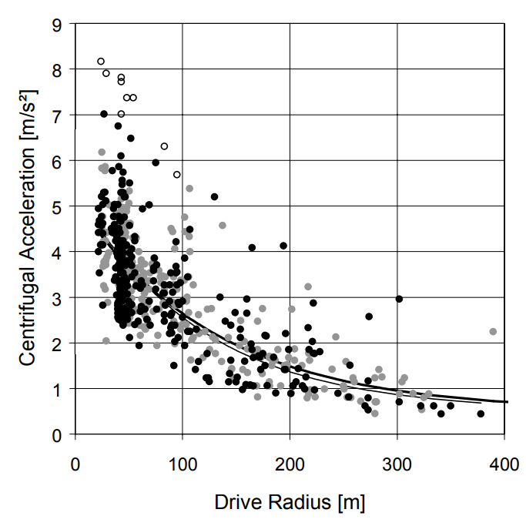
AEB IWG 4
Ref: http://www.unfallrekonstruktion.de/
Activation Calculation – Parameter, Lateral Acceleration
Study based on 11 subjects using their personal cars, monitoring
Tested on different road sections (e.g. country road, highway intersection, inner-city and round course)
Notes:
Longitudinal and Lateral acceleration in normal day driving
Accident research company in Germany
‘Sharp turns’ range from 1.9 – 5.6m/s/s
The average driver keeps a significant security margin from the physical driving limit, and this margin increases with speed.

Slide 8
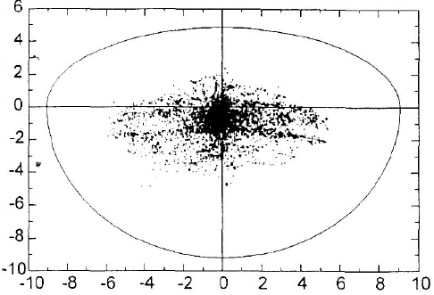
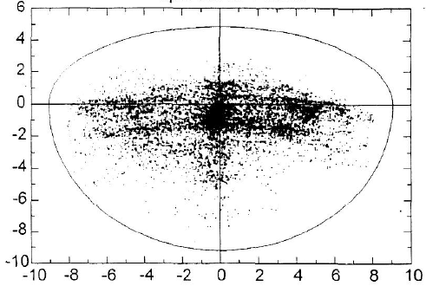
AEB IWG 4
Ref: http://www.unfallrekonstruktion.de/pdf/nickel.pdf
Activation Calculation – Parameter, Lateral Acceleration and Deceleration
normal driver
sportive driver
Longitudinal acceleration
Longitudinal acceleration
Lateral acceleration [m/s²]
Lateral acceleration [m/s²]
Normal drivers use lateral acceleration from 0 to 6 m/s².
Sportive drivers use lateral acceleration from 0 to 9 m/s².

Slide 9
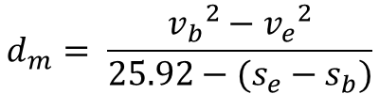
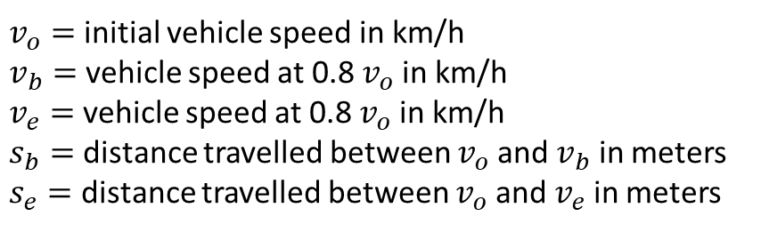
AEB IWG 04
Activation Calculation – Parameter, Deceleration
Regulated average deceleration value
R13-H
Type-0 test with engine disconnected; The mean fully developed deceleration > 6.43m/s/s
Type-0 test with engine connected; The mean fully developed deceleration > 5.76m/s/s
R13
Type-0 test with engine disconnected; The mean fully developed deceleration > 5.00m/s/s
Type-0 test with engine connected; The mean fully developed deceleration > 4.00m/s/s
$$d_{m}= \frac{{v_{b}}^{2}−{v_{e}}^{2}}{25.92−(s_{e}−s_{b})}$$
The stopping distance shall be the distance covered by the vehicle from the moment when
the driver begins to actuate the control of the braking system until the moment when the
vehicle stops; the initial speed shall be the speed at the moment when the driver begins to
actuate the control of the braking system
$v_{o}=$ initial vehicle speed in km/h
$v_{b}=$ vehicle speed at 0.8 $v_{o}$ in km/h
$v_{e}=$ vehicle speed at 0.8 $v_{o}$ in km/h
$s_{b}=$ distance travelled between $v_{o}$ and $v_{b}$ in meters
$s_{e}=$ distance travelled between $v_{o}$ and $v_{e}$ in meters

Slide 10
AEB IWG 04
Activation Calculation – Parameter, Deceleration
UNECE Regulation No.13-H/R13 the minimum service brake performance of the vehicle (Type 0 with the engine connected) is 5.76 or 4m/s² for M1 or N1 category vehicles respectively.
The regulation for advanced emergency braking shall not specify any minimum deceleration for the vehicle, since this is already regulated in R13-H / R13, but should be implicit by the performance requirements of the AEBS equipped vehicle . i.e. by defining the conditions when a collision shall be avoided or mitigated. The very same principle applies to the performance of the sensors.
AEBS emits a braking demand to the service braking system, higher values will require amendments for UNECE R13-H (& FVMSS135)
To enable technically neutral requirements for every manufacturer.
AEBS performance should be attainable in all vehicle and road conditions.

Slide 11
AEB IWG 04
Activation Calculation – Calculation strategy relevant for C2C
Continuation of braking performance is not possible at subject vehicle speeds above LPS=LPS, as above this point the theoretical brake application is applied at the last point to steer.
‘shark fin effect’ noted in AEBS-02-11 (D) AEB Car-Car and Pedestrian (2)

Slide 12
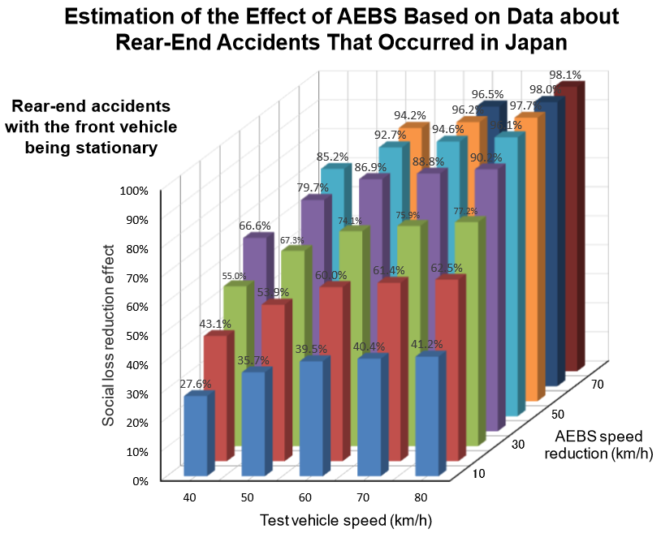
AEB IWG 04
AEBS-02-07 (J) Estimation of the Effect of AEBS (1) (1)
Activation Calculation – Calculation strategy relevant for C2C
M1
Speed mitigation of at least 20km/h at 50km/h.
Minimum social loss reduction of 53.9%
N1
Speed mitigation of at least 10km/h at 50km/h.
Minimum social loss reduction of 35.7%

Slide 13
AEB IWG 04
Activation Calculation – Collision Warning
Collision Warning at point of EBP
Collision Warning based on TTC.
>0.8seconds before EBP
Collision avoidance through automatic braking between 10km/h and [XX.X]km/h (LPS = LPB)
Collision avoidance by driver intervention in response to Collision Warning, or collision mitigation through automatic braking between [XX.X]km/h (LPS = LPB) and 50km/h

Slide 14
AEB IWG 04
Activation Calculation – Calculation strategy relevant for C2P
AEBS 03 discussed using test scenario in ENCAP 2016 protocol in the new Regulation for AEBS.
Industry proposes to use the ‘CVNA 50’ test as it is the most common recorded pedestrian to vehicle collision.
Daylight scenario
Adult dummy target travelling at 5km/h.
50% impact position
Impact at 0-5km/h = avoidance
Cannot account for steering to avoid the collision. LPS vs LPB phenomenon should not be consider for these scenarios.
Performance requirements are based on accident data.
Performance requirements for both M1/N1 category vehicles is a speed reduction of at least 20km/h at 50km/h test speed.
AEBS for pedestrian detection shall be regulated between 10 and 50km/h

Slide 15
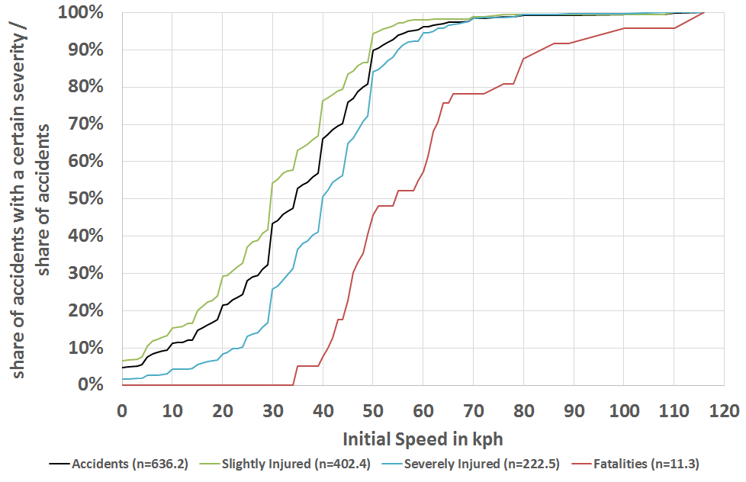
AEB IWG 04
Activation Calculation – Calculation strategy relevant for C2P (Test Scenario)
German In-Depth Accident Study (GIDAS), 2005-2017, weighted to German Federal Statistical Office (DESTATIS), 2016
DESTATIS, GIDAS analysis
Configuration |  | Accident scenarios |  | Casualties, Germany
 |  |  |  | 399 872
Car vs car | 40% | Rear-end | 46% | 73 567
Car vs truck | 6% | Rear-end | 18% | 4 319
Car vs motorcycle | 7% | Rear-end | 4% | 1 120
Car vs pedestrian | 6% | Crossing | 53% | 12 716
Car vs bicycle | 12% | Crossing | 50% | 23 992
Total |  |  |  | 115 723 29%

Slide 16
AEB IWG 04
Activation Calculation – Calculation strategy relevant for C2P (Test Scenario)
STATS 19 (2008) and the in-depth On-the-Spot database (2000-2009))
Pedestrian Impacts:
The study reviewed 28,482 collisions with pedestrians from STATS19. It was found that the highest proportion of incidents were frontal collisions with passengers cars and taxis (81%). Within this field the following information was obtained regarding the vehicles speed:
16-48kmh = 92%,
64-80kmh = 5%
97-113mph = 3%
OTS randomly reviewed 175 cases matching that scenario chosen for the STATS19 review, and found the mean vehicle speed = 44km/h

Slide 17
AEB IWG 04
Activation Calculation – Calculation strategy relevant for C2P (Test Scenario)
National Police Agency Traffic Section Traffic accident statistics March 2018
The percentage of pedestrian traffic accidents in crossing in Japan accounts for approximately 70%.
The percentage of Crossing from obstruction vehicles is only 22%.
The percentage of adults who died in traffic during walking was 97.5%.
TEST SCENARIO
Adult Crossing, without obstruction

Slide 18
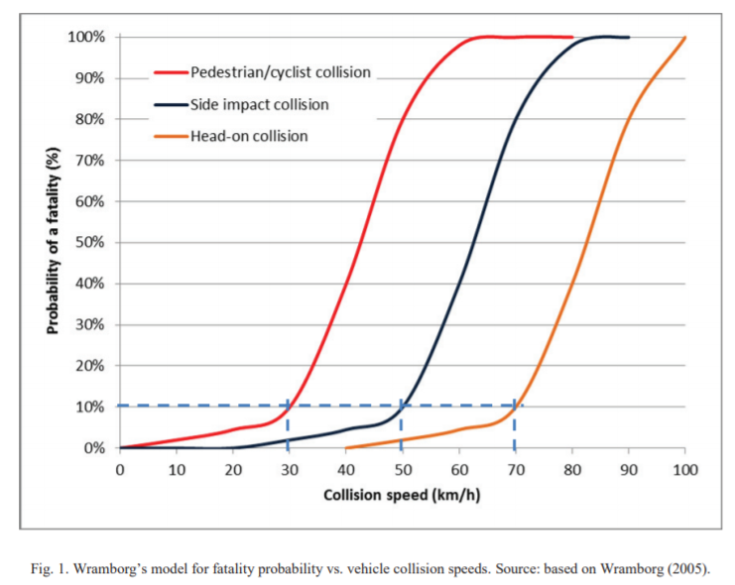
AEB IWG 04
https://www.ncbi.nlm.nih.gov/pmc/articles/PMC3503411/
Activation Calculation – Calculation strategy relevant for C2P (Performance)
Exploration of vehicle impact speed – injury severity relationships for application in safer road design Chris - Jurewicz et al. 2016

Slide 19
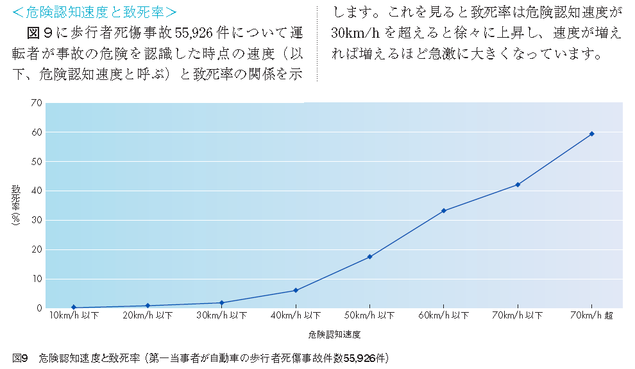
AEB IWG 04
Speed vs Fatality Rate from ITARDA Information No.83, 2010
Activation Calculation – Calculation strategy relevant for C2P (Performance)
Speed is less than 30 km/h, the Fatality rate is very low
Fatality Rate (%)
Recognition speed of danger
Fig. 3 Recognition speed of danger vs Fatality Rate
(Car vs Pedestrian accidents N=55,926)

Slide 20
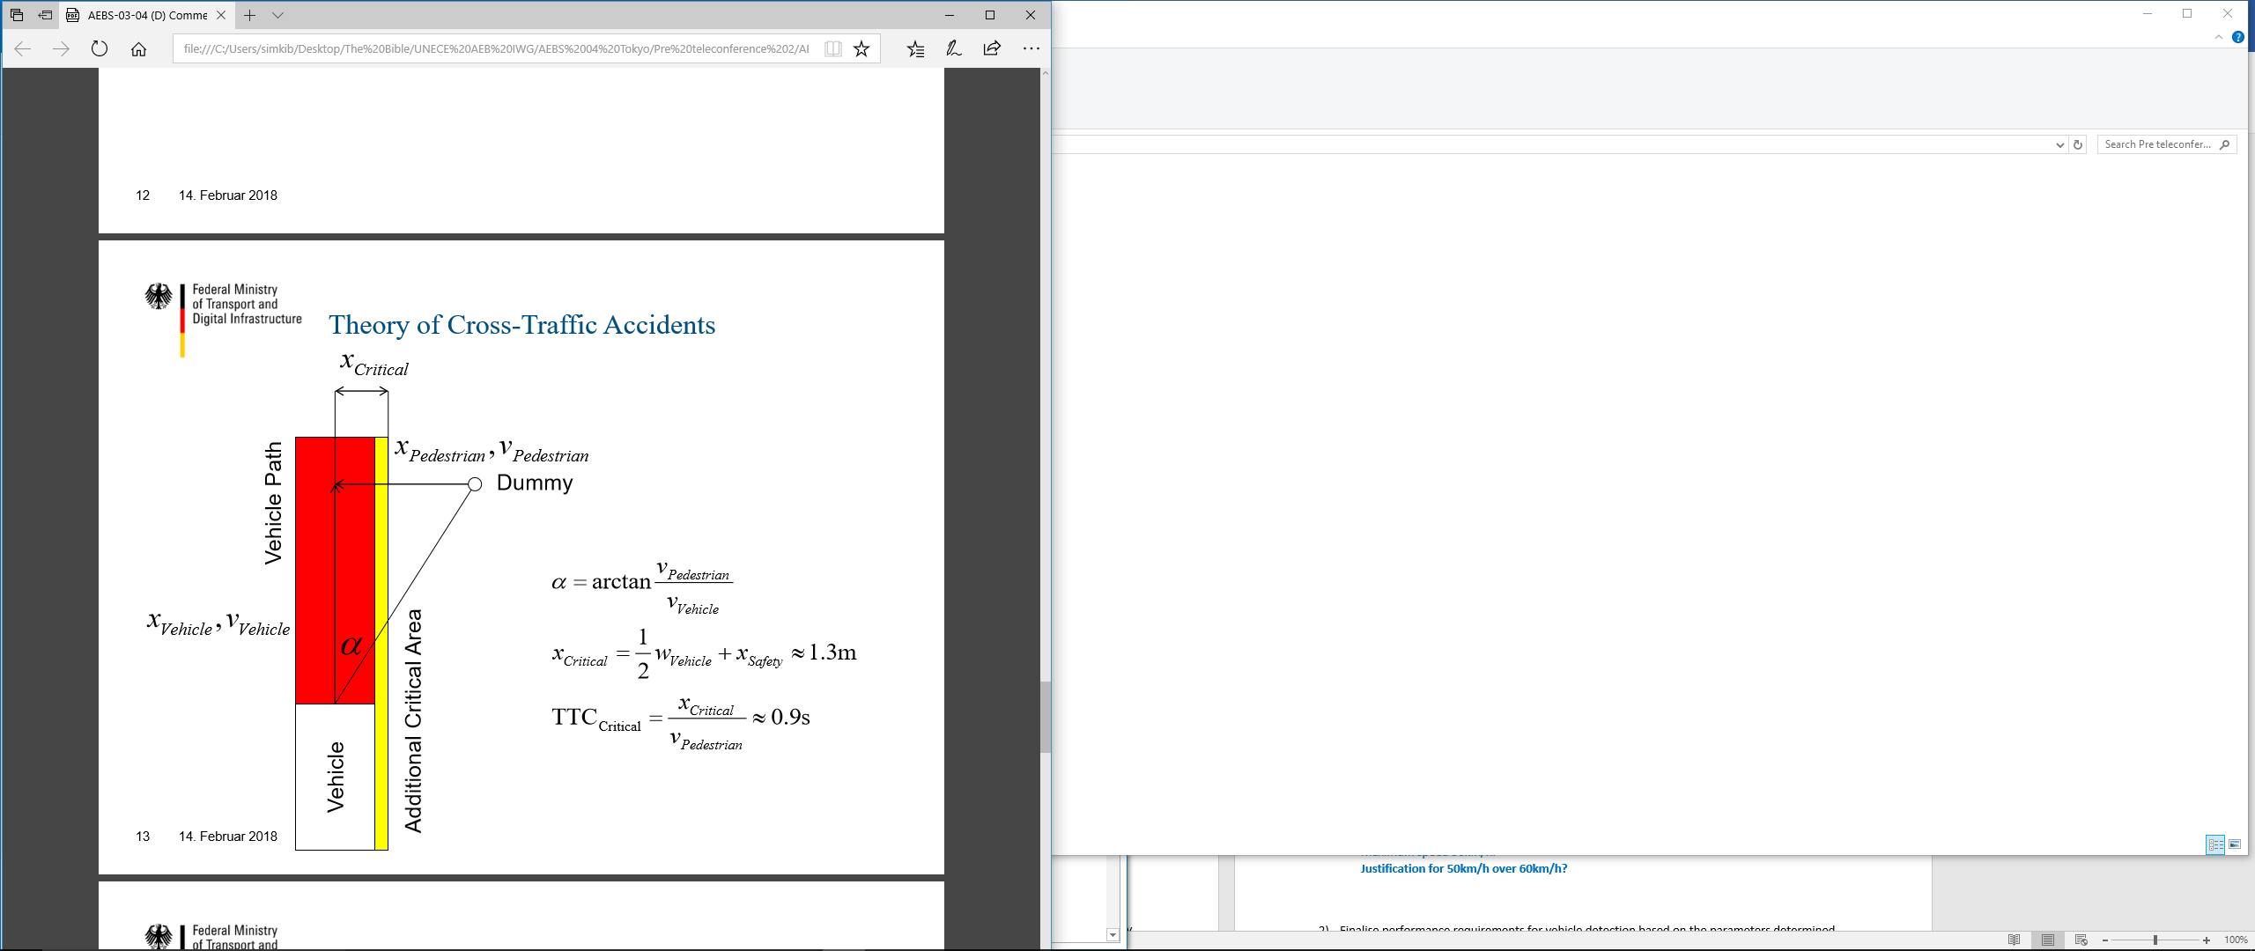
AEB IWG 04
Activation Calculation – Calculation strategy relevant for C2P (Performance)
When compared to German proposal for the critical point for brake application in AEBS 03-04 Slide 13
(TTC critical=0.9 seconds)
If 5.76m/s/s or 6.43m/s/s is applied at
0.9 seconds TTC between 10-50km/h:
@ 5.76m/s/s deceleration
Subject vehicle avoids up to 18km/h
Subject vehicle impacts <5km/h up to 36km/h
@ 4m/s/s deceleration
Subject vehicle avoids up to 13km/h
Subject vehicle impacts <5km/h up to 31km/h

Slide 21
AEB IWG 04
Reasons for AEBS deactivation.
Drivers are able to deactivate subcomponents for AEBS such as ESC and ABS, as the inability to this is extremely prohibitive in certain use-cases e.g. driving on snow. Drivers should be able to deactivate the AEBS for use cases such as:
Allows for use of normal M1/N1 vehicles off road without activation of AEBS triggered by terrain or flora.
Allows use vehicles on rolling roads during PTI and certification tests.
Manufacturers should allow the costumers to switch AEB off when using the vehicle on a track.
It could be possible to not allow the deactivation of AEBS to be ‘easy’, so either through at least 2 button presses or one long press of a button whilst the vehicle is Stationary. (Infotainment system or physical buttons). Ref. EuroNCAP bonus point for HMI + consolidated position from AEBS 03 Brussels.
If customers are not given an official mechanism for deactivation it may encourage them to use unofficial and illegal methods to tamper with the vehicle.

Slide 22
AEB IWG 04
Justification for not mandating AEBS above 50km/h absolute velocity.
Accident data suggests that the majority of vehicle collisions with other vehicles in urban environments, therefore AEBS for M1/N1 should be regulated for these scenarios where speed differences more than 50km/h are uncommon.
At higher speeds the difference in the which the last point to steer and last point to brake occur increases exponentially, this could lead to a greater possibility of false positives – at higher speeds a false positive will have a greater impact on the road user’s safety and traffic flow.
Greater alignment with voluntary commitment requirements from US manufacturers – ease the development of a GTR.
Applicable to urban scenarios which is relevant to 50km/h and under
AEBS 02 Back up slides - Accident data summary mk2 (Slide 4)

