Slide 1
Information on 4th AEBS Informal meeting
Informal Document - AEBS-04-01

Slide 2
4th AEBS Informal meeting
Informal meeting Date: May 16th – 17th, 2018
Wednesday 16 May, 2018 starting at 10:00 until
Thursday 17 May, 2018 ending at 17:00
Venue: Torakyo Hall, Yotsuya-sannchome 3rd Floor, Zennihon Truck Sogo Kaikan Building
Address: 3rd floor, Zennihon Truck Sogo Kaikan., 3-2-5 Yotsuya, Shinjuku-ku, Tokyo 160-0004
Caution!! This meeting room is (same building) different from JASIC office!

Slide 3
Registration
Please send the following information to;
Mr. Oliver Fontaine (ofontaine@oica.net) and
Mr. Yoshihisa Tsuburai (tsuburai@jasic.org)
no later than 27th April, 2018.
1) your name
2) your title and name of your business
3) your e-mail address
4) your arrival and departure date if you don’t participate in a full schedule.

Slide 4
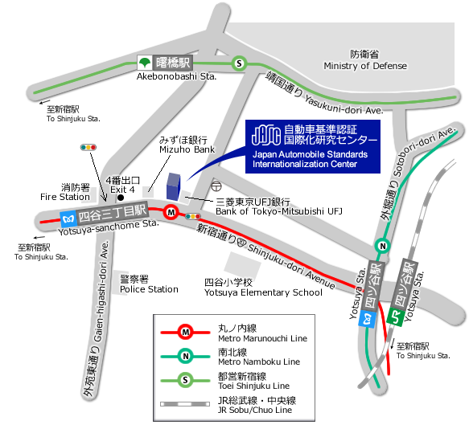

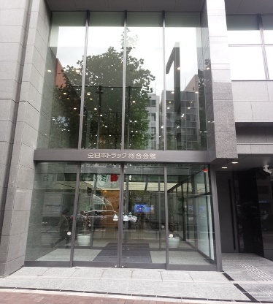
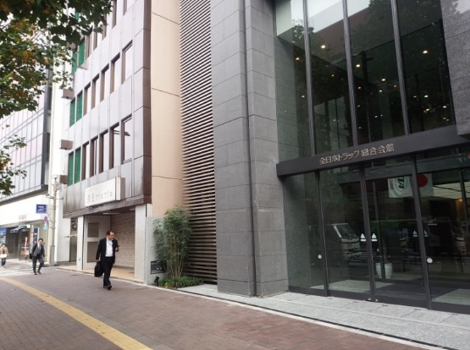

MAP
Address: 3rd floor, Zennihon Truck Sogo Kaikan., 3-2-5 Yotsuya, Shinjuku-ku, Tokyo 160-0004
TEL:
Calling from overseas
+81-3-5362-7751
Domestic call
03-5362-7751
Access:
3 minutes walk from Exit 4 of
Yotsuya-sanchome Sta.
(Marunouchi Line)
11minutes walk from Yotsuya Exit of
Yotsuya Sta.(JR Sobu/Chuo Line)
10minutes walk from Akasaka Exit of
Yotsuya Sta.(Marunouchi /Nanboku Line)
9minutes walk from Exit A1/A4 of
Akebonobashi Sta.
(Toei Shinjuku Line)
Torakyo Hall
3rd floor , Zennihon Truck Sogo Kaikan Bldg.
*JASIC office is located on the 7th floor of the same building.
Torakyo Hall Entrance

Slide 5
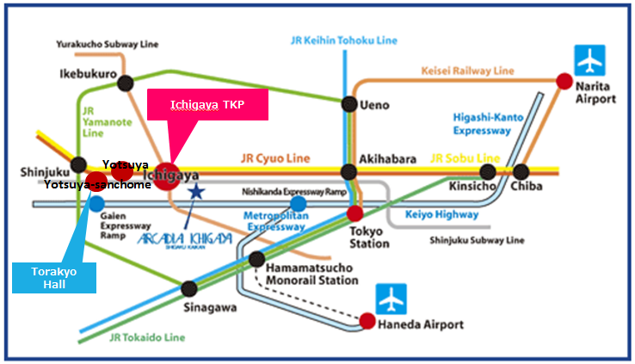
Access from the airports
Torakyo hall
From Narita Airport to Torakyo hall
80-120 mins by Airport Limousine Bus to Shinjuku.
Limousine Bus service to Shinjuku is available every hour.
https://www.limousinebus.co.jp/en/bus_services/narita/shinjuku.html
From Shinjuku, take JR Sobu Line(yellow above) for Yotsuya.
Narita Express Train is also available every hour and takes an hour to Shinjuku.
http://www.jreast.co.jp/e/nex/
From Haneda Airport to Torakyo hall
60 mins by Airport Limousine Bus to Shinjuku.
Limousine Bus service to Shinjuku is available every hour.
https://www.limousinebus.co.jp/en/bus_services/haneda/shinjuku.html
From Shinjuku, take JR Sobu Line (yellow above) for Yotsuya.
By Train
The easiest and quickest way to Yotsuya is:
►Take the Tokyo Monorail from each of the airport terminals and get off at Hamamatsucho.
http://www.tokyo-monorail.co.jp/english/index.html
►Transfer to the JR Yamanote Line at Hamamatsucho and get off at Akihabara.
https://www.jreast.co.jp/e/destinations/tokyo/
►Change to the JR Sobu Line at Akihabara and get off at Yotsuya.
By Taxi
The fare varies depending on traffic conditions for the route from each of the airport terminals to
Yotsuya (5,000 yen ~ 10,000 yen).

Slide 6
Accommodations
Hotel Name (En) | Hotel name (Jpn) | URL | Access to the nearest station
TOKYO DOME Hotel | 東京ドームホテル | http://www.tokyodome-hotels.co.jp/e/ | 5 minute walk to Suido-bashi Sta.
Hotel Agnes | アグネスホテル | http://www.agneshotel.com | 5 minute walk to Iidabashi Sta.
Arcadia Ichigaya | アルカディア市ヶ谷 | http://www.arcadia-jp.org/access_english.htm | 1 minute walk to Ichigaya Sta.
Tokyo Green Palace | 東京グリーンパレス | http://www.tokyogp.com/english/index.html | 1 minutes walk from Kojimachi Station ( Yurakucho Subway Line ) 7 minutes walk from Ichigaya Station ( JR Sobu Line or Yurakucho / Namboku Subway Line )
APA Hotel (Shinjuku Gyoemmae) | APAホテル＜新宿御苑前＞ | http://www.apahotel.com.e.ju.hp.transer.com/language/shutoken/33_shinjukugyoenmae.html | 1 minute walk to Sinjukugyoen Sta.
Shinjuku CITY Hotel N.U.T.S Tokyo | 新宿 CITY HOTEL N. U. T. S 東京 | http://hotel-nuts.com/eng/index.php | 5 minute walk to Shinjyuku-Gyoen Sta.
Hotel New Otani | ホテルニューオータニ | http://www.newotani.co.jp/tokyo/ | 5 minute walk to Akasaka Mitsuke Sta.
ANA Intercontinental Tokyo | ANAインターコンチネンタルホテル東京 | http://www.anaintercontinental-tokyo.jp/e/access/ | 5 minute walk to Tameike-Sanno Sat.
KEIO Plaza Hotel | 京王プラザホテル | http://www.keioplaza.com/ | 10 minute walk to Shinjuku Sta.
Hyatt Regency Tokyo | ハイアットリージェンシー東京 | http://tokyo.regency.hyatt.com/en/hotel/home.html | 10 minute walk to Shinjuku Sta.
The Capital Hotel Tokyu | キャピトルホテル東急 | http://www.capitolhoteltokyu.com/en/index.html | Direct access to Tameike-sanno Sta./Kokkai-Gijidomae Sta.
Akasaka Excel Hotel | 赤坂 エクセルホテル東急 | http://www.tokyuhotelsjapan.com/en/hotel/TE/TE_AKASA/index.html | 1 minute walk to Akasaka-Mitsuke Sta.
Hotel WING International | Hotel WING International | http://www.hotelwingjapan.com/ | 5 minute walk to Yotsuya-Sanchome Sta.
MITSUI GARDEN Hotel | 三井ガーデンホテル四谷 | https://secure.reservation.jp/gardenhotels/stay_pc/rsv/index.aspx?hi_id=3&lang=en-US | 5 minute walk to Yotsuya Sta.
TOKYU STAY YOTSUYA | 東急ステイ四谷 | http://www.tokyustay.co.jp/e/hotel/YOT/ | 3 minute walk to Yotsuya Sta.

Slide 7
Other Information
JASIC Website http://www.jasic.org/e/03_location/location_jasic.htm
Narita Airport Website
http://www.narita-airport.jp/en/index.html
Haneda Airport Website
http://www.haneda-airport.jp/inter/en/
JR lines in the Tokyo area
https://www.jreast.co.jp/e/downloads/
Tokyo Metro Guide
http://www.tokyometro.jp/en/index.html
General information on Japan
http://www.jnto.go.jp/eng/
General information on Tokyo
http://www.gotokyo.org/en/index.html

Slide 8
If you have any question, please contact with
Mr. Tsuburai
tsuburai@jasic.org
How to access Torakyo hall,
How to access Hotel

