Slide 1

AEB Car-Car and Pedestrian:
Last Point To Steer
For Various Cars and Speeds
Dr. Patrick Seiniger,
Federal Highway Research Institute (BASt)

Slide 2
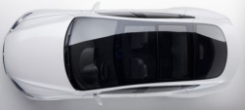
Recap:
Last Point to Steer (Theory)
Lateral acceleration
in m/s²
Lateral displacement
in m
0.635 s
100% Overlap
2m
Time in s

Slide 3
Goals and Methodology
  Car-Car AEB: Automatic braking is justified at the latest when avoidance by steering is not possible
    Last Point To Steer (highly dependend on speed)
    Last Time To Steer (in theory independent from speed)
  Goal: Identify last time to steer
    As function of driving speed (is it really independent?)
    As function of vehicle
  Subjective Tests
    Cars instrumented with DGPS only
    VW Passat 2011 (20, 30, 40, 50 km/h)
    Mercedes GLC 2017 (50 km/h)
    Alfa Romeo Mito 2010 (50 km/h)
    All tests performed by drivers with ATP License B
  Additional Objective Tests
    Fully instrumented driving robot in Mercedes GLC 2017
    Programmed lane change
    Measurement of steering and tire response time

Slide 4
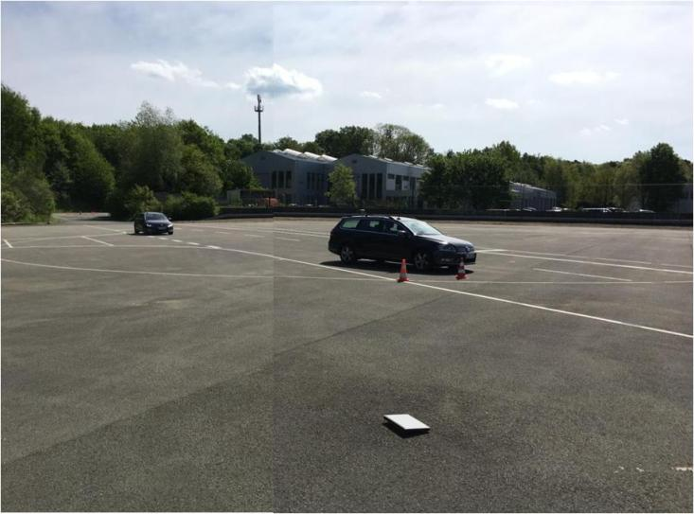
Subjective Tests - Concept
  Task: full lane change as quick as possible
  Lane change width 2 m
  preferably with overshoot
  less than 3 m (of reference)
  Manual speed control
  (CC if possible)
  Reference point:
  front right corner of car
  Result: Time needed to reach a lateral shift of 2m for the front right corner (NOT for whole car!)
2m
5m
2 m

Slide 5
Subjective Tests – Evaluation
1
  Step 1: Align approach phase (red), turn coordinates
  Step 2: Check when yaw rate crosses 1°/s for the first time
  Step 3: Check when y crosses 2 m for the first time
  Step 4: Check if lateral position within 2 s is > 3 m
  Final: t_{y,2m}
3
4
2
t_{y,2m}

Slide 6
Results – VW Passat 2011
20 km/h:
0.88s
30 km/h:
0.78s
40 km/h:
0.68s
50 km/h:
0.67s

Slide 7
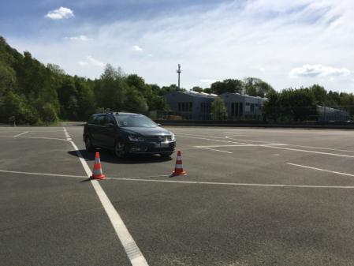
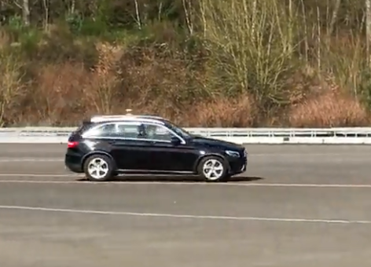
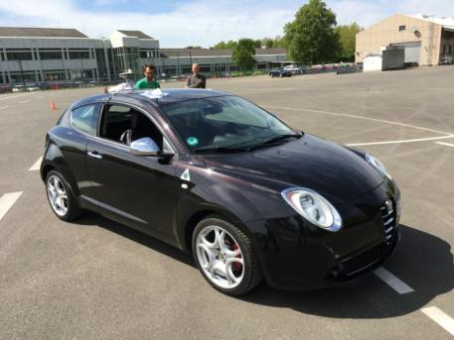
Results – Different Cars at 50 km/h
Passat: 0.67s
GLC: 0.77s
Mito: 0.69s

Slide 8
Results – Subjective Tests
  Last time to steer decreases slightly with speed
  Last time to steer seems to increase with vehicle mass
  Subjective Tests only give results from yaw rate = 1°/s
  Response from 1° steering angle to 1°/s yaw from objective tests
  Theoretical level (10 m/s², 2m) is never reached
Last time to steer
Last distance to steer
 | Passat | GLC | Mito | Theory | Passat | GLC | Mito | Theory
20 km/h | 0.88 s | - | - | 0.63 s | 4.89 m | - | - | 3.5 m
30 km/h | 0.78 s | - | - | 0.63 s | 6.5 m | - | - | 5.25 m
40 km/h | 0.68 s | - | - | 0.63 s | 7.56 m | - | - | 7 m
50 km/h | 0.67 s | 0.77 s | 0.69 s | 0.63 s | 9.31 m | 10.69m | 9.58 m | 8.75 m
Table does not include response time!

Slide 9
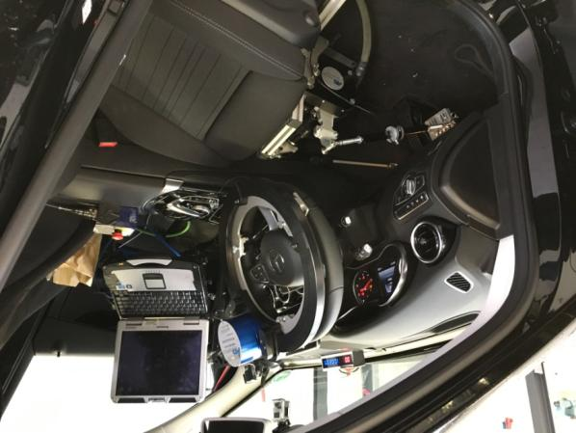
Objective Tests
Task: Robot programmed for lane change maneuver 0.9/1.0/1.1 s
Lane change width: 2m
Robot peak torque: 15 Nm
(ABD SR15+CBAR Robot System)
Evaluation:
Steering Rate > 10°/s → y > 2m (new)

Slide 10
Results – Objective Tests
0,11s
0,9s
Steering Input
Yaw rate response
(>0,11s)
Lateral shift
(0,79s Robot)
(0,68/0,77s Human)

Slide 11
Results and Discussion – Last Time To Steer
  The following values have been identified as limits for last point to steer for various speeds and cars
  These limits have been measured as „best case“ for trained drivers
  Judge for yourselves whether these values are representative for “planned behavior” in regular traffic situations:
Last time to steer
Last distance to steer
 | Passat | GLC | Mito | Theory | Passat | GLC | Mito | Theory
20 km/h | 0.99 s | - | - | 0.74 s | 5.5 m | - | - | 4.11 m
30 km/h | 0.89 s | - | - | 0.74 s | 7.42 m | - | - | 6.17 m
40 km/h | 0.79 s | - | - | 0.74 s | 8.78 m | - | - | 8.22 m
50 km/h | 0.78 s | 0.88 s | 0.8 s | 0.74 s | 10.83m | 12.22m | 11.11 m | 10.28m
Table does include 0.11s response time!

Slide 12
Videos

Slide 13
German Position wrt Last Point To Steer
  „Last Point To Steer“ avoidance is considered as part of a planned maneuver.
  An AEBS incorporating the „Last Point To Steer“ concept should not require drivers to perform an ermergency avoidance maneuver in order to avoid an accident.
  „Last Point To Steer“ should be kept at a total of 0.9 seconds despite that trained drivers in optimal conditions are able to achieve a full collision avoidance by steering up to a total of 0.78s.
  The resulting requirement of at least avoidance up to 42 km/h (relative speed) should still be maintained.

Slide 14
AEBS Pedestrian – Performance Req‘s
  Method to derive performance requirements for AEB-Car: Braking as soon as last point to steer has been passed is acceptable under certain conditions (see previous slide).
  This method is not acceptable for Pedestrian AEBS, since it effectively means that drivers should be given the chance to approach a pedestrian with high speed and steer at the last possible moment, see next slide for a comparison.
  Germany presented the „pedestrian-enters-path“-criterion in AEBS-03-04, which is much more appropriate to describe pedestrian situations. A „first time/point to brake“ can be derived from this method as well.
  Germany proposes to derive necessary speed reductions, also for those speeds where a full avoidance is physically not possible (e.g. higher speeds than the peak avoidance speed).

Slide 15
Comparison: Critical-Area-Approach vs. LPS
~1.5m
Dummy w=1m
Dummy
Vehicle Path
Brake at
TTC=0.9s:
v_{red} = 42 km/h
(~30 cm safety area)
TTC=0.72:
v_{red} = 30 km/h
(no add.safety area)
Brake at
TTC=0.68s
(0.9s*1.5m/2m)
v_{red} = 28 km/h
Vehicle
Vehicle
Additional Critical Area

Slide 16
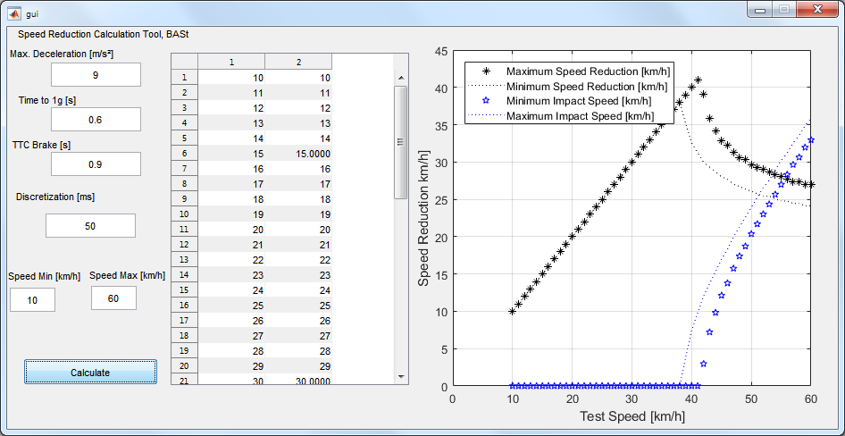
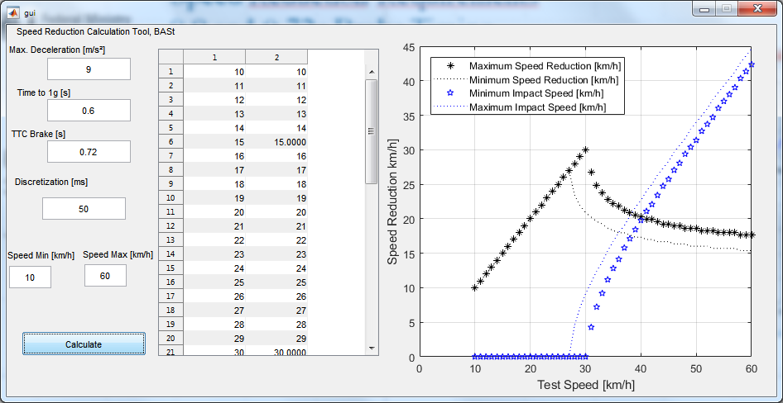
Speed Reduction Requirements –
0.9 and 0.72s Brake Timing
Brake when ped. is
30 cm from path
TTC 0.9s
Brake when ped. enters path
TTC 0.72s

Slide 17
Deaction of AEBS-M1 – German Position
  Manual deactivation of AEBS function is not acceptable for Germany
  An automatic activation/deactivation in specific situations is acceptable (e.g. those named at AEBS-04)
  However, sensor misalignment should rather be targeted by AEBS self-tests which are – by the state of the art – required for any given safety-critical function at startup!
  AEBS dectivation in offroad use is possible by
    E.g. evaluating vehicle gearbox and AWD status or
    E.g. evaluating vehicle chassis status, e.g. largely different wheel displacement at or between axles or …
  Towing with rope and engine running can be detected as prolonged driving in neutral gear with unexplicable wheel speeds
  Dynamometer can be detected by wheel acceleration without body acceleration
  …
  There is no technological need for manual deactivation

