Slide 1
AEBS 4th Meeting
UK Position Paper
OFFICIAL-SENSITIVE

Slide 2
Overview
Latest AEBS discussions have focussed on the concepts of last-point-to-brake (LPB) and last-point-to-steer (LPS).
Industry recommends delaying the brake application at higher speeds where the LPS occurs later than LPB.
The UK accepts the principle agreed within the group, but has concerns about the assumptions being applied to the calculations.
The UK understands the rationale for a longitudinal deceleration rate of 6.43m/s² and the lateral offset of 2.5m for dry conditions. However, we believe it should be recognised the value for longitudinal deceleration is subject to weather and road conditions. Therefore, 6.43m/s2 will not always be achievable. We believe this value could be reasonable reduced in line with BASt studies on wet concrete roads.
Furthermore, there is concern over the suggested lateral deceleration value of 10m/s². The UK has conducted some recent testing in this area.

Slide 3
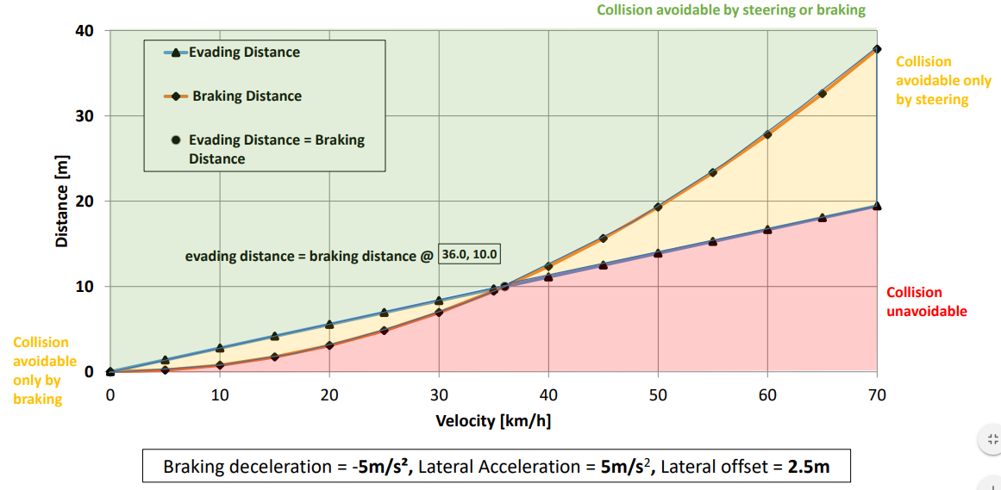
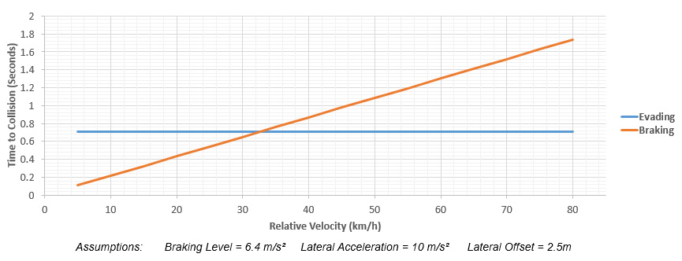
History
AEBS-02-05 extract
Industry presented the concept of LPB and LPS at the 2nd AEBS meeting as part of the paper AEBS-02-05. In this paper, a lateral deceleration value of 5m/s² was applied.
The latest industry paper (AEBS-03-08) used a value of 10m/s² for lateral acceleration in the LPS / LPB calculation.
The UK is unclear on the driver behind this change.
AEBS-03-08 extract

Slide 4
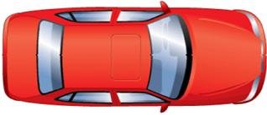
Real World Testing
To develop an understanding of lateral acceleration values experienced in the real world, the UK conducted a number of tests using a volume production vehicle piloted by an expert driver. These were conducted in dry conditions at the Horiba MIRA proving ground.
Two lanes were marked out using cones as shown in the diagram below. The distance X was varied, which had the effect of changing the severity of the manoeuvre in order to understand the range of lateral accelerations experienced.
X (variable distance in m)
2.5m

Slide 5
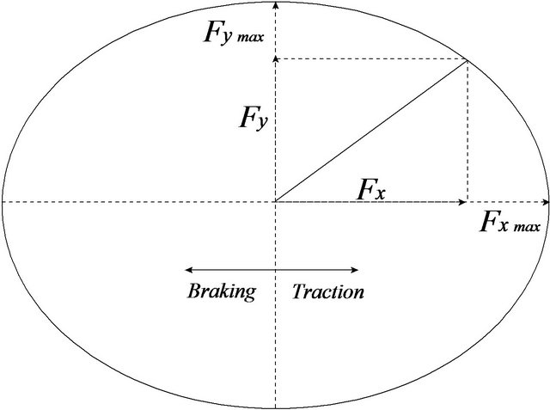
Adverse Weather Considerations
The ACSF IWG recently concluded an appropriate deceleration value for wet concrete of 3.7m/s². This equates to using all the available grip in one direction.
In emergency manoeuvring situations, it is likely that the driver will apply both braking and steering inputs. Based on the adhesion ellipse below, the available grip will need to be distributed between longitudinal and lateral deceleration. Therefore, calculations for LPS & LPB in adverse weather conditions cannot both be based on the maximum value of 3.7m/s².

Slide 6
Conclusions
The UK is still analysing the results of its lateral acceleration tests and will be able to share these at the 5th AEBS meeting in London.
Initial thoughts on the day were that the value of 10m/s² proposed by industry represented a very severe manoeuvre. It was challenging to achieve this value even with an expert driver operating on a closed test track area in ideal (dry) conditions.
Therefore, the UK does not believe that an average driver would achieve such a high lateral acceleration figure when manoeuvring.
The UK will recommend an alternative and more appropriate figure at the 5th AEBS meeting following completion of its analysis.
The UK recommends that the group consider AEBS operation in adverse weather by applying the maximum deceleration value of 3.7m/s² agreed within the ACSF IWG whilst also being cognisant of the need to share traction between longitudinal and lateral forces.

