Slide 1
VRU-Proxi-06-03
Definitions of
The driver’s looking back ocular points
JAPAN

Slide 2
Definitions
“The driver’s looking back ocular points” is the ocular points when driver is looking back in order to confirm rear fields of view.
It should be defined as adjusted locations from “The driver’s ocular points”.
Adjusted amounts calculated from measured data
 | X (longitudinal) | Y (horizontal) | Z (vertical)
Adjusted amounts [mm] | 96 | -158 | 6

Slide 3
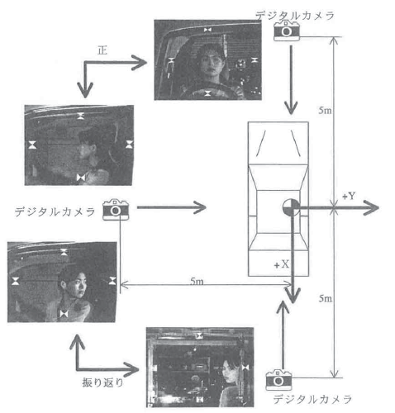
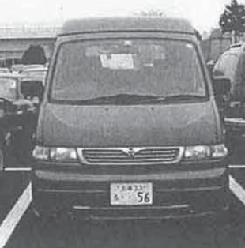
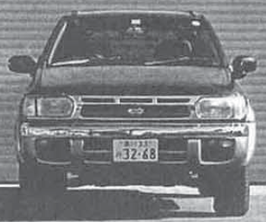
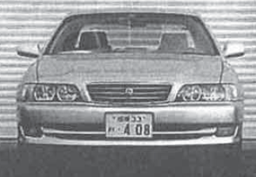
Methods
Measurement
  Driving eye-points and looking back eye-points coordinates obtained by 2D photometry.
Participants
  140 healthy adult participants
  (Male 70, Female 70, Age 20s~50s)
Vehicle
  Sedan (Eye-point~Ground: 1117mm)
  SUV (Eye-point~Ground: 1386mm)
  Mini-van (Eye-point~Ground: 1542mm)
Digital camera
Driving eye-points
Digital camera
Looking back eye-points
Digital camera

Slide 4
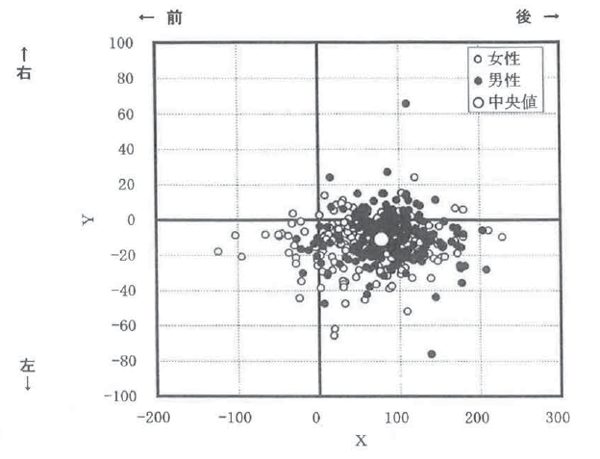
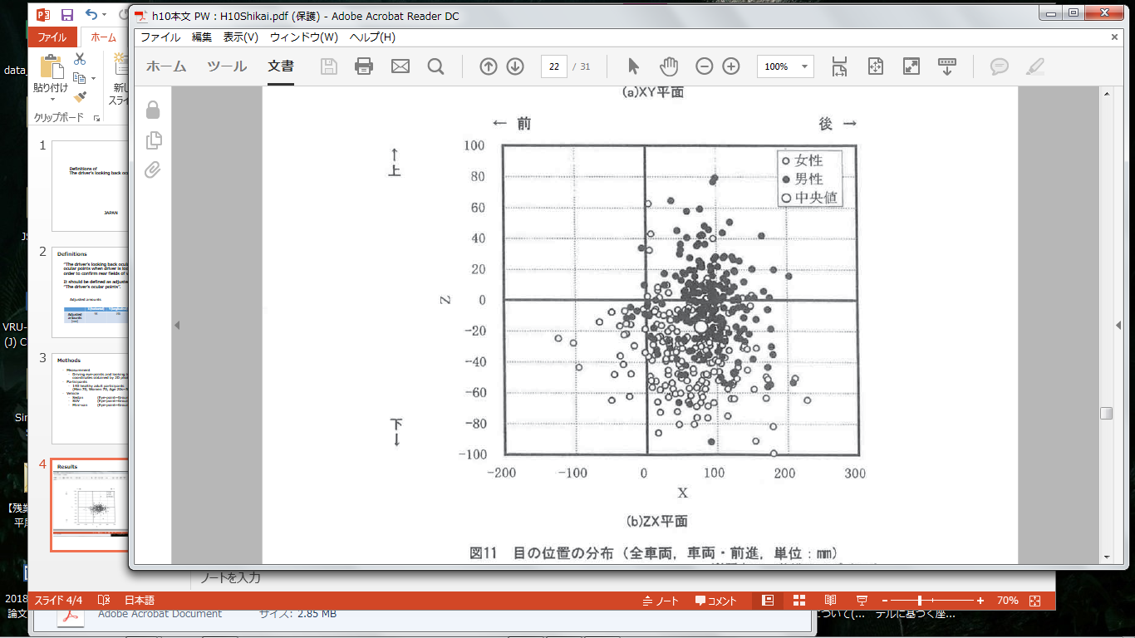
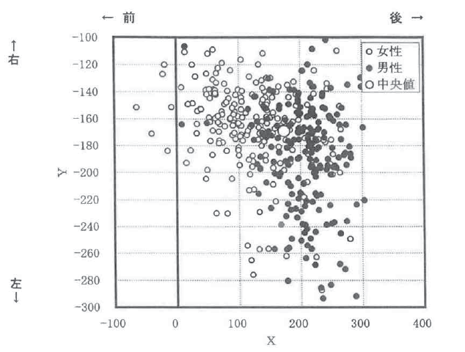
Results
Origin：Reference EP (Driver’s ocular points)
Driving eye-point
←Front
Rear→
←Front
Rear→
↑
Right
↑
Upper
○Male
●Female
○Mean
○Male
●Female
○Mean
Left
↓
Downer
↓
Looking back eye-point
←Front
Rear→
←Front
Rear→
↑
Right
○Male
●Female
○Mean
↑
Upper
○Male
●Female
○Mean
Left
↓
Downer
↓

