Slide 1
VRU-proxi IWG
Accidentology analysis summary
VRU-Proxi-06-06
AstaZero, Sandhult (Sweden), 19-21 june 2018

Slide 2
Introduction
Additional results:
  Injury criteria added and considered
  Distribution of vehicle categories according to accident scenarii and injury severity
  Updated data: Canadian data
    Completed with Peter BURNS’s presentation
  Additional data: GB data

Slide 3
Turn Opposite to Driver Side (TODS) scenario
VRU: bicyclist

Slide 4
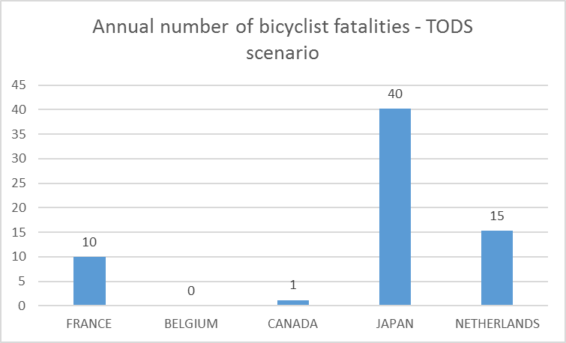
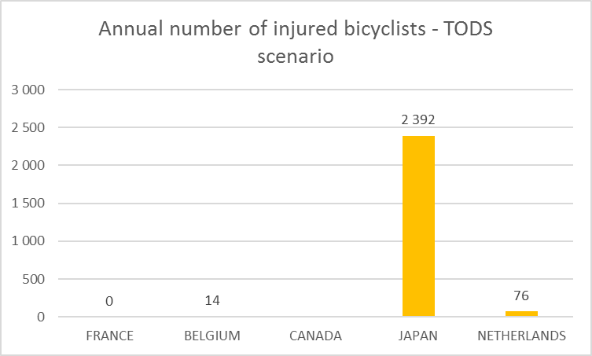
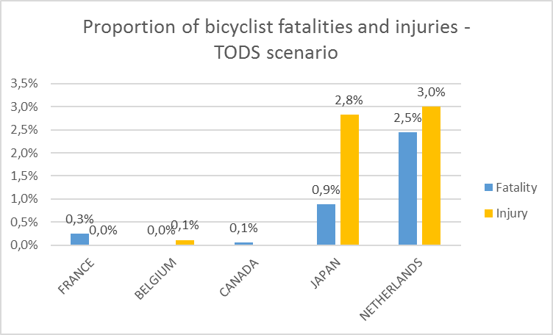
Turn Opposite to Driver Side (TODS)
Driving speed
  NL: ≤ 51 kph
  CA: ≤ 40 kph
  FR, BE: ≤ 30 kph
  JA: ≤ 20 kph: JA
Canada: Peter Burns will present more results regarding injured bicyclists

Slide 5
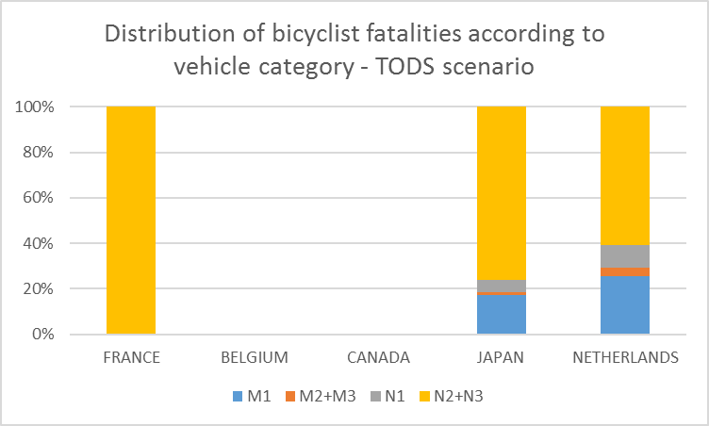
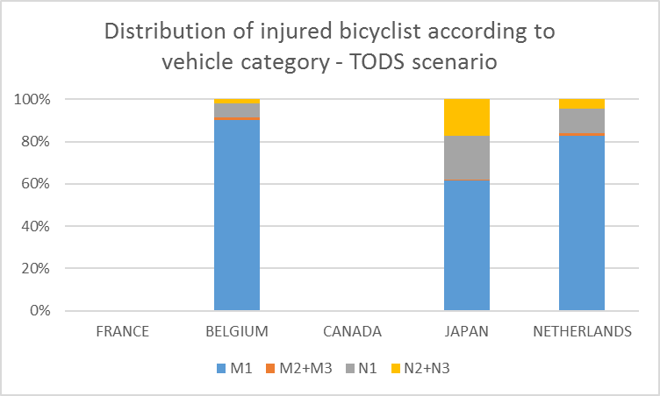
Turn Opposite to Driver Side (TODS)
Common vehicle categories available for each country
Mainly N2 +N3 vehicles for bicyclist fatalities
  In Japan, mainly N2 > 7,5t and N3
  In The Netherlands, mainly N3

Slide 6
Turn Opposite to Driver Side (TODS)
UK: Pedal cyclist casualties in 2-vehicle accidents (with an HGV) where the speed limit is 30mph or less, GB:2011-2016
  69 bicyclist fatalities (~ 4 fatalities per year)
  1394 injured bicyclists (~232 injured bicyclists per year)
  HGV driver turning left
    31 fatalities and 303 injuries
      HGV over 8t: 26 fatalities and 163 injuries
      HGV under 8t: 1 fatalities and 72 injuries
      HGV gross weight unknown: 4 fatalities and 68 injuries

Slide 7
Turn Opposite to Driver Side (TODS) - Conclusions
TODS does not consider the bicyclist manœuvre
Some figures may be overestimated because in some answers the vehicle speed (30 to 50 kph) was exceeding the “low speed” scope (20 kph).
The highest % of bicyclist injuries and fatalities are in Japan and The Netherlands where:
  Fatalities are the consequences of a collision with a N2 > 7.5 t or a N3

Slide 8

Turn Opposite to Driver Side (TODS) - Conclusions
SAFETYCUBE Decision Support System
  Funded within the Horizons 2020 Programme of the EC
  Aims to support evidence-based policy making
  Systematic literature review approach
  BSIS: One study found dealing with BSIS efficiency
  SAFETYCUBE conclusions:
  The safety potential of a 'turning assistant system' and an intelligent rear view camera accounts for 6% of prevented accidents in relation to all truck accidents.
  In the study generic systems are used and the estimates are probably higher than the real benefits from the systems, because real systems are subject to constraints, which can’t be included in these estimates.
  Kuehn, M. et al. "Advanced Driver Assistance Systems for Trucks – Benefit Estimation from Real-Life Accidents". 22nd Enhanced Safety of Vehicles Conference in Washington, D.C., June 2011. Paper Number 11-0153
  https://www.roadsafety-dss.eu/#/reference/345

Slide 9
Reversing manoeuvre (R)

Slide 10
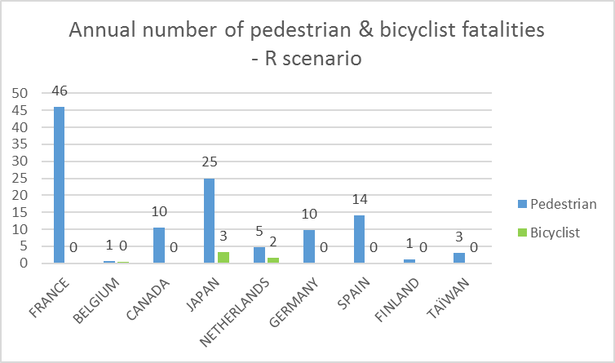
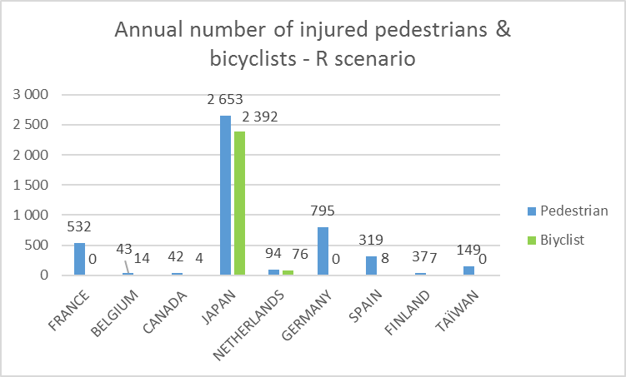
Reversing manoeuvre - R
All driving speeds are considered
Pedestrians are more involved in this accident configuration than bicyclists

Slide 11
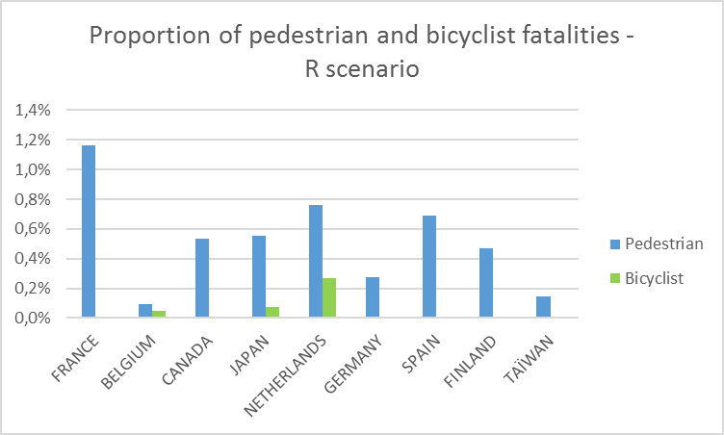
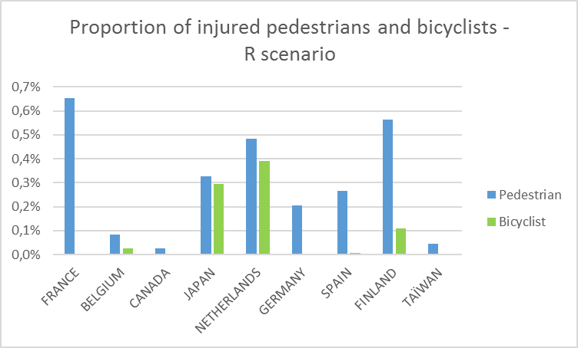
Reversing manoeuvre - R
It is not more than 1.2 % of national road fatalities and 0.7% of national road injured road users

Slide 12
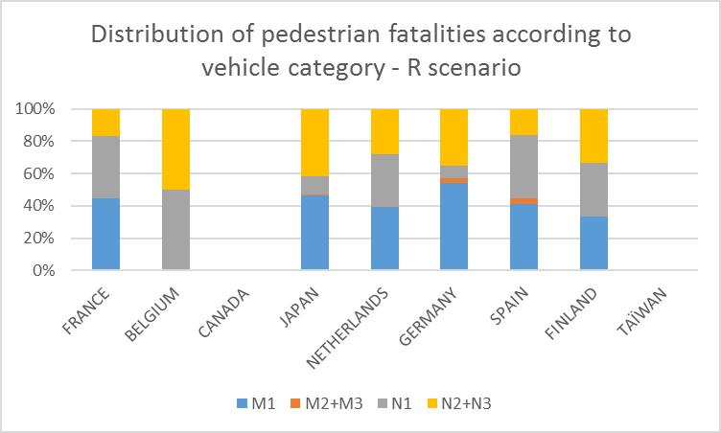
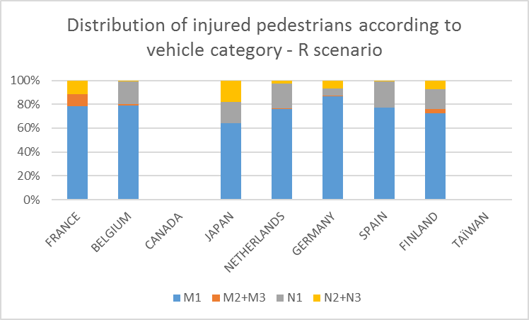
Reversing manoeuvre - R
More than 50% of pedestrian fatalities involved in R scenario are impacted by N1, N2 and N3

Slide 13
Reversing manoeuvre - R
Pedal cyclist casualties in 2-vehicle accidents (with an HGV) where the speed limit is 30mph or less, GB:2011-2016
  69 bicyclist fatalities (~ 4 fatalities per year)
  1394 injured bicyclists (~232 injured bicyclists per year)
  HGV reversing
    0 fatality and 18 injuries
      HGV over 8t: 0 fatality and 3 injuries
      HGV under 8t: 0 fatality and 11 injuries
      HGV gross weight unknown: 0 fatality and 4 injuries

Slide 14
Straight and taking-off manoeuvres (STO)

Slide 15
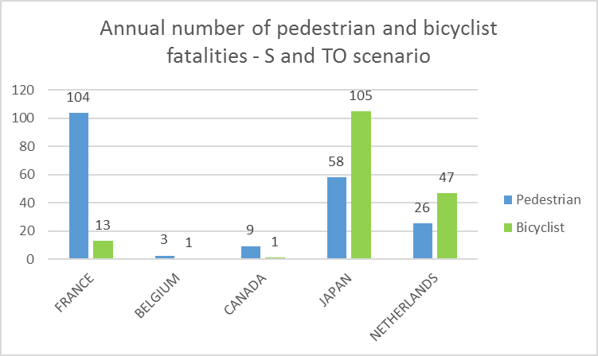
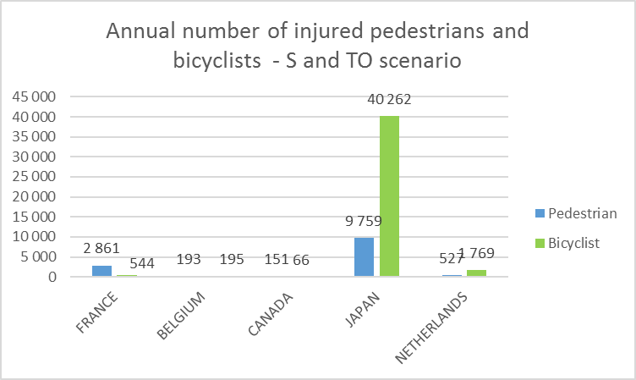
Straight and taking-off manoeuvres (STO)
Driving speed
  NL: ≤ 51 kph
  CA: ≤ 40 kph
  FR, BE: ≤ 30 kph
  JA: ≤ 20 kph: JA
A high number of injured bicyclists in this accident configuration in Japan

Slide 16
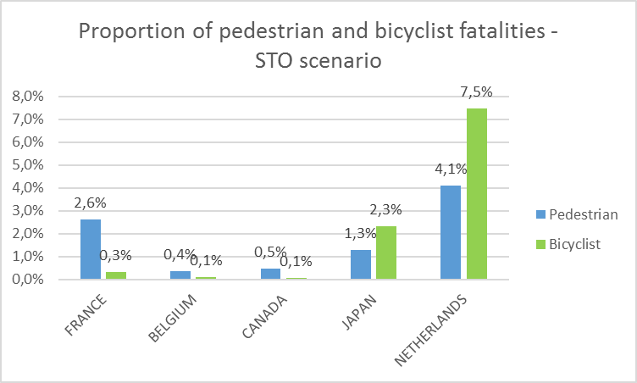
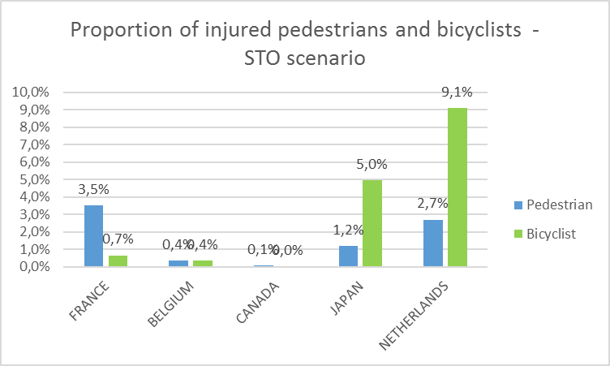
Straight and taking-off manoeuvres (STO)
Highest percentages for The Netherlands
  Could be an issue for NL comparing to other countries (but driving speed criteria is ≤ 51 kph)

Slide 17
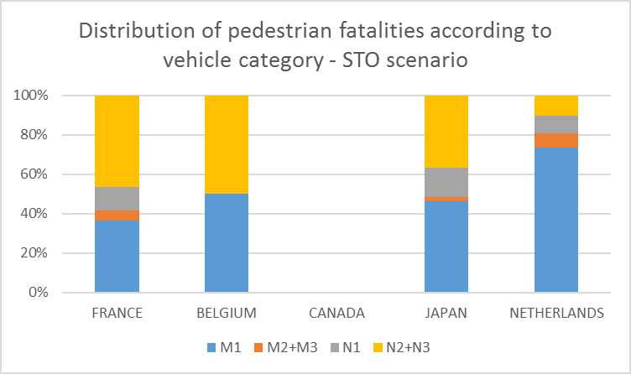
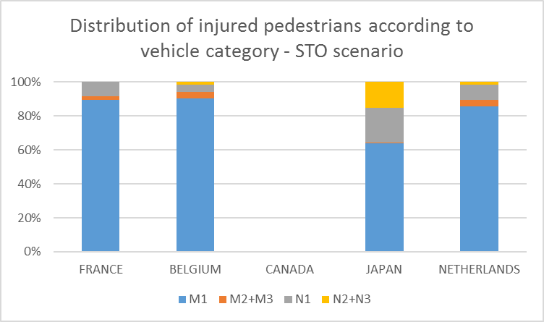
Straight and taking-off manoeuvres (STO)
Probably taking-off scenario and driving straight scenario have not the same causations; and not the same counter-measure
In such accident configuration, collision partner:
  for pedestrian fatalities: N2, N3 vehicles
  For injured pedestrians: M1 vehicles
Similar results with Canadian data

Slide 18
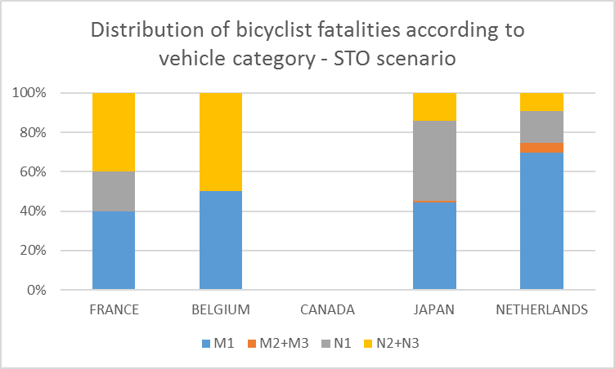
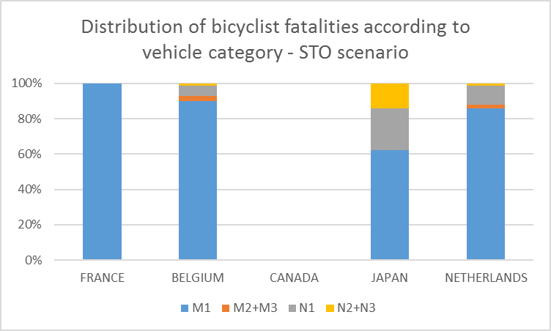
Straight and taking-off manoeuvres (STO)
Same conclusions as for pedestrian involved in STO scenario
Probably not the same accident configuration
Similar results with Canadian data

Slide 19
Straight and taking-off manoeuvres (STO)
Pedal cyclist casualties in 2-vehicle accidents (with an HGV) where the speed limit is 30mph or less, GB:2011-2016
  69 bicyclist fatalities (~ 4 fatalities per year)
  1394 injured bicyclists (~232 injured bicyclists per year)
  HGV going straight or taking off
    27 fatalities and 468 injuries
      HGV over 8t: 19 fatalities and 193 injuries
      HGV under 8t: 5 fatalities and 124 injuries
      HGV gross weight unknown: 3 fatalities and 151 injuries

Slide 20
Conclusions
Turn Opposite to Driver Side (TODS)
  VRU: Bicycle
  Overestimation of accident issues as bicyclist manoeuvre is not considered
  N2 > 7.5t and N3 are the main opposite vehicles for bicyclist fatalities
  Effectiveness of BSIS not studied
Reversing (R)
  VRU: Pedestrian
  N1, N2 and N3 are the main opposite vehicles for pedestrian fatalities
Straight and taking-off manoeuvres (STO)
  Further analysis (data available) to distinguish taking-off and driving straight manoeuvres

Slide 21
THANK YOU

