Slide 1
Analysis of the Polish proposal. GRE2016/18
Transmitted by CLEPA
Informal document GRE-76-21
(76th GRE, 25-28 October 2016, agenda item 7(f))
SLR-25-05
POLISH COMMENTS (RED)
FOR IWG-SLR PURPOSE

Slide 2
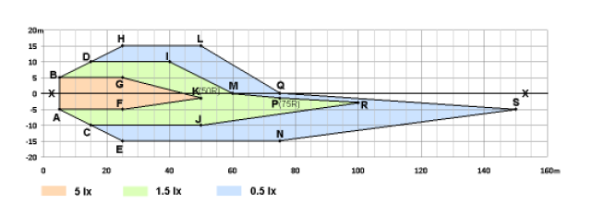
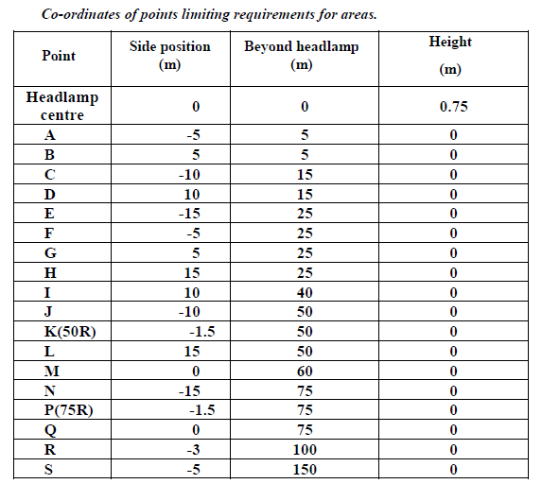
Polish Proposal
Isolux on the road:
IS IT STILL VALID?
FOLLOWING POLISH PROPOSAL GTB TRANSFORMED POINTS ANGULAR GONIOMETRIC SYSTEM TO ROAD SURFACE WHICH IS MORE RELEVANT TO PERFORMANCE (ROAD ILLUMINATION AREA)
CLEPA proposal:
To replace the points on the road by the corresponding angular directions in the forward field and to define the luminous intensity in the corresponding directions.
IN POLISH PROPOSAL POINTS ARE NOT FOR THEMSELVES BUT ARE USED TO CIRCUMSCRIBE AREAS OF REQUIRED ILUMINANCE. DISCUSSING OLD POINTS WITH POINTS OF PROPOSAL IS IRRELEVANT

Slide 3
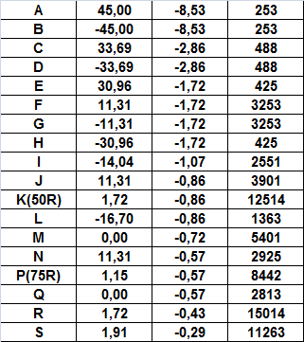
Table Angle/Luminous intensity
THE VALUE (10,100) IS TAKEN FROM PRESENT REGULATION WHICH IS BASED ON OBSOLETE PARABOLIC DESIGN WITH H4 BULB. FOR GOOD PERFORMING HEADLAMP 15,000 -20,000 cd IS NO PROBLEM
THIS IS ROAD SURFACE AREA LIMITER NOT THE EQUIVALENT OF PRESENT SCREEN REQUIREMENT
I (Cd)
Current R112 I> 10,100 cd
AS ABOVE. IN PP THIS IS WHOLE ROAD SURFACE ZONE REQUIREMENT NOT ONLY SINGLE POINT
Current R112 I> 10,100 cd

Slide 4
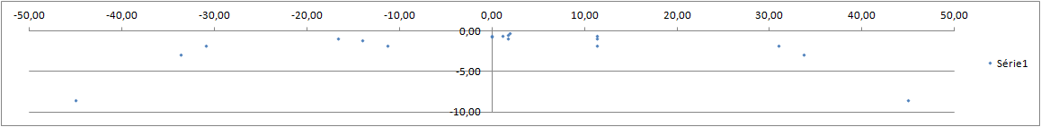
Requirement in the angular forward field.
Assessment of the width of the beam pattern:
Measurement points for Xenon HL (R98)
Current R112:
Same scale !
„DESIGN” POINT FOR „ON THE SCREEN REQUIREMENTS” PHILOSOPHY
R112 B1:
M,Q
F,J,N
P
R,S
25R2
>1250 Cd
L
I
HOW MUCH TOO WIDE? HOW MUCH SHOULD BE AND WHY?
THE ALTERNATIVE IS EXPECTED AND JUSTIFICATION FOR IT
D
H
G
E
C
15R
>625 Cd
B
A
Comments:
A, B, C, D, E, H : Too wide.
Relevance of 3 points F,J, and N which are very close each other.
G and F very close to 25L and 25R respectively: to be removed.
„DESIGN” POINTS COMING FROM ON THE SCREEN PHILOSOPHY

Slide 5
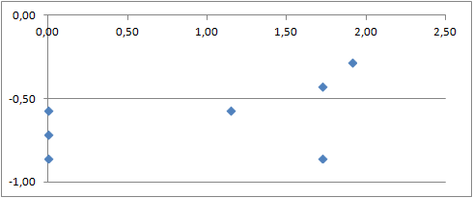
Zoom on the hot spot area
FROM POINT OF VIEW OF „PERFORMANCE” (ROAD SURFACE) IT IS NOT A PROBLEM. CUT-OFF SERVE FOR AIMING NOT FOR ROAD ILLUMINATION AND IS VERIFIED STARTING FROM 1.5° LEFT. HOWEVER THIS POINT IS REMOVED IN PRESENT PROPOSAL
S: I > 11263 Cd
Cut-off line
R: I> 15014 Cd
Q
M: I>5,400 Cd
P (75R): I > 10,100 Cd
50V I>5,100 Cd
K (50R): ): I > 10,100 Cd
« Q » on the Kink point
Comments:
Q is exactly on the kink point of the cut-off:
  Repeatable measurements are impossible.
M is very close to V50 in R112 (d= 0.14°) . Redundancy .
R & S are very close each other, close to the cut-off line.
  The requirement seems to be difficult to achieve.
  Assessment of current HL to be done before a conclusion on these points.

Slide 6
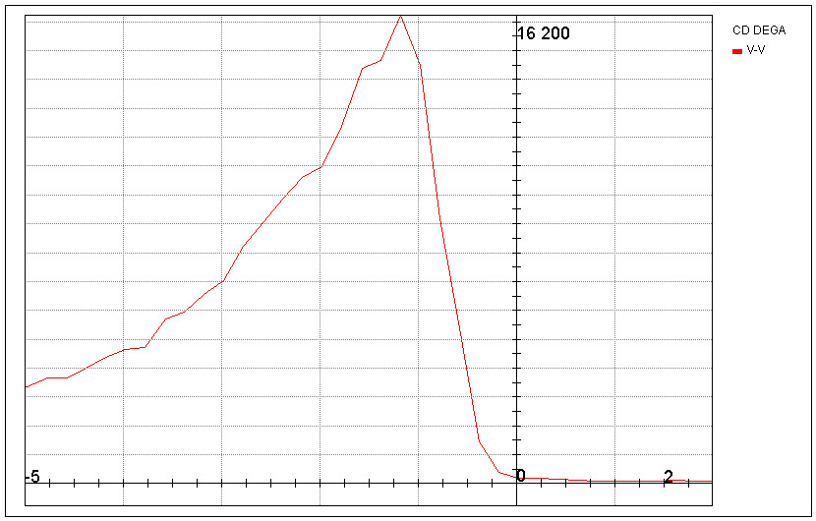
Measurement of luminous intensity on point Q.
The variation of the luminous intensity in the Neighborhood of « Q » along VV line, is high: 2000cd/0.1°
FROM POINT OF VIEW „PERFORMANCE” (ROAD SURFACE)
IT IS NOT A PROBLEM. HOWEVER IT IS REMOVED IN PRESENT POLISH PROPOSAL
Variation of the intensity along VV
2000Cd / 0.1° for an average value of 5,000 Cd.
Variation of 40%!
Q

Slide 7

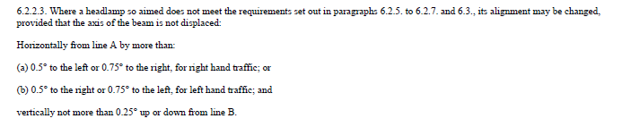
Adjustment tolerances.
POSSIBILITY TO MOVE HEADLAMP AFTER AIMING MEANS NOT PREDICTABLE AND NOT REPEATABLE ROAD ILLUMINATION. POLAND PROPOSE ABANDON SUCH POSSIBILITY AS NOT PERFORMANCE BASED
Justification?
This requirement is too binding.

Slide 8
Questions:
“At any point and area, the value of 50 lux shall not be exceeded.”
  Justification?
TO RESTRICT TO HIGH ILLUMINATION (INTENSITY) FOR GLARE REASONS: MISAIMING, WET ROAD ETC. IT IS EQUIVALENT FOR PRESENT MAXIMUM IN ZONE I AND MAXIMUM INTENSITY IN REG. 98

Slide 9
Questions:
“the random procedure may be used for reducing the number of measurements”.
  What is “random procedure”?
„RANDOM PROCEDURE” IS SUCH PROCEDURE DURING WHICH IS MEASURED RESTRICTED NUMBER OF POINTS. IT IS TO REDUCE TIME OF MEASUREMENTS. REQUIREMENTS ARE FIXED BUT MEASUREMENT PROCEDURE IS RANDOM TO PROTECT AGAINST INTENTIONAL PREPARING „EXOTIC” LIGHT DISTRIBUTION E.G. POINTS – LIKE (PIXEL) LIGHT DISTRIBUTION. THIS COULD HAPPEN IF FIXED AND SMALL NUMBER OF POINTS/SEGMENTS IT CHOSEN FOR MEASUREMENTS. BECAUSE IT IS RANDOM IT IS NOT PREDICTABLE AND NOT REPEATABLE. THEREFORE INTENTIONAL „POINT-LIKE” LIGHT DISTRIBUTION WILL NOT PASS TEST PROCEDURE. RANDOM IS NOT OBLIGATORY - CAMERA METHOD OR DENSE SCANNING IS ALSO POSSIBLE AND ANY EQUIVALENT METHOD - NO DESIGN RESTRICTIONS FOR MEASURING EQUIPMENT

Slide 10
Questions:
“Any visible inhomogeneity on the vertical screen illuminated by headlamp should be additionally verified by measurements of the darkest and the brightest visible points and areas as well as for any other doubts”.
  Homogeneity is not a safety criterion.
  How to define what is acceptable or not?
IT IS ADDITIONAL SECURITY TOOL FOR RANDOM PROCEDURE. IF WILL BE ANY VISIBLE „SPOT” „STRIPE”, BLACK HOLE OR SIMILAR EFFECT WHICH MIGHT BE OMITTED DURING „RANDOM PROCEDURE” IT SHOULD BE ADDITIONALLY TESTED ACCORDING MINIMUM AND MAXIMUM REQUIRED VALUES. HOMOGENEITY IS NEITHER REQUIRED NOR TESTED

Slide 11
Synthesis
Width of the beam pattern.
  B1 HL as proposed, has a requirement for the width which is
    4.5 X the one required by current R112,
    2.25 X the one required by current R98 for xenon headlamps.
  Not relevant.
PROPOSAL IS BASED ON REAL HALOGEN GOOD QUALITY HEADLAMPS USED DURING CIE TC 4-45 WORK IN 2004
(CIE 188:2010 STANDARD).
THE FUNDAMENTAL QUESTION IS: DO WE CREATE REALISTIC BUT TRUE PERFORMANCE BASED REQUIREMENTS FOR SAFETY OR PRESERVE OBSOLETE MINIMALISTIC PARABOLIC DESIGN-BASED REQUIREMENTS?

Slide 12
Synthesis
Range of the beam pattern:
  Points M, R & S are redundant with the already existing requirement.
WE SHOULD FORGET EXISTING, DESIGN BASED REQUIREMENTS WHEN WE PROPOSE NEW „PERFORMANCE BASED”. HOWEVER HEADLAMPS DESIGNED ACCORDING PROPOSED REQUIREMENTS WILL MEET PRESENT REG. 112 CLASS B REQUIREMENTS

Slide 13
Synthesis
Range of the beam pattern:
  Point Q (on the kink point of the cut-off line) is not measurable.
THIS POINT WAS REMOVED IN PRESENT VERSION. HOWEVER ACCORDING CUT-OFF IT IS POSSIBLE TO ADD SOME LIGHT IN THE KINK POINT USING PRESENT CUT-OFF DEFINITION.
FROM PERFORMANCE POINT OF VIEW PRESENT CUT-OFF SHAPE IS RESTRICTING FAR DISTANCE VISIBILITY. WE CAN IMAGINE MODIFIED CUT-OFF OR ALTERNATIVE AIMING SOLUTION INSTEAD PRESENT CUT-OFF LINE
(„CUT-OFF-LESS” BEAM PATTERN WHICH IS ALLOWED IN REG. 123)

Slide 14
Synthesis
Range of the beam pattern:
  The current requirements on 75R, V50 and 50R are relevant to assess the visibility distance of the low beam pattern.
75R IS NOT RELEVANT BECAUSE ONE POINT AT 75 M IS NOT ENOUGH FOR SAFETY. MANY CONTEMPORARY HALOGEN HEADLAMPS ILLUMINATE ROAD SIGNIFICANTLY LONGER AND WIDER. IF YOU WILL TAKE INTO ACCOUNT PRESENT REG. 48 AIMING/LEVELLING PROVISIONS 75R CAN CROSS THE ROAD AT 20 m ONLY! SUCH ROAD ILLUMINATION DISTANCE CANNOT BE ACCEPTED. IF YOU ADD RE-AIMING POSSIBILITY AND NON REPEATABILITY OF VISUAL CUT-OFF AIMING IN-USE CONDITION, SITUATION IS MUCH WORSE

Slide 15
Conclusion
There are still several pending technical questions.
Evaluation of the impact of the proposal upon the design of the headlamp must be done before.
The proposal should not be included into the current R112 regulation.
This topic has to be taken into account in the Simplification process phase 2.
WHICH MANUFACTURER (CLEPA) AGREES VOLUNTARY DO TESTS OF THEIR GOOD QUALITY PRODUCTS ACCORDING THIS PROPOSAL?
PROPOSED VALUES CAN BE ADJUSTED BUT IT IS NEEDED OPENNESS TO PERFORMANCE BASED REQUIREMENTS FROM INDUSTRY SIDE. FINALLY IT WILL BE PROFITABLE FOR MANUFACTURERS AND CUSTOMERS BECAUSE WILL ELIMINATE LOW QUALITY AFTERMARKET REPLACEMENTS

Slide 16
Synthesis
EXPLAINED EARLIER
Width of the beam pattern.
  B1 HL as proposed, has a requirement for the width which is
    4.5 X the one required by current R112,
    2.25 X the one required by current R98 for xenon headlamps.
  Not relevant.
Range of the beam pattern:
  Points M, R & S are redundant with the already existing requirement.
  Point Q (on the kink point of the cut-off line) is not measurable.
  The current requirements on 75R, V50 and 50R are relevant to assess the visibility distance of the low beam pattern.
Aiming tolerances:
  To keep the current existing tolerance as defined in R112 §6.2.2.3 .
Several pending questions.

