Slide 1
Relevant test scenarios on proving grounds for the urban use-case – OICA views
Transmitted by the experts of OICA
Document SG1-02-08
2018-09-03, Paris/OICA Office, 2nd meeting of the subgroup Physical Testing and Audit
Submitted by the experts of OICA
  M. Esser on behalf of OICA

Slide 2
Introduction/basis for discussion
The next slides are based on the concept document “Structure of a future Regulation of autonomous vehicles” that OICA provided to the TF AutoVeh at the meeting in Den Haag
→ Special requirements for the use-case urban traffic: See Annex 5, paragraph 2: “Physical tests required for type approval/certification”
The intention of this presentation is to start the discussion and explain a proposal on four critical test scenarios for the urban use-case that are suitable for testing on proving grounds. There may be additional scenarios to be added
These four critical test scenarios for the urban-use-case were presented at the 1st meeting of the subgroup physical testing and audit in Den Haag (TFAV-SG1-01-02) and were supported by the group as a starting point. OICA was asked to continue the work for specifying reproducible tests (i.e. define parameters like e.g. speed and distances, infrastructure, targets, pass/fail criteria, test equipment etc.).
This updated presentation is based on TFAV-SG1-01-02 and adds a first collection of parameters that need to be defined when developing the test procedures. There may be additional parameters to be specified.
It should be noted that defined tests on proving grounds/test tracks are only one single element in the overall concept of the system certification/assessment. Additional scenarios are addressed by other means e.g. during the real-world-driving test and the audit/assessment.

Slide 3
Scenario Justification
In a first step, the proposed test scenarios were identified and evaluated with an “engineering judgement approach” based on two criteria:
  Criteria 1: Performance based technical difficulty/complexity for the system to detect/manage the particular situation
  Criteria 2: Injury/crash severity
  Remark: It was qualitatively considered that the scenarios should have a significant relevance /occurrence probability in traffic
  Outlook: Additional statistics/external sources could be added in mid- and long-term to complete the justification on a scientific basis

Slide 4
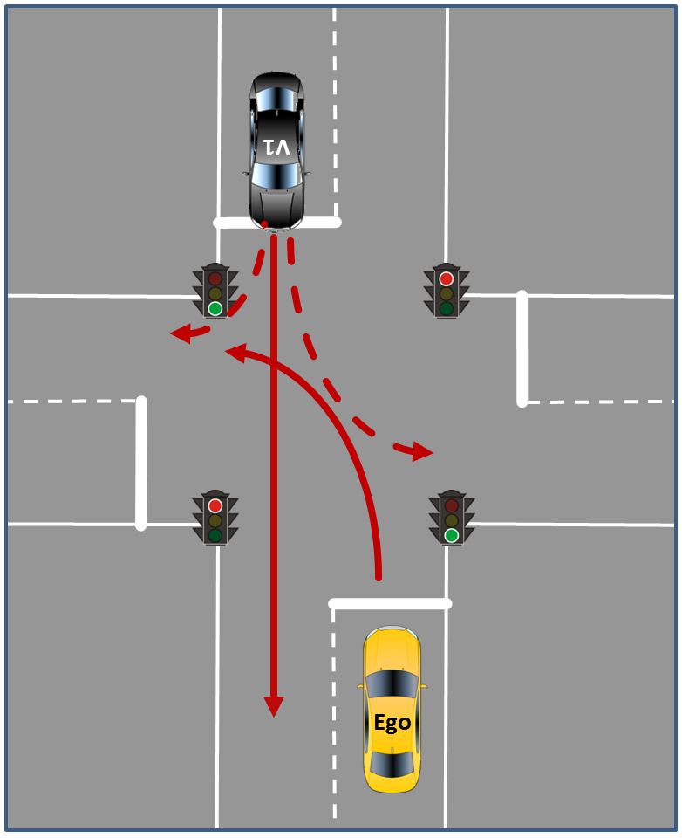
Proposal Test Track Scenarios „Urban“
2.1 Unprotected „left turn“ (in case of right hand traffic)
Situation: The vehicle approaches an intersection in autonomous mode with the intention to perform a left turn. Other Dynamic Objects are present.
Expected Behavior: The vehicle should automatically activate the left direction indicator when slowing down. Then, the vehicle yields considering the traffic rules from the corresponding country and turns left.
Initial Condition: The vehicle follows the ego-lane and is heading an intersection that is controlled by a traffic light without green arrows as status, by a yield sign or without any traffic elements at all.
Final Condition: The vehicle has applied the left turn indicators and turned left according to the traffic rules without endangering oncoming traffic. The vehicle drives on at the new lane.
Excerpt Parameters Test Procedure
INITIAL CONDITIONS:
Infrastructure: Crossing (dimensions, lane markings, design and position of traffic lights) → see e.g. EU-Project PROSPECT, design and position of speed sign on ego lane before the crossing, area before crossing to allow smooth acceleration of Ego to reach initial speed
Environment: Ambient temperature, track temperature, wind speed, ambient illumination etc.
Ego-Vehicle: Initial speed/speed range to approach the crossing
TEST MANEUVER:
Vehicles V1: Speed/speed range, differential position/trajectory to Ego
Options: Number and dimension of gaps between vehicles V1, trajectory of V1 (drive straight or left/right turn)
Justification:
Criteria 1: Technical difficulty/complexity for the system to detect/manage the situation
  Path of other vehicles is difficult to predict/sense; high differential speeds
Criteria 2: Injury/crash severity
  High severity due to side impact and high speeds of involved vehicles

Slide 5
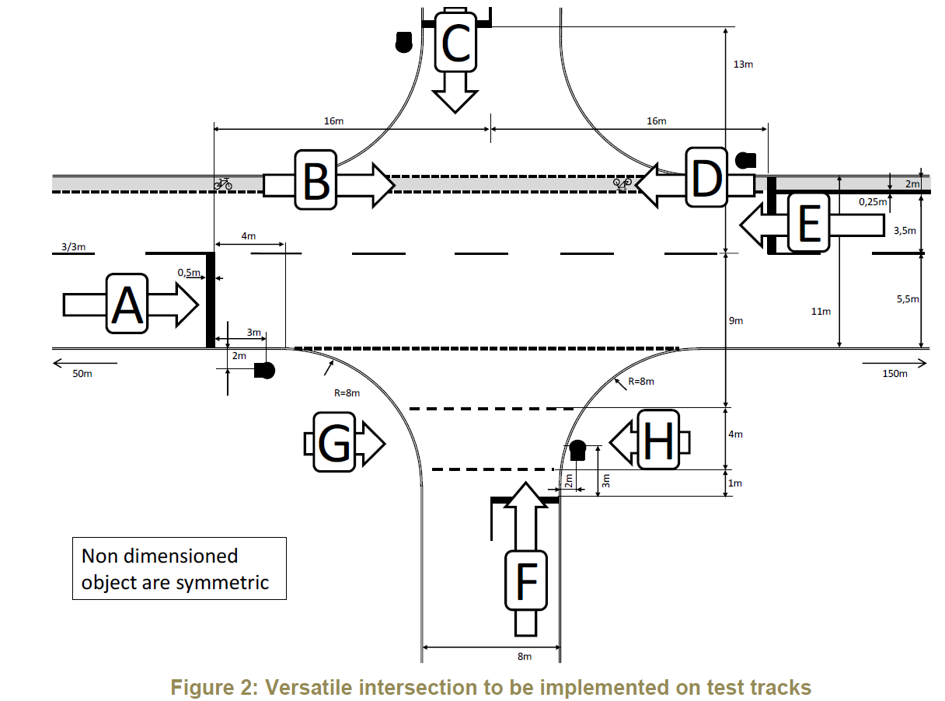
EU Project PROSPECT* – Standard Intersection Layout
EU-Project PROSPECT issued a draft proposal for standard intersection layout : “Deliverable D7.4 proposes an intersection geometry that allows the conduction of all intersection test cases with no need to manipulate the lane markings in-between tests: only tracks for Vehicle-Under-Test and VRU Dummy need to be reprogrammed, object positions need to be shifted and implemented.”
OICA proposes to consider this intersection geometry proposal for test scenario 2.1 and 2.3
Open point: Different intersection layouts needed for other countries like USA/CAN, China, etc.?
* Source: Proactive Safety for Pedestrians and Cyclists, European Commission, Eigth Framework Programme, Horizon 2020, GA No. 634149; Deliverable D7.4

Slide 6
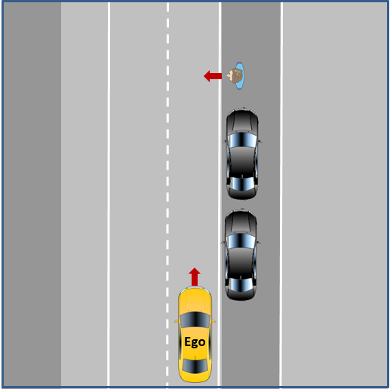
Proposal Test Track Scenarios „Urban“
2.2 Obstructed Pedestrian crossing (without traffic lights, without pedestrian walkway)
Situation: The vehicle follows in autonomous mode the ego-lane and approaches a gap after parked vehicles, where an obstructed pedestrian passes the street.
Expected Behavior: The vehicle shall stop in a safe manner in order to avoid the collision. The vehicle can continue the drive, when the driving path is clear.
Initial Condition: The vehicle follows the ego-lane and is heading towards an obstructed pedestrian behind parked vehicles.
Final Condition: The vehicle continues its drive without violating traffic rules as well as safety and comfort criteria.
Excerpt Parameters Test Procedure
OICA proposal:
Use established EuroNCAP maneuver CPNC-50 scenario (running child from nearside from obstruction vehicles (see Test Protocol AEB VRU systems, Version 2.0.2, November 2017)
A test protocol with all parameters is already available. A carry-over to automated driving is possible with the only deviation that the ego vehicle speed would not be constant throughout the scenario and therefore the pedestrian target’s trajectory needs to be synchronized with the Ego vehicle speed (the automated driving system can automatically reduce speed in the particular driving situation).
Child pedestrian target: Specified by NCAP, speed 5 kph, synchronized trajectory depending on Ego vehicle trajectory
Justification:
Criteria 1: Technical difficulty/complexity for the system to detect/manage the situation
  Dynamic obstacle test including obstruction of the pedestrian (child) dummy by other vehicles/objects on the side of the road is difficult to predict/sense; high differential speeds
Criteria 2: Injury/crash severity
  High severity for an unprotected pedestrian if the vehicle does not safely stop

Slide 7
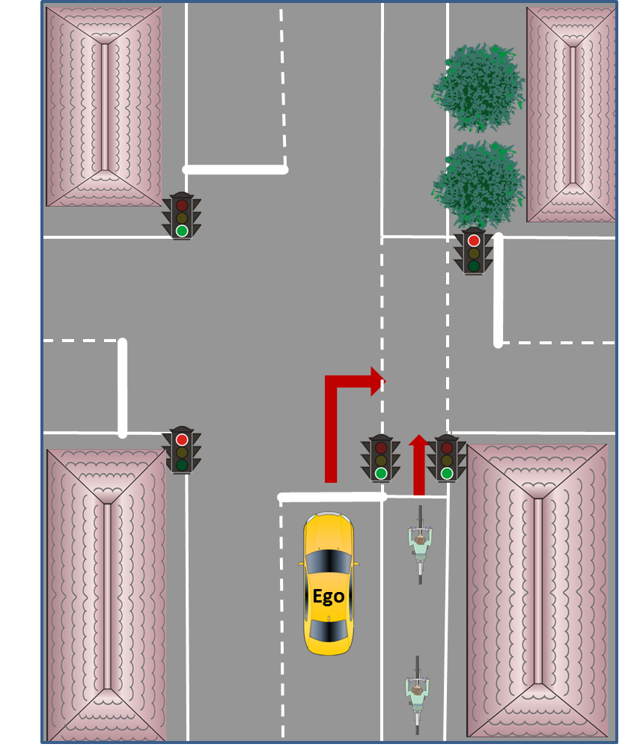
Proposal Test Track Scenarios „Urban“
2.3 Cyclist test in combination with right turn
Situation: The vehicle is driving with [50 km/h] in autonomous mode on a priority road and approaches an intersection (vehicle has right of way or traffic light “green”) to perform a right turn. A cyclist is driving with [15 km/h] in the same direction using a separate bicycle lane adjacent to the priority road and wants to keep straight on across the intersection. A second bicycle is following with a [20m] gap to the first, also driving with [15km/h].
Expected Behavior: The vehicle should automatically activate the right direction indicator when slowing down, first stop and let the first bicycle pass and then use the gap between the first and the second cyclist in order to turn right.
Initial Condition: The vehicle follows the ego-lane.
Final Condition: The vehicle has applied the right turn indicators and used the gap between the two cyclists for turning right. The vehicle drives on at the new lane.
Excerpt Parameters Test Procedure
INITIAL CONDITIONS:
Infrastructure: Crossing (dimensions, lane markings for both vehicles and bicycles, design and position of traffic lights → see e.g. PROSPECT intersection which includes bicycle lane), design and position of speed sign on ego lane before the crossing, area before crossing to allow smooth acceleration to reach initial speed
Environment: Ambient temperature, track temperature, wind speed, ambient illumination etc.
Ego-Vehicle: Initial speed/speed range to approach the crossing
TEST MANEUVER:
Bicycles: Speed, synchronized trajectory depending on Ego vehicle trajectory, dimension of gap between bicycles, target’s dimension (NCAP bicycle target available)
Justification:
Criteria 1: Technical difficulty/complexity for the system to detect/manage the situation
  Path of the cyclist that has a certain (parallel) distance to the road is difficult to predict/detect, relatively high differential speeds
Criteria 2: Injury/crash severity
  High severity for a protected/unprotected cyclist if the vehicle does not safely stop before making the right turn

Slide 8
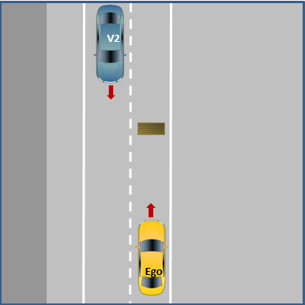
Proposal Test Track Scenarios „Urban“
2.4 Obstacle test
Situation: The vehicle follows in autonomous mode the ego-lane and reacts on static objects located ahead of the vehicle on the driving lane while there is oncoming traffic on the neighbor lane (so that there is not at all times a possibility for evading the static object). The static object may have different sizes, but is not moved by itself.
Expected Behavior: The vehicle has to decide if the static object is traversable or not. If it is not traversable, the vehicle has to decide when it has to stop and when to evade/drive around the static object.
Initial Condition: The vehicle follows the ego-lane. The vehicle is heading a static object in lane.
Final Condition: The vehicle has just followed the ego-lane if the static object is traversable. If it is not traversable, the vehicle has safely (without endangering oncoming traffic) driven around the obstacle to follow the ego-lane.
Excerpt Parameters Test Procedure
INITIAL CONDITIONS:
Infrastructure: Lane dimensions and markings, design and position of speed sign on ego lane before stationary object, area’s dimension before object to allow smooth acceleration to reach initial speed
Environment: Ambient temperature, track temperature, wind speed, ambient illumination etc.
Ego-vehicle: Initial speed/speed range to approach the stationary object
TEST MANEUVER:
Vehicle V2: Speed; synchronized trajectory depending on Ego vehicle trajectory
Stationary object: Dimension (traversable/non-traversable; extent of lane blockage), position within the lane
Options: Number of approaching vehicles V2, different differential speeds Ego to wait vs. Ego to evade immediately), additional vehicles in front of Ego
Justification:
Criteria 1: Technical difficulty/complexity for the system to detect/manage the situation
  Detect the stationary obstacle and then drive around/evade including consideration of oncoming traffic is difficult! Note: The dynamic object that suddenly crosses the road would be covered by 2.2. and requires different technical capabilities.
Criteria 2: Injury/crash severity
  High severity for drivers/passengers due to oncoming traffic

Slide 9
Next steps
Agree on how to handle certain options/variants of the test scenarios in a next step to have transparency what elements the scenarios should include
Based on this, continue working on a draft specification of reproducible tests for the scenarios 2.1 – 2.4 (i.e. define numerical values/parameters like e.g. speed and distances, road infrastructure, definition of objects, pass/fail criteria, test equipment etc.).
OICA proposes to consider the intersection geometry proposal of the EU-Project PROSPECT for test scenario 2.1 and 2.3 and not to start a separate activity.
→ Are different intersection layouts needed for other countries like e.g. USA/CAN, China, etc.? What is the expectation of the Contracting Parties?
Test Scenario 2.2 (Obstructed Pedestrian crossing): OICA proposes to use the existing EuroNCAP maneuver CPNC-50 scenario (running child from nearside from obstruction vehicles, see Test Protocol AEB VRU systems, Version 2.0.2, November 2017) with the only deviation that the ego vehicle speed would not be constant throughout the scenario (initial speed would be fixed, but the automated driving system may then automatically adapt its speed to the particular driving situation)

