Slide 1
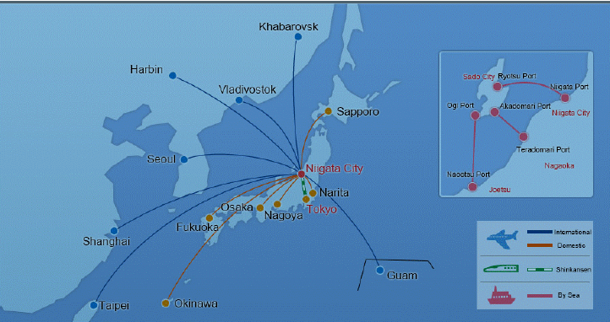
3rd Session AutoVeh, SG1 and SG2
SG1-02-09
Date :
23-25, October 2018
Place :
Niigata City, Japan
Venue :
N.A.
Getting To & Getting Around
Niigata City is located on the northwest coast of Honshu , Japan's largest island, facing the Japan Sea. The two main ways of reaching the city are by plane into Niigata International Airport , and by train into JR Niigata Station . Direct international flights fly to and from Seoul , Shanghai, and Harbin. Domestic flights fly to and from many major cities, including Tokyo (Narita), Osaka, Nagoya, Fukuoka, and Sappo ro. The JR Joetsu shinkansen (bullet train) can take you from Tokyo Station to JR Niigata Station in about 2 hours

Slide 2
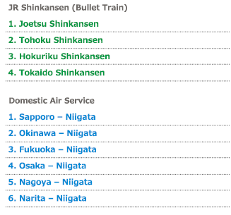
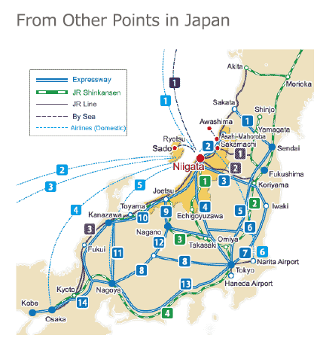

Access

Slide 3

Hotel information
ART HOTEL NIIGATA STATION
1-1 Sasaguchi Chuo-ku Niigata-shi Niigata
TEL/+81-25-240-2111 FAX/ +81-25-240-2112
http://www.art-niigata-station.com/
Foot by 1minits from Niigata station
Niigata daiichi Hotel
1-3-12, Hanazono, Chuo-ku Niigata-shi, Niigata,
TEL / 025-243-1111 FAX / 025-243-1040
http://0252431111.com/
NIIGATA TOEI HOTEL
2-1-6 Benten, Chuo-ku, Niigata-shi, Niigata, TEL/ +81-25-244-7101
https://toeihotel-niigata.com/
Niigata information site
https://www.nvcb.or.jp/index.html

Slide 4
Information on VISA in JAPAN
https://www.mofa.go.jp/j_info/visit/visa/index.html
Exemption of Visa (Short-Term Stay)
As of July 2017, Japan has taken measures concerning the Visa Exemption Arrangements with 68 countries and regions.
https://www.mofa.go.jp/j_info/visit/visa/short/novisa.html

