Slide 1
China amendment proposal for tyre marking of GTR
Submitted by the experts from China
TYREGTR-19-05
Agenda item 4.1
Action item IWG18/2
Geneva, Switzerland
Sep. 11, 2018
Comment on document TYREGTR-18-25 , addition to existing text is shown in bold blue

Slide 2
The tyre marking requirement according to China standard
The following marks should appear on the sidewall of each tyre:
  Tyre size designation
  Trade mark and manufacture’s name or plant address
  Load index or ply rating, loading capacity, inflation pressure
  Speed symbol
  For passenger car tyre: name and number of plies of framework material for radial tyre crown and sidewall, name of framework material for bias tyre;
  For LT tyre: name (or code) of framework material of tyre crown and sidewall
  Location marks of tyre treadwear indicator (TWI)
  Production code
  Plant inspection mark
  In which, a~f are moulded marks/ g is permanent mark/ h is unable to be washed off.

Slide 3
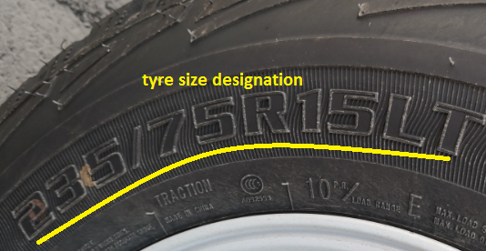
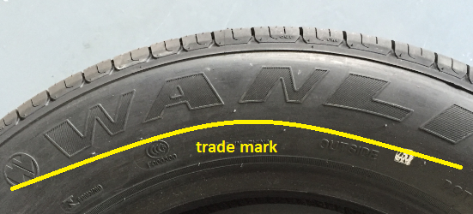
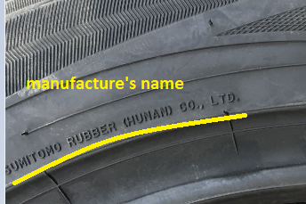
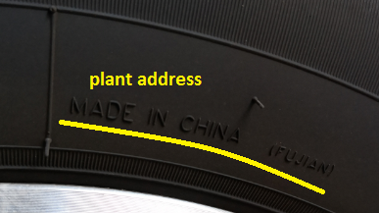
The tyre marking requirement according to China standard
  Tyre size designation
  Trade mark and manufacture’s name or plant address

Slide 4
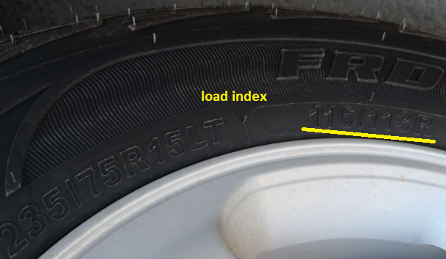
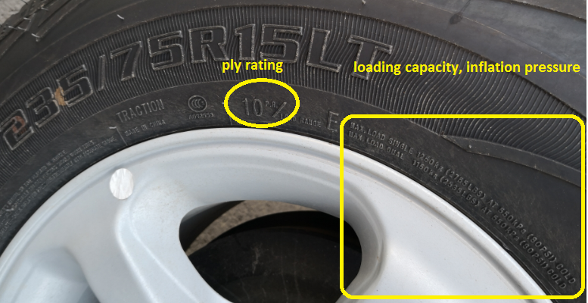
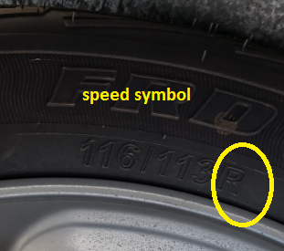
The tyre marking requirement according to China standard
  Load index or ply rating, loading capacity, inflation pressure
  Speed symbol

Slide 5
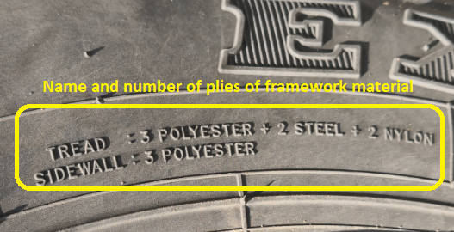
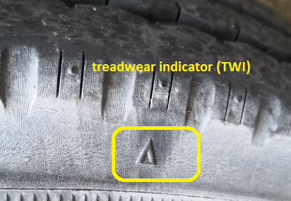
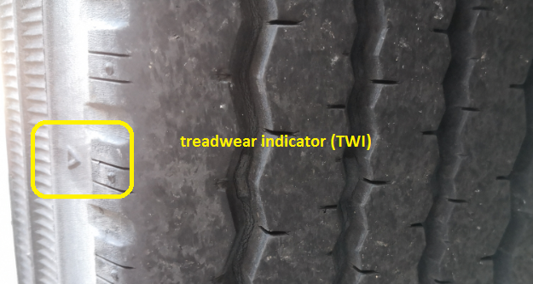
The tyre marking requirement according to China standard
  Name and number of plies of framework material for radial tyre crown and sidewall
  Location marks of tyre treadwear indicator (TWI)

Slide 6
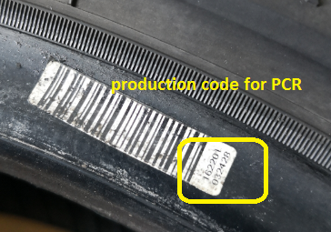
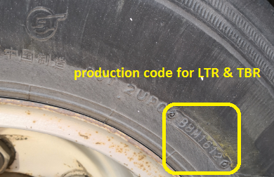
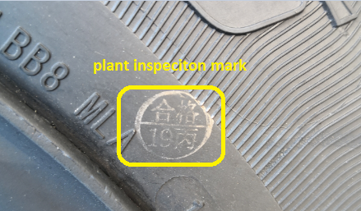
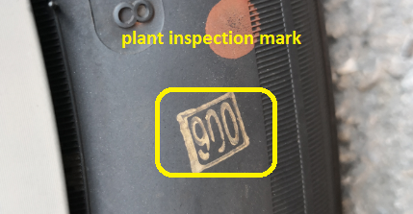
The tyre marking requirement according to China standard
  Production code
  Plant inspection mark

Slide 7
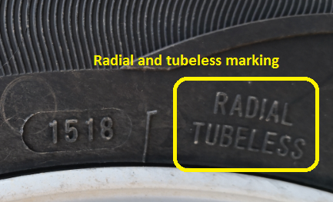
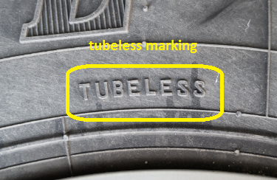
The tyre marking requirement according to China standard
Radial tyre shall be moulded with “RADIAL” marking, tubeless tyre shall be moulded with “TUBELESS” marking.

Slide 8
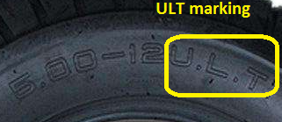
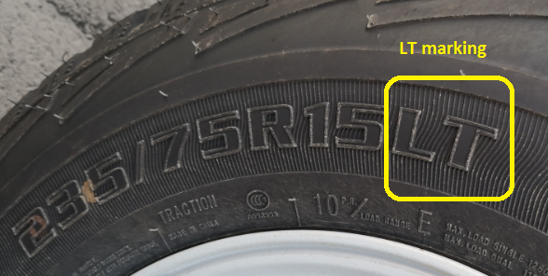
The tyre marking requirement according to China standard
Mini-type truck tyres shall be moulded with “ULT” marking, Light truck tyres shall be moulded with “LT” marking.

Slide 9
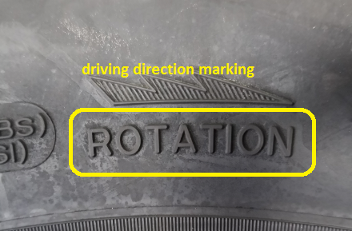
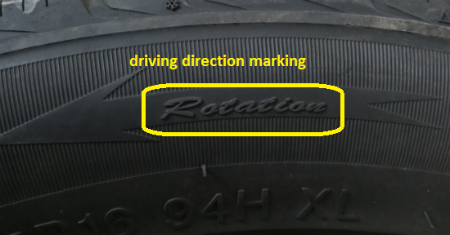
The tyre marking requirement according to China standard
Tyre with driving direction for tread pattern shall be moulded with driving direction marking.

Slide 10
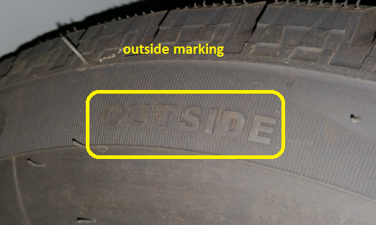
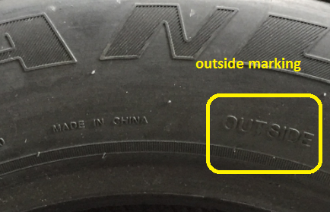
The tyre marking requirement according to China standard
For tyre assembly requirements with inside and outside, the out sidewall shall be moulded with “OUTSIDE” marking.

Slide 11
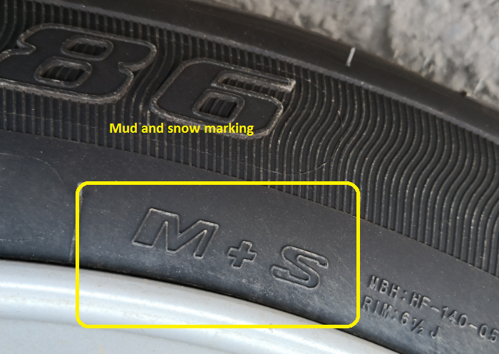
The tyre marking requirement according to China standard
Mud & snow tyre shall be moulded with M+S pattern marking.

Slide 12
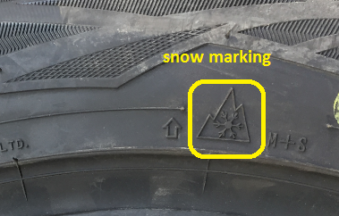
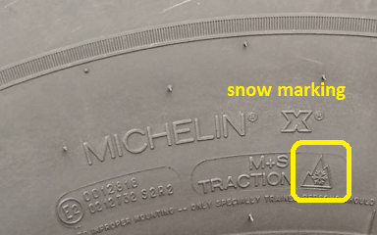
The tyre marking requirement according to China standard
Snow tyre should be moulded with “Alpine” symbol marking.

Slide 13
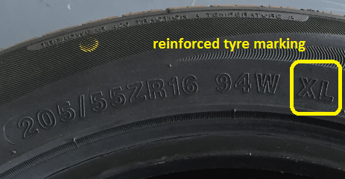
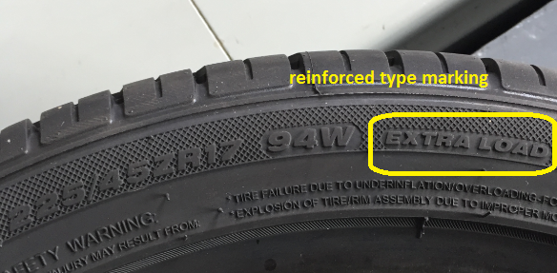
The tyre marking requirement according to China standard
For passenger car tyre, reinforced tyre shall be be moulded with reinforced type marking.

Slide 14
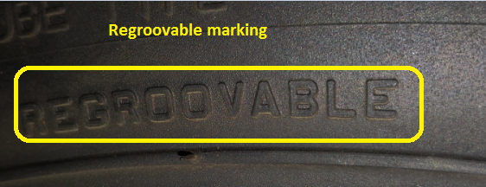
The tyre marking requirement according to China standard
For truck tyre, regroovable tyres should be moulded with “REGROOVABLE” marking.

Slide 15
The tyre marking requirement according to China standard
Outer casing of each tyre shall have at least 4 treadwear indicators (TWI) that can be observed visually and are spaced equally around the circumference of the tyre, the depth of TWI should be no less than 1.6mm.
Location marks of should be moulded on both shoulders of tyre.

Slide 16
Meeting Presentations
“IWG17-11 comment AB ETRTO.”(China,TYREGTR-18-06)
“Proposal for Amendment 1 to global technical regulation (UN GTR) No.16 (Tyres)” (China, GRRF-84-12)
“Proposal for harmonisation with the current provisions of GTR No.16” (China, GRRF-84-11)

Slide 17
Conclusions
(Optional marking requirements for China )
Add paragraph 3.3.16 amending as following:
Name(or code) and number of plies of framework material should be observed visually on tyre sidewall. For passenger car tyre: name and number of plies of framework material for radial tyre crown and sidewall, name of framework material for bias tyre; For LT tyre: name (or code) of framework material of tyre crown and sidewall.
Add paragraph 3.3.17 amending as following:
Plant inspection mark shall be observed visually on sidewall of tyre.
Add paragraph 3.3.18 amending as following:
Tyre with driving direction for tread pattern shall be moulded with driving direction.
Add paragraph 3.3.19 amending as following :
For tyre assembly requirements with inside and outside, the out sidewall shall be moulded with “OUTSIDE” marking.
Add paragraph 3.3.20 amending as following:
Regroovable tyres should be moulded with “REGROOVABLE” marking.

Slide 18

Thanks for your attention.

