Slide 1
Description of Japan RDE methodology
Environmental Policy Division,
Road Transport Bureau,
Ministry of Land, Infrastructure, Transport and Tourism,
Japan

Slide 2
Outline of Japan’s RDE

Slide 3
Outline of RDE in Japan
Scope
Diesel vehicles having a gross weight of 3.5t or less
Diesel powered passenger cars having a capacity of 9 or less people
Method and Requirement
[will be described later]
Schedule of Introduction for RDE in Japan
New Type Approval Vehicle : October 2022
Continuous Production Vehicle : October 2024

Slide 4
Concept of Japan’s RDE method
RDE method shall be able to detect whether result of chassis-dynamometer test reflects on real driving correctly or not.
The Japan’s RDE method is based on EC’s , but it is slightly modified considering different real world driving conditions and different phase of WLTC between Japan and Europe.
Therefore, we modified these factors in align with driving conditions in Japan.

Slide 5
WLTP phases
Japan are using 3 phases in WLTP.
The average speed and max speed are greatly different between 3 phases and 4 phases.
Based on these differences, Japan modified some factors slightly.
Main differences between WLTC 3 phases and 4 phases
 | 3 phases | 4 phases
Average Speed | 36.6 km/h | 46.5 km/h
Ratio of Idling Time | 15.4 % | 13.0 %
Max Speed | 97.4 km/h | 131.3 km/h
Max Acceleration | 5.7 km/h/s | 5.7 km/h/s
RPA | 0.167 | 0.152
Driving Time | 1477 s | 1800 s
Total Mileage | 15.01 km | 23.27 km

Slide 6
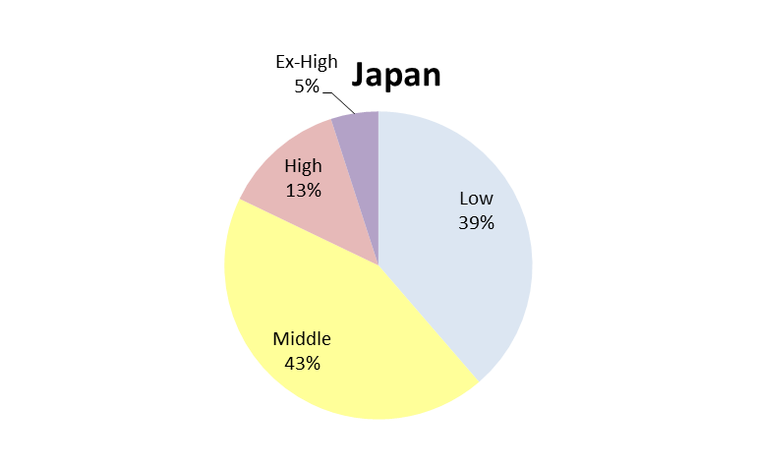
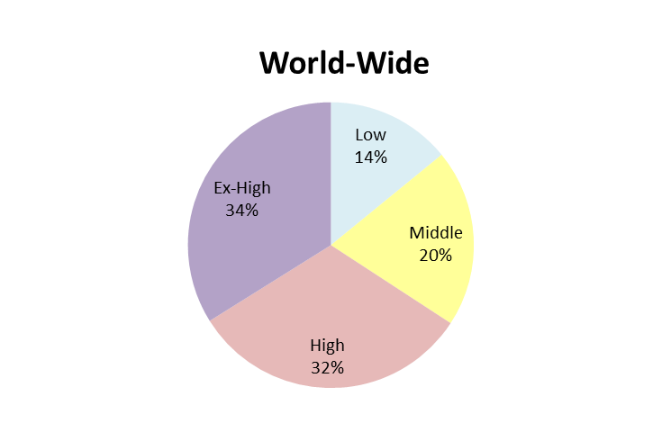
Traffic Conditions
The traffic speed in Japan’s real driving tends to be slow compared with World-Wide.
Especially, the ratio of driving speed at 60km/h or less (“Low” + “Middle”) is very high.
Since the speed limit of Japan’s motorway is less than 100km/h in most sections, the proportion of “EX-High” is low.
Traffic rate of Japan and World-Wide
EX-High
5%
Low
14%
High
13%
Low
39%
EX-High
34%
Middle
20%
Middle
43%
High
32%
The speed thresholds are 60km/h, 80km/h, 110km/h.

Slide 7
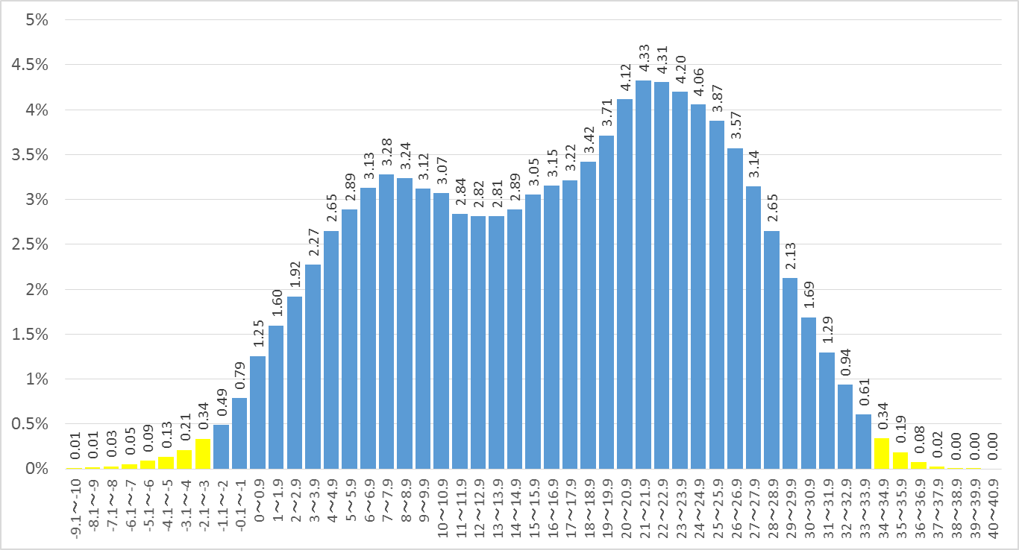
Weather Conditions
Japan is somewhat hotter than Europe.
98% of the traffic in Japan is between -2 to 34℃, calculating from traffic frequency distribution weighted by traffic volume, time and temperature, excluding upper and lower 1%.
In summer, the temperature near the vehicle increase about 4℃.
Average traffic volume for every air temperature （2012-2016）
Increased temperature on the road
Temperature near the vehicle
Air temperature
Yellow area is about 1% (low temperature and high temperature, respectively)

Slide 8
Detail of Japan’s RDE method

Slide 9
Structure of J-RDE method
Japan’s RDE is basically the same structure and method as EC’s RDE.
Japan’s RDE method
1. Scope
2. Definitions and Abbreviations
3. General Requirements
4. Special Requirements
5. Test Conditions
6. Running Requirement
7. Driving requirement
8. Lubricating Oil, Fuel and Reagent
9. Emission Amount of Exhaust Emission and Evaluation of Running
Appendix 1 Test Procedure for Exhaust Emission with PEMS
Appendix 2 Specification and Calibration of PEMS and Signals
Appendix 3 Validation of PEMS a Non-Traceable Exhaust Mass Flow Rate
Appendix 4 Determination of Emissions
Appendix 5 Verification of Trip Dynamic Conditions by Moving Average Window
Appendix 6 Verification of Overall Trip Dynamic State
Appendix 7 Procedure to Determine Cumulative Positive Elevation Gain of Trip
Appendix 8 Verification of Trip Conditions of OVC-HEV and Calculation of Final On-Road Emissions

Slide 10
Different respects between J – E WLTP phases
Based on difference of WLTP phases, Japan modified some of factors slightly as below.
 | J-RDE |  |  | E-RDE
Vehicle speed and Consist | Routes | Speed [km/h] | Consist [%] | Routes | Speed [km/h] | Consist [%]
 | Urban/Rural | V≦60 | 40-65 | Urban | V<60 | 29-44
 |  |  |  | Rural | 60<V<90 | 23-43
 | Motorway | 60<V | 35-55 | Motorway | 90<V | 23-43
Window speed characteristics | V<50:urban/rural speed 50≦V:motorway speed |  |  | V<45：urban speed 45≦V<80:rural speed 80≦V<145:motorway speed
CO₂ characteristic curve reference points | P1 : Same as E-RDE P2 : Same as E-RDE P3 : ー |  |  | P1:v_{p1}=18.882km/h (Average Speed of the Low Speed phase of the WLTP cycle) P2:v_{p2}=56.664km/h (Average Speed of the High Speed phase of the WLTP cycle) P3:v_{p3}=91.997km/h (Average Speed of the Extra High Speed phase of the WLTP cycle)

Slide 11
Different respects between J – E WLTP phases
 | J-RDE | E-RDE
RPA
v・apos_[95]
0.2
0.1
0
0.2
0.1
0
RPA
RPA
NG
NG
0 20 40 60 80 100 120
km/h
0 20 40 60 80 100 120
km/h
30
20
10
0
NG
30
20
10
0
NG
Vapos_[95]
Vapos_[95]
0 20 40 60 80 100 120
km/h
0 20 40 60 80 100 120
km/h

Slide 12
Different respects between J – E WLTP phases
Based on difference of real driving condition, Japan modified some of factors slightly as below.
 | J-RDE | E-RDE
Order | 1.Urban/Rural 2.Motorway | 1.Urban 2.Rural 3.Motorway
Ambient conditions Altitude | 0~1000m( 700m) (Moderate altitude) | 0 ~1300m( 700m) (Moderate altitude)
temp | -2℃(0)~38℃(35) （Moderate temp） | -7 ℃(0)~ 35℃(30) (Moderate temp)
Average speed (urban driving part) | ー | 15 ~ 40 km/h
Max speed | ー | 145km/h
Motorway speed | ー | Cover range : 90 ~ at least 110 km/h Velocity : Above 100 km/h for at least 5 minutes.
Test track | Available | ー

Slide 13
Different respects between J – E WLTP phases
Based on difference of regulation and concept, Japan modified some of factors slightly as below.
 | J-RDE | E-RDE
Measurement items | NOx, CO₂ Note: Japan doesn’t regulate PN under the chassis-dynamometer test and on road test. | NOx, PN, CO₂
Fuel | Basically same as E-RDE(If it exceed criteria, the reference fuel defined in Annex 3 of GTR15 may be used for second RDE test. ). | The fuel, lubricant and reagent (if applicable) used for RDE testing shall be within the specifications issued by the manufacturer for vehicle operation by the customer.
If a part of the test is performed outside of ambient conditions | It is basically the test may be invalid. However, it can be made valid if the CF value conforms to limit. | The test shall be invalid.

Slide 14
Thank you for your attention!

Slide 15
Reference
Notes:
Next content is ‘Investigation for On-Road Test’.

Slide 16
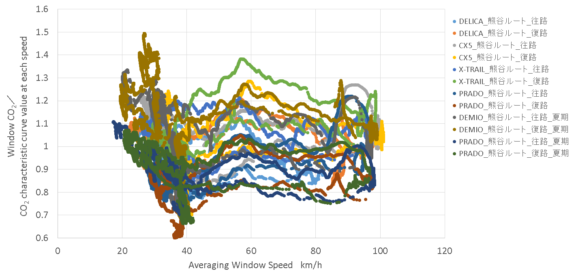
Consideration of CO2 Characteristic Curve
WLTC Low
WLTC High

