Slide 1



Transmitted by the expert from the Republic of Korea
KMVSS on the Reverse safety devices
Park Jin-woo, Chief Researcher
(truehelp@kotsa.or.kr)
KOTSA (Korea Transportation Safety Authority)
KATRI (Korea Automobile Testing & Research Institute)

Slide 2
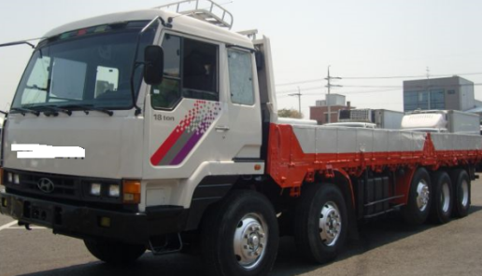
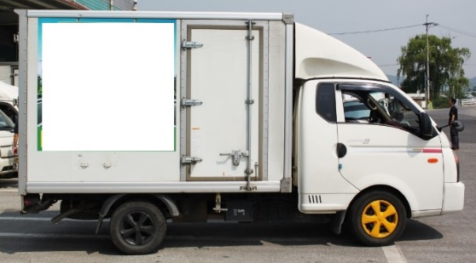
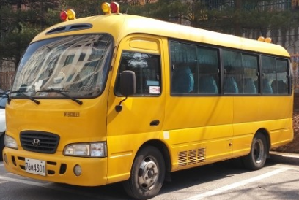
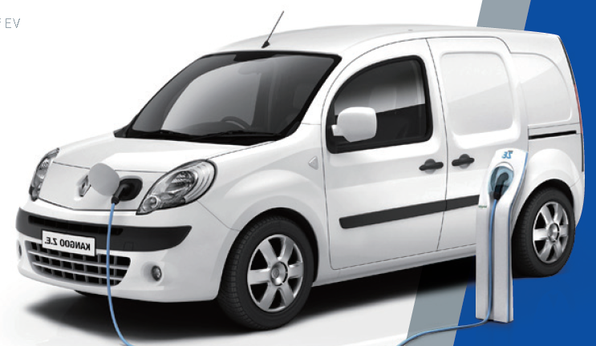

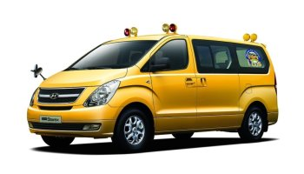
Reverse safety device regulation of Korea
Current regulation
The vehicles (N3, O4, Van, Box type vehicle, School bus) shall be equipped with back up camera, back up sonar or reverse warning system.
N3 & Van
Box type vehicle
School bus
2

Slide 3
Reverse safety device regulation of Korea
Revised regulation (Application date is 1 July 2019)
All vehicles (M, N, O) shall be equipped with back up camera, back up sonar or reverse warning system.
However, School bus shall be equipped with back up camera and reverse warning system.
3

Slide 4
Reverse safety device regulation of Korea
Specifications of the Reverse warning system
Sound type
  Shall be beep and tonal sound with same tone
  Shall be repeated constantly with same interval
SPL
  M, N1, O1~O2: 60dB(A) ~ 85dB(A) at 2m distance
  N2~N3, O3~O4: 65dB(A) ~ 90dB(A) at 2m distance
Tone
  Maximum sound level with 1/3 Octave band should be within 500Hz~4,000Hz
4

Slide 5
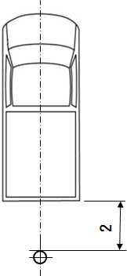
Reverse safety device regulation of Korea
Test methods of the Reverse warning system
Distance: 2m from the rear plane of the vehicle
Height: 1.2m above the ground
Test site: ISO 10844 or Flat Asphalt
Measurement Point: One point(Center)
Measurement times: 3 times
Measuring time: at least for 5 seconds with more than 2 times of beep sound
Measurement reading: Read maximum value and mathematical average of 3 samples

Slide 6
Opinions
Opinions on the reverse warning system
Measurement point: One point (no scanning)
Distance: 2m (For considering the background noise)
Height: 1.2m
Frequency Band: 500Hz ~ 4000Hz with 1/3 Octave band
SPL: 60 ~ 85 dB(A) at 2m distance
  SPL could be considered differently in accordance with the categories.
  Example : 65 ~ 85 dB(A) for N2, N3 and 60~80 dB(A) for M3
Sound type: Beep sound with same tone
No pause switch
New regulation (not be insulted in R28)
6

Slide 7
Example of test result
Example of N3 vehicle
7

Slide 8

Thank you
for your attention!

