Slide 1

SIMPLIFICATION.
Status after GTB WG FL meeting July17th, 2018
SLR-26-04/Rev.1

Slide 2
Introduction
Definition of requirements for basic/”C” passing beam which is technologically neutral and performance oriented.
Definition of Low speed /”V” and Motorway /”E” passing beam requirements
How to manage AFS?
Front fog beam and Cornering beam
How to manage beams / vehicles categories?

Slide 3
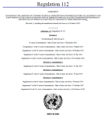
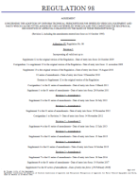
Strategy
R112 Class A
Class B
Class AR
Class BR
R98 Class DC
Class DR
R123 Class C
Class E
Class V
Class W
Class XR
ADB
R113 Class AS
Class BS
Class CS
Class DS
Class ES
Class R-BS
Class R-CS
Class R- DS
Class R- ES
R19 Class B- F3
R119 Class K
Class A
Class B
Class AR
Class BR
Class DC
Class DR
Class C
Class E
Class V
Class W
Class XR
ADB
Class AS
Class BS
Class CS
Class DS
Class ES
Class R-BS
Class R-CS
Class R- DS
Class R- ES
Class F3
Class K
Currently RID In the future: RID stage 2
Basic /”C” Passing beam
Low speed /”V” Passing beam
Motorway/”E” Passing beam
Basic Driving beam
Low speed Driving beam
ADB
Fog beam
Cornering beam
?
?
1 regulation
8 ? Beam patterns
…
6 regulations
24 Beam patterns
TC4-45 SAE J2829
Expertise of Optical engineers
1 regulation
23 Beam patterns

Slide 4
Next steps?
Polishing the strategy:
  How to manage the different technical requirements -> Done
    Basic passing beam, low speed/ town passing beam , Motorway Passing beam , AFS, which light distribution for which vehicles?
      Done but feed-back from IMMA and CEMA expected.
Technical requirements:
  Validation of basic requirement for passing beam. -> Done
  Management of AFS/ ADB. -> Nov 18
    Definition of requirement for Low speed /Town passing beam/ Motorway passing beam. -> Done . Final validation Nov 18
    ADB -> Scheduled in November 18
  Definition of requirements for driving beam. -> Introduction of a first proposal. Review scheduled in November 18
  Front fog beam-> Done: keep same requirements as F3 + corrections.
  Cornering -> Done. Similar to SAE requirements. Final validation Nov 18.
Redaction:
  Rewrite / optimization of RID text to be done as soon as the technical requirements are defined.

Slide 5
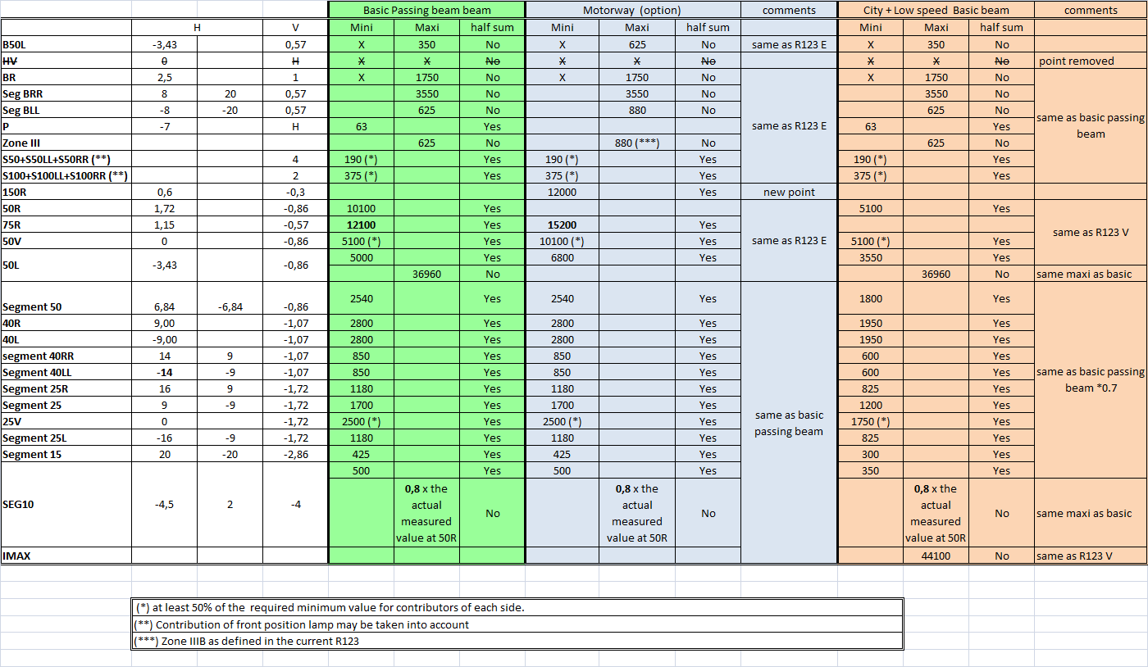
Grids for Passing beams
The photometric requirement for each single measuring point or segment of these functions applies to half of the sum of the respective measured values from all lighting units of the system applied for this function, except opposite prescription (i.e. “No” with regard to a certain test point or segment) in the column “half sum” of the table.

Slide 6
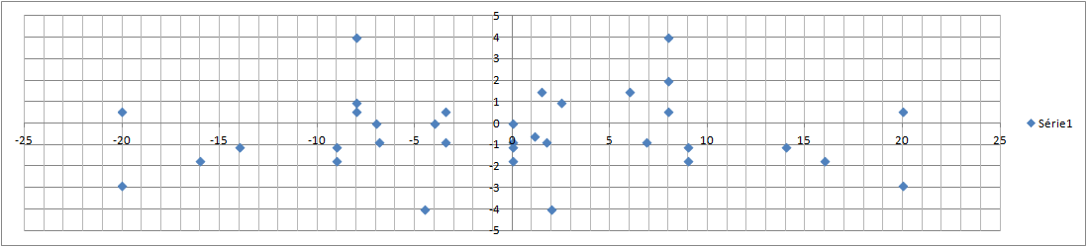
Measurement points and SEGMENTS
ZoneIII
BLL
B50L
BR
BRR
75R
50R
Seg 40LL
40L
50L
50V
Seg 50
40R
Seg 40RR
Seg 25L
Seg 25
Seg 15
25V
Seg 25R
Seg 10

Slide 7
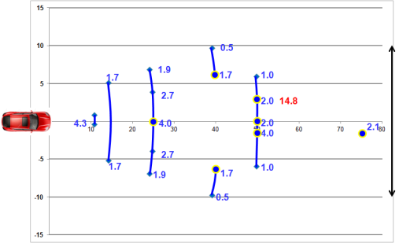
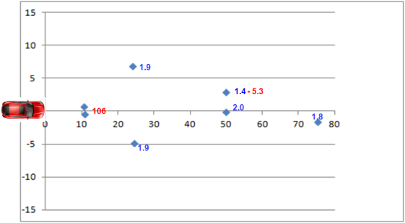
for comparison:
Illumination projected on the road for basic /”C” passing beam and current requirement RID class C (R123 Class C).
Bird’s eye view
Values in blue: Mini
Values in red: Maxi
Proposal Basic/”C” Passing Beam
RID class C
Significant improvement of the proposal / R123 class C
Width on the road : 20m instead of 11.6 m .
+20% at 75 m.

Slide 8
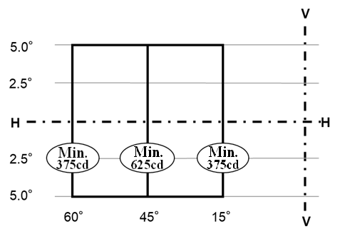
Cornering BEAM
To be discussed again in November 18
30°

Slide 9



IDEA for AFS
Basic/”C” passing beam, Low Speed/”V” passing beam, Motorway/”E” passing beam.
Which passing beam/speed/driving conditions?
Basic/ “C” passing beam
Low speed / “V” passing beam
Motorway/“E” passing beam
0
[50]
[110] km/h

Slide 10
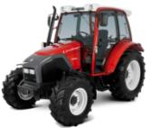
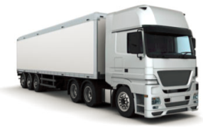
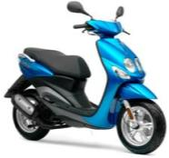

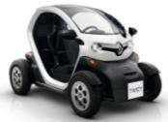
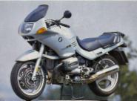
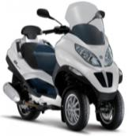

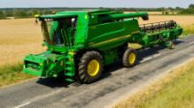
Which beam(s) for which vehicle?
To be addressed with WG-I

Slide 11

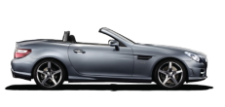


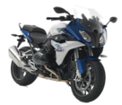
Installation requirements after SLR step 1 Regulation RID
GREEN colour means «optional»
BLACK colour means «mandatory»
AS
BS, R-BS
CS, R-CS
DS, R-DS
ES, R-ES
A, AR
B, BR
CS, R-CS
DS, R-DS
ES, R-ES
Class B, BR
Class DC, DR
F3
R74
Class B, BR
Class DC, DR
Class C
Class E
Class V
Class W
Class XR
ADB
Class F3
Class K
Class A, AR
Class B, BR
Class DC, DR
Class AS
Class BS, R-BS
Class CS, R-CS
Class DS, R-DS
Class ES, R-ES
Class F3
Class K
< 50 Km / h
R53
R48
R86
<125 cm³
2 x CS, 2 x R-CS
DS, R-DS
ES, R-ES
A, AR
B, BR
DC, DR
F3
Should the beam requirements be based on the category of the vehicle?
>125 cm³

Slide 12

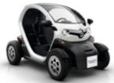
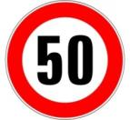
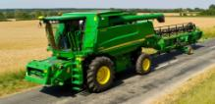
GTB WG_FL proposal for RID step II
GREEN colour means «optional»
BLACK colour means «mandatory»
For safety reasons, the beam requirements should depend on the speed of the vehicle and no longer on the vehicle category.
Common strategy to be shared with agricultural machines manufacturers and IMMA.
Basic/”C” Passing and Driving beams
Low speed/”V” Passing beam
High speed/”M” Passing beam
ADB
F3
K
>125 cm³
<125 cm³
R48
R86
R53
Low speed/”V” Passing beam
Low speed Driving beam
Basic/”C” Passing beam
Basic Driving beam
F3
K
R74

Slide 13
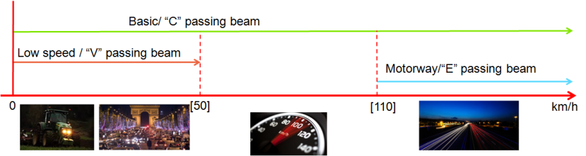
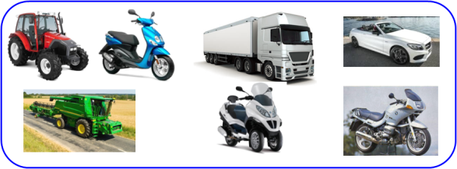

Proposal:
One simple rule for all vehicles?
Feed Back expected from Agricultural Machines Manufacturers before final validation. A proposal from IMMA for 2 wheelers will be addressed during the next WG-FL session in Nov 2018.

