Slide 1
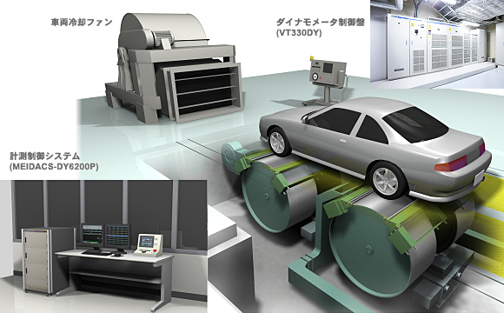
Status report
4WD dynamometer taskforce
WLTP-24-09e_4WD
by Iddo Riemersma (for EC)
24th meeting of WLTP IWG
18-20 September 2018, Tokyo, Japan
cooling fan
dynamometer controller
measurement unit

Slide 2
Current status
The GTR text proposal was discussed and agreed within the taskforce shortly before IWG 21 (January 2018, Geneva)
Discussion on vehicle restraining has been continued, a JSAE study was published with recommendations
The proposed way forward by Japan is not acceptable by Europe, and has resulted in a deadlock situation
Guidance from IWG is needed

Slide 3
alr check proposed by japan
ALR = Automatic Load Regulator (dynamometer function). Essentially the check consists of a number of coastdowns on the chassis dynamometer and a calculation.
ALR check (developed by JSAE) is an indicator for the similarity between the road load during the test and during the chassis dyno setting procedure
Check result represents the sum of the work by the vehicle and the absorbed work by the chassis dynamometer.
Determines in particular the change in rolling resistance caused by reinstallation of the vehicle, but does not reflect the influences of vehicle movements during a Type 1 test.

Slide 4
Current positions of Europe and japan
EUROPE | JAPAN
ALR is only useful if a vertical force is applied by vehicle restraining | ALR check mandatory after each Type 1 test
Functional requirement for vehicle restraining is sufficient; ALR not needed if no vertical force applied | Functional requirement is not acceptable, having the same vertical force cannot be guaranteed
Compromise solution proposed: Approving vehicle restraining system to avoid ALR | Compromise solution rejected
EUROPEAN CONCERNS
Mandatory ALR adds unnecessary testing burden (2-3 coastdowns and additional pre-test)
ALR result is dependent of chassis dyno setting procedure
Taskforce cannot reach an agreed position

Slide 5
Guidance from IWG needed
Should an ALR test be always mandatory for each Type 1 test?
Is an ALR test useful for every type of vehicle restraining system?
Could a compromise solution be accepted for vehicle restraining systems that have demonstrated to impose no vertical forces?

Slide 6
outlook
Upon guidance by the IWG the taskforce will continue to discuss the issue of 4WD dyno vehicle restraining and prepare a text proposal.
The taskforce will then continue to address solutions for other than Type 1 tests (CoP, Low Temperature, etc.)

Slide 7
additional information

Slide 8
Infographic
4WD dynamometer in 4WD operation
Contracting Party option
4WD dynamometer in 2WD operation
(upon demonstration of equivalency)
2WD dynamometer in 2WD operation
(upon demonstration of equivalency)
4WD vehicle
4WD vehicle
converted to 2WD
4WD vehicle
converted to 2WD
4WD vehicle
converted to 2WD
4WD vehicle
converted to 2WD
4WD vehicle
2 powered axles
mainly powered axle is front
(situation for rear is equivalent)
single roller
dynamometer
twin-roller
dynamometer
2WD vehicle
2WD vehicle
2WD vehicle
2WD vehicle
2WD vehicle
2WD vehicle
1 powered axle
front wheel drive
(situation for rear wheel drive is equivalent)
single roller
dynamometer
twin-roller
dynamometer
4WD dynamometer in 4WD operation
(at the request of the manufacturer)
4WD dynamometer in 2WD operation
2WD dynamometer in 2WD operation
dyno: simulates road load and inertia
dyno: just rotating, not included in energy balance
vehicle: powered axle
vehicle: non-powered axle / in case of 4WD vehicle:
a powered axle, that is converted such, that it
is non-powered for dyno testing

