Slide 1
ACSF IWG 20th Meeting
Informal Document - ACSF-20-02-Rev.1
Liverpool, UK, 6th to 8th 9th November 2018

Slide 2
Venue & Timings
All meetings will take place at the Jury’s Inn Hotel in Liverpool. The hotel is located next to the iconic Albert Docks.
Meeting | Start | Finish
CP & Industry Pre-meetings | 10:0012:00, Tuesday 6th November | 12:0017:00, Tuesday 6th November
ACSF 20 | 13:00, Tuesday 6th 10:00, Wednesday 7th November | 17:00, Thursday 8th 17:00, Friday 9th November

Slide 3
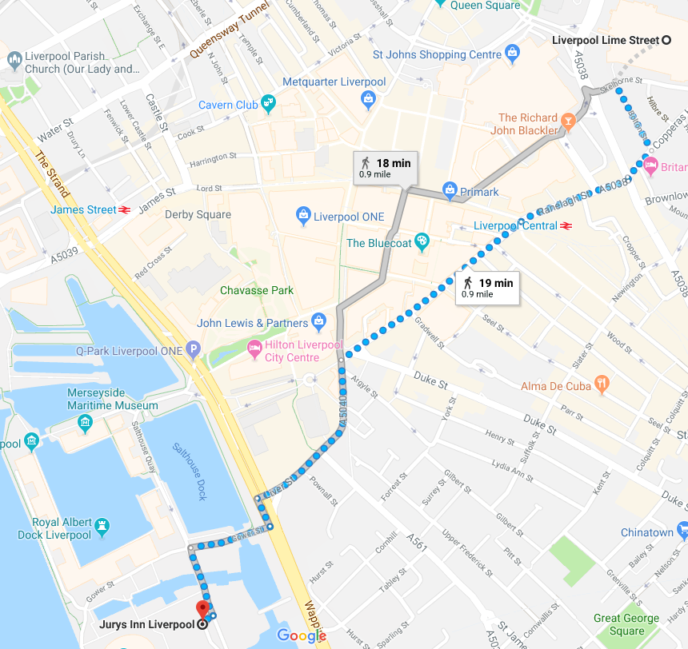
Travel to the venue
Delegates are advised to fly into Manchester Airport, which is under 2 hours from the venue.
Trains run regularly from Manchester Airport to Liverpool Lime Street station. You can purchase Advance tickets here.
The venue is located in front of the Wheel of Liverpool and is a 20-minute walk from Liverpool Lime Street station, as shown (link). You can also take a bus partway (link).
Alternatively, there is a taxi rank in Liverpool Lime Street station. Uber also operate in the area.

Slide 4
Accommodation
Delegates wishing to stay at the conference venue can do so at a reduced rate of £92 per person per night, which includes breakfast. To do so, please contact the venue directly (phone or e-mail) and quote the code 23707272. Note that the venue is only holding the rooms until 24th September 5th October; availability and price after that date are subject to change.
liverpool_conference@jurysinns.com
Below are a number of alternative options, along with an estimate of the walking distance to the venue:
  Ibis Liverpool Centre Albert Dock (~7 minutes)
  Days Inn Liverpool (~11 minutes)
  Hampton by Hilton Liverpool City Centre (~8 minutes)
  Tune Hotel Liverpool (~14 minutes)
  Hotel Indigo Liverpool (~18 minutes)

Slide 5
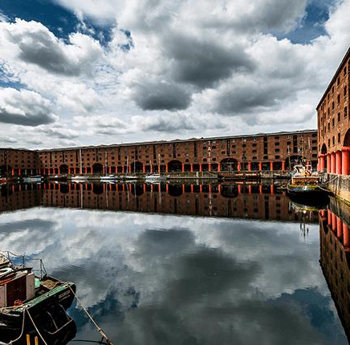
Things to do in Liverpool: Albert Dock and nearby
Next to the venue and on the waterfront is Albert Dock (shown opposite), which offers a good variety of restaurants and cafes.
The nearby Museum of Liverpool, Tate Liverpool, and the Merseyside Maritime Museum are all free to explore.
Music fans can also explore The Beatles Story or take a trip on the Magical Mystery Tour bus.
Slightly further North from Albert Dock, you can see the iconic Royal Liver Building, or check out the British Music Experience.

Slide 6
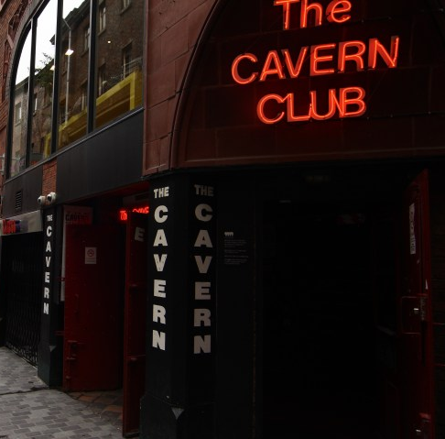
Things to do in Liverpool: Further afield
More centrally located is the Cavern Club, famed for where the Beatles developed their sound.
Football fanatics can also take a tour of Anfield stadium. A number of tour companies operate from just outside the Jury’s Inn Hotel.
The World Museum near Liverpool Lime Street station currently includes an exhibit on ancient Egypt.
Next door to the World Museum is the Walker Art Gallery, which includes works by Rubens, Rembrandt, and Poussin.

