Slide 1
AEBS Car to Car(CCRm)
Average Deceleration and Peak Deceleration
AEBS IG 7th meeting
Nov. 2018, Geneva
Korea Automobile Testing & Research Institute
Automated Driving Research Office

Slide 2
Introduction
KNCAP AEBS Test Protocol
  Implementation of KNCAP AEB
    C2C(CCRs - City)
    C2C(CCRm, CCRb - Interurban)
    C2P(Adult, Child)
  KNCAP AEB Plan
    GST/ C2B
C2C(CCRm) Test result
  Average Deceleration 3.8m/s2 Data
  Peak Deceleration 6.4m/s2 Data
Conclusion(Proposal)
  Deceleration requirement

Slide 3
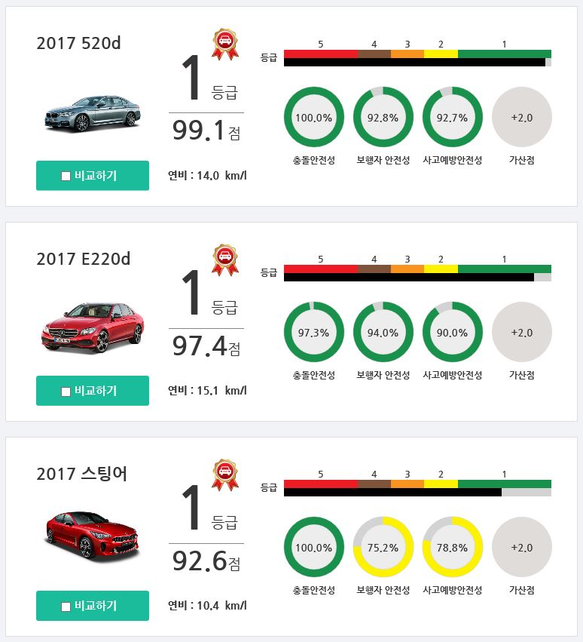
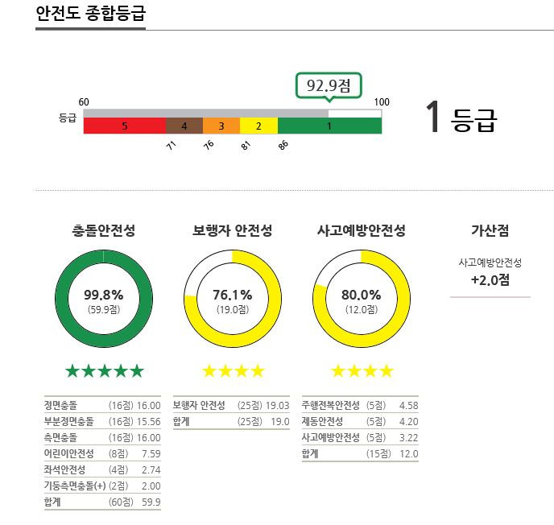
KNCAP AEBS Test Protocol
Implementation of KCNAP AEB
  Since 2017, AEBS testing was carried out as a test item for KNCAP
  Annually more than 9 test car(~2018, Total of 18 tested)
  Every year, KNCAP select this year’s safety car based on test results(www.kncap.org)

Slide 4
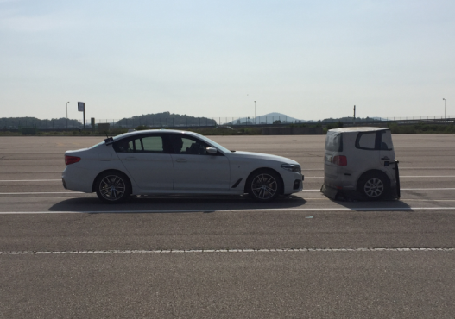
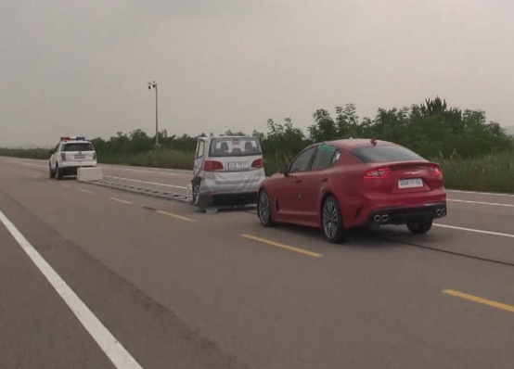
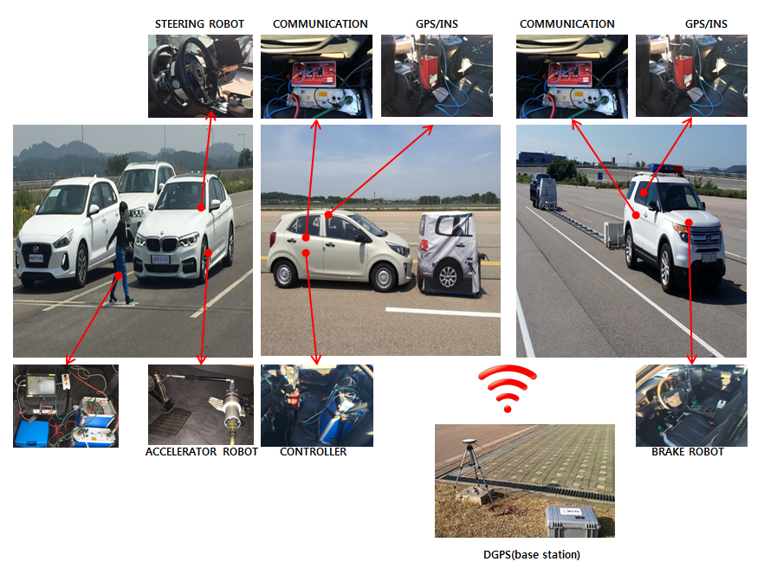
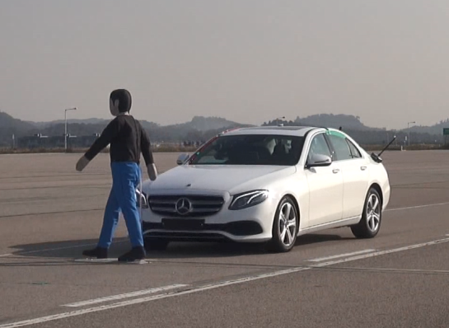
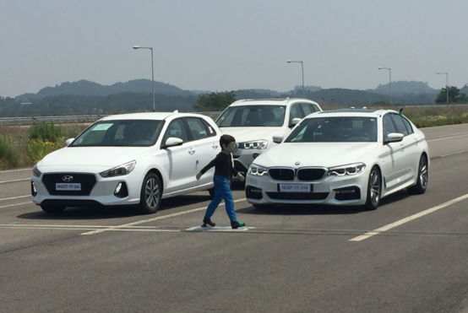
KNCAP AEBS Test Protocol
AEBS Test mode
  Car to Car(city)
  Car to Car(Interurban)
  Car to Pedestrian(Adult, Child)
CCRs
CCRm, CCRb
C2P - Adult
C2P - Child

Slide 5
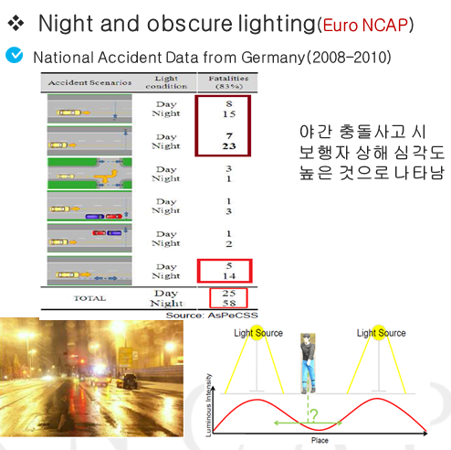
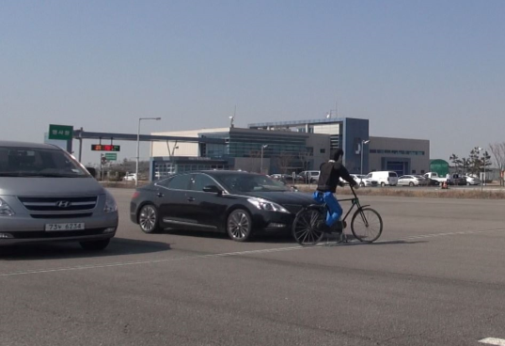
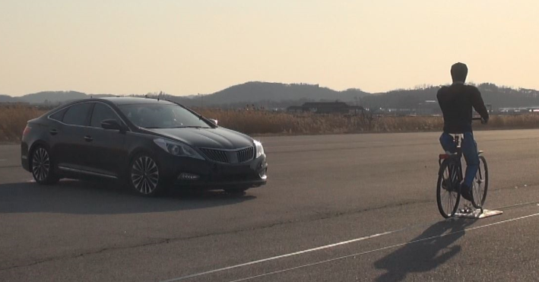
KNCAP AEBS Test Protocol
KNCAP AEB Plan
  Car to Bicycle(Cyclist, 2020~)
  Automated Vehicle test protocol(AEBS+ESF)
  Car to ??(night and obscure lighting, R&D)
 | BCNU | BCNO | BTLCN | BTRCF | BLD
Vehicle Speed | 10~60kph | 20~40kph | 20kph | 10kph | 20~60kph
Cyclist Speed | 15kph | 15kph | 15kph | 15kph | 15kph
Obstruction | X | O | X | X | X
Hit Point | 50% | 50% | 50% | 50% | 20, 50%

Slide 6
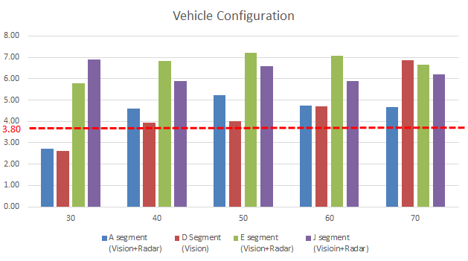
C2C(CCRm) Test Result
Average Deceleration 3.8m/s2
  Regarding the deceleration requirement mentioned in the last 6th meeting
  Vehicles that do not meet the average deceleration value of 3.8m/s2 only occurred below D Seg.
  only at low speed(30km/h)
  However, Not all the test vehicles collide
  ※ The above test results are calculated by averaging test vehicles.

Slide 7
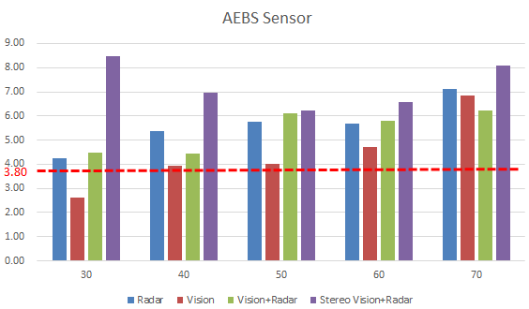
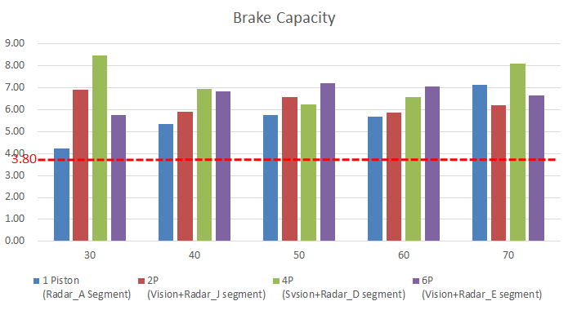
C2C(CCRm) Test Result
Average Deceleration 3.8m/s2
  Vehicle with Vision sensor only had lower average deceleration than vehicles with other sensors
  And the average deceleration in the entire speed range
  However, Not all the test vehicles collide
  Although the average deceleration may be low depending on the brake capacity, it is expected to
  be independent of the AEBS requirements

Slide 8
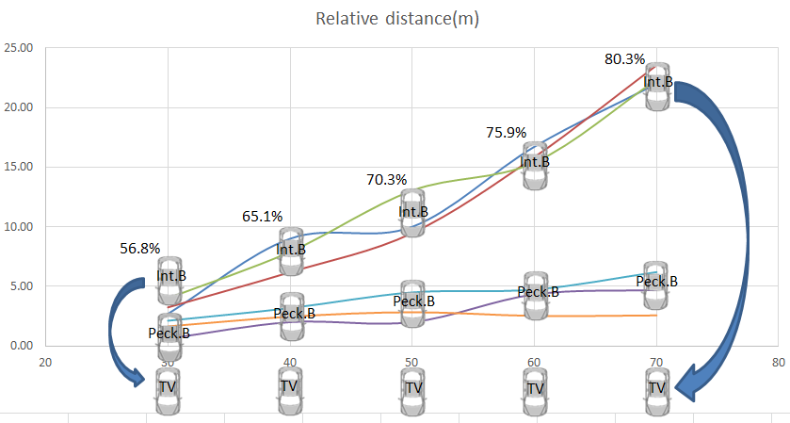
C2C(CCRm) Test Result
Reduction rate by test speed
  As the test speed increases, Subject Vehicle shall begin braking in advance and shall not collide
  with the Target Vehicle. However cars equipped with only vision experienced a deceleration of
  more than 70% in all speed zones
78.6%
74.1%
80.0%
77.8%
Vision Sensor vehicle data
77.0%
Average vehicle data

Slide 9
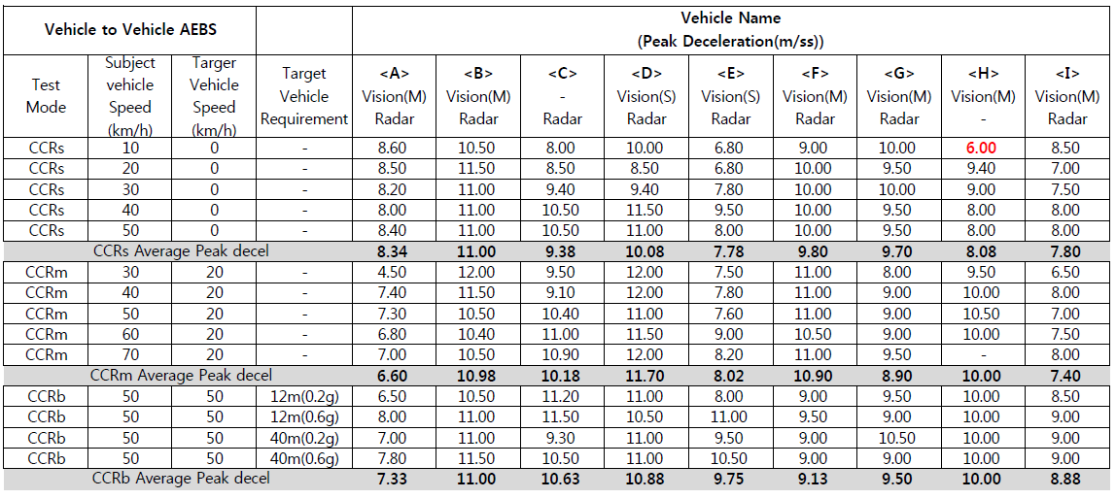
C2C Test Result
Peak deceleration 6.43m/s2
  All test vehicles met the peak deceleration value of 6.43m/s2
  However, if 6.43m/s2 is not satisfied, a collision has occurred

Slide 10
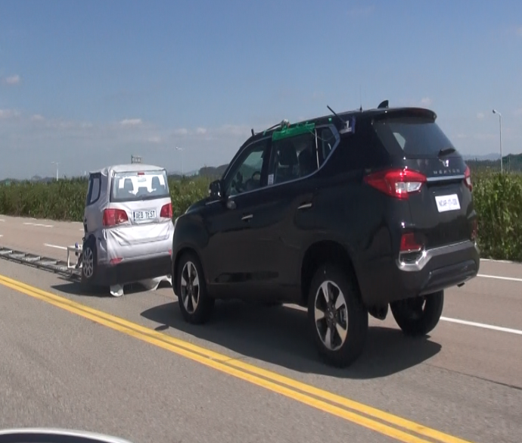
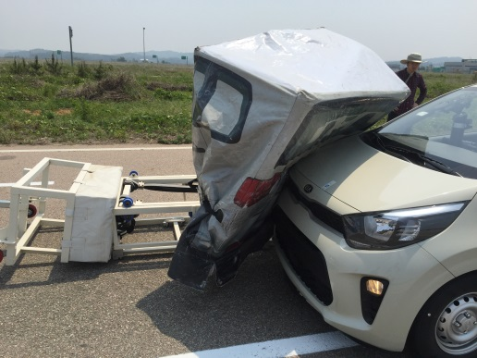
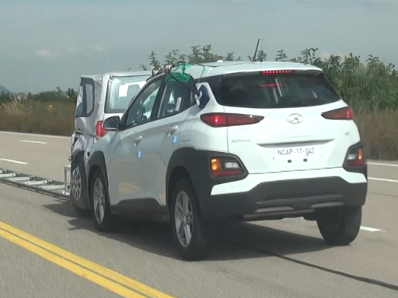
Conclusion
Average deceleration 3.80m/s2
  When KNCAP test results are analyzed, the average deceleration occurred above 3.8m/s2
  overall, but some vehicles were not satisfied at low speeds
    The requirement value of the average deceleration shall be specified
    (Because Test results that average deceleration value was low had collision with target car)
    Average deceleration 3.8m/s2(AEBS IWG) or 3.7m/s2(ACSF IWG – EM requirement)
Peak deceleration 6.43m/s2
  Peak deceleration can be satisfied if the service brake requirement of UN R13-H is met
  If the peak deceleration value is less than 6.43m/s2, it is dangerous to collide

